Slide 1
1.Manage interest rate risk
1.1 Interest Rate Swaps
In particular, they are designed to manage the risk on cash flows arising from investors’ assets and liabilities. Interest rate swaps and futures can also be used to modify the risk and return profile of a portfolio. This is associated with managing a portfolio of bonds that generally involves controlling the portfolio’s duration. Although futures are commonly used to make duration changes, swaps can also be used, and we shall see how in this reading. Finally, interest rate swaps are used by financial institutions to hedge the interest rate risk exposure deriving from the issuance of financial instruments sold to clients.

Slide 2
1.Manage interest rate risk
Example1:
Using an Interest Rate Swap to Convert Floating-Rate Securities into Fixed-Rate Securities
Here the firm initially expects continuing low interest rates, so it issues floating-rate bonds. But after concluding that rates are likely to increase, the firm seeks to convert its interest rate risk to a fixed obligation.

Slide 3
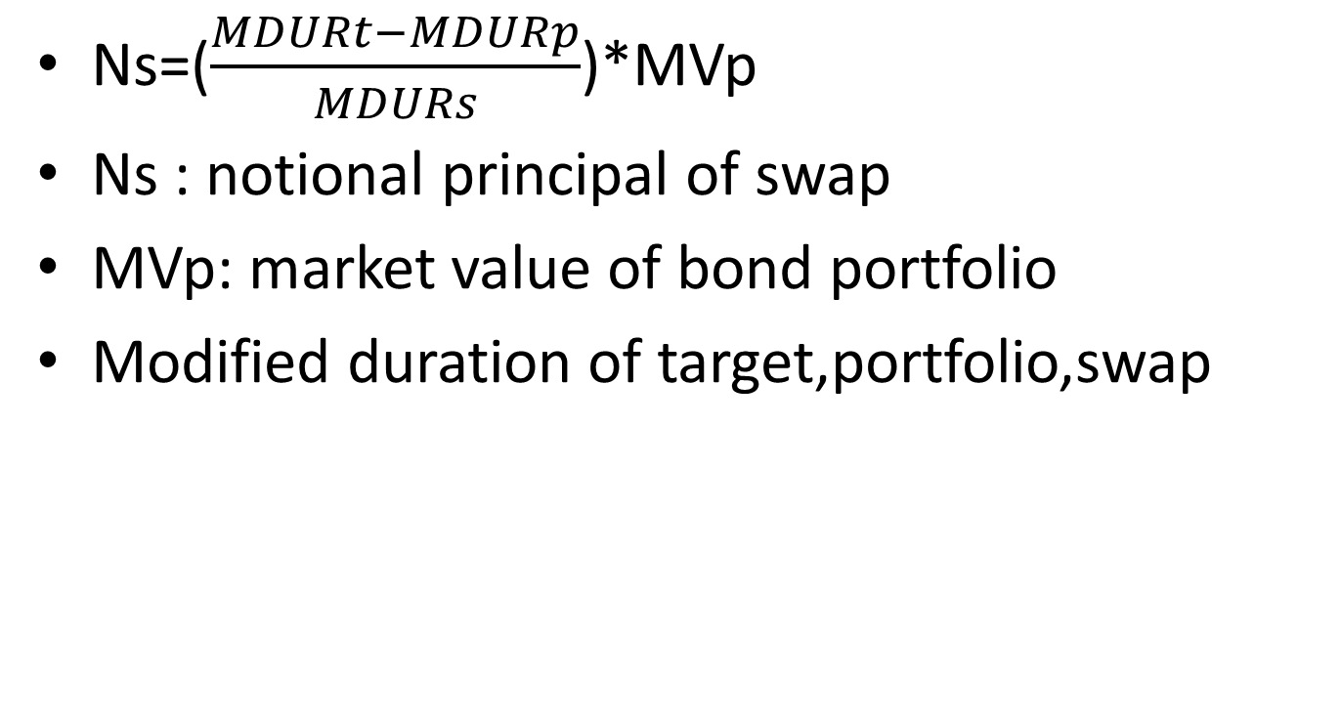
1.Manage interest rate risk
Ns=($\frac{MDURt−MDURp}{MDURs}$)*MVp
Ns : notional principal of swap
MVp: market value of bond portfolio
Modified duration of target,portfolio,swap

Slide 4
1.Manage interest rate risk
Example2:
Using an Interest Rate Swap to Achieve a Target Duration
Consider a portfolio manager with an investment portfolio of €50 million of fixed-rate German bonds with an average modified duration of 5.5. Because he fears that interest rates will rise, he wants to reduce the modified duration of the portfolio to 4.5, but he does not want to sell any of the securities. One way to do this would be to add a negative-duration position by entering into an interest rate swap where he pays the fixed rate and receives the floating rate. A two-year interest rate swap has an estimated modified duration of –2.00 from the perspective of the fixed-rate payer.

Slide 5
1.Manage interest rate risk
1.2 Interest Rate Forwards and Futures
Forward rate agreements and interest rate futures are widely used to hedge the risk associated with interest rates changing from the time a loan or a deposit is anticipated until it is actually implemented.

Slide 6
1.Manage interest rate risk
Example 3:
Using Interest Rate Futures to Lock in an Interest Rate
Amanda Wright, the chief investment officer (CIO) of a US-based philanthropic foundation is expecting a donation of $30 million in two months’ time from a member of the foundation’s founding family. This significant donation will then be invested for three months and subsequently will be divided into smaller grants to be made to medical and educational institutions supported by the foundation. The current (i.e., spot) three-month reference rate is 2.40% (annualized). The CIO expects interest rates to fall, and she decides to hedge the rate on the deposit with Eurodollar futures.

Slide 7
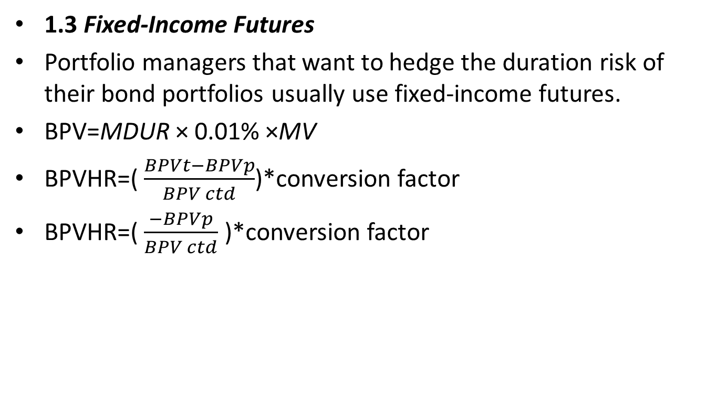
1.Manage interest rate risk
1.3 Fixed-Income Futures
Portfolio managers that want to hedge the duration risk of their bond portfolios usually use fixed-income futures.
BPV=MDUR × 0.01% ×MV
BPVHR=( $\frac{BPVt−BPVp}{BPV ctd}$)*conversion factor
BPVHR=( $\frac{−BPVp}{BPV ctd}$ )*conversion factor

Slide 8
1.Manage interest rate risk
Example 4:Hedging Bond Holdings with Fixed-Income Futures
A portfolio manager is holding €50 million (principal) in German bunds (DBRs) and wants to fully hedge the value of the bond investment against a rise in interest rates. The portfolio has a modified duration of 9.50 and a market value of €49,531,000. Moreover, the manager wishes to fully hedge the bond portfolio (so, BPVT = 0) with a short position in Euro-Bund futures with a price of 158.33. The cheapest-to- deliver bond is the DBR 0.25% 02/15/27 that has a conversion factor of 0.619489. The size of the futures contract is €100,000.

Slide 9
1.Manage interest rate risk
Example 4:Hedging Bond Holdings with Fixed-Income Futures
Cheapest-To-Deliver Bond
DBR 0. 02/15/27 Gov’t.
Modified Duration 8.623
Bond Price 98.14
Conversion Factor 0.619489
Determine the following:
1 The BPVP of the portfolio to be hedged
2 The BPVCTD of the futures contract hedging instrument
3 The number of Euro-Bund futures contracts to sell to fully hedge the portfolio

Slide 10
1.Manage interest rate risk
Example 5: Decreasing Portfolio Duration with Futures
Consider the portfolio manager from Example 4 who now decides to decrease the portfolio’s modified duration from 9.50 to 8.50. The yield curve is flat. Additionally, we have already demonstrated that given the portfolio’s market value of €49,531,000, the BPVP is €47,054.50. Finally, assume the CTD bond underlying the Euro-Bund futures is the same as before, DBR 0.25% 02/15/27, with a BPVCTD of €84.63 and a conversion factor of 0.619489.
Determine the following:
1 The BPVT of the portfolio to be hedged
2 The number of Euro-Bund futures contracts to sell to reduce the portfolio’s modified duration to 8.50

Slide 11
2.Manage currency exposure
2.1 currency swaps
A currency swap is similar to an interest rate swap, but it is different in two ways: (1) The interest rates are associated with different currencies, and (2) the notional principal amounts may or may not be exchanged at the beginning and end of the swap’s life.
In particular, a cross-currency basis swap exchanges notional principals because the goal of the transaction is to issue at a more favorable funding rate and swap the amount back to the currency of choice.

Slide 12
2.Manage currency exposure
2.2 Currency Forwards and Futures
These two financial instruments are used to hedge against undesired moves in the exchange rate by buying or selling a specified amount of foreign currency, at a defined time in the future and at an agreed-on price at contract initiation.

Slide 13
2.Manage currency exposure
Example 6:Hedging Currency Risk with Futures
Consider the same US-based VC firm that is calling down capital commitments and will receive CAD50 million in 30 days. The general partner now decides to sell futures contracts to lock in the current USD/CAD rate. The hedge ratio is assumed to be equal to 1. The firm hedges its risk by selling Canadian dollar futures contracts with the closest expiry to the future Canadian dollar inflow. Given a price for the Canadian dollar futures contract of USD/CAD 0.7838 (number of US dollars for 1 Canadian dollar) and a contract size of CAD100,000, determine how many Canadian dollar futures contracts the VC firm must sell to hedge its risk.

Slide 14
3.Manage equity risk
3.1 Equity Swaps
An equity swap is a derivative contract in which two parties agree to exchange a series of cash flows whereby one party pays a variable series that will be determined by a single stock, a basket of stocks, or an equity index and the other party pays either (1) a variable series determined by a different equity or rate or (2) a fixed series.
There are three main types of equity swaps:
receive-equity return, pay-fixed;
receive-equity return, pay-floating;
And receive-equity return, pay-another equity return

Slide 15
3.Manage equity risk
Example 7:Six-Month Equity Swap
An institutional investor holds a $100 million portfolio of US stocks indexed to the S&P 500. He expects the index will fall in the next six months and wants to reduce his market exposure by 30%. He enters into an equity swap with notional principal of $30 million whereby he agrees to pay the return on the index and to receive the floating reference interest rate, assumed to be 2.25%, minus 25 bps—so, 2.00% per annum.
We will consider two scenarios: In the first scenario, in six months the underlying portfolio is up 5%; in the second, it is down 5%.

Slide 16

3.Manage equity risk
3.2 Equity Forwards and Futures
Change the beta of equity portfolio
βT*S = βS*S + Nf*βf*F
Nf=($\frac{\text{β}\text{T}−\text{β}\text{S}}{\text{β}\text{f}})$($\frac{S}{F}$)

Slide 17
3.Manage equity risk
EXAMPLE 8: Increasing the Beta of a Portfolio with Futures
Paulo Bianchi is the manager of a fund that invests in UK defensive stocks, such as consumer staples producers and utilities. His firm’s market outlook for the next quarter has become more positive, so Bianchi decides to increase the beta on the ￡40 million portfolio he manages from its current level of βS = 0.85 to βT = 1.10 for the next three months. He will execute this increase in equity market risk exposure using futures on the FTSE 100 Index. The futures contract price is currently ￡7,300, the contract’s multiplier is ￡10 per index point (so each futures contract is worth ￡73,000), and its beta, βf, is 1.00. At the end of the three-month period, the UK stock market has increased by 2%. The stock portfolio has increased in value to ￡40,680,000, calculated as ￡40,000,000 × [1 + (0.02 × 0.85)]. The FTSE 100 futures contract has risen to ￡74,460.
1 Determine the appropriate number of FTSE 100 Index futures Bianchi should buy to increase the portfolio’s beta to 1.10.
2 Demonstrate how the effective beta of the portfolio of stocks and the FTSE 100 Index futures matched Bianchi’s target beta of 1.10.

Slide 18
3.Manage equity risk
3.3 Cash Equitization
Cash securitization (also known as “cash equitization” or “cash overlay”) is a strategy designed to boost returns by finding ways to “equitize” unintended cash holdings. By purchasing futures contracts, fund managers attempt to replicate the performance of the underlying market in which the cash would have been invested.

Slide 19
3.Manage equity risk
Example 9:
Akari Fujiwara manages a large equity fund denominated in Japanese yen that is indexed to the Nikkei 225 stock index. She determines that the current level of excess cash that has built up in the portfolio amounts to JPY140 million. She decides to purchase futures contracts to replicate the return on her fund’s target index. Nikkei 225 index futures currently trade at a price of JPY23,000 per contract, the contract multiplier is JPY1,000 per index point (so each futures contract is worth JPY23 million), and the beta, βf, is 1.00. Determine the appropriate number of futures Fujiwara must buy to equitize her portfolio’s excess cash position.

Slide 20
4. DERIVATIVES ON VOLATILITY
4.1 Volatility Futures and Options
The CBOE Volatility Index, known as the VIX or the “fear index,” is a measure of investors’ expectations of volatility in the S&P 500 over the next 30 days. It is calculated and published by the Chicago Board Options Exchange (CBOE) and is based on the prices of S&P 500 Index options.
Investors cannot invest directly in the VIX but instead must use VIX futures contracts that offer investors a pure play on the level of expected stock market volatility, regardless of the direction of the S&P 500.

Slide 21
4. DERIVATIVES ON VOLATILITY
Assuming that the basis declines linearly until settlement, when the term structure is in contango (backwardation), the trader who is long in back-month VIX futures would realize roll-down losses (profits).
To understand the use of VIX calls and puts, it is very important to recognize that the increases in the VIX (and VIX futures) are negatively correlated with the prices of equity assets. In particular, a trader or investor would purchase VIX call options when he expects that volatility will increase owing to a significant sell-off in the equity market. In contrast, VIX put options would be bought to profit from an expectation that volatility will decrease because of stable equity market conditions.

Slide 22
4. DERIVATIVES ON VOLATILITY
4.2 Variance Swaps
In a variance swap, the buyer of the contract will pay the difference between the fixed variance strike agreed on in the contract and the realized variance (annualized) on the underlying over the period specified and applied to a variance notional.
In variance swaps, there is no exchange of cash at the contract inception or during the life of the swap.
The payoff at expiration of a long variance position will be positive (negative) when realized variance is greater (less) than the swap’s variance strike. If the payment amount is positive (negative), the swap seller (buyer) pays the swap buyer (seller).

Slide 23
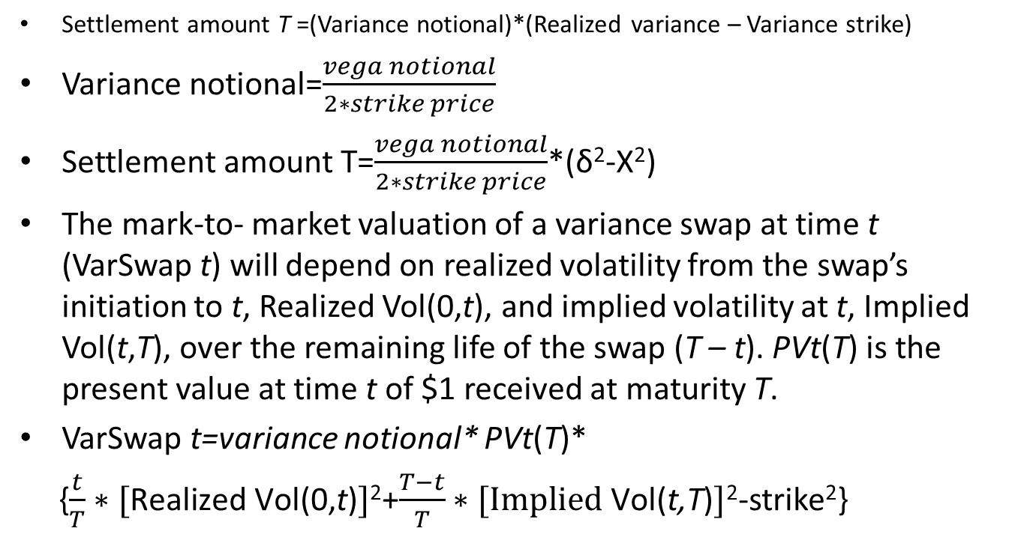
4. DERIVATIVES ON VOLATILITY
Settlement amount T =(Variance notional)*(Realized variance – Variance strike)
Variance notional=$\frac{vega notional}{2∗strike price}$
Settlement amount T=$\frac{vega notional}{2∗strike price}$*(δ²-X²)
The mark-to- market valuation of a variance swap at time t (VarSwap t) will depend on realized volatility from the swap’s initiation to t, Realized Vol(0,t), and implied volatility at t, Implied Vol(t,T), over the remaining life of the swap (T – t). PVt(T) is the present value at time t of $1 received at maturity T.
VarSwap t=variance notional* PVt(T)*
{$\frac{t}{T}∗[\text{Realized} \text{Vol}\text{(0,}\text{t}\text{)}]$²+$\frac{T−t}{T}∗[\text{Implied} \text{Vol}\text{(}\text{t}\text{,}\text{T}\text{)}]$²-strike²}

Slide 24
4. DERIVATIVES ON VOLATILITY
Example 10:
Variance Swap Valuation and Settlement
Olivia Santos trades strategies that systematically sell volatility on the S&P 500 Index. She sells $50,000 vega notional of a one-year variance swap on the S&P 500 at a strike of 20% (quoted as annual volatility). Now six months have passed, and the S&P 500 has experienced a realized volatility of 16% (annualized). On the same day, the fair strike of a new six-month variance swap on the S&P 500 is 19%.
Determine the following:
1 The current value of the variance swap sold by Santos (note that the annual interest rate is 2.5%)
2 The settlement amount at expiration of the swap if the one-year realized volatility is 18%

Slide 25
5. USES OF DERIVATIVES IN PORTFOLIO MANAGEMENT
5.1 Equity swaps
5.2 Cash Equitization
5.3 Asset Allocation Using Derivatives

Slide 26
5. USES OF DERIVATIVES IN PORTFOLIO MANAGEMENT
Example 11:
Yolanda Grant manages a portfolio with a target allocation of 40% in stocks and 60% in bonds. Over the last month, the value of the portfolio has increased from €100 million to €106 million, and Grant wants to rebalance it back to the target allocation (40% stocks/60% bonds). The current portfolio has €46 million (43.4%) in European stocks (with beta of 1.2 with respect to the EURO STOXX 50 index) and €60 million (56.6%) in German bunds. The bonds have a modified duration of 9.5.

Slide 27
5. USES OF DERIVATIVES IN PORTFOLIO MANAGEMENT
Grant will use stock index futures and bond futures to achieve this objective. Once the notional values to be traded are known, she determines how many futures contracts should be purchased or sold to achieve the desired asset allocation.
The EURO STOXX 50 index futures contract has a price of €3,500 and a multiplier of €10, for a value of €35,000. The Euro-Bund futures contract has a contract size of €100,000. The cheapest-to- deliver bond has a modified duration of 8.623 and a price of 98.14, so (per Equation 7) its BPVCTD is €84.63, calculated as 8.623 × 0.0001 ×[(98.14/100) × €100,000)]. Its conversion factor is 0.619489.
Determine how many stock index and bond futures contracts Grant should use to implement the desired asset allocation and whether she should go long or short.

Slide 28
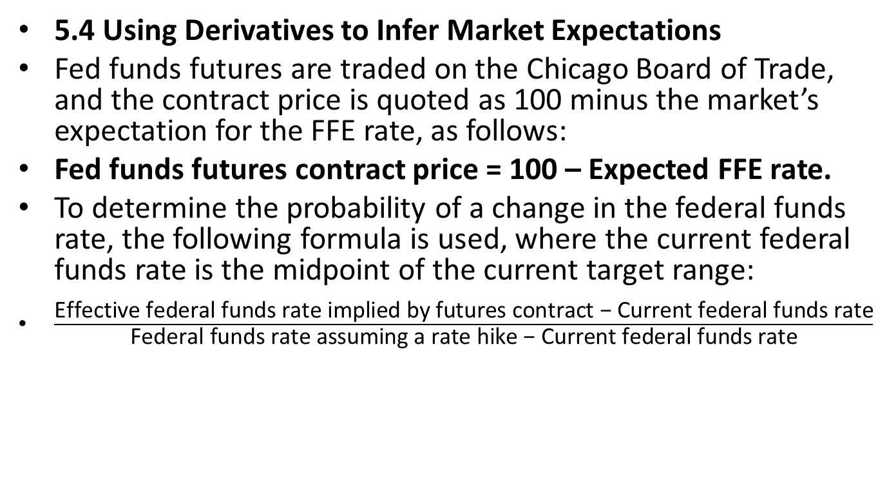
5. USES OF DERIVATIVES IN PORTFOLIO MANAGEMENT
5.4 Using Derivatives to Infer Market Expectations
Fed funds futures are traded on the Chicago Board of Trade, and the contract price is quoted as 100 minus the market’s expectation for the FFE rate, as follows:
Fed funds futures contract price = 100 – Expected FFE rate.
To determine the probability of a change in the federal funds rate, the following formula is used, where the current federal funds rate is the midpoint of the current target range:
$\frac{\text{Effective} \text{federal} \text{funds} \text{rate} \text{implied} \text{by} \text{futures} \text{contract}\text{ − }\text{Current} \text{federal} \text{funds} \text{rate}}{\text{Federal} \text{funds} \text{rate} \text{assuming} \text{a} \text{rate} \text{hike}\text{ − }\text{Current} \text{federal} \text{funds} \text{rate}}$

Slide 29
5. USES OF DERIVATIVES IN PORTFOLIO MANAGEMENT
Example 12:
Andrew Okyung manages a portfolio of short-term floating-rate corporate debt, and he is interested in understanding current market expectations for any Fed rate actions at the upcoming FOMC meeting. He observes that the current price for the fed funds futures contract expiring after the next FOMC meeting is 97.90. The current federal funds rate target range is set between 1.75% and 2.00%.
Demonstrate how Okyung can use the information provided to determine the following:
1 The expected average FFE rate
2 The probability of a 25 bp interest rate hike at the next FOMC meeting

