Slide 1
1.REVIEW OF FOREIGN EXCHANGE CONCEPTS
1.1 spot markets
In foreign exchange markets—as in other financial markets—market participants confront a two-sided price in the form of a bid price and an offer price (also called an ask price) being quoted by potential counterparties.
For example, given a price request from a client, a dealer might quote a two-sided price on the spot USD/EUR exchange rate of 1.3648/1.3652.

Slide 2
1.REVIEW OF FOREIGN EXCHANGE CONCEPTS
1.2 forward markets
In professional FX markets, forward exchange rates are typically quoted in terms of “points.” The points on a forward rate quote are simply the difference between the forward exchange rate quote and the spot exchange rate quote.
Maturity | Spot Rate or Forward Points
Spot (USD/EUR) | 1.3549/1.3651
One months | –5.6/–5.1
Three months | –15.9/–15.3
Six months | –37.0/–36.3
Twelve months | –94.3/–91.8

Slide 3
1.REVIEW OF FOREIGN EXCHANGE CONCEPTS
1.2 forward markets
As with other financial instruments, the mark-to-market value of forward contracts reflects the profit (or loss) that would be realized from closing out the position at current market prices.
To close out a forward position, it must be offset with an equal and opposite forward position using the spot exchange rate and forward points available in the market when the offsetting position is created.

Slide 4
1.REVIEW OF FOREIGN EXCHANGE CONCEPTS
Example 1:
Suppose that a market participant bought GBP10,000,000 for delivery against the AUD in six months at an “all-in” forward rate of 1.6100 AUD/GBP. (The all-in forward rate is simply the sum of the spot rate and the forward points, appropriately scaled to size.) Three months later, the market participant wants to close out this forward contract. To do that would require selling GBP10,000,000 three months forward using the AUD/GBP spot exchange rate and forward points in effect at that time. Assume the bid–offer for spot and forward points three months prior to the settlement date are as follows:
Spot rate (AUD/GBP) 1.6210/1.6215
Three-month points 130/140
three-month AUD Libor is 4.80% (annualized)

Slide 5
1.REVIEW OF FOREIGN EXCHANGE CONCEPTS
1.3 fx swap markets
An FX swap transaction consists of offsetting and simultaneous spot and forward transactions, in which the base currency is being bought (sold) spot and sold (bought) forward. These two transactions are often referred to as the “legs” of the swap. The two legs of the swap can either be of equal size (a “matched” swap) or one can be larger than the other (a “mismatched” swap). FX swaps are distinct from currency swaps. Similar to currency swaps, FX swaps involve an exchange of principal amounts in different currencies at swap initiation that is reversed at swap maturity. Unlike currency swaps, FX swaps have no interim interest payments and are nearly always of much shorter term than currency swaps.

Slide 6
1.REVIEW OF FOREIGN EXCHANGE CONCEPTS
1.4 currency option
The final product type within FX markets is currency options. The market for currency options is, in many ways, similar to option markets for other asset classes, such as bonds and equities. As in other markets, the most common options in FX markets are call and put options, which are widely used for both risk management and speculative purposes. However, in addition to these vanilla options, the FX market is also characterized by active trading in exotic options. (“Exotic” options have a variety of features that make them exceptionally flexible risk management tools, compared with vanilla options.)

Slide 7
2.CURRENCY RISK AND PORTFOLIO RETURN AND RISK
2.1 Return Decomposition
A domestic asset is an asset that trades in the investor’s domestic currency (or home currency).
Foreign assets are assets denominated in currencies other than the investor’s home currency.
The return on a foreign asset will be affected by exchange rate movements in the home currency against the foreign currency.
RDC = (1 + RFC)(1 + RFX) – 1
where RDC is the domestic-currency return (in percent), RFC is the foreign-currency return, and RFX is the percentage change of the foreign currency against the domestic currency.

Slide 8
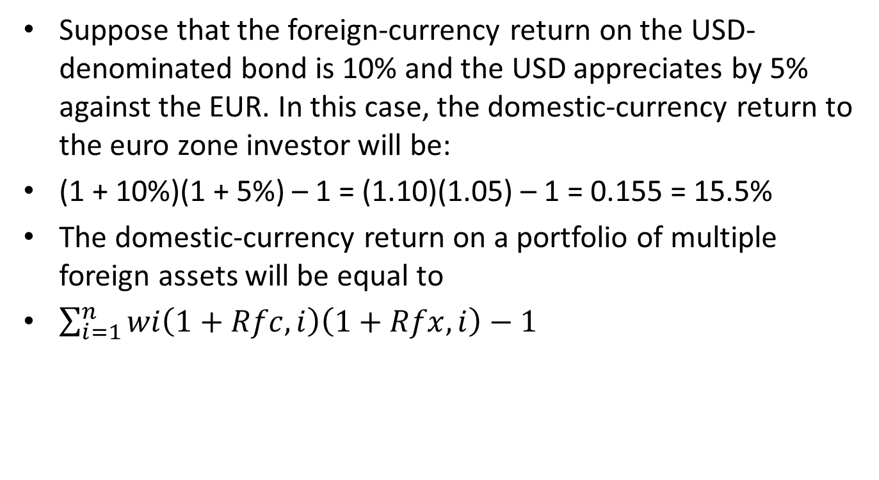
2.CURRENCY RISK AND PORTFOLIO RETURN AND RISK
Suppose that the foreign-currency return on the USD-denominated bond is 10% and the USD appreciates by 5% against the EUR. In this case, the domestic-currency return to the euro zone investor will be:
(1 + 10%)(1 + 5%) – 1 = (1.10)(1.05) – 1 = 0.155 = 15.5%
The domestic-currency return on a portfolio of multiple foreign assets will be equal to
$\sum_{i=1}^{n}{wi\left(1+Rfc,i\right)\left(1+Rfx,i\right)−1}$

Slide 9
2.CURRENCY RISK AND PORTFOLIO RETURN AND RISK
Example 2:
Assume the following information for a portfolio held by an investor in India. Performance is measured in terms of the Indian rupee (INR) and the weights of the two assets in the portfolio, at the beginning of the period, are 80% for the GBP-denominated asset and 20% for the EUR-denominated asset, respectively. (Note that the portfolio weights are measured in terms of a common currency, the INR, which is the investor’s domestic currency in this case.)
 | One Year Ago | Today
INR/GBP spot rate | 84.12 | 85.78
INR/EUR spot rate | 65.36 | 67.81
GBP-denominated asset value, in GBP millions | 43.8 | 50.7
EUR-denominated asset value, in EUR millions | 14.08 | 12.17

Slide 10
2.CURRENCY RISK AND PORTFOLIO RETURN AND RISK
2.2 volatility decomposition
σ²(RDC) ≈ σ²(RFC) + σ²(RFX) + 2σ(RFC)σ(RFX)ρ(RFC,RFX)

Slide 11
2.CURRENCY RISK AND PORTFOLIO RETURN AND RISK
Example 3:Portfolio Risk and Return Calculations
1 What is the expected domestic-currency return for a eurozone investor holding the Canadian asset?
2 What is the expected domestic-currency return for a Canadian investor holding the eurozone asset?
3 From the perspective of the Canadian investor, assume that σ(RFC) = 3% (the expected risk for the foreign-currency asset is 3%) and the σ(RFX) = 2% (the expected risk of exchange rate movements is 2%). Furthermore, the expected correlation between movements in foreign-currency asset returns and movements in the CAD/EUR rate is +0.5. What is the expected risk of the domestic-currency return [σ(RDC)]?
 | Eurozone |  | Canada
 | Today | Expected | Today | Expected
Asset price | 100.69 | 101.5 | 101 | 99.8
CAD/EUR | 1.2925 | 1.3100

Slide 12
3. CURRENCY MANAGEMENT: STRATEGIC DECISIONS
3.1 The Investment Policy Statement
For most portfolios, currency management can be considered a sub-set of these more specific portfolio management policies within the IPS. The currency risk management policy will usually address such issues as the:
target proportion of currency exposure to be passively hedged;
latitude for active currency management around this target;
frequency of hedge rebalancing;
currency hedge performance benchmark to be used; and
hedging tools permitted (types of forward and option contracts, etc.).

Slide 13
3. CURRENCY MANAGEMENT: STRATEGIC DECISIONS
3.2 The Portfolio Optimization Problem
First the portfolio manager could pick the set of portfolio weights (ωi) for the foreign-currency assets that optimize the expected foreign-currency asset risk–return trade-off (assuming there is no currency risk). Then the portfolio manager could choose the desired currency exposures for the portfolio and decide whether and by how far to relax the constraint to a full currency hedge for each currency pair.

Slide 14
3. CURRENCY MANAGEMENT: STRATEGIC DECISIONS
3.3 Choice of Currency Exposures
Concerning beliefs, one camp of thought holds that in the long run currency effects cancel out to zero as exchange rates revert to historical means or their fundamental values.
Another camp of thought notes that currency movements can have a dramatic impact on short-run returns and return volatility and holds that there are pricing inefficiencies in currency markets

Slide 15
3. CURRENCY MANAGEMENT: STRATEGIC DECISIONS
3.3.1 Diversification Considerations
Diversification considerations will also depend on the asset composition of the foreign-currency asset portfolio. The reason is because the foreign-currency asset returns (RFC) of different asset classes have different correlation patterns with foreign-currency returns (RFX). If there is a negative correlation between these two sets of returns, having at least some currency exposure may help portfolio diversification and moderate the domestic-currency return risk, σ(RDC).

Slide 16
3. CURRENCY MANAGEMENT: STRATEGIC DECISIONS
3.3.2 cost considerations
Hedging costs come mainly in two forms: trading costs and opportunity costs. The most immediate costs of hedging involve trading expenses.
A second form of costs associated with hedging are the opportunity cost of the hedge. To be 100% hedged is to forgo any possibility of favorable currency rate moves.

Slide 17
3. CURRENCY MANAGEMENT: STRATEGIC DECISIONS
3.4 Locating the Portfolio Along the Currency Risk Spectrum
3.4.1 Passive Hedging
In this approach, the goal is to keep the portfolio’s currency exposures close, if not equal to, those of a benchmark portfolio used to evaluate performance.
Passive hedging is a rules-based approach that removes almost all discretion from the portfolio manager, regardless of the manager’s market opinion on future movements in exchange rates or other financial prices.

Slide 18
3. CURRENCY MANAGEMENT: STRATEGIC DECISIONS
3.4.2 Discretionary Hedging
This approach is similar to passive hedging in that there is a “neutral” benchmark portfolio against which actual portfolio performance will be measured. However, in contrast to a strictly rules-based approach, the portfolio manager now has some limited discretion on how far to allow actual portfolio risk exposures to vary from the neutral position.
This discretion allows the portfolio manager at least some limited ability to express directional opinions about future currency movements—to accept risk in an attempt to earn reward—in order to add value to the portfolio performance.

Slide 19
3. CURRENCY MANAGEMENT: STRATEGIC DECISIONS
3.4.3 Active Currency Management
The active currency manager is supposed to take currency risks and manage them for profit. The primary goal is to add alpha to the portfolio through successful trading.
But for all forms of active management (i.e.,having the discretion to express directional market views), there is no allowance for unlimited speculation; there are risk management systems in place for even the most speculative investment vehicles, such as hedge funds

Slide 20
3. CURRENCY MANAGEMENT: STRATEGIC DECISIONS
3.4.4 Currency Overlay
In the most limited sense of the term, currency overlay simply means that the portfolio manager has outsourced managing currency exposures to a firm specializing in FX management
A broader view of currency overlay allows the externally hired currency overlay manager to take directional views on future currency movements
In contrast, the concept of foreign exchange as an asset class does not restrict the currency overlay manager, who is free to take FX exposures in any currency pair where there is value-added to be harvested, regardless of the underlying portfolio.

Slide 21
3. CURRENCY MANAGEMENT: STRATEGIC DECISIONS
3.5 Formulating a Client-Appropriate Currency Management Program
Generally speaking, the strategic currency positioning of the portfolio, as encoded in the IPS, should be biased toward a more-fully hedged currency management program the more
■ short term the investment objectives of the portfolio;
■ risk averse the beneficial owners of the portfolio are (and impervious to ex post regret over missed opportunities);
■ immediate the income and/or liquidity needs of the portfolio;
■ fixed-income assets are held in a foreign-currency portfolio;
■ cheaply a hedging program can be implemented;
■ volatile (i.e., risky) financial markets are;and
■ skeptical the beneficial owners and/or management oversight committee are of the expected benefits of active currency management

Slide 22
4. CURRENCY MANAGEMENT: TACTICAL DECISIONS
In this section, we consider the case in which the IPS has given the portfolio manager (or currency overlay manager) at least some limited discretion for actively managing currency risk within these mandated strategic bounds. This then leads to tactical decisions: which FX exposures to accept and manage within these discretionary limits. In other words, tactical decisions involve active currency management.
In what follows, we will explore some of the methods used to form directional views about the FX market

Slide 23
4. CURRENCY MANAGEMENT: TACTICAL DECISIONS
4.1 Active Currency Management Based on Economic Fundamentals
The simple economic framework is based on the assumption that in the long run, the real exchange rate will converge to its “fair value,” but short- to medium-term factors will shape the convergence path to this equilibrium.
As a result, all else equal, the base currency’s real exchange rate should appreciate if there is an upward movement in:
■ its long-run equilibrium real exchange rate;
■ either its real or nominal interest rates, which should attract foreign capital;
■ expected foreign inflation, which should cause the foreign currency to depreciate;
■ the foreign risk premium, which should make foreign assets less attractive compared with the base currency nation’s domestic assets.
The real exchange rate should also increase if it is currently below its long-term equilibrium value.

Slide 24
4. CURRENCY MANAGEMENT: TACTICAL DECISIONS
4.2 Active Currency Management Based on Technical Analysis
Technical analysis is based on three broad themes.
First, market technicians believe that in a liquid, freely traded market the historical price data can be helpful in projecting future price movements.
Second, market technicians believe that historical patterns in the price data have a tendency to repeat, and that this repetition provides profitable trade opportunities.
Third, technical analysis does not attempt to determine where market prices should trade (fair value, as in fundamental analysis) but where they will trade.

Slide 25
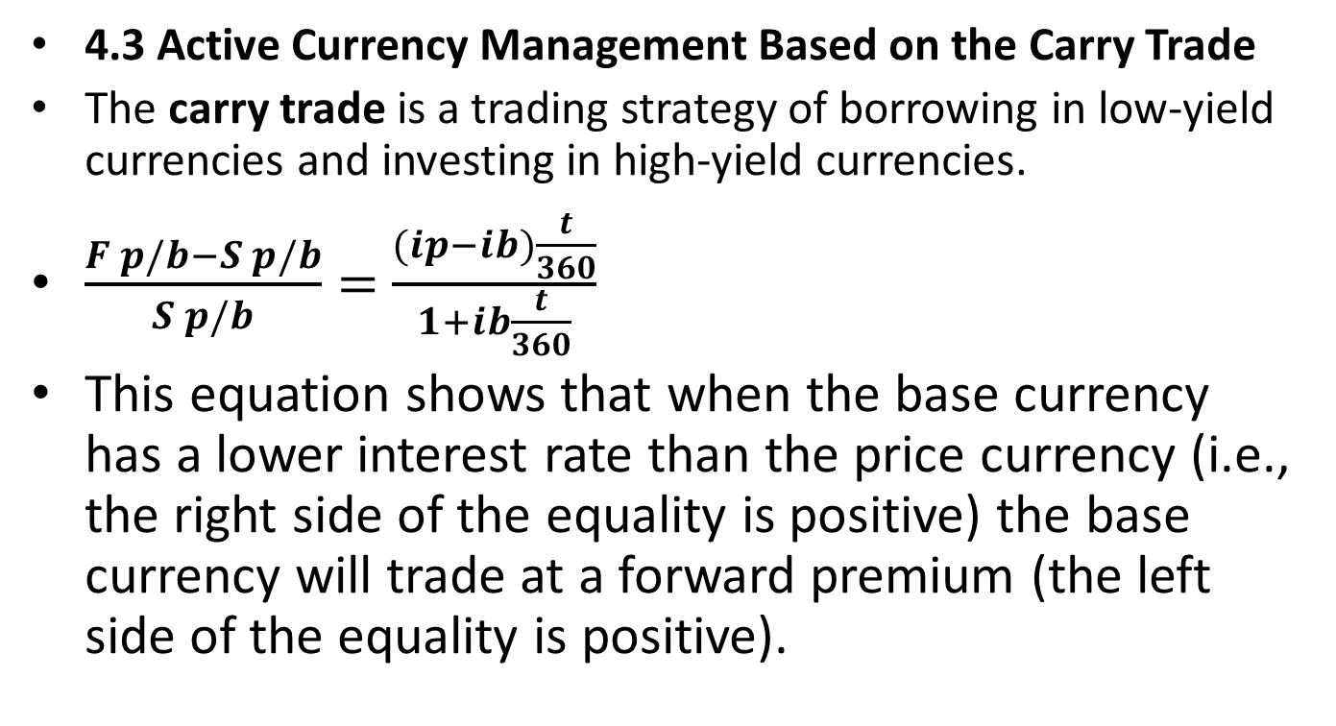
4. CURRENCY MANAGEMENT: TACTICAL DECISIONS
4.3 Active Currency Management Based on the Carry Trade
The carry trade is a trading strategy of borrowing in low-yield currencies and investing in high-yield currencies.
$\frac{F p/b−S p/b}{S p/b}=$ $\frac{(ip−ib)\frac{t}{360}}{1+ib\frac{t}{360}}$
This equation shows that when the base currency has a lower interest rate than the price currency (i.e., the right side of the equality is positive) the base currency will trade at a forward premium (the left side of the equality is positive).

Slide 26
4. CURRENCY MANAGEMENT: TACTICAL DECISIONS
 | Invest/buy | Borrow/sell
Implementing the carry trade | High-yield currency | Low-yield currency
Trading the forward rate bias | Forward discount currency | Forward premium currency
Example 4:
Todays one year | Currency pair | Exchange rate
Libor |  | Today | One year later
Jpy 0.1% | Jpy/usd | 81.30 | 81.00
Aud 4.5% | Usd/aud | 1.0750 | 1.0803

Slide 27
4. CURRENCY MANAGEMENT: TACTICAL DECISIONS
4.4 Active Currency Management Based on Volatility Trading
Another type of active trading style is unique to option markets and is known as volatility trading (or simply “vol trading”).
Delta: The sensitivity of the option premium to a small change in the price of the underlying15 of the option, typically a financial asset. This sensitivity is an indication of price risk.
Delta hedging is the act of hedging away the option position’s exposure to delta, the price risk of the underlying (the FX spot rate, in this case). Because delta shows the sensitivity of the option price to changes in the spot exchange rate, it thus defines the option’s hedge ratio: The size of the offsetting hedge position that will set the net delta of the combined position (option plus delta hedge) to zero. Typically implementing this delta hedge is done using either forward contracts or a spot transaction

Slide 28
4. CURRENCY MANAGEMENT: TACTICAL DECISIONS
One simple option strategy that implements a volatility trade is a straddle, which is a combination of both an at-the-money (ATM) put and an ATM call. A long straddle buys both of these options. Because their deltas are –0.5 and +0.5, respectively, the net delta of the position is zero; that is, the long straddle is delta neutral.
Similarly, a short straddle is a bet that the spot rate will stay relatively stable.
A similar option structure is a strangle position for which a long position is buying out-of-the-money (OTM) puts and calls with the same expiry date and the same degree of being out of the money

Slide 29
4. CURRENCY MANAGEMENT: TACTICAL DECISIONS
Example 5:
McYelland begins by examining yield spreads between various countries and the implied volatility extracted from the option pricing for several currency pairs. She collects the following data:
One-year yield levels |  | One-year implied volatility
Switzerland | -0.103% | PLN/CHF | 8.4%
United states | 0.162% | MXN/CHF | 15.6%
Poland | 4.753% | PLN/USD | 20.3%
Mexico | 4.550% | MXN/USD | 16.2%

Slide 30
4. CURRENCY MANAGEMENT: TACTICAL DECISIONS
Example 5:
McYelland is also examining various economic indicators to shape her market views. After studying the economic prospects for both Japan and New Zealand, she expects that the inflation rate for New Zealand is about to accelerate over the next few years, whereas the inflation rate for Japan should remain relatively stable.
Turning her attention to the economic situation in India, McYelland believes that the Indian authorities are about to tighten monetary policy, and that this change has not been fully priced into the market. She reconsiders her short-term view for the Indian rupee (i.e., the INR/USD spot rate) after conducting this analysis.

Slide 31
4. CURRENCY MANAGEMENT: TACTICAL DECISIONS
Example 5:
McYelland also examines the exchange rate volatility for several currency pairs to which the investment trusts are exposed. Based on her analysis of the situation, she believes that the exchange rate between Chilean peso and the US dollar (CLP/USD) is about to become much more volatile than usual, although she has no strong views about whether the CLP will appreciate or depreciate.
One of McYelland’s colleagues, Catalina Ortega, is a market technician and offers to help McYelland time her various market position entry and exit points based on chart patterns. While examining the JPY/NZD price chart, Ortega notices that the 200-day moving average is at 62.0405 and the current spot rate is 62.0315.

Slide 32
4. CURRENCY MANAGEMENT: TACTICAL DECISIONS
1 Based on the data she collected, all else equal, McYelland’s best option for implementing a carry trade position would be to fund in:
A USD and invest in PLN.
B CHF and invest in MXN.
C CHF and invest in PLN.
2 Based on McYelland’s inflation forecasts, all else equal, she would be more likely to expect a(n):
A depreciation in the JPY/NZD.
B increase in capital flows from Japan to New Zealand.
C more accommodative monetary policy by the Reserve Bank of New Zealand.

Slide 33
4. CURRENCY MANAGEMENT: TACTICAL DECISIONS
3 Given her analysis for India, McYelland’s short-term market view for the INR/USD spot rate is now most likely to be:
A biased toward appreciation.
B biased toward depreciation.
C unchanged because it is only a short-run view.
4 Using CLP/USD options, what would be the cheapest way for McYelland to implement her market view for the CLP?
A Buy a straddle
B Buy a 25-delta strangle
C Sell a 40-delta strangle
5 Based on Ortega’s analysis, she would most likely expect:
A support near 62.0400.
B resistance near 62.0310.
C resistance near 62.0400.

Slide 34
5.TOOLS OF CURRENCY MANAGEMENT
5.1 Forward Contracts:
Futures or forward contracts on currencies can be used to obtain full currency hedges, although most institutional investors prefer to use forward contracts for the following reasons:
1.Futures contracts are standardized in terms of settlement dates and contract sizes. These may not correspond to the portfolio’s investment parameters.
2.Futures contracts may not always be available in the currency pair that the portfolio manager wants to hedge.
3.Futures contracts require up-front margin (initial margin).

Slide 35
5.TOOLS OF CURRENCY MANAGEMENT
5.1.1Hedge Ratios with Forward Contracts
A static hedge (i.e., unchanging hedge) will avoid transaction costs, but will also tend to accumulate unwanted currency exposures as the value of the foreign-currency assets change.
This characteristic will cause a mismatch between the market value of the foreign-currency asset portfolio and the nominal size of the forward contract used for the currency hedge; this is pure currency risk. For this reason, the portfolio manager will typically need to implement a dynamic hedge by rebalancing the portfolio periodically. This hedge rebalancing will mean adjusting some combination of the size, number, and maturities of the forward currency contracts.

Slide 36
5.TOOLS OF CURRENCY MANAGEMENT
However, we can observe that the higher the degree of risk aversion, the more frequently the hedge is likely to be rebalanced back to the “neutral” hedge ratio.
Similarly, the greater the tolerance for active trading, and the stronger the commitment to a particular market view, the more likely it is that the actual hedge ratio will be allowed to vary from a “neutral” setting, possibly through entering into new forward contracts.

Slide 37
5.TOOLS OF CURRENCY MANAGEMENT
5.1.2 Roll Yield
The roll yield (also called the roll return) on a hedge results from the fact that forward contracts are priced at the spot rate adjusted for the number of forward points at that maturity (see the example shown in Exhibit 3). This forward point adjustment can either benefit or detract from portfolio returns (positive and negative roll yield, respectively) depending on whether the forward points are at a premium or discount, and what side of the market (buying or selling) the portfolio manager is on.
The magnitude of roll yield is given by |(FP/B ‒ SP/B)/SP/B| where “||” indicates absolute value.

Slide 38
5.TOOLS OF CURRENCY MANAGEMENT
Example6:The Hedging Decision
The reporting currency of Hong Kong SAR-based Kwun Tong Investment Advisors is the Hong Kong dollar (HKD). The investment committee is examining whether it should implement a currency hedge for the firm’s exposures to the GBP and the ZAR (the firm has long exposures to both of these foreign currencies). The hedge would use forward contracts. The following data relevant to assessing the expected cost of the hedge and the expected move in the spot exchange rate has been developed by the firm’s market strategist.

Slide 39
5.TOOLS OF CURRENCY MANAGEMENT
 | Current Spot Rate | Six-Month Forward Rate | Six-Month Forecast Spot Rate
HKD/GBP | 12.4610 | 12.6550 | 12.3000
HKD/ZAR | 0.9510 | 0.9275 | 0.9300
1 Recommend whether to hedge the firm’s long GBP exposure. Justify your recommendation.
2 Discuss the trade-offs in hedging the firm’s long ZAR exposure.
In this case, the decision to hedge the currency risk would depend on the trade-offs
Between (1) the level of risk aversion of the firm; and (2) the conviction the firm held
in the currency forecast—that is, the level of certainty that the ZAR would not
depreciate by more than 2.5%.

Slide 40
5.TOOLS OF CURRENCY MANAGEMENT
5.2 Currency Options
As with forward contracts, a portfolio manager will have to make judgments about the cost/benefit trade-offs of options-based strategies. Although options do allow the portfolio upside potential from favorable currency movements, options can also be a very expensive form of insurance.

Slide 41
5.TOOLS OF CURRENCY MANAGEMENT
Example 7:
Brixworth & St. Ives Asset Management is a UK-based firm managing a dynamic hedging program for the currency exposures in its Aggressive Growth Fund. One of the fund’s foreign-currency asset holdings is denominated in the Mexican peso (MXN), and one month ago Brixworth & St. Ives fully hedged this exposure using a two-month MXN/GBP forward contract. The following table provides the relevant information.
 | One Month Ago | today
Value of assets (in MXN) | 10,000,000 | 9,500,000
MXN/GBP spot rate (bid–offer) | 20.0500/20.0580 | 19.5985/20.0065
One-month forward points (bid–offer) | 625/640 | 650/665
Two-month forward points (bid–offer) | 875/900 | 900/950

Slide 42
5.TOOLS OF CURRENCY MANAGEMENT
The Aggressive Growth Fund also has an unhedged foreign-currency asset exposure denominated in the South African rand (ZAR). The current mid-market spot rate in the ZAR/GBP currency pair is 5.1050.
1 One month ago, Brixworth & St. Ives most likely sold:
A MXN9,500,000 forward at an all-in forward rate of MXN/GBP 19.6635.
B MXN10,000,000 forward at an all-in forward rate of MXN/GBP 20.1375.
C MXN10,000,000 forward at an all-in forward rate of MXN/GBP 20.1480.
2 To rebalance the hedge today, the firm would most likely need to:
A buy MXN500,000 spot.
B buy MXN500,000 forward.
C sell MXN500,000 forward.

Slide 43
5.TOOLS OF CURRENCY MANAGEMENT
3 Given the data in the table, the roll yield on this hedge at the forward contracts’ maturity date is most likely to be:
A zero.
B negative.
C positive.
4 Assuming that all ZAR/GBP options considered have the same notional amount and maturity, the most expensive hedge that Brixworth & St. Ives could use to hedge its ZAR exposure is a long position in a(n):
A ATM call.
B 25-delta call.
C put with a strike of 5.1050.

Slide 44
5.TOOLS OF CURRENCY MANAGEMENT
5.3 Strategies to Reduce Hedging Costs and Modify a Portfolio’s Risk Profile
The key point to keep in mind is that all of these various cost-reduction measures invariably involve some combination of less downside protection and/or less upside potential for the hedge. In efficient markets, lower insurance premiums mean lower insurance.
Select Currency Management Strategies
Forward Contracts | Over-/under-hedging | Profit from market view
Option Contracts | OTM options | Cheaper than ATM
 | Risk reversals | Write options to earn premiums
 | Put/call spreads | Write options to earn premiums
 | Seagull spreads | Write options to earn premiums
Exotic Options | Knock-in/out features | Reduced downside/upside exposure
 | Digital options | Extreme payoff strategies

Slide 45
5.TOOLS OF CURRENCY MANAGEMENT
5.3.1 Over-/Under-Hedging Using Forward Contracts
A variant of this approach would be to adjust the hedge ratio based on exchange rate movements: to increase the hedge ratio if the base currency depreciated, but decrease the hedge ratio if the base currency appreciated.
5.3.2 Protective Put Using OTM Options
One way to reduce the cost of using options is to accept some downside risk by using an OTM option, such as a 25- or 10-delta option. These options will be less costly, but also do not fully protect the portfolio from adverse currency movements.

Slide 46
5.TOOLS OF CURRENCY MANAGEMENT
5.3.3 Risk Reversal (or Collar)
Another set of option strategies involves selling options (also known as writing options) to earn income that can be used to offset the cost of buying a put option, which forms the “core” of the hedge.
In professional FX markets, having a long position in a call option and a short position in a put option is called a risk reversal.

Slide 47
5.TOOLS OF CURRENCY MANAGEMENT
5.3.4 Put Spread
This position is typically structured by buying an OTM put, and writing a deeper-OTM put to gain income from premiums; both options involved have the same maturity.
The put spread reduces the cost of the hedge, but at the cost of more limited downside protection.
5.3.5 Seagull Spread
Of course, the manager can always do both: that is, be long a protective put and then write both a call and a deep-OTM put. This option structure is sometimes referred to as a seagull spread.
As always, lower structure costs come with some combination of lower downside protection and/or less upside potential.

Slide 48
5.TOOLS OF CURRENCY MANAGEMENT
5.3.6 Exotic Options
In general, the term “exotic” refers to all options that are not “vanilla.” In FX, vanilla refers essentially to European-style put and call options.
The two most common type of exotic options encountered in foreign exchange markets are those with knock-in/ knock-out features and digital options.

Slide 49
5.TOOLS OF CURRENCY MANAGEMENT
5.3.6 Exotic Options
An option with a knock-in feature is essentially a vanilla option that is created only when the spot exchange rate touches a pre-specified level (this trigger level, called the “barrier,” is not the same as the strike price). Similarly a knock-out option is a vanilla option that ceases to exist when the spot exchange rate touches some pre-specified barrier level. Because these options only exist (i.e., get knocked-in or knocked-out) under certain circumstances, they are more restrictive than vanilla options and hence are cheaper. But again, the knock-in/ out features provide less upside potential and/ or downside protection.
Digital options are also called binary options, or all-or- nothing options. They are called this because they pay a fixed amount if they “touch” their exercise level at any time before expiry (even if by a single pip).

Slide 50
5.TOOLS OF CURRENCY MANAGEMENT
Example 8:
Brixworth & St. Ives Asset Management, the UK-based investment firm, has hedged the exposure of its Aggressive Growth Fund to the MXN with a long position in a MXN/GBP forward contract. The fund’s foreign-currency asset exposure to the ZAR is hedged by buying an ATM call option on the ZAR/GBP currency pair. The portfolio managers at Brixworth & St. Ives are looking at ways to modify the risk–reward trade-offs and net costs of their currency hedges.
Jasmine Khan, one of the analysts at Brixworth & St. Ives, proposes an option-based hedge structure for the long-ZAR exposure that would replace the hedge based on the ATM call option with either long or short positions in the following three options on ZAR/GBP:
a ATM put option
b 25-delta put option
c 25-delta call option

Slide 51
5.TOOLS OF CURRENCY MANAGEMENT
Khan argues that these three options can be combined into a hedge structure that will have some limited downside risk, but provide complete hedge protection starting at the relevant 25-delta strike level. The structure will also have unlimited upside potential, although this will not start until the ZAR/GBP exchange rate moves to the relevant 25-delta strike level. Finally, this structure can be created at a relatively low cost because it involves option writing.
1 The best method for Brixworth & St. Ives to gain some upside potential for the hedge on the Aggressive Growth Fund’s MXN exposure using MXN/GBP options is to replace the forward contract with a:
A long position in an OTM put.
B short position in an ATM call.
C long position in a 25-delta risk reversal.

Slide 52
5.TOOLS OF CURRENCY MANAGEMENT
2 While keeping the ATM call option in the ZAR/GBP, the method that would lead to greatest cost reduction on the hedge would be to:
A buy a 25-delta put.
B write a 10-delta call.
C write a 25-delta call.
3 Setting up Khan’s proposed hedge structure would most likely involve being:
A long the 25-delta options and short the ATM option.
B long the 25-delta call, and short both the ATM and 25-delta put options.
C short the 25-delta call, and long both the ATM and 25-delta Put options.

Slide 53
5.TOOLS OF CURRENCY MANAGEMENT
5.4 Hedging Multiple Foreign Currencies
We now expand our discussion to hedging a portfolio with multiple foreign-currency assets. The hedging tools and strategies are very similar to those discussed for hedging a single foreign-currency asset, except now the currency hedge must consider the correlation between the various foreign-currency risk exposures.
5.4.1 Cross Hedges and Macro Hedges
A cross hedge occurs when a position in one asset (or a derivative based on the asset) is used to hedge the risk exposures of a different asset (or a derivative based on it). Normally, cross hedges are not needed because, as we mentioned earlier, forward contracts and other derivatives are widely available in almost every conceivable currency pair.

Slide 54
5.TOOLS OF CURRENCY MANAGEMENT
Cross hedge:
For example, consider the case of a US-domiciled investor who has exposures to foreign-currency assets in Australia and New Zealand. These two economies are roughly similar in that they are resource-based and closely tied to the regional economy of the Western Pacific, especially the large emerging markets in Asia. As a result, the movements in their currencies are often closely correlated; the USD/AUD and USD/NZD currency pairs will tend to move together.
If the portfolio manager has the discretion to take short positions, the portfolio may (for example) possibly have a net long position in the Australian foreign-currency asset and a net short position in the New Zealand foreign-currency asset. In this case, there may be less need to hedge away the AUD and NZD currency exposures separately because the portfolio’s long exposure to the AUD is diversified by the short position on the NZD.

Slide 55
5.TOOLS OF CURRENCY MANAGEMENT
Macro hedge:
Some types of cross hedges are often referred to as macro hedges. The reason is because the hedge is more focused on the entire portfolio, particularly when individual asset price movements are highly correlated, rather than on individual assets or currency pairs. Another way of viewing a macro hedge is to see the portfolio not just as a collection of financial assets, but as a collection of risk exposures. These various risk exposures are typically defined in categories, such as term risk, credit risk, and liquidity risk.
Putting gold in the portfolio sometimes serves this purpose by helping to provide broad portfolio protection against extreme market events. Using a volatility overlay program can also hedge the portfolio against such risks because financial stress is typically associated with a spike in exchange rates’ implied volatility.

Slide 56
5.TOOLS OF CURRENCY MANAGEMENT
5.4.2Minimum-Variance Hedge Ratio
A mathematical approach to determining the optimal cross hedging ratio is known as the minimum-variance hedge ratio. Recall that regression analysis based on ordinary least squares (OLS) is used to minimize the variance of ε , the residual between actual and fitted values of the regression
yt = α+ βxt + ε t
In the regression formula, we substitute the percentage change in the value of the asset to be hedged for yt, and the percentage change in value of the hedging instrument for xt (both of these values are measured in terms of the investor’s domestic currency).

Slide 57
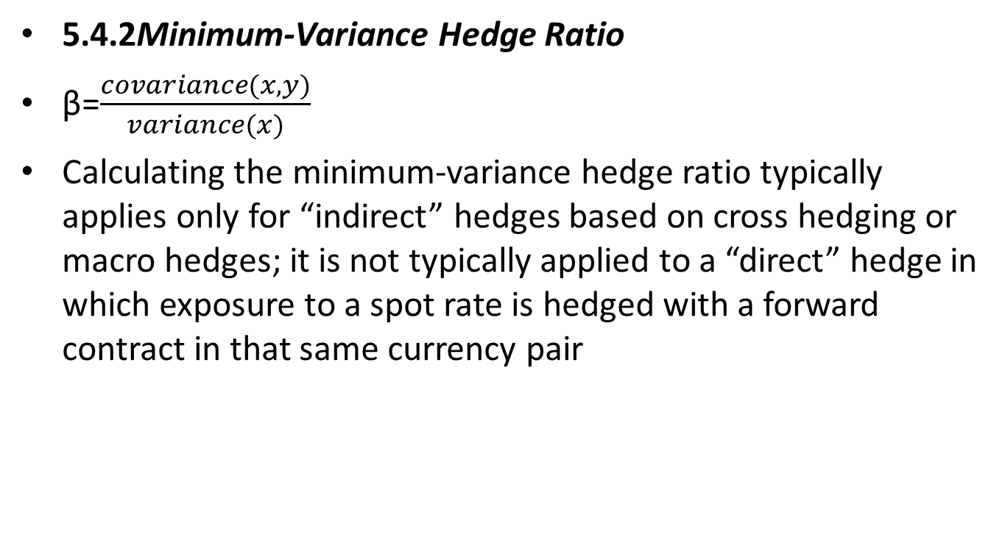
5.TOOLS OF CURRENCY MANAGEMENT
5.4.2Minimum-Variance Hedge Ratio
β=$\frac{covariance(x,y)}{variance(x)}$
Calculating the minimum-variance hedge ratio typically applies only for “indirect” hedges based on cross hedging or macro hedges; it is not typically applied to a “direct” hedge in which exposure to a spot rate is hedged with a forward contract in that same currency pair

Slide 58
5.TOOLS OF CURRENCY MANAGEMENT
5.4.3 Basis Risk
The portfolio manager must be aware that any time a direct currency hedge (i.e., a spot rate hedged against its own forward contract) is replaced with an indirect hedge (cross hedge, macro hedge), basis risk is brought into the portfolio. This risk reflects the fact that the price movements in the exposure being hedged and the price movements in the cross hedge instrument are not perfectly correlated, and that the correlation will change with time—and sometimes both dramatically and unexpectedly.

Slide 59
5.TOOLS OF CURRENCY MANAGEMENT
For an example of basis risk, return to the illustration earlier of the foreign-currency asset portfolio that cross hedged a long USD/AUD exposure with a short USD/ NZD exposure. It is not only possible, but highly likely, that the correlation between movements in the USD/AUD and the USD/NZD spot rates will vary with time.
Another example of basis risk would be that the correlation between a multi-currency portfolio’s domestic-currency market value and the value of currency basket derivatives being used as a macro hedge will neither be perfect nor constant.

Slide 60
5.TOOLS OF CURRENCY MANAGEMENT
Example 9:
Ireland-based Old Galway Capital runs several investment trusts for its clients. Fiona Doyle has just finished rebalancing the dynamic currency hedge for Overseas Investment Trust III, which has an IPS mandate to be fully hedged using forward contracts. Shortly after the rebalancing, Old Galway receives notice that one of its largest investors in the Overseas Investment Trust III has served notice of a large withdrawal from the fund.
1 Given the sudden liquidity need announced, Doyle’s best course of action with regard to the currency hedge is to:
A do nothing.
B reduce the hedge ratio.
C over-hedge by using currency options.

Slide 61
5.TOOLS OF CURRENCY MANAGEMENT
Padma Bhattathiri works at Malabar Coast Capital, an India-based investment company. Her mandate is to seek out any alpha opportunities in global FX markets and aggressively manage these for speculative profit. The Reserve Bank of New Zealand (RBNZ) is New Zealand’s central bank, and is scheduled to announce its policy rate decision within the week. The consensus forecast among economists is that the RBNZ will leave rates unchanged, but Bhattathiri believes that the RBNZ will surprise the markets with a rate hike.
2 Given her market view, Bhattathiri would most likely choose which of the following long positions?
A 5-delta put option on NZD/AUD
B 10-delta put option on USD/NZD
C Put spread on JPY/NZD using 10-delta and 25-delta options

Slide 62
5.TOOLS OF CURRENCY MANAGEMENT
Jasmine Khan, analyst at UK-based Brixworth & St. Ives Asset Management, has been instructed by the management team to reduce hedging costs for the firm’s Aggressive Growth Fund, and that more currency exposure—both downside risk and upside potential—will have to be accepted and managed. Currently, the fund’s ZAR-denominated foreign-currency asset exposures are being hedged with a 25-delta risk reversal (on the ZAR/GBP cross rate). The current ZAR/ GBP spot rate is 13.1350.
3 Among the following, replacing the current risk reversal hedge with a long position in which of the following would best meet Khan’s instructions? (All use the ZAR/GBP.)
A 10-delta risk reversal
B Put option with a 13.1300 strike
C Call option with a 13.1350 strike

Slide 63
5.TOOLS OF CURRENCY MANAGEMENT
Bao Zhang is a market analyst at South Korea–based Kwangju Capital, an investment firm that offers several actively managed investment trusts for its clients. She notices that the exchange rate for the Philippines Peso (PHP/USD) is increasing (PHP is depreciating) toward its 200-day moving average located in the 42.2500 area (the current spot rate is 42.2475). She mentions this to Akiko Takahashi, a portfolio manager for one of the firm’s investment vehicles. Takahashi’s view, based on studying economic fundamentals, is that the PHP/ USD rate should continue to increase, but after speaking with Zhang she is less sure. After further conversation, Zhang and Takahashi come to the view that the PHP/USD spot rate will either break through the 42.2500 level and gain upward momentum through the 42.2600 level, or stall at the 42.2500 level and then drop down through the 42.2400 level as frustrated long positions exit the market. They decide that either scenario has equal probability over the next month.
4 Which of the following positions would best implement Zhang’s and Takahashi’s market view?
A Long a 42.2450 put and long a 42.2550 call
B Long a 42.2450 put and short a 42.2400 put
C Long a 42.2450 put and short a 42.2550 call

Slide 64
5.TOOLS OF CURRENCY MANAGEMENT
Annie McYelland is an analyst at Scotland-based Kilmarnock Capital. The firm is considering a USD10,000,000 investment in an S&P 500 Index fund. McYelland is asked to calculate the minimum-variance hedge ratio. She collects the following statistics based on 10 years of monthly data:
5 Which of the following positions would best implement Kilmarnock Capital’s minimum-variance hedge?
A Long a USD/GBP forward contract with a notional size of USD1.2 million
B Long a USD/GBP forward contract with a notional size of USD3.3 million
C Short a USD/GBP forward contract with a notional size of USD2.0 million
σ(%ΔSGBP/USD) | σ(RDC) | ρ
2.7% | 4.4% | 0.2

Slide 65
6.CURRENCY MANAGEMENT FOR EMERGING MARKET CURRENCIES
6.1 Special Considerations in Managing Emerging Market Currency Exposures
Managing emerging market currency exposure involves unique challenges. Perhaps the two most important considerations are (1) higher trading costs than the major currencies under “normal” market conditions, and (2) the increased likelihood of extreme market events and severe illiquidity under stressed market conditions.

Slide 66
6.CURRENCY MANAGEMENT FOR EMERGING MARKET CURRENCIES
6.2 Non-Deliverable Forwards
Currencies of many emerging market countries trade with some form of capital controls. Where capital controls exist and delivery in the controlled currency is limited by the local government, it is often possible to use what are known as non-deliverable forwards (NDFs). These are similar to regular forward contracts, but they are cash settled (in the non-controlled currency of the currency pair) rather than physically settled (the controlled currency is neither delivered nor received).

Slide 67
6.CURRENCY MANAGEMENT FOR EMERGING MARKET CURRENCIES
Example 10:
a trader could enter into a long position in a three-month NDF for the BRL/USD. Note that the BRL—the currency with capital controls—is the price currency and the base currency, the USD, is the currency that settlement of the NDF will be made in. Assume that the current all-in rate for the NDF is 2.0280 and the trader uses an NDF with a notional size of USD1,000,000. Suppose that three months later the BRL/USD spot rate is 2.0300 and the trader closes out the existing NDF contract with an equal and offsetting spot transaction at this rate.

