Slide 1

Derivatives Definition of derivatives
A derivative is a financial instrument that derives its value from the performance of an underlying asset.

Slide 2

Derivatives TYPES OF DERIVATIVES
Primary derivative types include a firm(forward) commitment in which a predetermined amount is agreed to be exchanged between counterparties at settlement and a contingent claim in which one of the counterparties determines whether and when the trade will settle.

Slide 3

Forward Contracts
Forward commitments
Forward
Futures
Swap
Contingent claims
Option
Credit Derivatives

Slide 4
Forward Contracts
Definition: A forward contract is an over-the-counter (OTC) derivative in which two counterparties agree that one counterparty, the buyer, will purchase an underlying from the other counterparty, the seller, in the future at a pre-agreed fixed price.
These markets are known as cash markets or spot markets in which specific assets are exchanged at current prices referred to as cash prices or spot prices.
At time t = 0, the counterparties do not exchange a payment upfront but, rather, agree on delivery of the underlying at time T for a forward price of F₀(T).

Slide 5
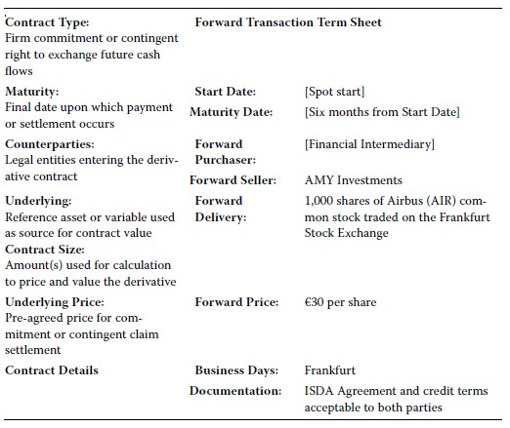
Forward Contracts example

Slide 6
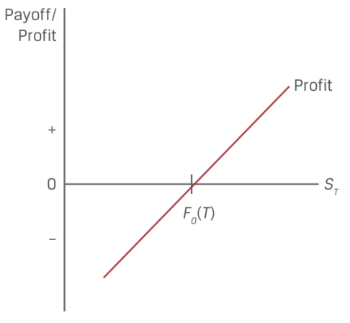
Forward Contracts
Long Forward Payoff Profile
Buyer Payoff = S_{T}-F₀(T)

Slide 7
Forward Contracts
Characteristics:
An important element of forward contracts is that no money changes hands between parties when the contract is initiated.
The long and the short are engaged in a zero- sum game, which is a type of competition in which one participant’s gains are the other’s losses.
Forward contracts have zero value at the start.
Forward contracts need not specifically settle by delivery of the underlying asset. They can settle by an exchange of cash. These contracts—called non- deliverable forwards (NDFs), cash- settled forwards, or contracts for differences.
The primary purpose of derivatives is for risk management.

Slide 8

Forward Contracts example
Forward Gold Purchase
An investor, Procam Investments, enters a cash-settled forward contract with a financial intermediary to buy 100 ounces of gold at a forward price, F0(T), of $1,792.13 per ounce in three months.
Today’s spot gold price (S0) is $1,770 per ounce.
At contract maturity, the gold price (ST) is $1,780.50 per ounce.

Slide 9
Forward Contracts practice
1. Describe a scenario in which a forward contract has cash settlement of zero at maturity and neither counterparty has defaulted.
2. Determine the correct answers to fill in the blanks: An oil producer enters a derivative contract with an investor to sell 1,000 barrels of oil in two months at a forward price of $64 per barrel. If the spot oil price at maturity is $58.50 per barrel, the investor realizes a __________ at maturity equal to __________.

Slide 10

Futures Contracts
Forward commitments
Forward
Futures
Swap
Contingent claims
Option
Credit Derivatives

Slide 11

Futures Contracts
Definition: Futures contracts are forward contracts with standardized sizes, dates, and underlying that trade on futures exchanges.
The futures contract buyer creates a long exposure to the underlying by agreeing to purchase the underlying at a later date at a pre-agreed price. The seller makes the opposite commitment. This agreed-on price is called the futures price, f0(T).

Slide 12
Futures Contracts
Probably the most important distinctive characteristic of futures contracts is the daily settlement of gains and losses and the associated credit guarantee provided by the exchange through its clearinghouse.
At the end of each day, the clearinghouse engages in a practice called mark to market, also known as the daily settlement.
The account is specifically referred to as a margin account.
Initial margin
Maintenance margin
Margin call
Variation margin

Slide 13
Futures Contracts example
Futures price=5.5,quantity=20,initial margin=11,maintenance margin=6
 | Beginning Balance | Fund Deposit | Futures( settlement) price | Gain/Loss | Ending Balance
Day 0 | 0 | 11 | 5.5 | 0 | 11
Day 1 | 11 | 0 | 5.4 | -2 | 9
Day 2 | 9 | 0 | 5.2 | -4 | 5
Day 3 | 5 | 6 | 5.0 | -4 | 7
Day 4 | 7 | 0 | 5.1 | 2 | 9
Day 5 | 9 | 0 | 4.9 | -4 | 5
Day 6 | 5 | 6 | 5.0 | 2 | 13

Slide 14
Futures Contracts Way to against default
By standardizing these contracts and creating an organized market with rules, regulations, and a central clearing facility, the futures markets offer an element of liquidity and protection against loss by default.
Futures exchanges are highly regulated at the national level in all countries.
Some futures contracts also limit daily price changes. These rules, called price limits, establish a band relative to the previous day’s settlement price within which all trades must occur.
In other cases, exchanges use what is called a circuit breaker to pause intraday trading for a brief period if a price limit is reached.

Slide 15

Futures Contracts Final Settlement of futures
Futures contracts specify whether physical delivery of an underlying or cash settlement occurs at expiration.
At any given time, the number of outstanding contracts is called the open interest.
The futures price converges to the spot price at expiration.

Slide 16
Futures Contracts
Difference between forward and futures
Forward | Futures
More privacy/Less regulated | Highly regulated
 | More transparent
More flexibility
More customized | Standardized
Settle at expiration | Daily settlement
 | Credit guarantee(Margin account)

Slide 17
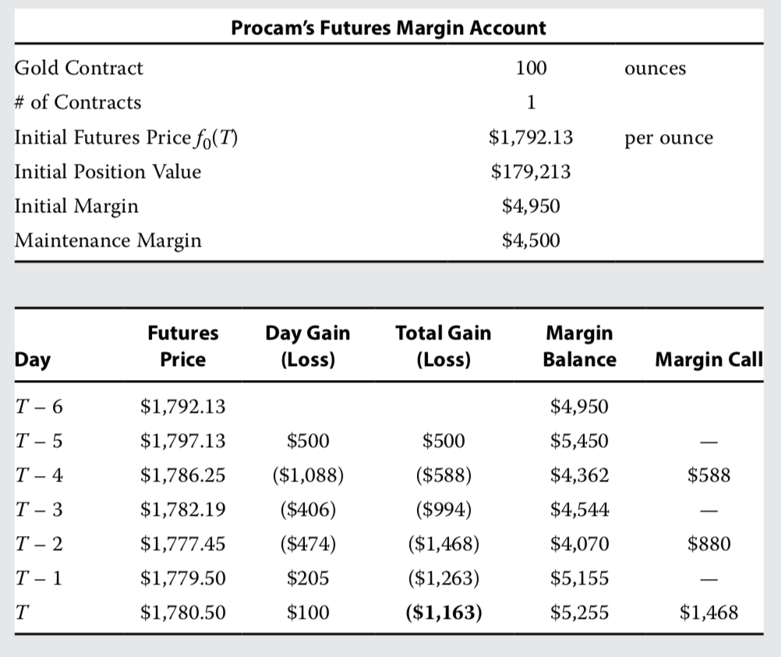
Futures Contracts example
Procam purchases a futures contract [f0(T) = $1,792.13] on the exchange via a financial intermediary.

Slide 18

Swap Contracts
Forward commitments
Forward
Futures
Swap
Contingent claims
Option
Credit Derivatives

Slide 19
Swap Contracts
Definition: A swap is a firm commitment under which two counterparties exchange a series of cash flows in the future. One set of cash flows is typically variable, or floating, and determined by a market reference rate that resets each period. The other cash flow stream is usually fixed or may vary based on a different underlying asset or rate.

Slide 20
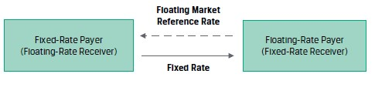
Swap Contracts
Plain vanilla swap: the most common swap is the fixed- for- floating interest rate swap.

Slide 21
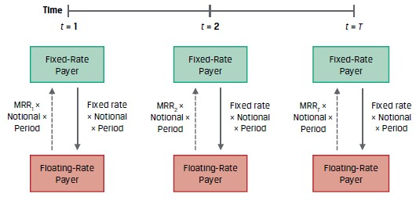
Swap Contracts
Counterparties usually exchange a net payment on fixed- and floating-rate payments

Slide 22
Swap Contracts example
Fyleton Investments has entered a five-year, receive-fixed GBP200 million interest rate swap with a financial intermediary to increase the duration of its fixed-income portfolio. Under terms of the swap, Fyleton has agreed to receive a semiannual GBP fixed rate of 2.25% and pay six-month MRR.
Calculate the first swap cash flow exchange if six-month MRR is set at 1.95%.

Slide 23
Swap Contracts
Characteristics
A swap is more or less just a series of forwards.
A swap is a bit more like a forward contract than a futures contract in that it is an OTC contract, so it is privately negotiated and subject to default.
The party owing the lesser amount cannot default to the party owing the greater amount.
As with futures and forwards, no money changes hands at the start; thus, the value of a swap when initiated must be zero.
The notional amount of a swap is not typically exchanged, the credit risk of a swap is much less than that of a loan.

Slide 24
Swap contracts practices
1.Which of the following characterizes forward contracts and swaps but not futures?
A They are customized.
B They are subject to daily price limits.
C Their payoffs are received on a daily basis.
2.Which of the following distinguishes forwards from swaps?
A Forwards are OTC instruments, whereas swaps are exchange traded.
B Forwards are regulated as futures, whereas swaps are regulated as securities.
C Swaps have multiple payments, whereas forwards have only a single payment.
3.Which of the following occurs in the daily settlement of futures contracts?
A Initial margin deposits are refunded to the two parties.
B Gains and losses are reported to other market participants.
C Losses are charged to one party and gains credited to the other.

Slide 25
Option Contracts
Forward commitments
Forward
Futures
Swap
Contingent claims
Option
Credit Derivatives

Slide 26
Option Contracts
Definition: An option is a derivative contract in which one party, the buyer, pays a sum of money to the other party, the seller or writer, and receives the right to either buy or sell an underlying asset at a fixed price either on a specific expiration date or at any time prior to the expiration date.

Slide 27
Option Contracts Call Option
Long：花钱获得一个权力
Short：收钱卖出一个权力
Call option: The right to buy an underlying.
Long call:花钱（请老板吃饭）获得一个买资产（买可乐）的权力
Short call:收钱（被请吃饭）卖出一个买资产（买可乐）的权力
 | right | obligation
我 | long call
杂货店老板 |  | short call

Slide 28
Option Contracts Call Option
The right to exercise in the future has a value that is paid upfront to the option seller in the form of an option premium.
The pre-agreed execution price is called the exercise price (or strike price).

Slide 29
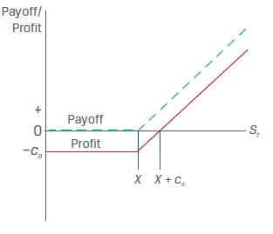
Option Contracts Call Option
Payoff and profit of long call

Slide 30
Option Contracts Call Option
Payoff of call option
Long call = MAX (S_{T}-X,0)
Short call = - MAX (S_{T}-X,0)
Profit of call option
Long call = MAX (S_{T}-X,0) – C₀
Short call = - MAX (S_{T}-X,0) + C₀

Slide 31
Option Contracts Practices
Hightest Capital purchases a call option on the S&P 500 Health Care Select
Sector Index (SIXV). This six-month exchange-traded option contract has a
size of 100 index units and an exercise price of $1,240 per unit versus the initial
SIXV spot price of $1,180.95. The option premium paid upfront is $24.85
per unit, or $2,485 (= $24.85 × 100). As the option nears maturity, a Hightest
analyst is asked to determine the expected option payoff and profit per unit at
maturity under different scenarios for the SIXV spot price on the exercise date.

Slide 32
Option Contracts Practices
S_{T} | payoff | profit
1,260
1,220
Calculate the SIXV spot price at maturity from Practices at which Hightest Capital will reach a breakeven point and earn zero profit.

Slide 33
Option Contracts Put Option
Long:花钱获得一个权力
Short:收钱卖出一个权力
Put option: The right to sell the underlying.
Long put:花钱（喝酒）买入一个卖资产（卖可乐）的权力
Short put:收钱（喝酒）卖出一个卖资产（卖可乐）的权力
 | right | Obligation
杂货店老板 | long put
小柏 |  | short put

Slide 34
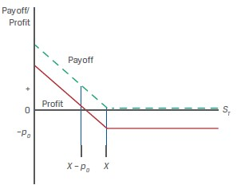
Option Contracts Put Option
Payoff and profit of long put

Slide 35
Option Contracts Put Option
Payoff of put option
Long put = MAX (X-S_{T},0)
Short put = - MAX (X-S_{T},0)
Profit of put option
Long put = MAX (X-S_{T},0) – P₀
Short put = - MAX (X-S_{T},0) + P₀

Slide 36
Option Contracts
Characteristics：
Options that can be exercised early are referred to as American- style.
Options that can be exercised only at expiration are referred to as European- style.
Thus, only the short can default, which would occur if the long exercises the option and the short fails to do what it is supposed to do.
This asymmetric payoff profile is a common feature of contingent claims, which are sometimes referred to as non-linear derivatives.

Slide 37
Option Contracts
 | In the money | Out of the money | At the money
Call option | S_{T}>X | S_{T}<X | S_{T}=X
Put option | S_{T}<X | S_{T}>X | S_{T}=X
In the money(价内期权，实值期权): when the buyer will exercise the option
Out of the money(价外期权，虚值期权) : when the buyer will not exercise the option
At the money : when the option payoff is zero to the buyer

Slide 38
Option Contracts Practices
A put option seller receives a $5 premium for a put option sold on an underlying with an exercise price of $30. What is the option seller’s maximum profit under the contract? What is the maximum loss under the contract?

Slide 39
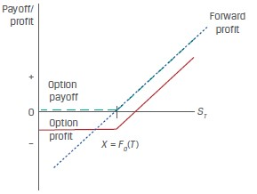
Forward commitment and contingent claim
Long forward and long call option payoff profile
S_{T}-F₀(T)>-C₀ | Forward profit exceeds option profit
S_{T}-F₀(T)=-C₀ | Forward profit equals option profit
S_{T}-F₀(T)<-C₀ | Option profit exceeds forward profit
The long call option’s similarity to a long position in the underlying with downside protection in exchange for paying a premium.

Slide 40
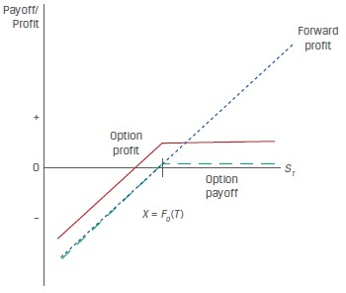
Forward commitment and contingent claim
Long forward and short put option payoff profile
S_{T}-F₀(T)>p₀ | Forward profit exceeds option profit
S_{T}-F₀(T)=p₀ | Forward profit equals option profit
S_{T}-F₀(T)<p₀ | Option profit exceeds forward profit
The sold put option’s similarity to a long position in the underlying, with gains from price appreciation forgone in exchange for receiving a premium.

Slide 41
practices
Biomian Limited is a Mumbai-based biotech company with common stock and listed futures and options on the National Stock Exchange (NSE). The Viswan Family Office (VFO) currently owns 10,000 Biomian common shares. VFO would like to reduce its long Biomian position and diversify its equity market exposure but will delay a cash sale of shares for tax reasons for six months.

Slide 42
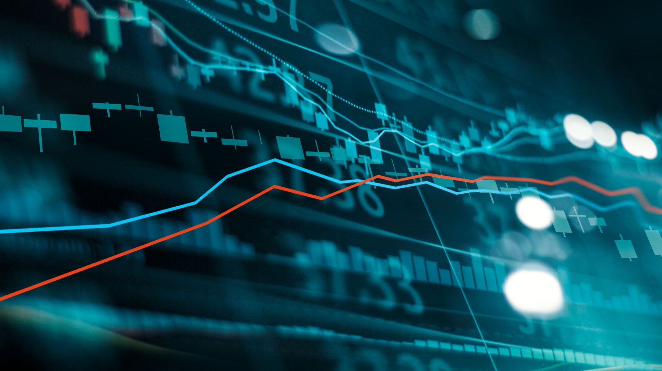
practices
1. Which of the following derivative contracts available to VFO’s chief investment officer is best suited to reduce exposure to a decline in Biomian’s stock price in the next six months?
A. A short put position on Biomian stock that expires in six months
B. A long call position on Biomian stock that expires in six months
C. A short futures position in Biomian stock that settles in six months
2. VFO’s market strategist believes that Biomian’s share price will rise over the next six months but would like to protect against a decline in Biomian’s share price over the period. Which of the following positions is best suited for VFO to manage its existing Biomian exposure based on this view?
A. A long put position on Biomian stock that expires in six months
B. A short call position on Biomian stock that expires in six months
C. A long futures position in Biomian stock that settles in six months

Slide 43
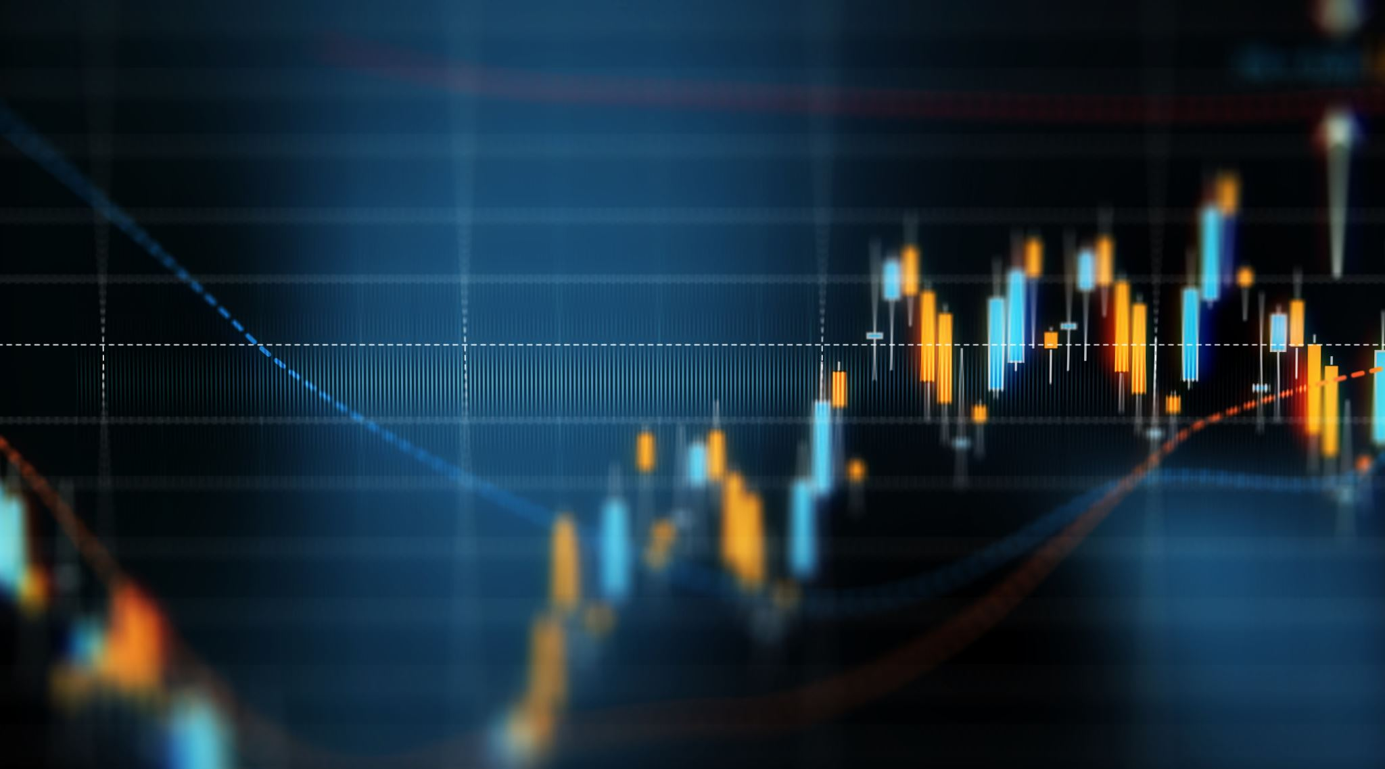
practices
3. Assume that Biomian shares rise over the next six months. Which of the following statements about VFO’s derivative strategies under this scenario is most accurate?
A. A forward sale of Biomian shares in six months would be more profitable
than purchasing the right to sell Biomian shares in six months.
B. Purchasing the right to sell Biomian shares in six months would be more
profitable than a forward sale of Biomian shares in six months.
C. We do not have enough information to determine whether a forward sale or
the right to sell Biomian shares will be more profitable in six months.

Slide 44
practices
4. VFO’s market strategist is considering a six-month call option strategy on the
NIFTY 50 benchmark Indian stock market index to increase broad market equity
exposure. The NIFTY 50 price today is INR15,200, and the strategist observes
that a call option with a INR16,000 exercise price (X) is trading at a premium of
INR1,500. Which of the following represents the payoff and profit of this strategy
just prior to maturity if the NIFTY 50 is trading at INR16,500?
A. Payoff is INR500; profit is –INR1,000.
B. Payoff is INR1,300; profit is INR800.
C. Payoff is INR1,300; profit is INR500.

Slide 45
Credit Derivatives
Forward commitments
Forward
Futures
Swap
Contingent claims
Option
Credit Derivatives

Slide 46
Credit Derivatives
Definition : A credit derivative is a class of derivative contracts between two parties, a credit protection buyer and a credit protection seller, in which the latter provides protection to the former against a specific credit loss.
Buyer:面临信用风险，买入信用保护
债券持有人，发放贷款机构
Seller:卖出信用保护
各类金融机构（保险公司，券商）

Slide 47
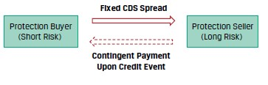
Credit Derivatives
Definition: a credit default swap is a derivative contract between two parties, a credit protection buyer and a credit protection seller, in which the buyer makes a series of cash payments to the seller and receives a promise of compensation for credit losses resulting from the default of a third party.

Slide 48

Credit Derivatives
Characteristics:
Credit spreads depend on the probability of default (POD) and the loss given default (LGD).
This contingent payment equals the issuer loss given default for the CDS contract notional amount.
A credit protection buyer without the corresponding fixed-income exposure who
buys a CDS is seeking to gain from higher credit spreads (which correspond to lower
cash bond prices) for an underlying issuer and is therefore short credit risk.

Slide 49
practices
Describe how a credit protection seller’s position is similar to that of an underlying cash bond investment.

Slide 50
Pricing and valuation of forward
The forward, futures, or swap pricing is a concept that represents the fixed price or rate at which the underlying will be purchased at a later date.
Opportunity cost (risk-free interest rate, r)
Other costs of ownership (C):Owners of some underlying assets, such as physical commodities, must incur storage, transportation, insurance, and/or spoilage costs.
Benefits of ownership (B):Stock dividends or bond coupons are examples of cash flow benefits.

Slide 51
Pricing and valuation of forward
For underlying assets with ownership benefits or benefit (B) or costs (C) expressed as a known amount in present value terms at t = 0—shown as PV()₀—the relationship between spot and forward prices in discrete compounding terms can be shown as
F_{T}=S₀*(1+r)^{T}
F_{T}=(S₀+PVC₀-PVB₀)*(1+r)^{T}
For benefit (B) and cost (c) expressed as rates of return, the relationship between spot and forward prices under continuous compounding is
F_{T}=S_{0*}e^{r*T}
F_{T}=S_{0*}e^{(r+C-B)*T}

Slide 52
Pricing and valuation of forward
1.Assume Hightest Capital agrees to deliver 1,000 Unilever (UL) shares at an agreed-upon price to a financial intermediary in six months under a forward contract. Assume that UL has a spot price (S0) of EUR50 and pays a quarterly dividend of EUR0.30, which occurs in exactly three months and again at time T, and assume a risk-free rate (r) of 5%.
2.The Viswan Family Office (VFO) would like to enter into a three-month forward commitment contract to purchase the NIFTY 50 benchmark Indian stock market index traded on the National Stock Exchange. The spot NIFTY 50 index price is INR15,200, the index dividend yield is 2.2%, and the Indian rupee risk-free rate is 4%.

Slide 53
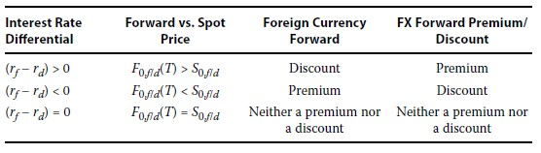
Pricing and valuation of forward
fc/dc, price currency/base currency
USD/EUR=1.2 USD1.2=EUR1
A long FX forward position involves the purchase of the base currency and the sale of the price currency.
F₀,_{f/d}(T)=S₀,_{f/d}*e^{(r}_{f}^{-r}_{d}^{)T}

Slide 54
Pricing and valuation of forward
Assume the current AUD/USD spot price is 1.3335. The Australian dollar is the price currency or foreign currency, and the US dollar is the base or domestic currency (AUD1.3335 = USD1). The six-month Australian dollar risk-free rate is 0.05%, and the six-month US dollar risk-free rate is 0.20%.

Slide 55
Pricing and valuation of forward
This mark-to-market value of a contract reflects the change in the underlying price and other factors that would result in a gain or loss to a counterparty if the forward contract were to be settled immediately.
Pricing and Valuation of Forward Contracts at Initiation:
V₀(T) = 0
Pricing and Valuation of Forward Contracts at Maturity:
V_{T}(T) = S_{T} − F₀(T)

Slide 56
Pricing and valuation of forward
The mark-to-market value of a contract at any point in time from inception to maturity, Vt(T), reflects the relationship between the current spot price at time t (St) and the present value of the forward price at time t discounted at the current risk-free rate.
Pricing and Valuation of Forward Contracts during the Life of the Contract:
V_{t}(T) = S_{t} − F₀(T)(1 + r)^{-(T-t)}
Pricing and Valuation of Forward Contracts with Additional Costs or Benefit:
V_{t}(T) = (S_{t}–PVB_{t}+ PVC_{t}) − F₀(T)(1 + r)^{-(T-t)}

Slide 57
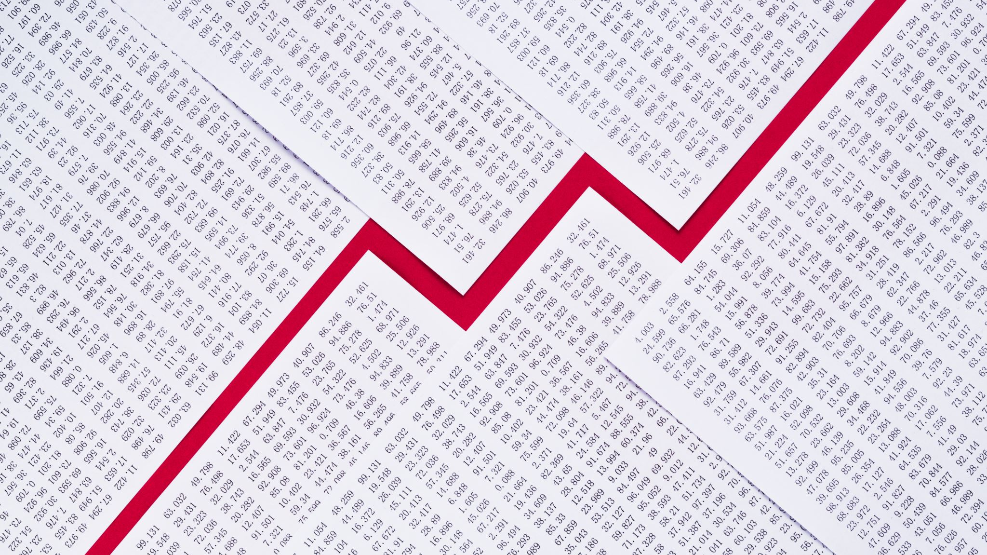
Pricing and valuation of forward
VFO enters into a six-month forward contract with a financial intermediary to sell Biomian shares at F0(T) = INR300.84 per share. The spot price at t = 0 is INR295 per share and the risk-free rate is 4%.
1. Calculate the forward contract MTM from VFO’s perspective in three months (t = 0.25) if Biomian’s spot price (St) falls to INR285 per share.
2. Show the forward contract MTM from VFO’s perspective in Question (1) if the risk-free rate doubles from 4% to 8%, and interpret the results.

Slide 58
Pricing and valuation of forward
Hightest Capital agreed to deliver 1,000 Unilever (UL) shares to a financial intermediary in six months under a forward contract at a price of EUR 50,631.10, or EUR 50.6311 per share. Unilever pays a quarterly dividend of EUR 0.30 three months after contract inception and at time T, and the risk-free rate (r) is 5%. Calculate the forward contract breakeven price, St, where Vt(T) = MTM = 0 four months after contract inception if the risk-free rate, r, remains unchanged at 5%.

Slide 59
Pricing and valuation of forward
At any given time t, the MTM value of the FX forward is the difference between the current spot FX price (St,f/d) and the present value of the forward price discounted by the current difference in risk-free rates (rf − rd) for the remaining period through maturity.
V_{t}(T) = S_{t},_{f/d} − F₀,_{f/d}(T)e^{-(r}_{f}^{–r}_{d}^{)(T–t)}

Slide 60
Pricing and valuation of forward
Rook Point Investors LLC has entered into a long one-year USD/EUR forward contract. That is, it has agreed to purchase EUR1,000,000 in exchange for USD1,201,000 in one year. At time t = 0 when the contract is initiated, the USD/EUR spot exchange rate is 1.192 (i.e., USD1.192 = EUR1), the one-year USD risk-free rate is 0.50%, and the one-year EUR risk-free rate is −0.25%.
Describe the MTM impact on the FX forward contract from Rook Point’s perspective if the one-year USD risk-free rate instantaneously rises by 0.25% once the contract is initiated, with other details unchanged.

Slide 61
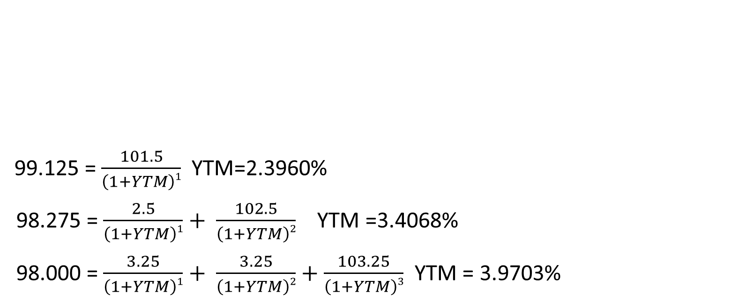
Forward rate agreement Yield to maturity (Market discount rate)
99.125 = $\frac{101.5}{\left(1+YTM\right)1}$YTM=2.3960%
98.275 = $\frac{2.5}{\left(1+YTM\right)1}+ \frac{102.5}{\left(1+YTM\right)2}$ YTM =3.4068%
98.000 = $\frac{3.25}{\left(1+YTM\right)1}+ \frac{3.25}{\left(1+YTM\right)2}+\frac{103.25}{\left(1+YTM\right)3}$ YTM = 3.9703%
Years to maturity | Annual coupon | PV(per 100 FV)
1 | 1.50% | 99.125
2 | 2.50% | 98.275
3 | 3.25% | 98.000

Slide 62
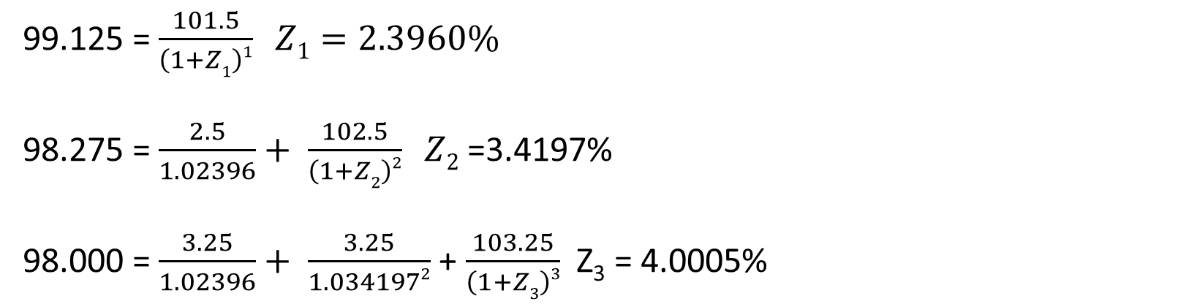
Forward rate agreement Spot rate(Zero rate)
Years to maturity | Annual coupon | PV(per 100 FV) | YTM
1 | 1.50% | 99.125 | 2.3960%
2 | 2.50% | 98.275 | 3.4068%
3 | 3.25% | 98.000 | 3.9703%
99.125 = $\frac{101.5}{\left(1+Z1\right)1} Z1=2.3960\%$
98.275 = $\frac{2.5}{1.02396}+ \frac{102.5}{\left(1+Z2\right)2} Z2$ =3.4197%
98.000 = $\frac{3.25}{1.02396}+ \frac{3.25}{1.0341972}$ + $\frac{103.25}{\left(1+Z3\right)3}$ Z₃ = 4.0005%

Slide 63
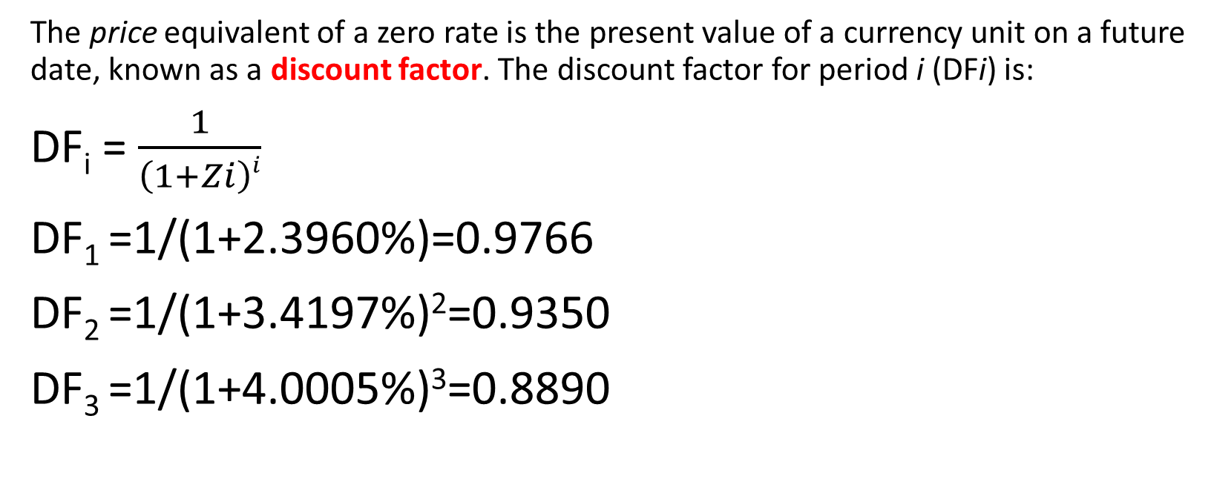
Forward rate agreement
The price equivalent of a zero rate is the present value of a currency unit on a future date, known as a discount factor. The discount factor for period i (DFi) is:
DF_{i} = $\frac{1}{\left(1+Zi\right)i}$
DF₁ =1/(1+2.3960%)=0.9766
DF₂ =1/(1+3.4197%)²=0.9350
DF₃ =1/(1+4.0005%)³=0.8890

Slide 64
Forward rate agreement
The breakeven reinvestment rate linking a short-dated and a long-dated zero-coupon bond is an implied forward rate (IFR).
(1+Z_{A})^{A} * (1+IFR_{A,B-A})^{B-A} =(1+Z_{B})^{B}
Years to maturity | Zero rate
1 | 2.3960%
2 | 3.4197%
3 | 4.0005%
IFR_{1,1} (1+2.3960%)*(1+IFR_{1,1})=(1+3.4197%)² IFR_{1,1}=4.4536%
IFR_{2,1} (1+3.4197%)²*(1+IFR_{2,1})=(1+4.0005%)³ IFR_{2,1}=5.1719%

Slide 65
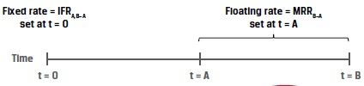
Forward rate agreement
An OTC derivatives contract in which counterparties agree to apply a specific interest rate to a future period is a forward rate agreement (FRA).
The FRA buyer, or long position, agrees to pay the deposit interest based on the agreed upon fixed rate and receives deposit interest based on a market reference rate that begins in A periods and ends in B periods (with a tenor of B − A periods) and is determined on or just before the forward settlement date at time t = A.

Slide 66
Forward rate agreement
A counterparty agrees to be the FRA fixed-rate receiver on a one-month AUD MRR in three months’ time based on a AUD150,000,000 notional amount. If IFR3m,1m at contract inception is 0.50% and one-month AUD MRR sets at 0.35% for settlement of the contract, calculate the settlement amount and interpret the results.

Slide 67
practices
A client seeking advice on her fixed-income portfolio observes the price and yield-to-maturity of one-year (r1) and two-year (r2) annual coupon government benchmark bonds currently available in the market. Which of the following statements best describes how the analyst can determine a breakeven reinvestment rate in one year’s time to help decide whether to invest now for one or two years?
A. As the two-year rate involves intermediate cash flows, divide the square root of (1 + r2) by (1 + r1) and subtract 1 to arrive at a breakeven reinvestment rate for one year in one year’s time.
B. Since the first year’s returns are compounded in the second year, set (1 + r1) multiplied by 1 plus the breakeven reinvestment rate equal to (1 + r2)² and solve for the breakeven reinvestment rate.
C. Since the breakeven reinvestment involves a zero-coupon cash flow, first substitute the one-year rate (r1) into the two-year bond price equation to solve for the two-year spot or zero rate (z2), then set (1 + r1) × (1 + breakeven reinvestment rate) = (1 + z2)² and solve for the breakeven reinvestment rate.

Slide 68
practices
Baywhite Financial seeks to gain a competitive advantage by making margin loans at fixed rates for up to 60 days to its investor clients. Since Baywhite borrows at a variable one-month market reference rate to finance these client loans, the firm enters into one-month FRA contracts on one-month MRR to hedge the interest rate exposure of its margin loan book. Which of the following statements best describes Baywhite’s interest rate exposure and the FRA position it should take to hedge that exposure?
A. Baywhite faces exposure to a rise in one-month MRR over the next 30 days, so it should enter into the FRA as a fixed-rate payer in order to benefit from a rise in one-month MRR above the FRA rate and offset its higher borrowing cost.
B. Baywhite faces exposure to a rise in one-month MRR over the next 30 days, so it should enter into the FRA as a fixed-rate receiver in order to benefit from a rise in one-month MRR above the FRA rate and offset its higher borrowing cost.
C. Baywhite faces exposure to a decline in one-month MRR over the next 30 days, so it should enter into the FRA as a fixed-rate receiver in order to benefit from a rise in one-month MRR above the FRA rate and offset its higher borrowing cost.

Slide 69
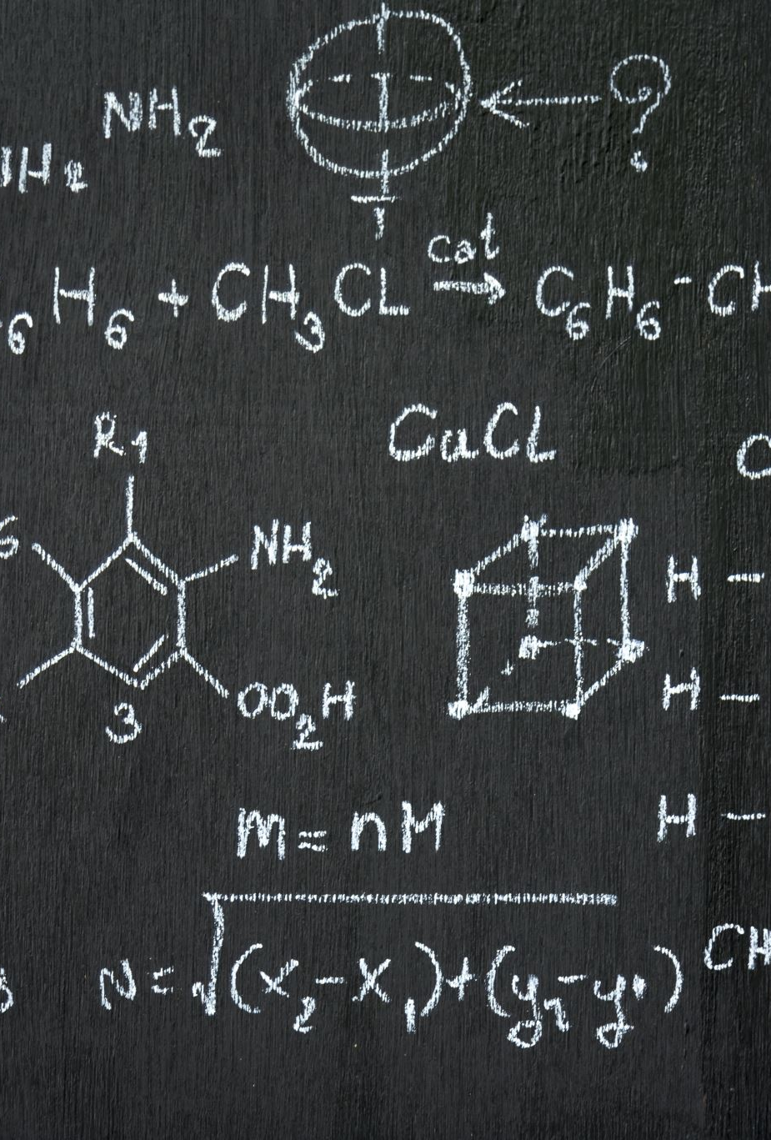
Pricing and valuation of futures pricing
The futures price, f₀(T), is identical to the forward price from a previous lesson.
f₀(T)=S₀(1+r)^{T}
f₀(T)=[S₀+PVC₀-PVB₀ ](1+r)^{T}
f₀(T)=S₀e^{rT}
f₀(T)=S₀e^{(r+C-B)T}

Slide 70
Pricing and valuation of futures pricing
The different patterns of cash flows for forwards and futures can lead to a difference in the pricing of forwards versus futures. Forward and futures prices are identical under certain conditions, namely:
■ if interest rates are constant, or
■ if futures prices and interest rates are uncorrelated.
If futures prices are positively correlated with interest rates, long futures contracts are more attractive than long forward positions for the same underlying and maturity.
A negative correlation between futures prices and interest rates leads to the opposite interpretation, with long forward positions being more desirable than long futures positions.

Slide 71
Pricing and valuation of futures valuation
Procam Investments enters a cash-settled forward commitment to buy 100 ounces of gold at a price (f₀[T] = F₀[T]) of $1,778.76 per ounce in 91 days, with a risk-free rate of 2% and no gold storage cost.
Assume that the gold futures price, f₁(T), falls by $5 on the first trading day to $1,773.76 and the spot price, S₁, ends the day at a no arbitrage equivalent of $1,765.12 (= $1,773.76(1.02)^{–90/365}).
Contract type | Contract MTM | Realized MTM
Forward | -497.58 | 0
Futures | 0 | -500

Slide 72
Pricing and valuation of futures valuation
The forward contract price, F₀(T), remains fixed until the contract matures.
Forward contract MTM value changes are captured by the difference between the current spot price, S_{t}, and the present value of the forward price, PV_{t}[F₀(T)].
This forward contract MTM is not settled until maturity, giving rise to counterparty credit risk over time since no cash is exchanged from inception of the contract to its maturity or expiration.
Futures contract prices fluctuate daily based upon market changes.
The daily settlement mechanism resets the futures MTM to zero, and variation margin is exchanged to settle the difference, reducing counterparty credit risk.

Slide 73
Pricing and valuation of futures interest rate futures
f_{A,B−A} = 100 − (100 × MRR_{A,B−A})
Where f_{A,B-A} represents the futures price for a market reference rate for B-A periods that begins in A periods (MRR_{A,B-A})
f3m,3m : 98.25 = 100-(100*MRR_{3m,3m})
MRR_{3m,3m}=1.75%
■ Long futures contract (lender): Gains as prices rise, future MRR falls
■ Short futures contract (borrower): Gains as prices fall, future MRR rises

Slide 74
Pricing and valuation of futures interest rate futures
Contract type | Gains from rising MRR | Gains from falling MRR
Interest rate futures | Short futures contract | Long futures contract
FRA | Long FRA Fixed-rate payer Floating-rate receiver | Short FRA Fixed-rate receiver Floating-rate payer

Slide 75
Pricing and valuation of futures interest rate futures
Interest rate futures daily settlement occurs based on price changes, which translate into futures contract basis point value (BPV) as follows:
Futures Contract BPV = Notional Principal × 0.01% × Period
If Baywhite were to use an interest rate futures contract instead, it would sell a futures contract on one-month MRR. The futures contract BPV for a $50,000,000 notional amount is:
Contract BPV = $416.67 (= $50,000,000 × 0.01% × [1/12])
If Baywhite sells f_{1,1} for $98.75 (or MRR_{1,1} = 1.25%) and settles at maturity at a price of $97.75 (MRR_{1,1} = 2.25%), it would expect to have a cumulative gain on the contract through maturity equal to $41,667 (= Contract BPV × 100 bps).

Slide 76
Pricing and valuation of futures interest rate futures
MRR_{3m,3m} | Short FRA cash settlement(PV) | Long futures settlement
2.01% | 497.50 | 500
2.11% | 248.69 | 250
2.21% | 0 | 0
2.31% | -248.56 | -250
2.41% | -497.01 | -500
An interest rate futures contract of $1,000,000 notional for three-month MRR of 2.21% for one quarter (or 90/360 days).
BPV=1,000,000*0.01%*0.25=25
Consider in contrast a $1,000,000 notional FRA on three-month MRR in three months’ time with an identical 2.21% rate.

Slide 77
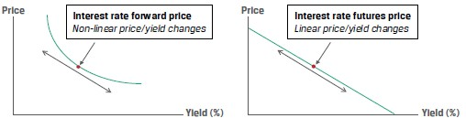
Pricing and valuation of futures interest rate futures
We see that the percentage price change is greater (in absolute value) when MRR falls than when it rises，which is called convexity bias.
The discounting feature of the FRA, which is not present in the futures contract, leads to a convexity bias that is greater for longer discounting periods

Slide 78
Pricing and valuation of futures
EFFECT OF CENTRAL CLEARING OF OTC DERIVATIVES
The advent of derivatives central clearing, introduced in an earlier lesson, has created futures-like margining requirements for OTC derivative dealers who buy and sell forwards to derivatives end users. Dealers who are required to post cash or highly liquid securities to a central counterparty often impose similar requirements on derivatives end users.

Slide 79
practices
One of Ace’s investor clients has entered a long six-month forward transaction with Ace on 100 shares of Xenaliya (XLYA), a non-dividend-paying technology stock. The stock’s spot price per share, S0, is €85, and the risk-free rate is a constant 1% for all maturities. Ace has hedged the client transaction with a long six-month XLYA futures contract at a price f0(T) of €85.42 and posted initial margin of €1,000. Three months after the forward and futures contracts are initiated, XYLA announces a strategic partnership with a major global technology firm, and its spot share price jumps €15 on the day’s trading to close at €123. Which of the following statements best characterizes the impact of the day’s trading on the MTM value of the forward versus the futures contract?
A. Ace’s client realizes an MTM gain of approximately €1,500 (= €15 × 100) on its margin account, which Ace must deposit at the end of the day to cover its margin call.
B. Ace’s client benefits from an MTM unrealized gain on its forward contract with Ace, and Ace has a corresponding MTM gain of approximately €1,500 (= €15 × 100) deposited in its margin account by the exchange.
C. Because Ace has entered a hedge of its client’s long forward position on XLYA by executing a futures contract with otherwise identical terms, the two contract MTM values exactly offset one another and no cash is exchanged on either transaction.

Slide 80
Classification of derivatives Forward commitments and contingent claims
Forward commitments
Forward
Futures
Swap
Contingent claims
Option
Credit Default Swap

Slide 81
Classification of derivatives Exchange-traded and OTC market
Over-the-counter market
Forward
Swap
Option
Exchange-traded market
Futures
Option

Slide 82
Classification of derivatives Exchange-traded and OTC market
Exchange-traded derivative market
characteristics
Standardized
More liquid
Market makers and speculators
Clear and settle all contracts overnight
Credit guarantee
Transparency(regulatory bodies)
Loss of privacy and flexibility

Slide 83
Classification of derivatives Exchange-traded and OTC market
Over-the-counter derivative market
characteristics
Customization
More flexible
Lower degree of regulation
Retain a degree of privacy with lower transparency

Slide 84
Practices
1.Which of the following is not a forward commitment?
A An agreement to take out a loan at a future date at a specific rate
B An offer of employment that must be accepted or rejected in two weeks
C An agreement to lease a piece of machinery for one year with a series of fixed monthly payments
2.Which of the following statements is true about contingent claims?
A Either party can default to the other.
B The payoffs are linearly related to the performance of the underlying.
C The most the long can lose is the amount paid for the contingent claim.

Slide 85
Practices
3.Which of the following characteristics is not associated with exchange-traded derivatives?
A Margin or performance bonds are required.
B The exchange guarantees all payments in the event of default.
C All terms except the price are customized to the parties’ individual needs.
4.Which of the following characteristics is associated with over- the- counter derivatives?
A Trading occurs in a central location.
B They are more regulated than exchange- listed derivatives.
C They are less transparent than exchange- listed derivatives.

Slide 86
Practices
5.Market makers earn a profit in both exchange and over- the- counter derivatives markets by:
A charging a commission on each trade.
B a combination of commissions and markups.
C buying at one price, selling at a higher price, and hedging any risk.
6.Which of the following statements most accurately describes exchange-traded derivatives relative to over- the- counter derivatives? Exchange-traded derivatives are more likely to have:
A greater credit risk.
B standardized contract terms.
C greater risk management uses

Slide 87
The purposes and benefits of derivatives
The origin of modern futures markets is the creation of the Chicago board of trade in 1848.
‘To-arrive’ contract

Slide 88
The purposes and benefits of derivatives
Risk allocation , transfer , and management
Information discovery
Operational advantages
Market efficiency

Slide 89
Practices
1.Which of the following is not an advantage of derivative markets?
A They are less volatile than spot markets.
B They facilitate the allocation of risk in the market.
C They incur lower transaction costs than spot markets.
2.Which of the following pieces of information is not conveyed by at least one type of derivative?
A The volatility of the underlying
B The most widely used strategy of the underlying
C The price at which uncertainty in the underlying can be eliminated

Slide 90
Criticisms and misuses of derivatives Speculation and gambling
Speculators are often thought to be short- term traders who attempt to exploit temporary inefficiencies.
Speculators are thought to engage in price manipulation and to trade at extreme prices.
The profits from short- term trading are almost always taxed more heavily than the profits from long- term trading.

Slide 91
Criticisms and misuses of derivatives Destabilization and Systemic Risk
Defaults by speculators can then lead to defaults by their creditors, their creditors’ creditors, and so on. These effects can, therefore, be systemic and reflect an epidemic contagion whereby instability can spread throughout markets and an economy, if not the entire world.
Such effects occurred in the Long- Term Capital Management fiasco of 1998 and again in the financial crisis of 2008, in which derivatives, particularly credit default swaps, were widely used by many of the problem entities.
Some of these events preceded the era of modern derivatives markets, and others were completely unrelated to the use of derivatives.
Another criticism of derivatives is simply their complexity.
One explanation probably lies in the fact that scientists create models of markets by using scientific principles that often fail.

Slide 92
Practices
1.Which of the following responds to the criticism that derivatives can be destabilizing to the underlying market?
A Market crashes and panics have occurred since long before derivatives existed.
B Derivatives are sufficiently regulated that they cannot destabilize the spot market.
C The transaction costs of derivatives are high enough to keep their use at a minimum level.

Slide 93
Elementary principles of derivative pricing
F_{T}=(S₀+cost-benefit)*(1+rf)^{T}

Slide 94
Elementary principles of derivative pricing-Storage
Storage incurs costs.(commodity)
Some assets pay returns during storage.(financial asset)

Slide 95
Elementary principles of derivative pricing-Arbitrage
In well- functioning markets with low transaction costs and a free flow of information, the same asset cannot sell for more than one price.
For this reason, arbitrage is often referred to as the law of one price.
This trade would get profit at no risk and not require the commitment of any of the investor’s capital.
To summarize, the forces of arbitrage in financial markets assure us that the same asset cannot sell for different prices, nor can two equivalent combinations of assets that produce the same results sell for different prices.

Slide 96
Elementary principles of derivative pricing-Arbitrage
Tencent A:600 B:610

Slide 97
Elementary principles of derivative pricing-Arbitrage
Tencent S₀=500, F₁=530 , RF=4%

Slide 98
Elementary principles of derivative pricing-Arbitrage
Tencent S₀=500, F₁=510 , RF=4%

Slide 99
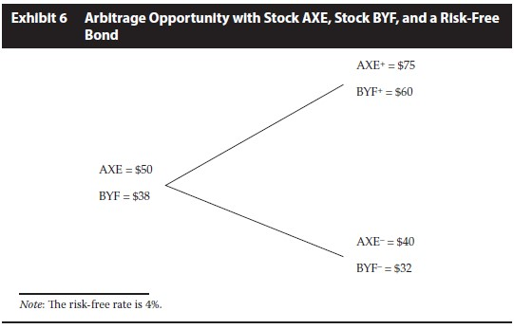
Elementary principles of derivative pricing-Arbitrage

Slide 100
Practices
1 Which of the following is a result of arbitrage?
A The law of one price
B The law of similar prices
C The law of limited profitability
2 When an arbitrage opportunity exists, what happens in the market?
A The combined actions of all arbitrageurs force the prices to converge.
B The combined actions of arbitrageurs result in a locked- limit situation.
C The combined actions of all arbitrageurs result in sustained profits to all.

Slide 101
Practices
3 Which of the following accurately defines arbitrage?
A An opportunity to make a profit at no risk
B An opportunity to make a profit at no risk and with the investment of no capital
C An opportunity to earn a return in excess of the return appropriate for the risk assumed
4 Which of the following ways best describes how arbitrage contributes to market efficiency?
A Arbitrage penalizes those who trade too rapidly.
B Arbitrage equalizes the risks taken by all market participants.
C Arbitrage improves the rate at which prices converge to their relative fair values.

