Slide 1
Face Recognition
Eigen-faces with 99 PCA coefficients
Project Presentation
Ashish Tiwari
MAS622J/1.126J
Pattern Classification and Analysis

Slide 2
Problem Statement
Given
  2000 Training data points
  2000 Test data points
  faceDR and faceDS: Description files for both training and testing data points.
  faceR: Matlab data file containing 99 PCA coefficients for training images
  faceS: Matlab file containing 99 PCA coefficients for test images.
Required to classify
Gender |  | Male |  |  |  | Female
Age |  | Child |  | Teen |  | Adult |  | Senior
Race | White /Hispanic/ Asian/ Black/ Other
Facial Expressions |  |  | Serious |  | Funny |  | Smiling
Hat |  |  | Yes |  | No
Moustache |  |  | Yes |  | No
Glasses |  |  | Yes |  | No
Bandana |  |  | Yes |  | No

Slide 3
Objective
The Objective is to implement, test and compare performance of the various ‘ Pattern Classification Algorithms ’ on different facial features and to come up with a quantitative analysis of effectiveness of Algorithms in different scenarios.
To develop insight of a designer’s perspective.

Slide 4
Summary of the Work
Parzen Window
K- nearest neighborhood
Generalized linear discriminant
Neural network
Boosting (neural nets as component classifiers)
I have implemented all 5 Algorithms for almost all feature classification excluding Facial Expressions.

Slide 5
Bad Data Issues
As it invariably happens with any real-world problem data base, this problem also contains few bad faces, missing faces and outliers.
In the implementation here the faces with missing descriptors are taken out from the data base where as outliers and bad faces are kept as it is.

Slide 6
Eigen-faces
An Introduction
Developed in 1991 by M.Turk
Based on PCA
Relatively simple
Fast
&
Robust

Slide 7
Eigenfaces
PCA seeks directions that are efficient for representing the data
PCA reduces the dimension of the data
Speeds up the computational time
not efficient
efficient
Class A
Class A
Class B
Class B
Notes:
In the standard data set we have been given 99 PCA coffecients

Slide 8
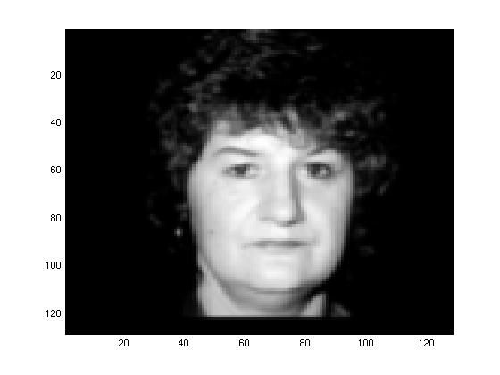
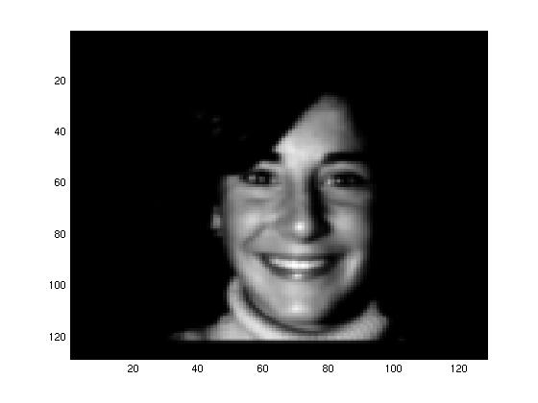
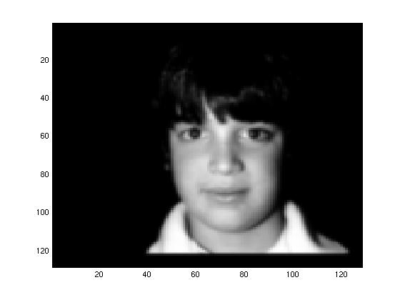
Eigenfaces, the algorithm
Original Images
……

Slide 9
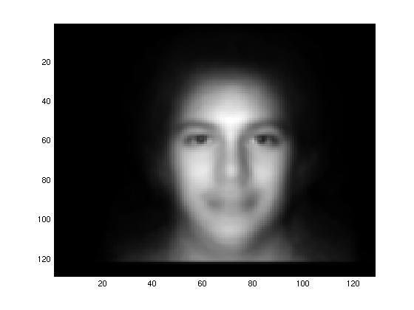
Eigenfaces, the algorithm
The mean face can be computed as:
Mean-Face

Slide 10
Eigenfaces, the algorithm
Then subtract it from the training faces

Slide 11
Eigenfaces, the algorithm
Now we build the matrix which is N² by M
The covariance matrix which is N² by N²

Slide 12
Eigenfaces, the algorithm
Find eigenvalues of the covariance matrix
  The matrix is very large
  The computational effort is very big
We are interested in at most M (?) eigenvalues
  And in the given problem we have taken 99 most significant Eigen directions to represents the data.

Slide 13
Results – Gender Classification
KNN | Male | Female | Accuracy
Male | 917 | 360 | 71.8%
Female | 297 | 422 | 58.6%
Overall Accuracy: 66.95%
NNET | Male | Female | Accuracy
Male | 959/1277 | 318/719 | 75.09%
Female | 304/1277 | 415/719 | 57.71%
Overall Accuracy: 63.15%
BOOSTING | Male | Female | Accuracy
Male | 920 | 357 | 72.04%
Female | 279 | 440 | 61.19%
Overall Accuracy: 68%
Parzen | Male | Female | Accuracy
Male | 1276 | 1 | 99.92%
Female | 0 | 719 | 100%
Overall Accuracy: 99.75%

Slide 14
Results – Gender Classification
Generalized Linear Discriminant | Male | Female | Accuracy
Male | 1024 | 253 | 80.18%
Female | 267 | 452 | 62.86%
Overall Accuracy: 73.94%

Slide 15
Discussion – Gender Classification
Male / Female
Very well behaved data set.
Both class examples are in good proportion.
Good results are obtained using Generalized linear discriminant.
Even comparable results for simplest “Minimum distance Classifier”
Neural net, GLD and KNN results are almost same.
Wonderful performance by Parzen window classifier.
Boosting – comments
Boosting doesn’t seem improving the performance anymore for this class.
Very few training points.
Samples are not in equal proportion in second dataset (D2)
(not proper utilization of the entire training set)

Slide 16
Results – Race Classification
KNN | Correctly Classified | Accuracy
White | 1657/1699 | 97.52%
Hispanic | 0/13 | 0%
Asian | 1/26 | 3.84%
Black | 9/249 | 0.03%
Other | 0/9 | 0%
Overall Accuracy: 83.35%
Parzen | Correctly Classified | Accuracy
White | 1699/1699 | 100%
Hispanic | 0/13 | 0
Asian | 0/26 | 0
Black | 0/249 | 0
Other | 0/9 | 0
Overall Accuracy: 84.95%

Slide 17
Results – Race Classification
NNET | Correctly Classified | Accuracy
White | 1476/1699 | 86.87%
Hispanic | 0/13 | 0%
Asian | 1/26 | 3.84%
Black | 15/249 | 5.79%
Other | 1/9 | 7.69%
Overall Accuracy: 74.65%
BOOSTING | Correct | Accuracy
White | 1322/1699 | 77.81%
Hispanic | 3/13 | 23.07%
Asian | 9/26 | 34.61%
Black | 12/249 | 4.63%
Other | 8/9 | 88.83%
Overall Accuracy: 67.95%

Slide 18
Discussion- Race Classification
White/Hispanic/Asian/Black/Other
Huge Dimensional space, few training points
Very few examples of categories other than white
Classifiers tend to bias towards White class
Caution: Even a trivial classifier (classify all as white) can attain a accuracy of 85%
What is the solution?
  Gather more training data of different classes.
  Synthesize data from existing ones.
  Boosting

Slide 19
Race - Discussion
Let us try to scrutinize the reasons for fairly poor performance of
the Parzen Window and K- nearest neighborhood methods.
Reason
Very few training points are given for the classes other than the white class (85%), so by the inherent structure of the dataset, the whites points are most likely to be present in any chosen volume in the space.
Also it is clear from the projection of data as if white data form a sphere in the space and other classes are wrapped around the sphere like ribbons (this is also the case when the data inherently don’t have that much dimension in which it is actually projected). Owing to the above mentioned reason whenever we try to develop a volume around a point, it is more likely to contain points of white data than one of itself because of its many fold character.
Had it been these faces were projected onto lower dimensional space should have obtained better results for KNN and Parzen. (Intuition)

Slide 20
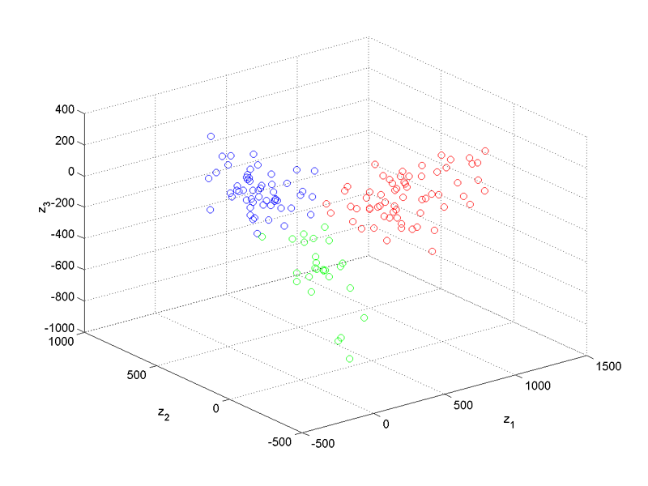
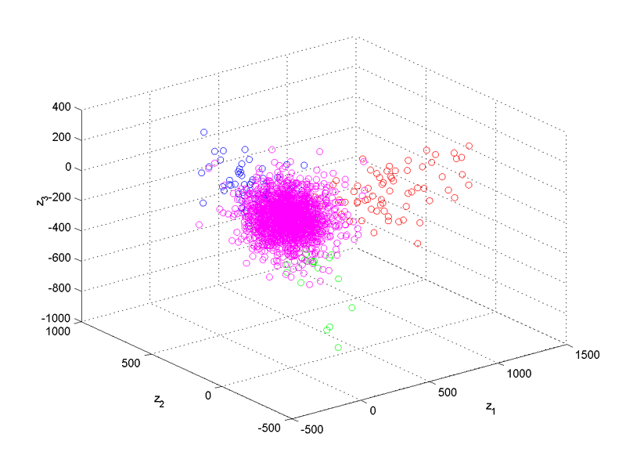
Fisher Projected Race data on 3D
Courtesy - Larissa

Slide 21
Results – Age Classification
KNN | Correctly Classified | Accuracy
Child | 47/68 | 69.11%
Teen | 0/83 | 0%
Adult | 1688/1730 | 97.57%
Senior | 1/115 | 0.86%
Overall Accuracy: 86.97%
Parzen | Correctly Classified | Accuracy
Child | 23/68 | 33.82%
Teen | 0/83 | 0%
Adult | 1707/1730 | 98.67%
Senior | 0/115 | 0%
Overall Accuracy: 86.67%

Slide 22
Results – Age Classification
NNET | Correctly Classified | Accuracy
Child | 12/68 (3) | 69.11%
Teen | 10/83 (3) | 0%
Adult | 1390/1730 (1695) | 97.57%
Senior | 19/115 (1) | 0.86%
Overall Accuracy: 71.69%
Boosting | Correctly Classified | Accuracy
Child | 16/68 | 23.52%
Teen | 27/83 | 32.53%
Adult | 1219/1730 | 70.46%
Senior | 33/115 | 28.69%
Overall Accuracy: 64.87%

Slide 23
Discussion - Age Classification
Q: Although it looks like both child and teens are in almost equal proportion (68 - 83) then why both KNN and Parzen always favoring child over teen??
A: This proportion is actually reflecting the fact about Testing set, whereas in Training set this thing is much more clearer where number of child (240) dominates number of teen data points significantly.
NNET: Although the evidence curve suggested highest accuracy can be achieved at n = 23 neurons in the hidden layer, I deliberately chosen 8 neurons. The idea was to not allow the net to build complex boundaries so that it may have good generalization on the unseen data. And the results support the argument too. Bracketed results are from n=23 neurons.

Slide 24
Boosting - Comments
In almost all of the implementations boosting helped improving performance of the week classes but have not shown very encouraging results. The reasons I sort out may be:
1. The amount of data needed to actually implement boosting was not sufficient.
2. In constructing the second dataset sometimes we do not find appropriate proportion to maximize disorder at the same time utilizing full training resource. (A part of the expensive data set left unutilized)
3. More often than not the condition to construct third data set further excludes most of the remaining data points, hence reducing the size of available samples for training.

Slide 25
Results – Bandana Classification
KNN | YES | NO | Accuracy
BANDANA | 1 | 7 | 12.5%
NO BANDANA | 0 | 1988 | 100%
Overall Accuracy: 99.64%
Parzen | YES | NO | Accuracy
BANDANA | 8 | 0 | 100%
NO BANDANA | 0 | 1988 | 100%
Overall Accuracy: 100%
NNET | YES | NO | Accuracy
BANDANA | 0 | 8 | 0%
NO BANDANA | 0 | 1988 | 100%
Overall Accuracy: 99.49%
BOOSTING | YES | NO | Accuracy
BANDANA | 3 | 5 | 37.5%
NO BANDANA | 1 | 1987 | 99.94%
Overall Accuracy: 99.69%

Slide 26
Results – Moustache Classification
KNN | NO | YES | Accuracy
NO MOUSTACHE | 1562 | 0 | 100%
MOUSTACHE | 434 | 0 | 0%
Overall Accuracy: 78.25%
Parzen | NO | YES | Accuracy
NO MOUSTACHE | 1561 | 1 | 99.93%
MOUSTACHE | 7 | 427 | 98.38%
Overall Accuracy: 99.59%
NNET | NO | YES | Accuracy
NO MOUSTACHE | 382 | 52 | 88.01%
MOUSTACHE | 122 | 1440 | 92.18%
Overall Accuracy: 91.28%
BOOSTING | NO | YES | Accuracy
NO MOUSTACHE | 366 | 68 | 84.33%
MOUSTACHE | 240 | 1322 | 84.63%
Overall Accuracy: 84.56%

Slide 27
Results – Glasses Classification
KNN | NO | YES | Accuracy
NO GLASSES | 1987 | 1 | 99.94%
GLASSES | 8 | 0 | 0%
Overall Accuracy: 99.54%
Parzen | YES | NO | Accuracy
NO GLASSES | 1988 | 0 | 100%
GLASSES | 0 | 8 | 100%
Overall Accuracy: 100%
NNET | YES | NO | Accuracy
NO GLASSES | 1960 | 28 | 98.59%
GLASSES | 7 | 1 | 14.28%
Overall Accuracy: 98.24%
BOOSTING | YES | NO | Accuracy
NO GLASSES | 1955 | 33 | 98.34%
GLASSES | 5 | 3 | 37.54%
Overall Accuracy: 98.09%

Slide 28
Results – Beard Classification
KNN | NO | YES | Accuracy
NO BEARD | 1701 | 19 | 98.89%
BEARD | 275 | 1 | 0.36%
Overall Accuracy: 85.27%
Parzen | NO | YES | Accuracy
NO BEARD | 1720 | 0 | 100%
BEARD | 0 | 276 | 100%
Overall Accuracy: 100%
NNET | NO | YES | Accuracy
NO BEARD | 1696 | 24 | 98.60%
BEARD | 271 | 5 | 1.84%
Overall Accuracy: 85.22%
BOOSTING | NO | YES | Accuracy
NO BEARD | 1688 | 32 | 98.13%
BEARD | 61 | 215 | 77.89%
Overall Accuracy: 95.34%

Slide 29
Conclusion
In this project I have made an effort to compare various algorithms on various classification tasks such as Gender, Age, Race and other properties like Hat, Moustache etc. and where ever possible I also tried to compare the results obtained from simplest ‘Minimum distance classifier’
Gender | PW, GLD, KNN
Race | NNET
Age | NNET with Boosting
Moustache, Hat, Beard, Bandana, Glasses | PW

