Slide 1
Getting Started with React.js
Juan Jose Florez Rangel
Franklin Ekwale
Gustavo Iserte Bonfim
Joseph Frederick Opoku
Adebayo Daniel Ojo
Pedro Henrique Rego Barros Coutinho
20/08/2025 – IST107

Slide 2
Introduction to React.js
Definition: A JavaScript library for building UIs
Why React?
Component-based architecture
Declarative rendering
Backed by Facebook and a large community

Slide 3
Key Features
Components
Reusable UI building blocks
Virtual DOM
Efficient diffing and updates
JSX
JavaScript syntax extension for templating
State & Props
State: internal, mutable data
Props: external inputs passed down

Slide 4
How React Differs from Alternatives
Feature | React | Angular | Vue
Architecture | Library (UI only) | Full framework | Progressive framework
Data Binding | One-way | Two-way | Optional two-way
Learning Curve | Moderate | Steep | Gentle
Ecosystem | Rich, but flexible | Batteries-included | Growing rapidly

Slide 5
Popular Use Cases
Facebook, Instagram, Airbnb, Netflix
Dashboards and admin panels
Interactive forms and real-time apps

Slide 6
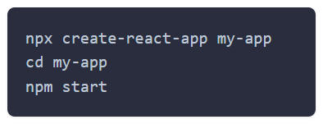
Project Setup
Using create-react-app:
npx create-react-app my-demo
cd my-demo
npm start

Slide 7
Demo Overview
App: Simple Counter
Features:
Two components (Display & Controls)
State management (useState)
Props to pass handlers and data

Slide 8
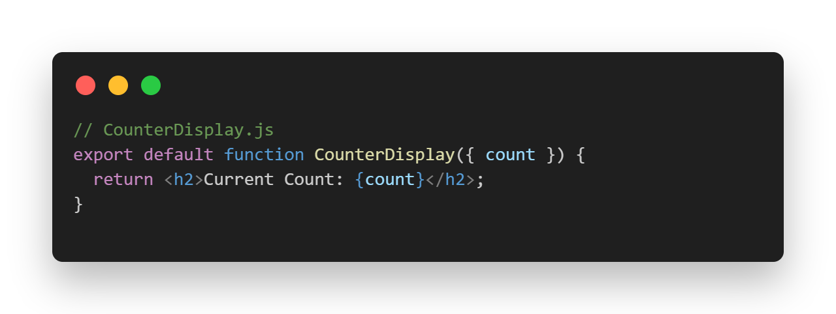
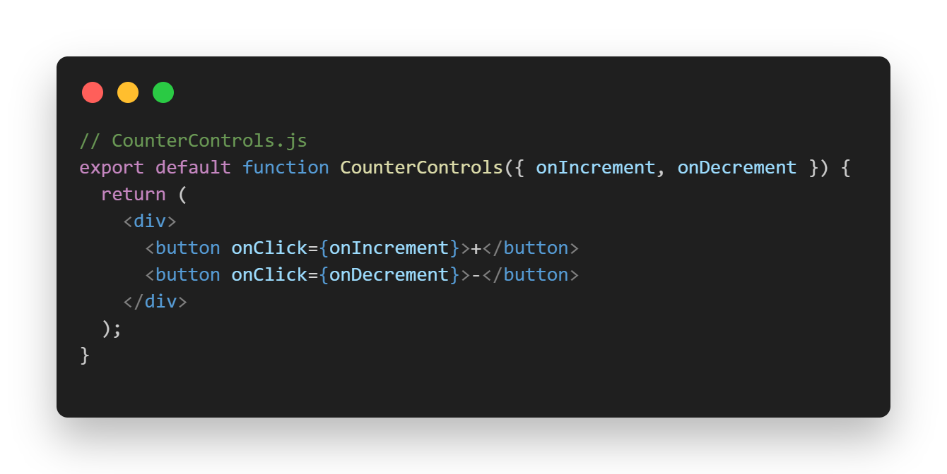
Code Snippets
// CounterDisplay.js
export default function CounterDisplay({ count }) {
return <h2>Current Count: {count}</h2>;
}
// CounterControls.js
export default function CounterControls({ onIncrement, onDecrement }) {
return (
<div>
<button onClick={onIncrement}>+</button>
<button onClick={onDecrement}>-</button>
</div>
);
}

Slide 9
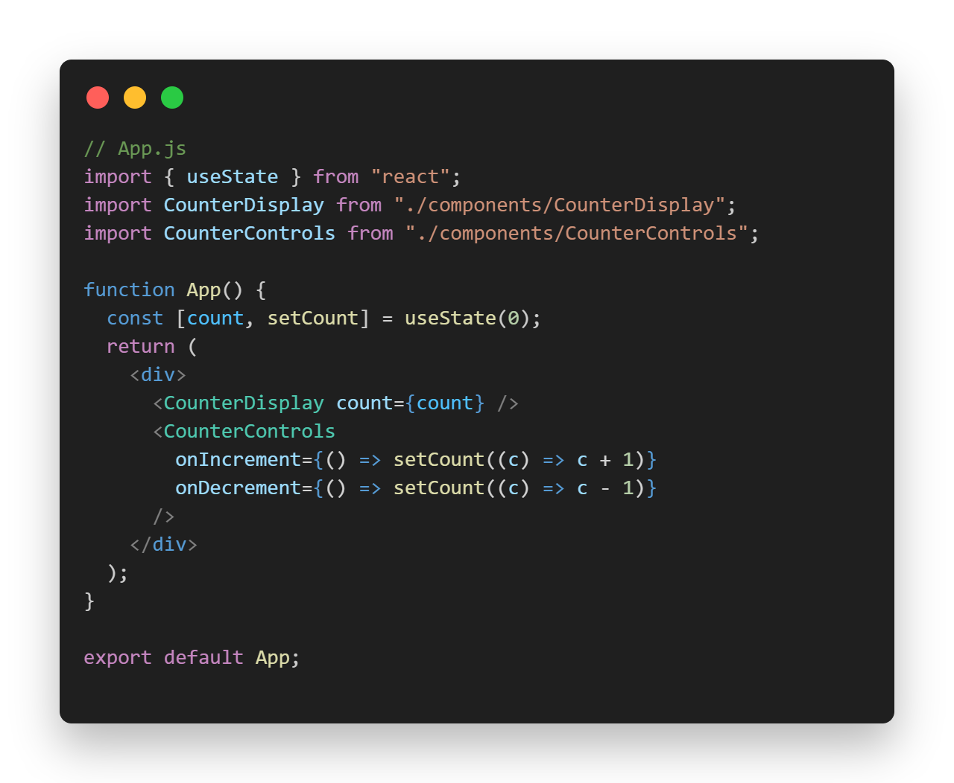
Bringing It Together
// App.js
import { useState } from ‘react’;
import CounterDisplay from ‘./CounterDisplay’;
import CounterControls from ‘./CounterControls’;
export default function App() {
const [count, setCount] = useState(0);
return (
<div>
<CounterDisplay count={count} />
<CounterControls
onIncrement={() => setCount(c => c + 1)}
onDecrement={() => setCount(c => c – 1)}
/>
</div>
);
}

