Slide 1
Containerized Application
Learn how containerization allows applications to run reliably on many different host systems and platforms.

Slide 2

$ who am i ?
{ “Name” : “Isfhan Ahmed” ,
“designation” : “Software Engineer” ,
“company” : “Cloud Primero B.V” ,
“location” : “Karachi” ,
}

Slide 3
What is Containerized Application ?
Containerized application is application that run in isolated runtime environment called containers.
Containers encapsulate an application with all its dependencies, including system libraries, binaries, and configuration files .
This all-in-one packaging makes an application portable allowing developers to write code once and run almost anywhere.

Slide 4
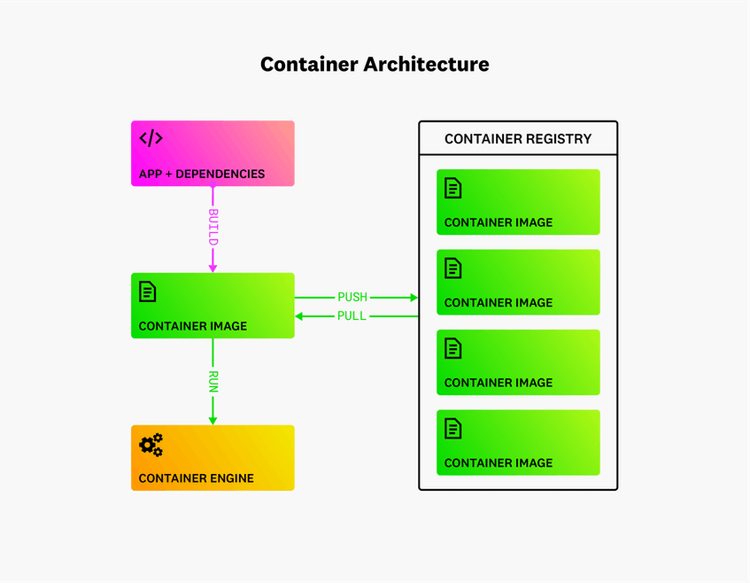
How Containerized Applications Work
Several components work together to allow applications to run in a containerized environment.
Containers package application code and dependencies into an isolated unit, allowing the application to run consistently in any environment.

Slide 5
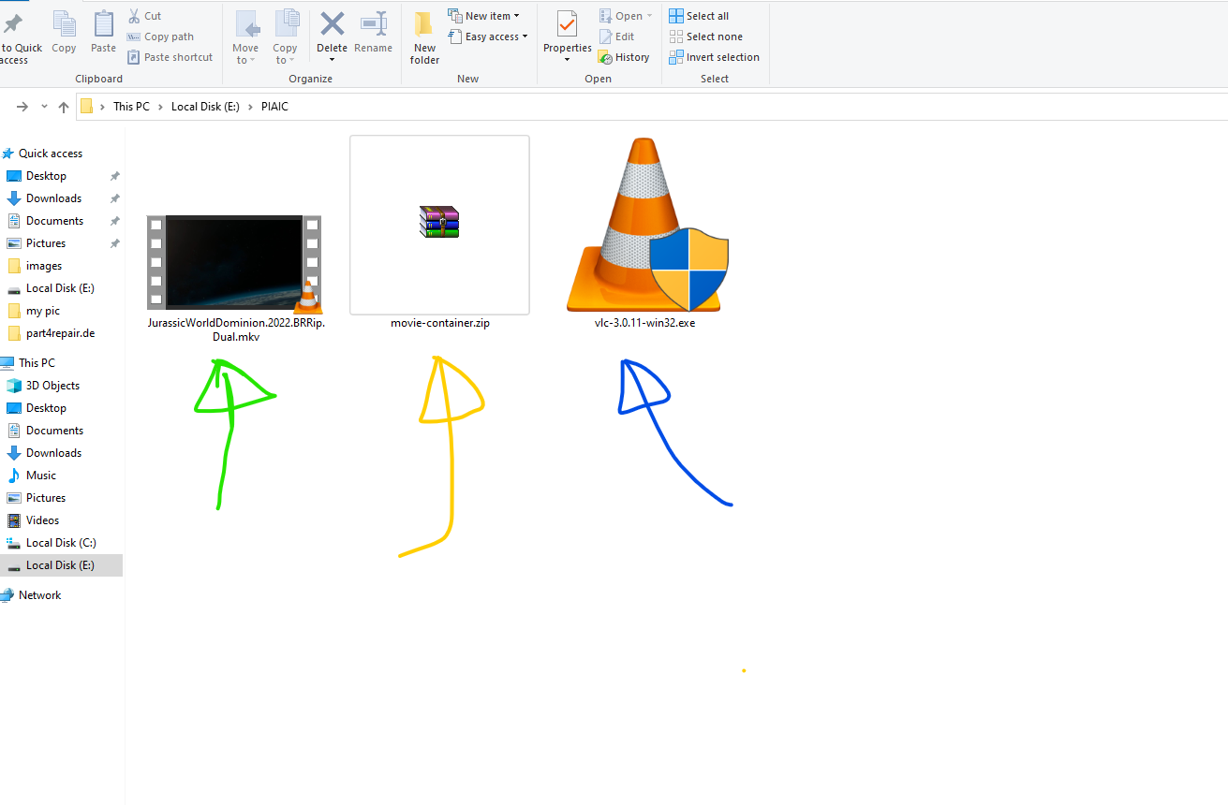
For Example.
In this example movie is your app code .
VLC player is your app dependency .
Movie-container.zip is your container image or Containerized App

Slide 6
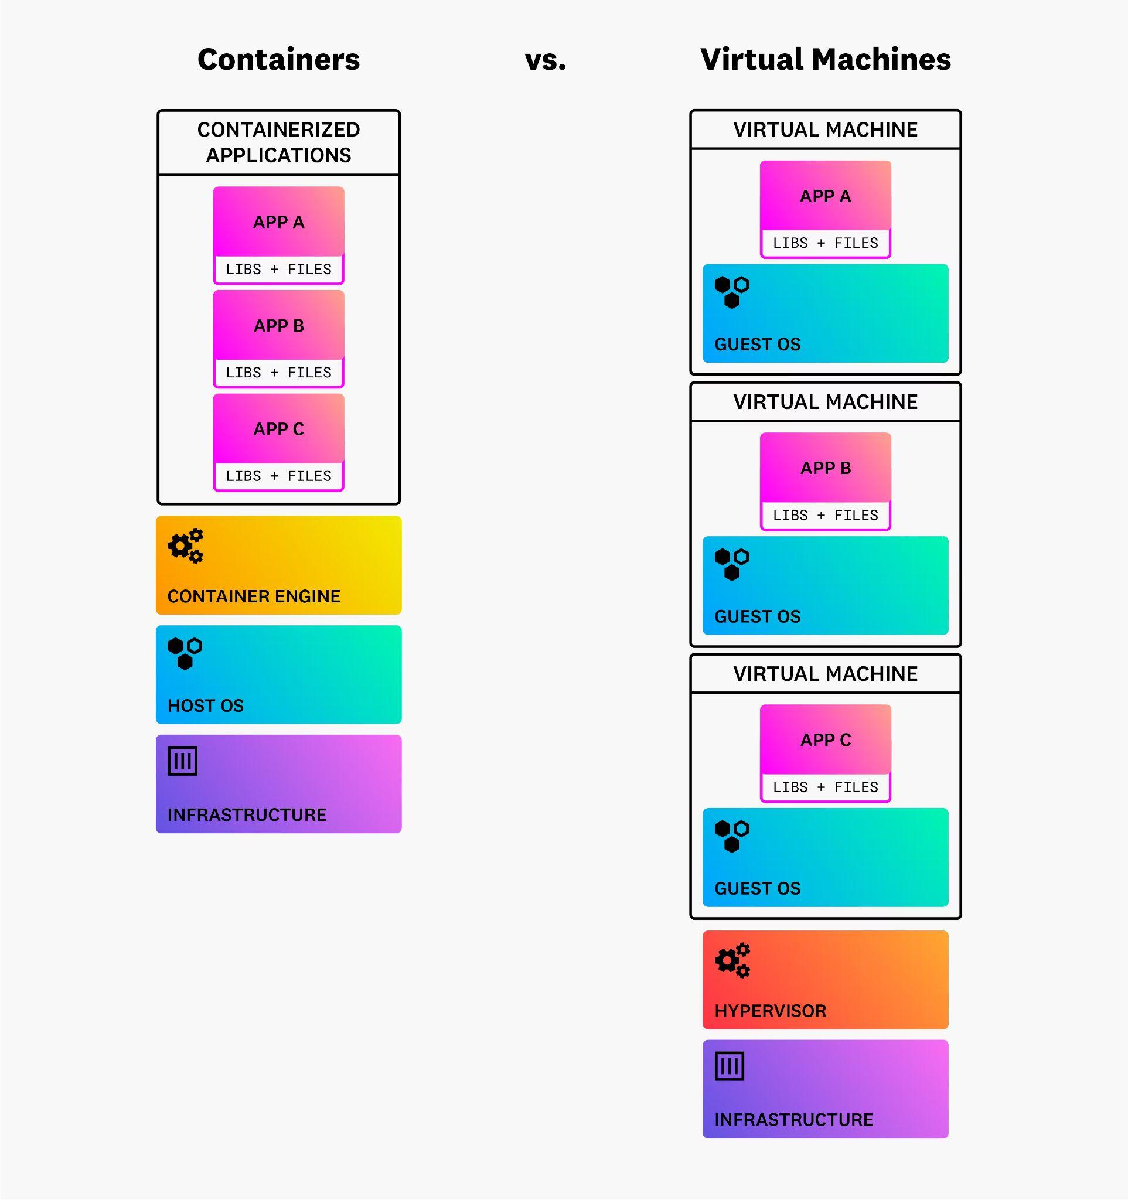
Containers vs. Virtual Machines
Containers and VMs can both provide a secure, reliable, and consistent runtime environment for hosted applications, but they offer different approaches.
When multiple VMs run on the same host, each VM must include its own OS, along with the files and libraries the VM needs to support the application it is hosting.
When multiple containers run on the same host, they all share the OS of that host and don’t require their own copy of an OS. As a result, containers are far more lightweight than VMs are, spin up and down much more quickly, and consume fewer resources.
Container share resources with the host OS

Slide 7
This is just a basic of containerized application there are lots of topic that you need to understand .
Till then keep learning 😎👍

