Slide 1
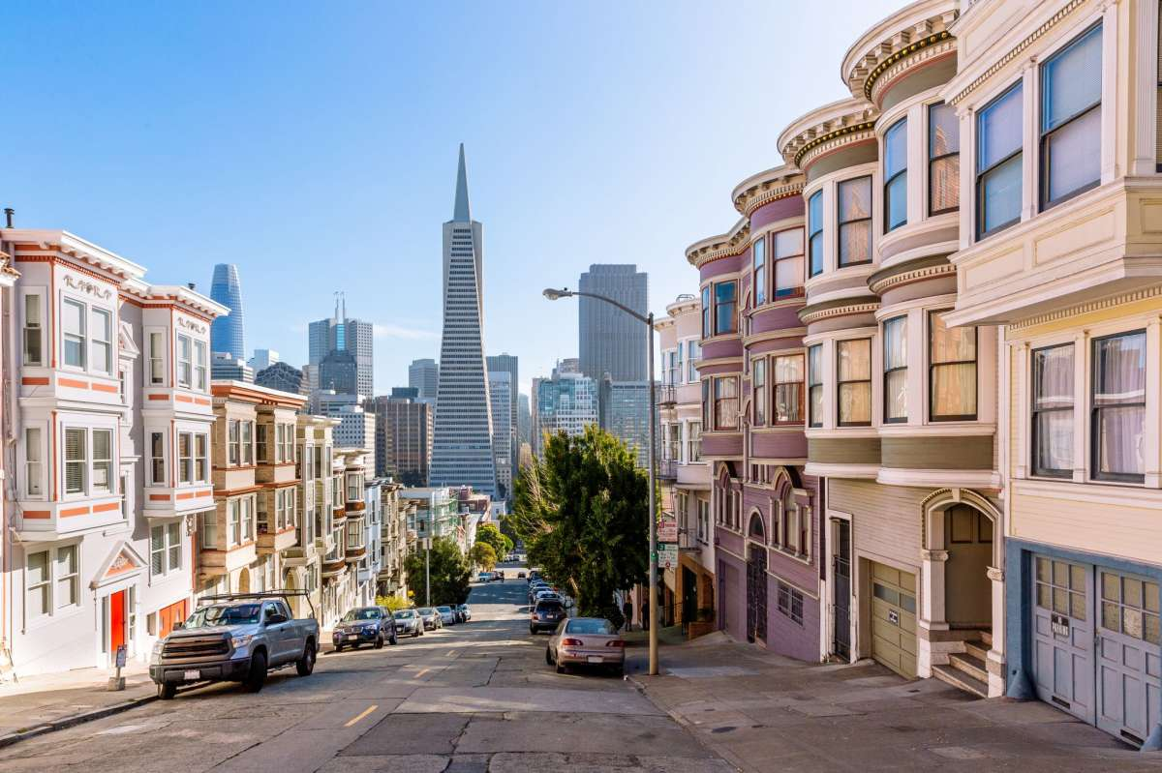
Are coffee shops a good predictor of gentrification?
Isgandar Asgarov
July 5th, 2021

Slide 2
1 Introduction
Gentrification, a common and controversial topic in politics and in urban planning, is the process of changing the character of a neighborhood through the influx of more affluent residents and businesses. Assessing gentrification is the topic of many studies, and one of the more anecdotal metrics is the amount of expensive coffee shops in the neighborhood. This study aims to find whether there is any validity to this claim.

Slide 3
2 Data gathering
The names of the neighborhoods were scraped off of the Wikipedia page for the postal codes of Canada. After processing the string data into a pandas dataframe, the names were sent to the Google Geocoding API. Returned coordinates were then passed to the FourSquares API in a script provided by IBM to acquire the venues in the surrounding area. The only information about venues to be used were their type. The data on the types of venues was then one-hot encoded to be fit for use in a regression. Since the FourSquares API returned multiple venues per neighborhood, to facilitate analysis dummy indicators for venue types were averaged and summed in two different data frames.

Slide 4
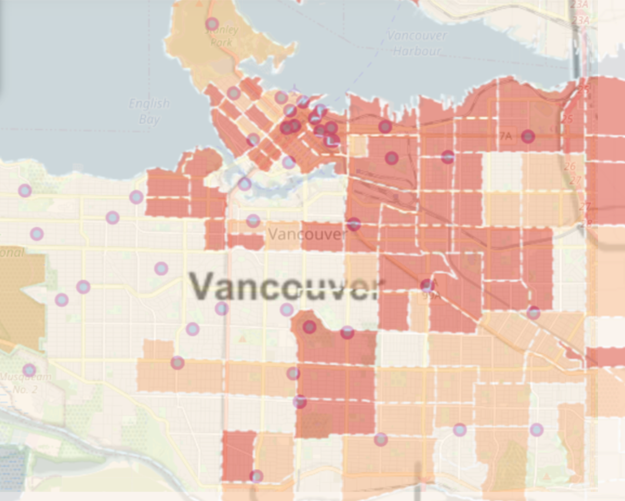
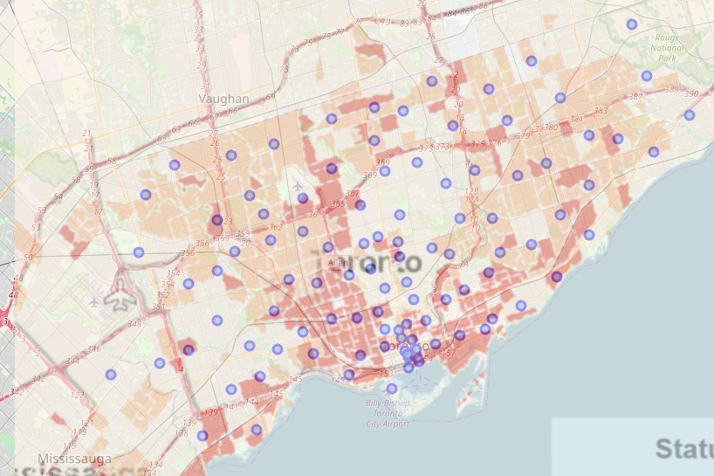
Determining the gentrification status of a neighborhood was one of the main challenges at this stage in the study. Due to the limited scope of the analysis, to avoid excessive time wastage the most direct method available was chosen. First, the coordinates of the neighborhoods obtained in the early stages of the study were visualised on maps using the Folium library in Python. The maps were cross-referenced with the GENUINE tool created by Statistics Canada. The gentrified neighborhoods of Vancouver and Toronto were then manually selected.

Slide 5
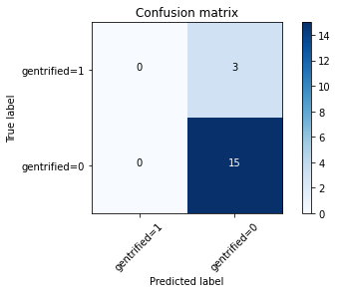
3 Analysis
It was determined that the most appropriate statistical tool for classification as in the presented research question is a logistic regression. To create the various regressions, scikit-learn machine learning library for Python was utilized. In all models, a 75/25 train/test split was applied to the Vancouver data.
Approach 1
The first approached was the simplest: an attempt to establish a causational link between coffee shops, the anecdotal indicators, and gentrification.
This model failed to return a single true positive.

Slide 6
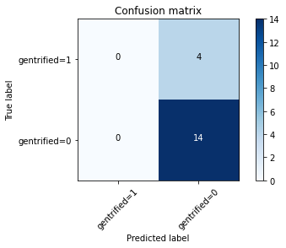
Approach 2
In the second approach, all venues types were used in the regression.
The results of this approach were similarly inauspicous. With the Jaccard score of 0.78 and logarithmic loss of 0.66, the model nonetheless again falsely pegged the gentrified neighborhoods as non-gentrified.

Slide 7
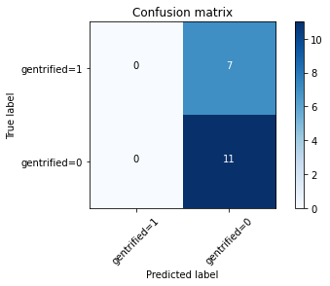
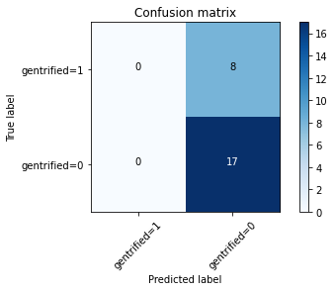
Approach 3
According to a paper titled paper "Nowcasting Gentrification: Using Yelp Data to Quantify Neighborhood Change", "the opening of a Starbucks — and cafes more generally — is a leading indicator of gentrification, and is associated with an increase in local housing prices of .5%. Gentrifying neighborhoods tend to spawn a growing number of grocery stores, cafes, restaurants, and bars". Based on this assessment, in the third approach the venue types used were limited to restaraunts, bars, cafes and similar. The exclusion of other venue types did not, however, produce a difference. The model once again returned not a single true positive.
Vancouver dataset
Retraining the model for the Toronto datased (some of the venue types chosen for the analysis were not present in the Toronto dataset, rendering the usage of the already trained model impossible) similarly failed to produce results.
Toronto dataset

Slide 8
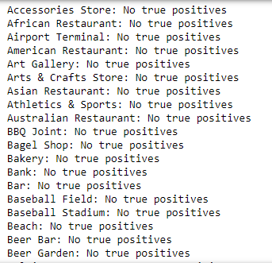
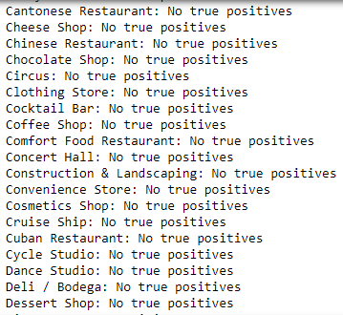
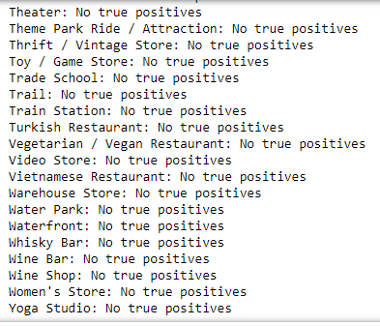
Approach 4
In this approach, a looping script was written to model a regression based on data on each individual venue type by neighborhood. After running the process several times, the outcome was the same: not a single regression based on any venue type produced any true positives.

Slide 9
Approach 5
The fifth and final appoach was based not simply on the number of coffee shops, but their rellative popularity in the neighborhood. A script was written to generate a dataset with the 3 most popular venue types in each neighborhood. A dummy variable was then created for neighborhoods in which coffee shops were either in any of the 3 top rankings or the top 2 spots. For both cases, the models failed to identify gentrified neighborhoods.
Coffee shops are the first, second or third most popular venues
Coffee shops are the first or second most popular venues

Slide 10
Results and discussion
This analysis failed to find a link between a number of certain venue types in the neighborhood and gentrification, but it is important to keep in mind the limited scope of the research.
The data on gentrified neighborhoods was taken as is based on one of many potential measurements of gentrification.
The datasets are small and perhaps unrepresentative of similar cities
The data is limited to the number of venues, not separated by average prices of similar distinguishing factors.
The fact that all models consistently flagged false negatives rather than a random number of false positives and false negatives might indicate that the model was overfitted or that the sample size or the nature of the data warped the model.
In conclusion, further research is necessary before any conclusive statements could be made.

