Slide 1
Health Care
Amazing Technology, Graceful Care

Slide 2
Digital Health Care Services :Because Your Life Matters
The Goal of real healthcare reform must be high-quality, universal coverage in a cost and time effective way.
Virtual Visit can effectively treat some ailments at a lower cost as well instantly.
No Location Boundaries anymore.

Slide 3
Digital Health Care Services :Because Your Life Matters
Improving on Self Diagnoses
Cost Effective Solution
Easy Prescription Process
Security and Expertise
Comfort and Convenience

Slide 4
KEYPOINTS
Facilitates Online Diagnosis
BMI Calculation
Instant Ambulance Booking
Instant Lab Booking

Slide 5
Online Diagnosis and BMI Calculation

Slide 6
Ambulance Booking

Slide 7
Instant Lab Booking

Slide 8
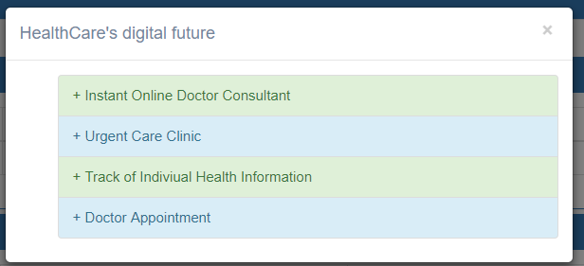
HealthCare’s Digital Future

Slide 9
Conclusion :
Digital healthcare facilities can allow dissemination of specialised knowledge among the medical commmunity through advanced network ,tech enabled peer-to-peer reviews, emergency medical consulations during epidemics and crises, instant bookings of ambulances and labs ,Many others can be achieved with this.
Do we choose to live in the era where everything is available on click of a button or the swipe of a finger ,If yes ,Join us !

Slide 10
Questions ?????

Slide 11

Thank You ☺

