Slide 1

Revolutionizing Interview Scheduling: An AI-Powered Solution
In today's fast-paced world, efficient interview scheduling is critical for attracting top talent and maintaining a competitive edge. Traditional manual scheduling processes are often time-consuming, error-prone, and frustrating for both candidates and hiring teams. Our AI-powered interview scheduling bot offers a revolutionary solution, automating the entire scheduling process and minimizing manual effort.

Slide 2




Meet the Team Behind the Innovation
Punati Shreya
Mohamed Ishfaq P
Shreyash Pandey
.

Slide 3
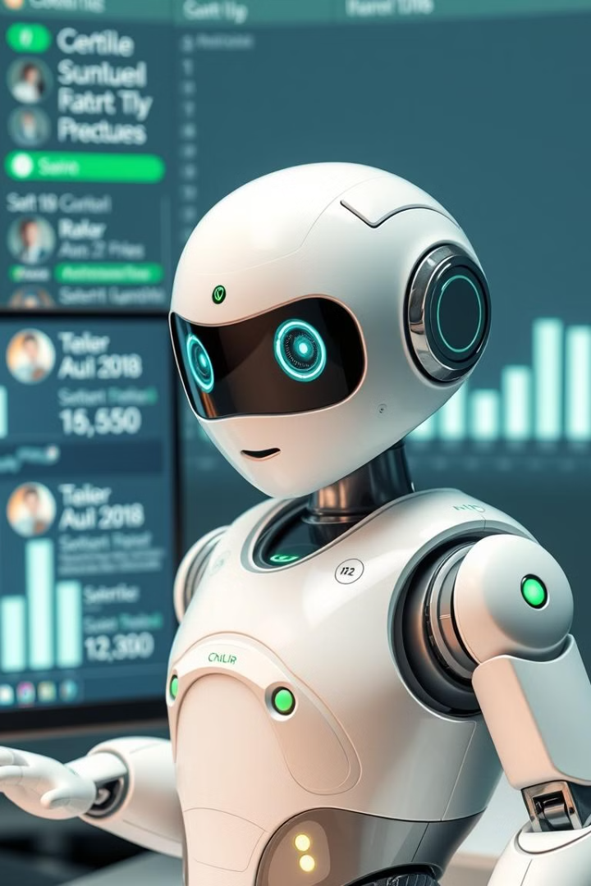
AI-Powered Interview Scheduling: A Solution Overview
1
Problem
2
Solution
Traditional interview scheduling is time-consuming, error-prone, and often leads to candidate and interviewer frustration.
Our AI-powered bot automates the process by intelligently matching available interview slots, sending invites, and handling conflicts automatically.
3
Outcome
Ensures smoother scheduling, enhances candidate satisfaction, and boosts employee productivity by reducing manual intervention.

Slide 4
Key Functionality & Problems Addressed
Automated Slot Matching
Real-time Updates
Reminder Notifications
AI intelligently matches available times based on candidate and interviewer preferences, eliminating manual coordination.
Seamlessly syncs with Google Calendar APIs to reflect up-to-date availability, preventing scheduling conflicts.
Sends automated email/SMS reminders to ensure candidates and interviewers stay on track, reducing no-shows.

Slide 5





High-Level Architecture
Frontend
React interface for candidates and interviewers to view and interact with schedules.
Backend
Java Spring Boot handles API requests, business logic, and scheduling functionality.
Database
MongoDB stores scheduling data, user details, and interview times.
External Integrations
Google Calendar API for real-time availability and scheduling.
AI Layer
Machine learning algorithms and NLP for parsing user preferences and optimizing slot matching.

Slide 6

Tech Stack Deep Dive
React Interface
Java Spring Boot
Provides an intuitive interface for candidates and interviewers to view and interact with schedules. Allows users to input availability in free-text format and get real-time updates.
Handles API requests and business logic, managing the scheduling flow and user interactions. Coordinates data processing between the frontend, database, and external integrations.
MongoDB
Stores scheduling data, user profiles, and interview availability information. Uses a flexible data model to manage free-text inputs and AI-generated scheduling data.

Slide 7



AI-Powered Interview Scheduling System
Automates Scheduling
2
Streamlines the scheduling process by automatically matching interview slots based on user preferences.
Handles Free-Text
Enables AI to handle free-text availability inputs, making it easier for users to provide their schedules.
1
NLP Integration
3
Integrates with Natural Language Processing (NLP) techniques to optimize slot matching efficiently.

Slide 8
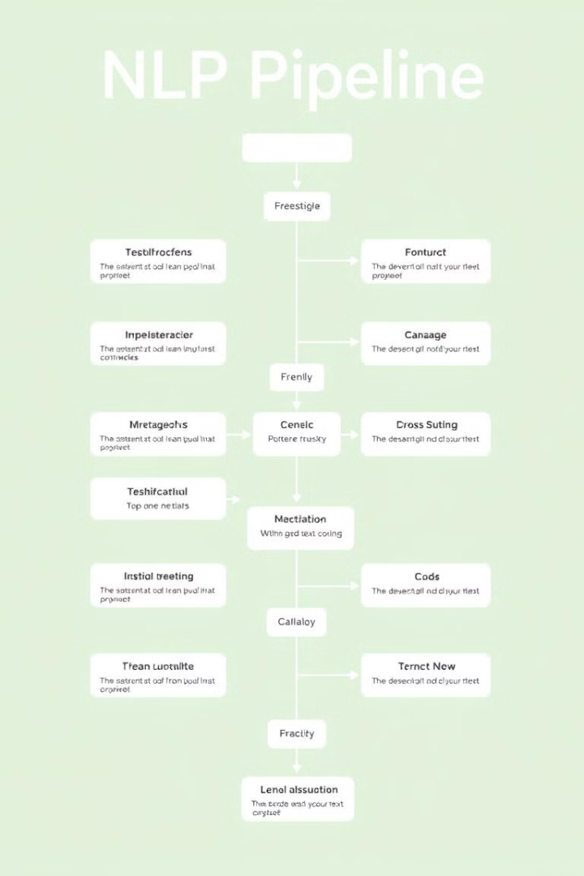
Natural Language Processing (NLP) Pipeline
1
Input Text
Free-text availability inputs (e.g., "I'm available next Tuesday 2-4pm or Wednesday morning").
2
Named Entity Recognition
Detects dates and times using Named Entity Recognition (NER).
3
Contextual Understanding
Resolves relative dates like "tomorrow" or "next week" through contextual understanding.

Slide 9

Named Entity Recognition (NER) - Extracting Key Data
2
2
Dates
Times
Identifies specific dates from the text input.
Extracts time intervals and specific times.
The purpose of Named Entity Recognition (NER) is to extract dates and times from free-text availability inputs such as, "I'm available next Tuesday 2-4pm or Wednesday morning." This functionality detects dates like "next Tuesday" and "Wednesday," as well as times like "2-4pm" and "morning."

Slide 10
Hybrid Approach & AI-Driven Communication
ML Techniques
Rule-Based Fallback
Utilizes spaCy's neural network for pattern recognition and machine learning-driven insights.
Incorporates regex patterns for specific time ranges (e.g., "9-11am") to ensure accuracy and reliability.
After availability is confirmed, AI automatically sends confirmation emails to both the recruiter and the candidate. If no interviewers are free, the AI sends an alternate suggestion email to the candidate, simulating a virtual agent handling scheduling workflows automatically.

Slide 11



AI Email Agent for Interview Invitations
Agent Initialization
The AI email agent is initialized within the AutoGen framework.
Email Composition
The agent crafts personalized interview invitation emails automatically.
Sending Invitations
Emails are sent to candidates and recruiters.

Slide 12
Thank You

