Slide 1


Phonebook App
Ish verma
991541414

Slide 2
Functions :
insertContact()
readingFile()
retrievingContact()
printList()
writeToTheFile()

Slide 3
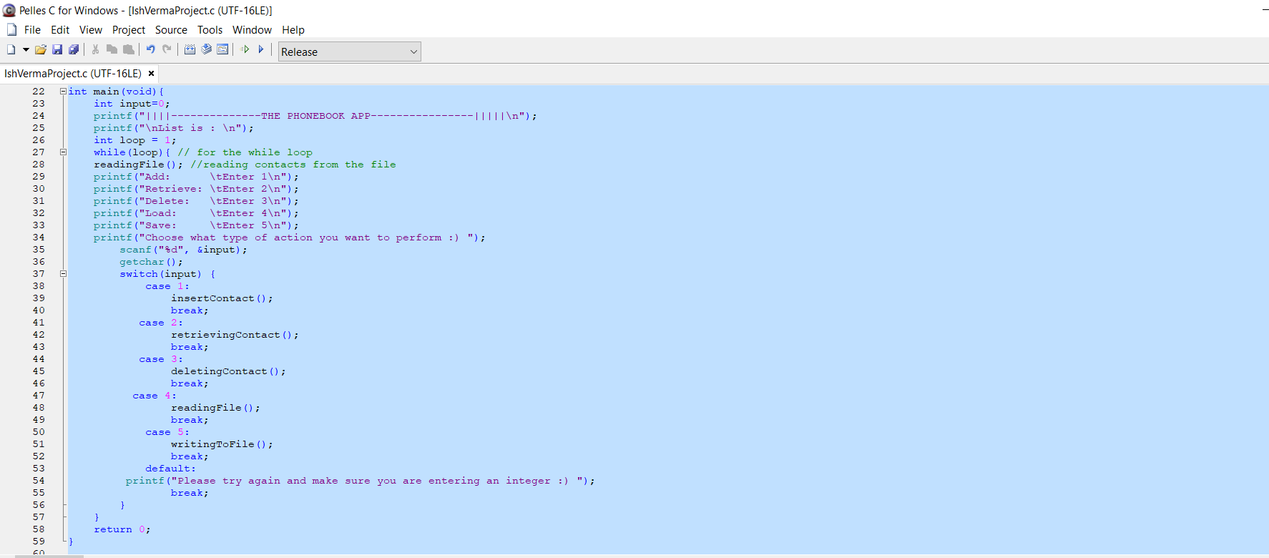
main();
This is the function from where everything starts up as it calls other functions and allows us to play with the functions of the app

Slide 4
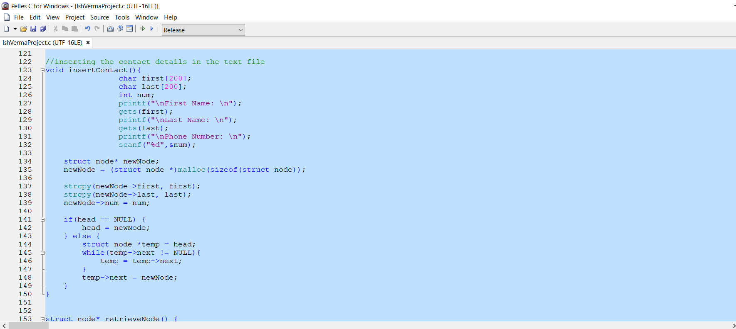
insertContact();
It is basically the add feature of the app which adds the contact to the linked list that we have created of the struct node type

Slide 5
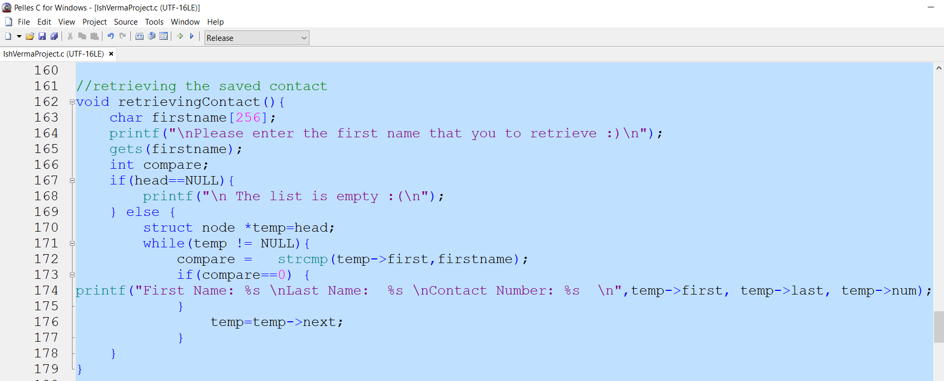
retrieveContact();
It is basically the retrieve function of the app which basically pulls out the contact that we wrote into the file

Slide 6
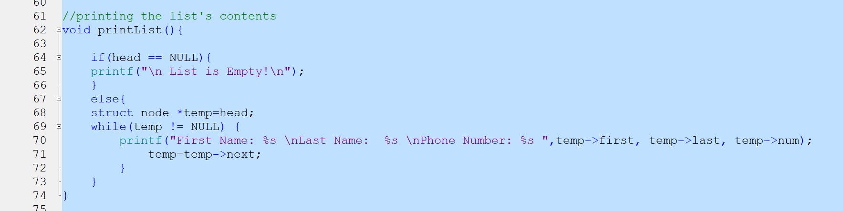
printList();
It is basically the function which displays out the linked list of the contacts that we have created

Slide 7
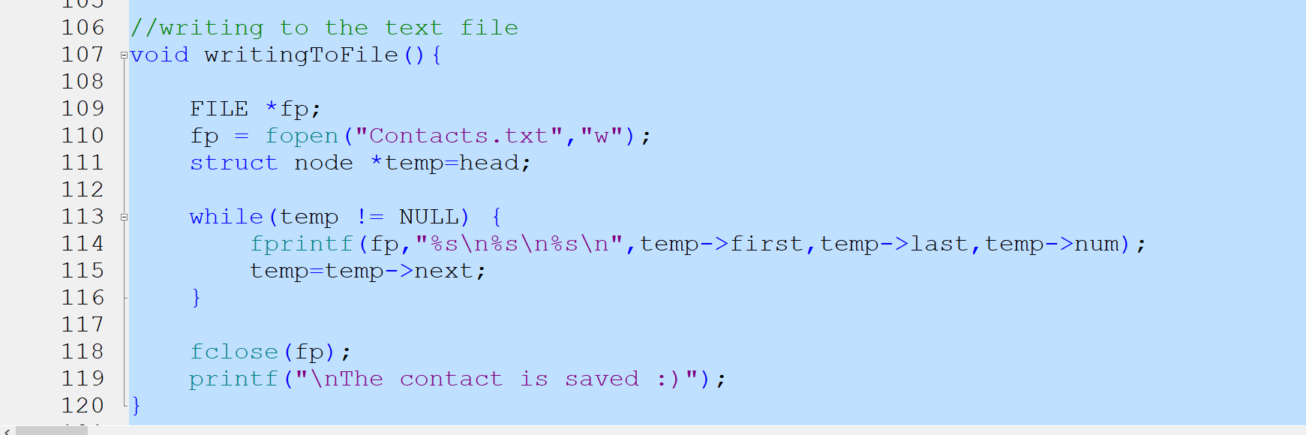
writeToFile();
This is the save function of the app which saves the text into the text file so that we can actually retrieve it

Slide 8
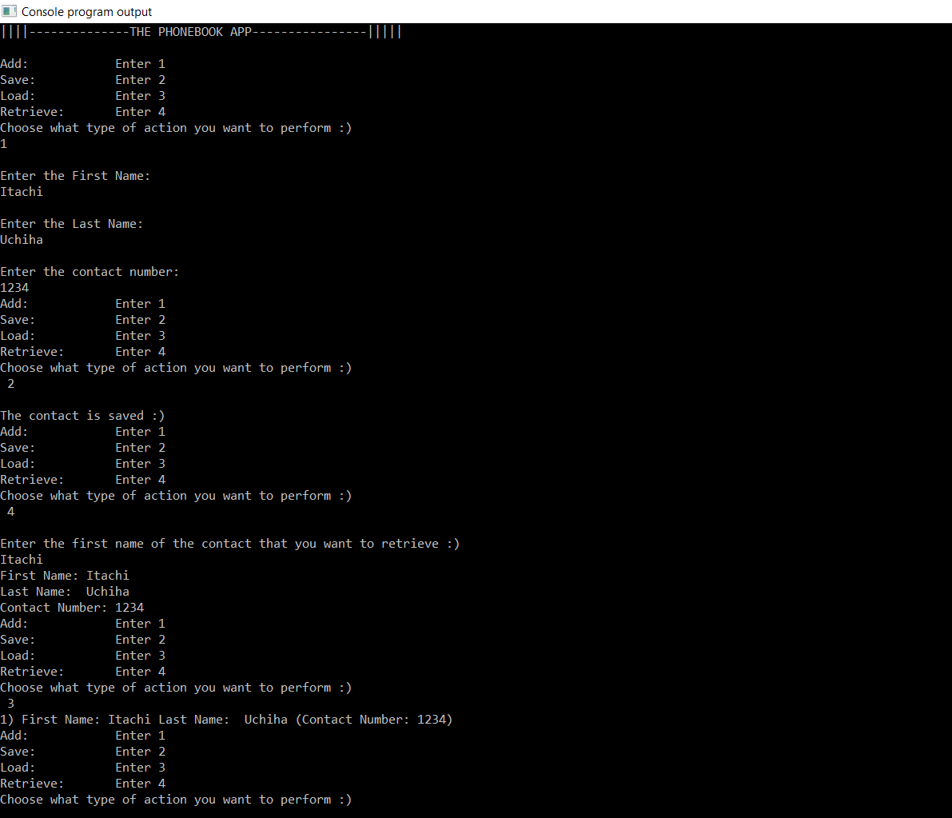
The output of the code with all the 4 operations used, add contact, save it, retrieve it then load it.

