Slide 1
MICROSERVICES
Isha Pradhan
Deepthi Vishwanath

Slide 2
MONOLITH ARCHITECTURE
Traditional architecture for building softwares
Components of the program are interconnected and interdependent rather than loosely coupled
Functionally distinguishable aspects (like, data input and output, data processing, error handling, and the user interface) are all interwoven, rather than containing architecturally separate components

Slide 3
SERVICE ORIENTED ARCHITECTURE (SOA)
It is an architectural approach to design applications around a collection of independent services
Communication can involve either simple data passing or it could involve two or more services coordinating some activity
Services can be stitched together to create composite applications which provide greater functionality to end users
Users can access these independent services without any knowledge of their internal implementation

Slide 4
PROBLEMS WITH SOA AND MONOLITH ARCH.
Monolithic architecture makes the application too complex and it is difficult to make changes fast and correctly
You must redeploy the entire application on each update
Monolithic applications can also be difficult to scale when different modules have conflicting resource requirements
With SOA, it is difficult to achieve asynchronous communication
Managing and providing information on how services interact is a complicated task in SOA

Slide 5
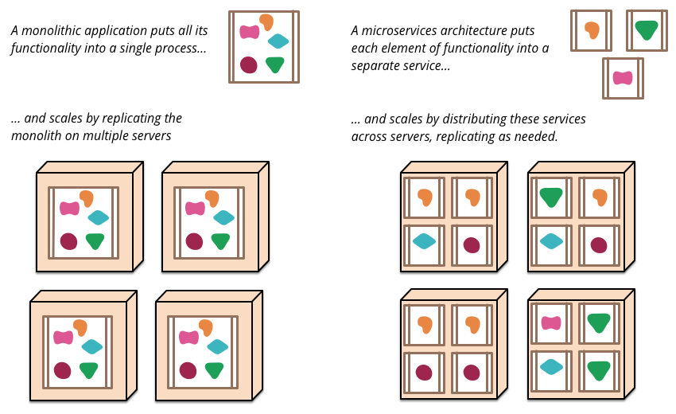
WHAT ARE MICROSERVICES?
Microservice architecture is a method of developing software applications as a suite of independently deployable, small, modular services
Each service runs a unique process and communicates through a well-defined, lightweight mechanism to serve a business goal

Slide 6
COMMUNICATION METHODS IN MICROSERVICES
Communication methods in microservices can be classified into :
Synchronous Method OR Asynchronous Method
Asynchronous method can be: Single Receiver Vs Multi Receiver
Single receiver: There is point-to-point communication that delivers a message to exactly one of the consumers that is reading from the channel, and that the message is processed just once
Multi Receiver: It employs a publish/subscribe mechanism. hat way, additional subscribers can be added in the future without the need to modify the sender service.

Slide 7
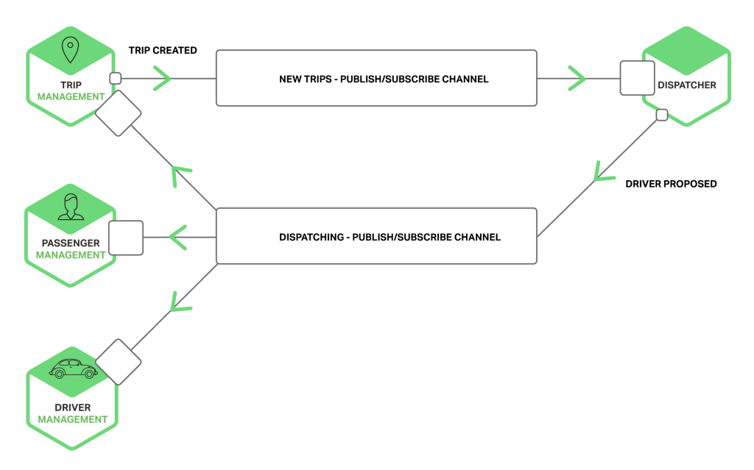
ASYNCHRONOUS MODEL: USE CASE
A client makes a request to a service by sending it a message > Service sends a different message back to the client > The client does not wait for an immediate response.
Messages are usually sent through asynchronous protocols like AMQP
Example: Taxi‑hailing application
Notes:
Messages are exchanged over channels. There are two kinds of channels, point‑to‑point and publish‑subscribe.
The Trip Management service notifies interested services such as the Dispatcher about a new Trip by writing a Trip Created message to a publish‑subscribe channel. The Dispatcher finds an available driver and notifies other services by writing a Driver Proposed message to a publish‑subscribe channel.

Slide 8
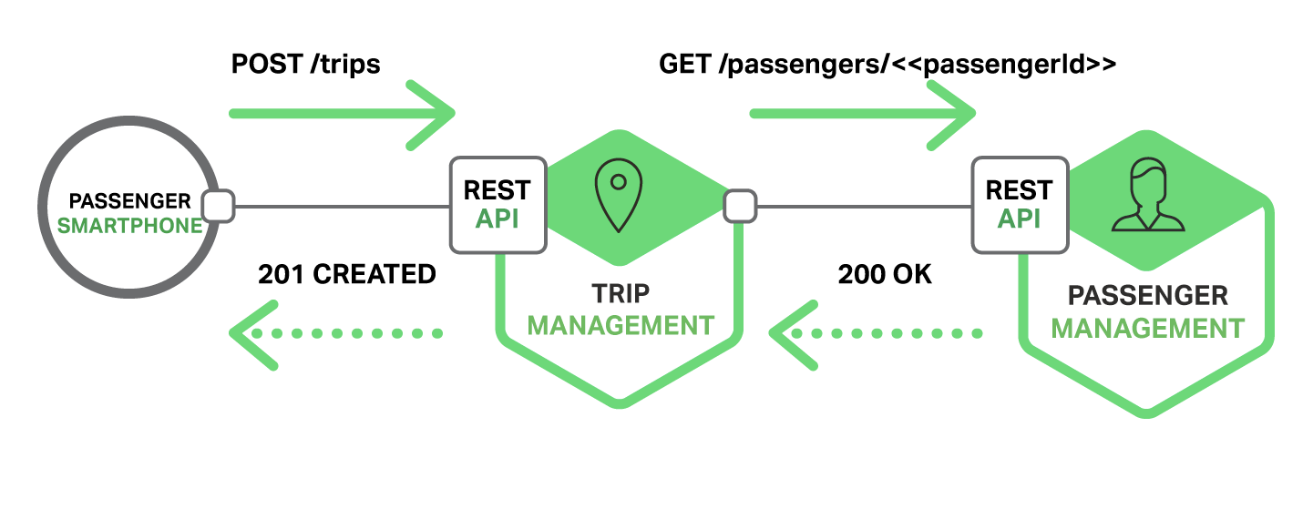
SYNCHRONOUS MODEL: USE CASE
When using a synchronous, request/response‑based IPC mechanism, a client sends a request to a service. The service processes the request and sends back a response.
Two popular protocols are REST and Thrift.
The following diagram shows one of the ways that the taxi-hailing application might use REST.
Notes:
Another rule you should try to follow, as much as possible, is to use only asynchronous messaging between the internal services, and to use synchronous communication (such as HTTP) only from the client apps to the front-end services (API Gateways plus the first level of microservices).

Slide 9
TECHNIQUES TO SCALE MICROSERVICES
To ensure a microservice is scalable, we need to know that it is:
Qualitatively scalable , i.e whether it scales with page views or customer orders
Quantitatively scalable i.e. how many requests per second it can handle
Prepared for bursts of traffic and can handle it carefully, and prevent it from taking down the service entirely
Is prepared to alert the dependencies of the service when increase in traffic is expected

Slide 10
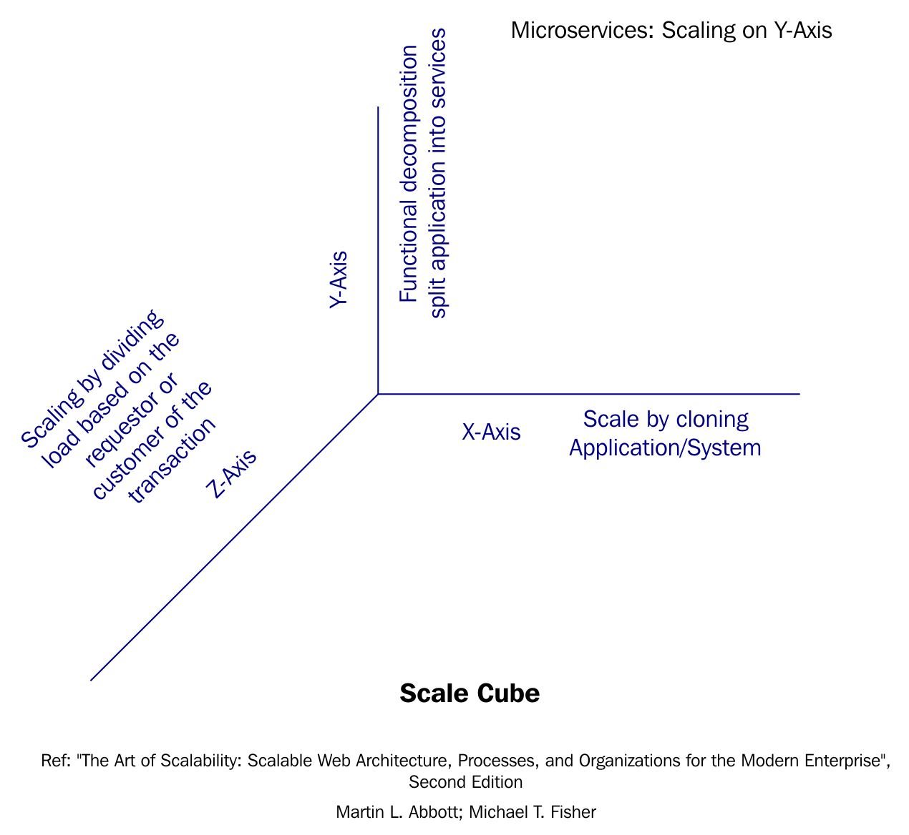
TECHNIQUES TO SCALE MICROSERVICES
Scale Cube model of scalability:

Slide 11
TECHNIQUES TO SCALE MICROSERVICES
X-axis scaling consists of running multiple copies of an application behind a load balancer. If there are N copies then each copy handles 1/N of the load.
Y-axis scaling splits the application into multiple, different services. Each service is responsible for one or more closely related functions.
In Z-axis scaling, each server is responsible for only a subset of the data. Each request is routed to the appropriate server. For example, an application might provide paying customers with a higher SLA than free customers by routing their requests to a different set of servers with more capacity.

Slide 12
QUESTIONS ?

