Slide 1
Automatic Room Lights Using IoT
ISHA R SALIAN
(4NM19EC065)
Department of Electronics and Communication Engineering
NMAM Institute of Technology, Nitte.

Slide 2
INTRODUCTION
Lowering utility costs, electricity usage or ensuring safety and security – Basic requirements of almost all institutions.
The project focuses on creating an Internet of Things (IoT) system for automatic room lighting and person counting using two Passive Infrared (PIR) sensors.
In addition to lighting control, the project incorporates a person counting feature that provides valuable data on room occupancy patterns and utilization.
The combination of PIR sensors, IoT connectivity, and intelligent automation brings about a smart and efficient solution for managing room lighting and occupancy detection.
The project contributes to sustainable practices by reducing unnecessary energy consumption and promoting a more responsive and comfortable environment for users.
This project has numerous practical applications in various domains, including museums, libraries, go-downs etc., where efficient space utilization and energy management are crucial.

Slide 3
OBJECTIVE
To design a system that can detect the presence of people in a room using a PIR(Passive Infrared) sensors.
To program an io cube Devkit microcontroller to receive signals from the PIR sensor and send commands to the lighting system based on occupancy.
To display the number of people entering and leaving the room, status of light and total number of people visited, in the local server.

Slide 4
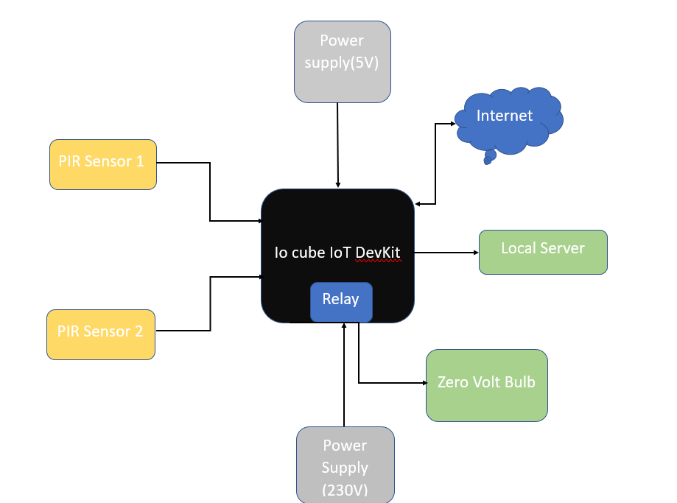
METHODOLOGY
Block diagram:

Slide 5
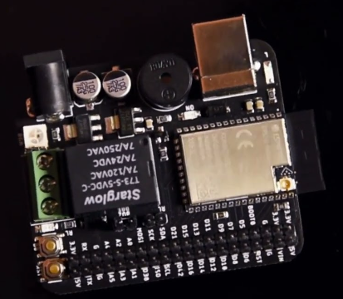
METHODOLOGY
Required components:
Microcontroller board (io cube Devkit), two PIR (Passive Infrared) sensors, zero watt bulb, power supply (230V AC), jumper wires.
USB SERIAL PORT
BUZZER
ESP32S3
5V RELAY
RICH GPIO

Slide 6
METHODOLOGY
Hardware setup:
Connect the two PIR sensors to the IoT development kit (e.g., IO Cube DevKit).
Connect the bulb to the IoT development kit, ensuring it can be controlled through digital signals or a suitable interface.
2. Sensor configuration:
Configure the PIR sensors to provide digital output signals indicating motion detection.
Adjust the sensitivity and range of the sensors to ensure accurate detection within the desired area.

Slide 7
METHODOLOGY
3. IoT platform setup:
Set up an IoT platform that can receive data from the IoT development kit and control the bulb remotely.
4. Code implementation:
Develop code for the IoT development kit to handle sensor data and control the bulb based on the number of people in the room.
Continuously monitor the output of the PIR sensors for motion detection events. Maintain a count variable to track the number of people in the room.

Slide 8
METHODOLOGY
Increment the count variable when a person enters the room (PIR sensor 1 detect motion), and decrement it when a person leaves (PIR sensors 2 detect motion for a certain period).
Control the bulb based on the count variable. If the count is greater than or equal to one, turn on the bulb. Otherwise, turn it off.
5. Testing and refinement:
Test the system in various scenarios to ensure accurate detection and proper functioning of the bulb control.
Fine-tune the code and sensor settings as needed to optimize performance and minimize false positives or false negatives.

Slide 9
METHODOLOGY
6. Deployment and monitoring:
Deploy the system in the desired room or environment.
Monitor the system's operation and performance, ensuring that it continues to accurately count the number of people and control the bulb accordingly.
Regularly maintain and calibrate the sensors if required.

Slide 10
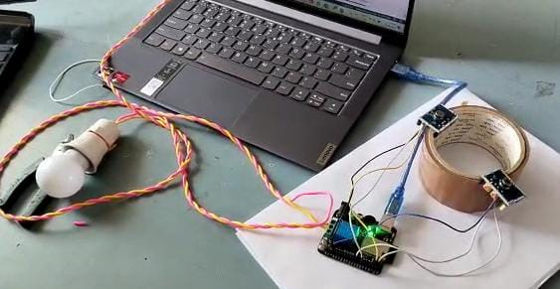
RESULTS
Entry Sensor
OFF state
Exit Sensor
Relay switched off
When no people present

Slide 11
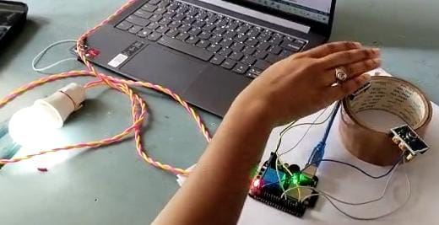
RESULTS
Entry Sensor
ON state
Exit Sensor
Relay triggered
When people are present

Slide 12

RESULTS
Serial Monitor Output: When Wifi module is connected to mobile hotspot

Slide 13
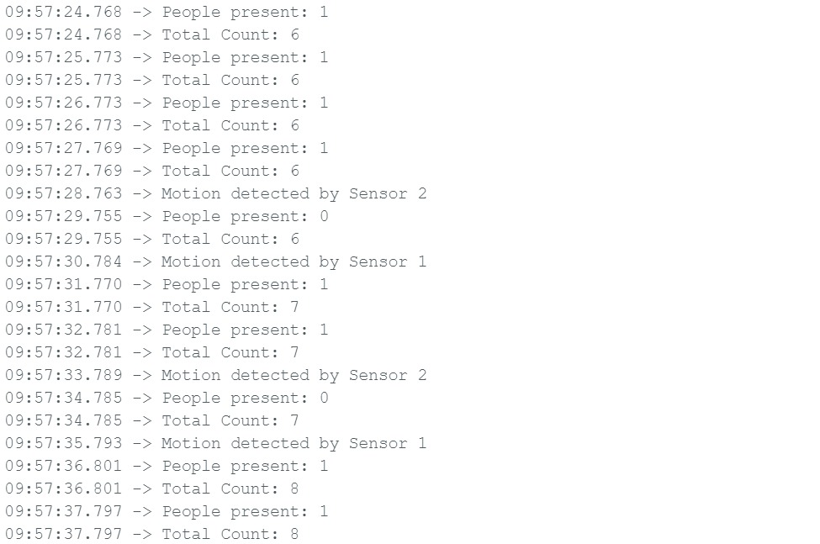
RESULTS
Serial Monitor Output: People present denotes the number of people present in the room. Total count gives the number of people visited in total

Slide 14
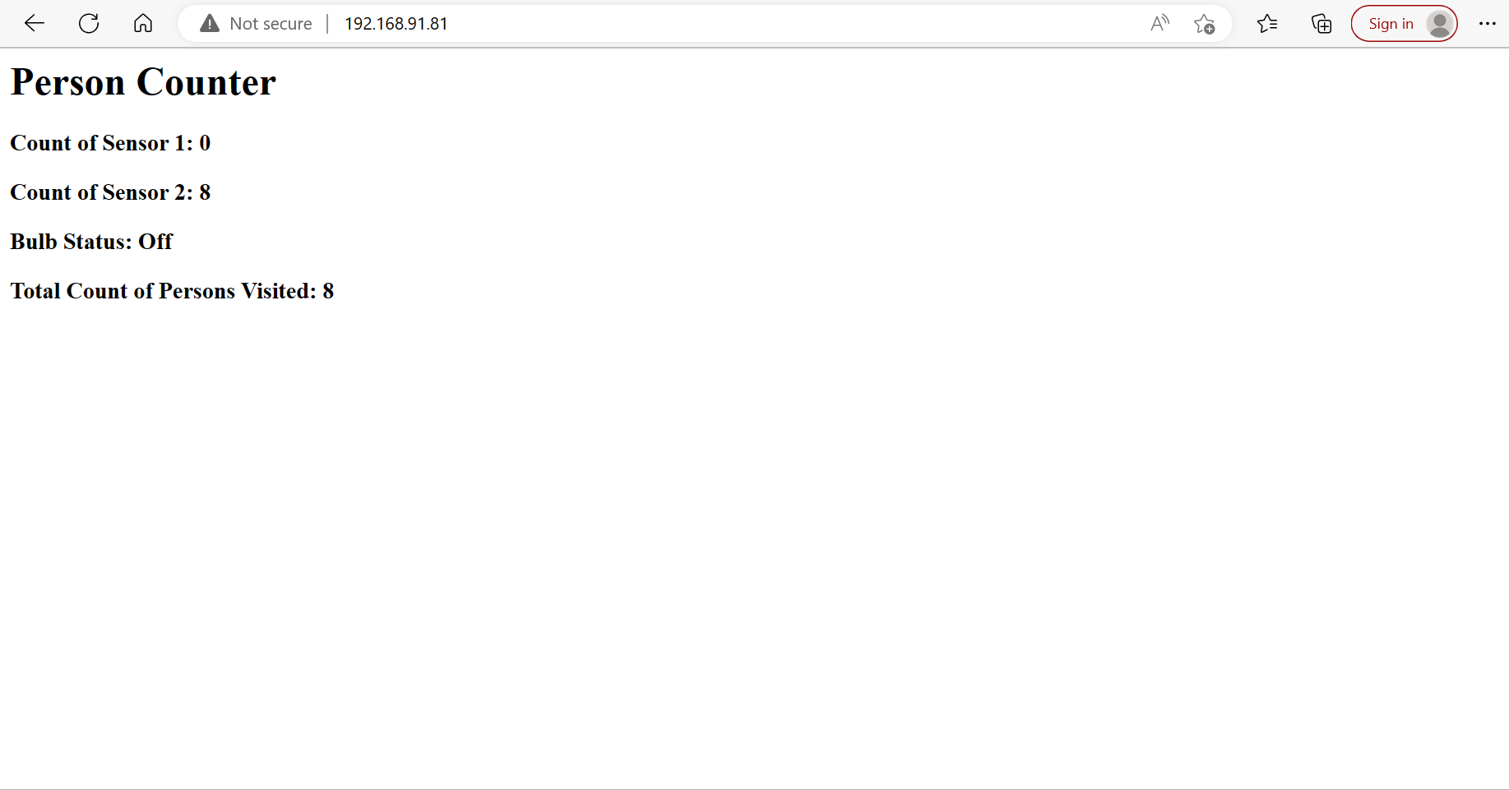
RESULTS
Local Server Output 1

Slide 15
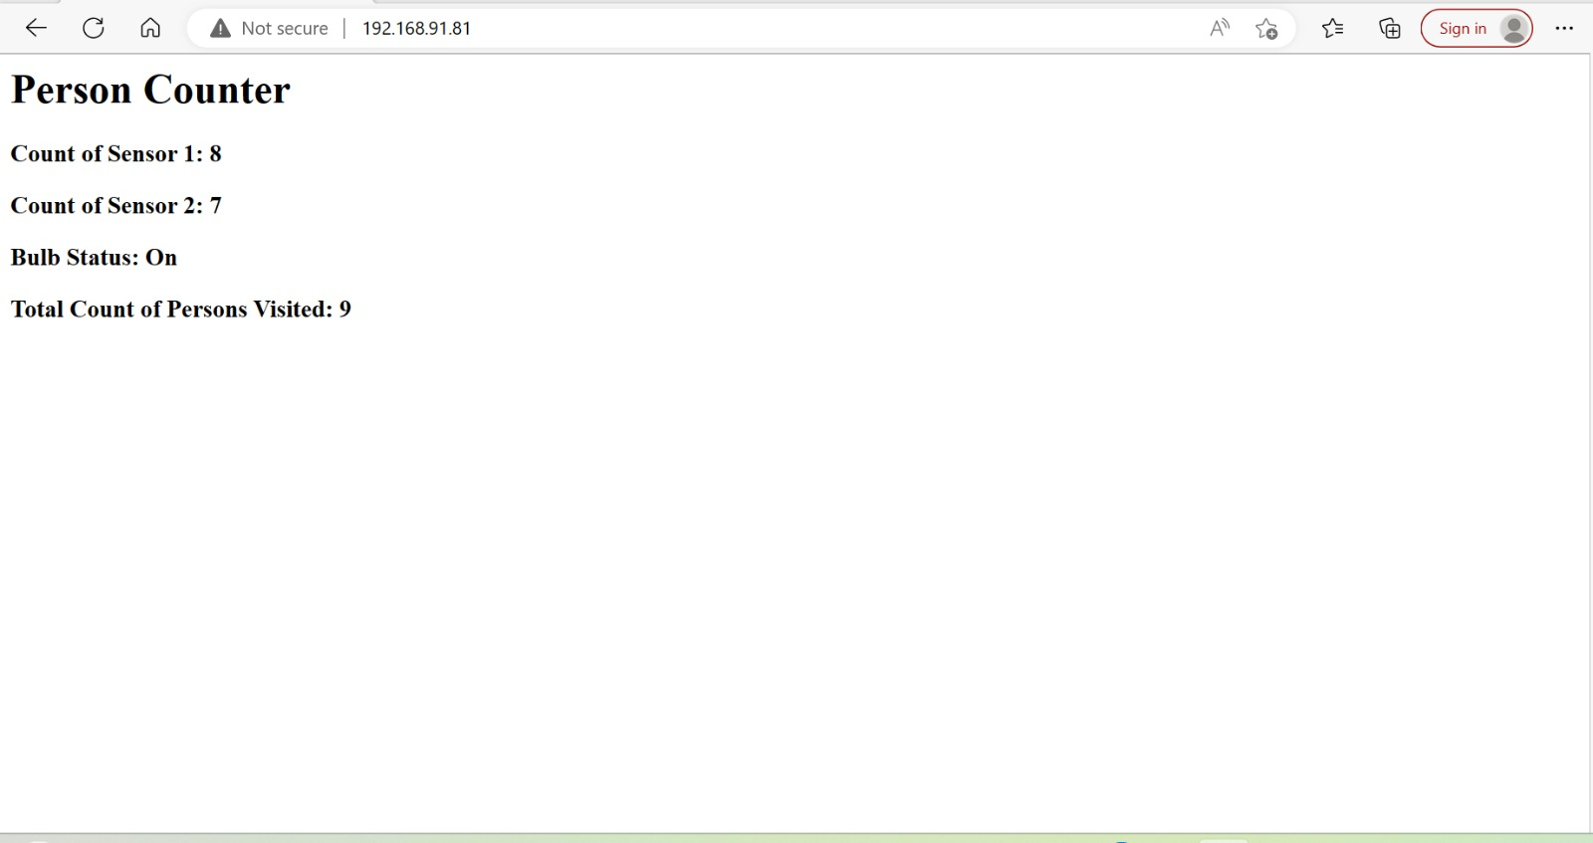
RESULTS
Local Server Output 2

Slide 16
CONCLUSION
The project successfully achieves its objectives of turning the lights on when people are present and turning them off when no one is present in the room.
Additionally, the system accurately counts the number of persons who enter and exit the room.
This project demonstrates the effectiveness of integrating IoT technologies and PIR sensors for energy-efficient and automated lighting control, as well as providing valuable data on occupancy patterns.

Slide 17
REFERENCES
Mahesh Kumar Singh ”Arduino based: Automatic Room Light Control” department of ECE, Buddha Institute of Technology, Gorakhpur (Uttar Pradesh), India.
[1] Karthikeyan. R.A, [2] Piyush. D “Automatic Lighting Using Arduino and PIR Sensor”, International Journal of Computer Science Trends and Technology, Volume 6, Sept Oct 2018.
[1]Abhishek N Vaghela,[2]Bhavin D Gujjar “Automatic Switch using PIR Sensor” International Journal of Engineering Development and Research.

Slide 18
THANK YOU

