Slide 1



Isha's Dashbord
View in Power BI
Last data refresh:
01/03/2025 14:00:57 UTC
Downloaded at:
02/03/2025 13:08:37 UTC

Slide 2
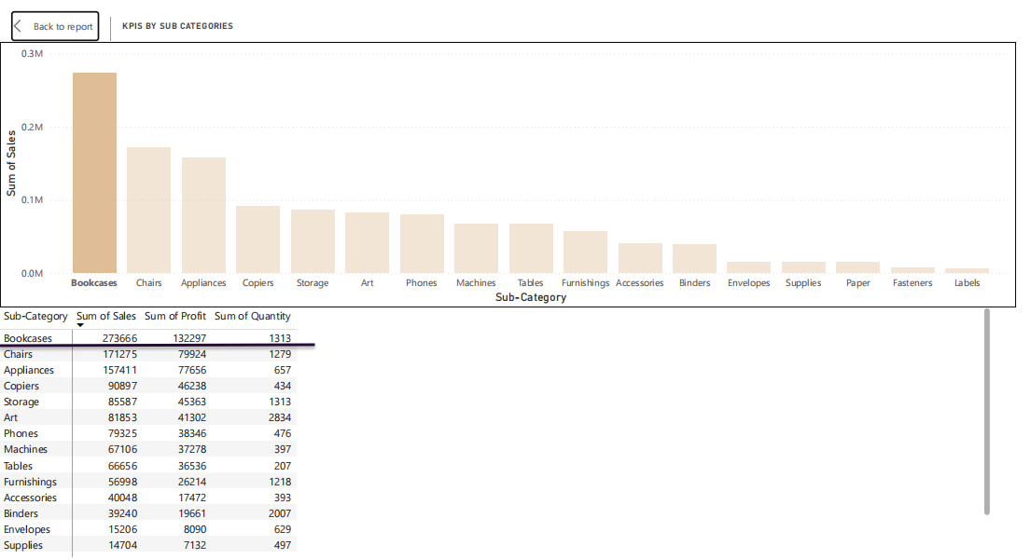

Slide 3
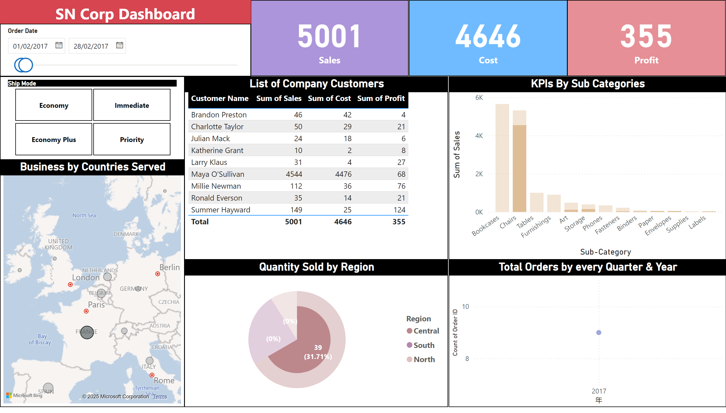
Page 1
Notes:
slicer
No alt text provided
slicer
No alt text provided
textbox
No alt text provided
Business by Countries Served
No alt text provided
Quantity Sold by Region
No alt text provided
Total Orders by every Quarter & Year
No alt text provided
KPIs By Sub Categories
No alt text provided
List of Company Customers
No alt text provided
card
No alt text provided
card
No alt text provided
card
No alt text provided

Slide 4
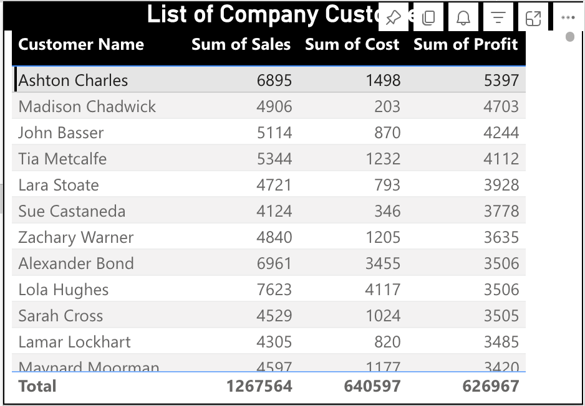

Slide 5
