Slide 1
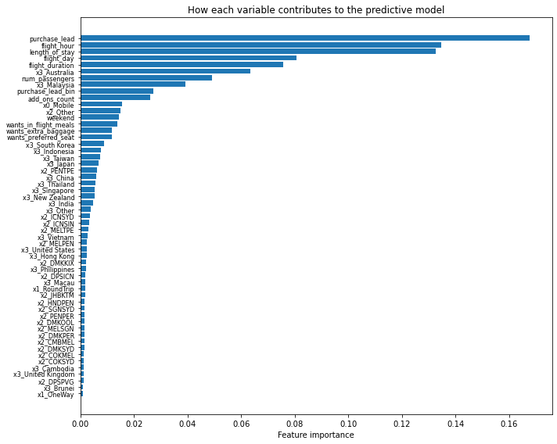
Predictive model for customer booking completion
Objective: Predict whether a customer completes a booking; use data to be proactive in acquiring customers.
Data: Customer booking dataset (50k rows); target = booking completion (~15% complete).
Results (test set):
Accuracy: 85.10% | F1: 0.182 | ROC-AUC: 0.762 | Precision: 0.509 | Recall: 0.111
Top drivers of predictive power: purchase_lead, flight_hour, length_of_stay, flight_day, flight_duration
Conclusion: The data is sufficiently predictive to support targeting customers for holidays. Feasible to use this model to prioritise which customer and booking attributes to act on; recommend deploying for proactive acquisition.

