Slide 1



Gardein’s Growth Strategy: Closing the Gap with Morningstar Farms
VS

Slide 2

INTRODUCTION
Objective: Transform Gardein into the leading meat substitute brand by strategically enhancing product, brand, and market presence.
Focus: Evaluate how to surpass competitive brands using data-driven insights and actionable recommendations.
Market Growth: In the dynamic market of meat substitutes, growth rate of 7% annually is observed.

Slide 3
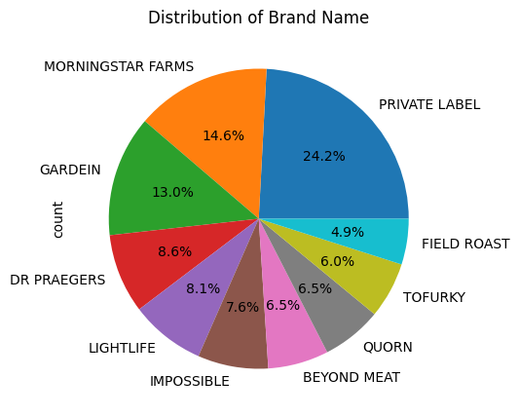
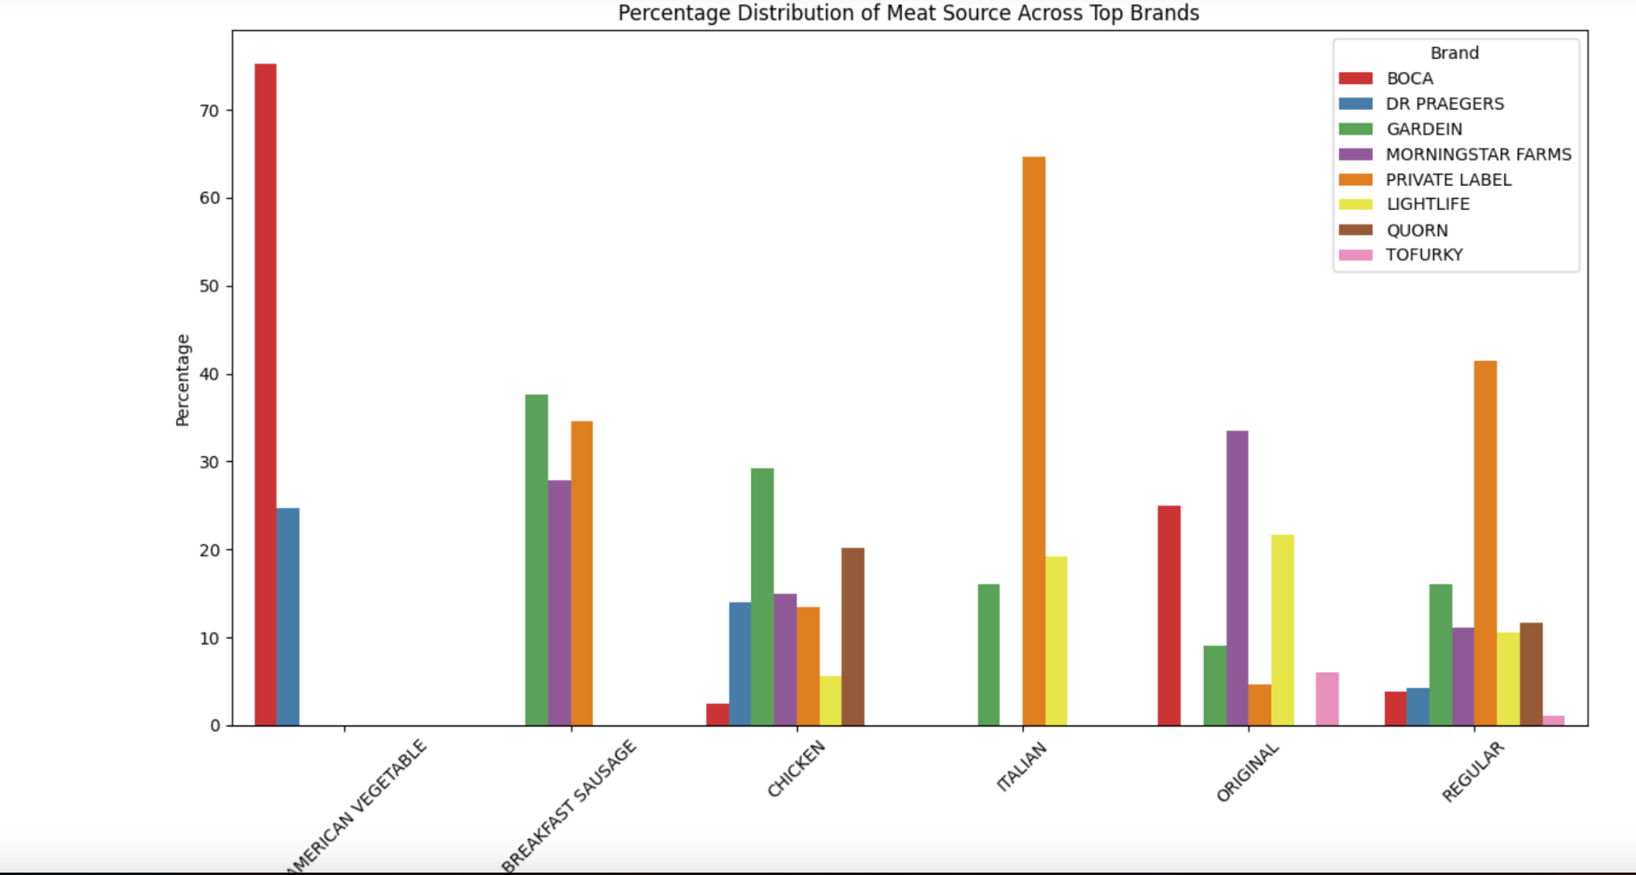
MARKET SHARE ANALYSIS
Used bivariate analysis to find Morningstar as the biggest competitor and market share holder.
Overall Market Share:
Morningstar Farms: 14.6%
Gardein: 13% (Opportunity: +1.6 percentage points)
Original Meat Source (Flavour):
Morningstar Farms: 33.5%
Gardein: 9% (Opportunity: +24.5 percentage points)
Plant-Based Substitutes:
Morningstar Farms: 33.5%
Gardein: 16% (Opportunity: +17.5 percentage points)

Slide 4
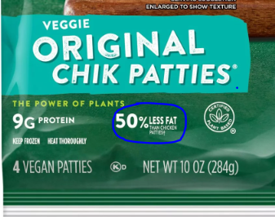
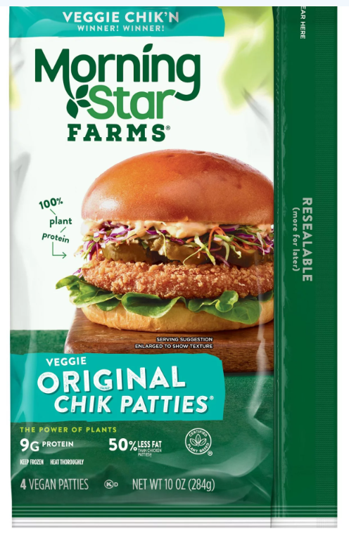
Competitor Insights
Health Messaging: MorningStar Farms highlights health benefits like "50% less fat than chicken patties" on their packaging, aligning their products with health-conscious consumer trends.
Ethical and Environmental Commitments: Companies like Beyond Meat and Impossible Foods emphasize sustainability and ethical practices, which resonate with environmentally conscious consumers and enhance brand loyalty.
Innovative Ingredients: Beyond Meat and Impossible Foods use innovative ingredients such as avocado oil and “heme” to cater to nutritional preferences and provide a meat-like experience, respectively.
Diverse Product Portfolios and Partnerships: Both brands offer a wide range of products and have formed strategic alliances with restaurants to increase product visibility and consumer trial.
Strategy Improvement Opportunities:
Health-focused messaging, Diverse product portfolio
Improve product messaging, increase product variety.
Ethical and environmental messaging, Innovative ingredients
Enhance branding, innovate with unique flavors

Slide 5
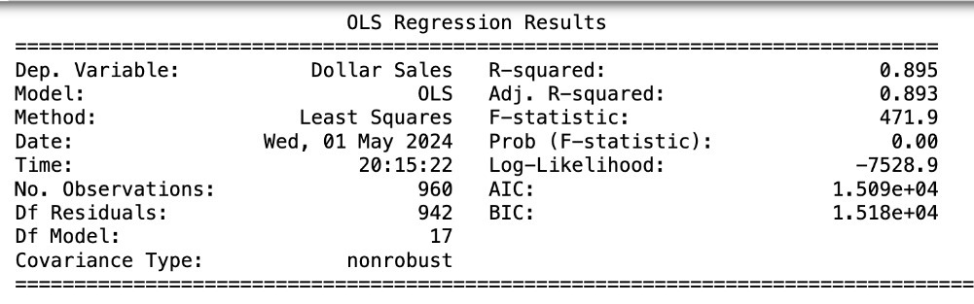
REGRESSION ANALYSIS:
Regression model: Dollar Sales ~ ß0 + ß1(label ounces) + ß2(price per unit) + ß3(ACU weighted distribution) + ß4(geography) + ß5(product) + ß6(brand franchise name) + ß7(meat source) + e.
MODEL SUMMARY
Dependent Variable: Dollar Sales
R-squared: 0.895, indicating that about 89.5% of the variance in Dollar Sales is explained by the model.
Adjusted R-squared: 0.893, adjusting for the number of predictors.
F-statistic: 400.9, showing the overall significance of the model.
P-value (F-statistic): 0.003, which is very low, indicating the model is statistically significant.
Key Coefficients and Interpretation:
Total Ounces: Positive coefficient, implying a marginally positive relationship with Dollar Sales. (p-value = 0.066 suggests marginal statistical significance)
UPC 13 digit: Negative coefficient, which might not be meaningful due to its scale. Statistically significant (p-value < 0.05).
Price per Unit: Negative coefficient, suggesting that as the price per unit increases, Dollar Sales decrease. Statistically significant (p-value = 0.047).
ACV Weighted Distribution: A very strong positive coefficient and highly significant, indicating a positive relationship between distribution and sales (p-value < 0.05).

Slide 6
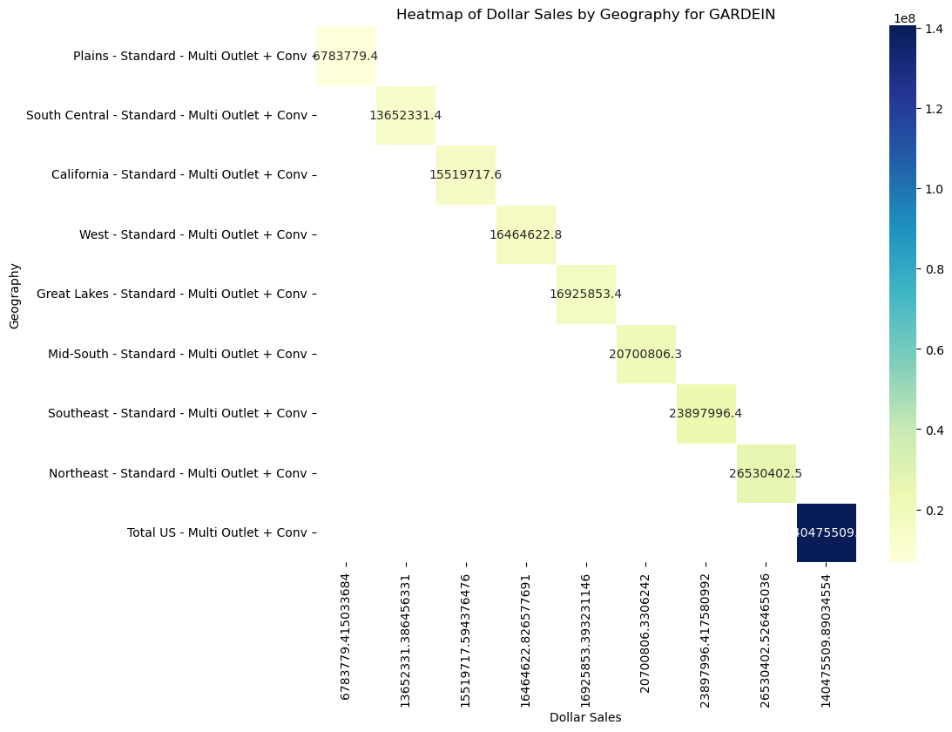
REGIONAL ANALYSIS:
Coefficients based on Regression Analysis along with data analysis.
Top-Performing Regions: Mid-South (393.10), Northeast (538.81), Southeast (217.51)
Underperforming Regions: Plains (-473.80), South Central (-165.05)
Northeast region shows a potential increase in sales by 30%, based on regression coefficients.
South Central and Plains need strategic revisions to improve Dollar Sales value.
Product Performance Based on Regression Findings and Market Analysis:
High-performing product: Regular Meat Substitute Burger 12 OZ, potential to increase sales by 15% in the next year.
Underperforming product: Spicy Meat Substitute Breakfast Patty 8 OZ, sales down by 5% last quarter.

Slide 7
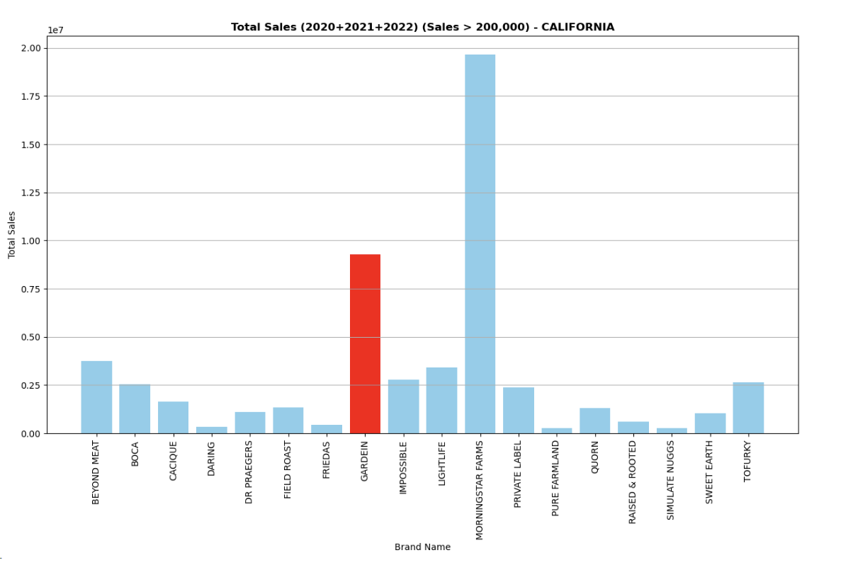
Strategy Suggestions and Expected Return:
Market Share Growth: Potential $80 million increase in sales from 1.6 percentage point market share gain.
Regional Sales Growth: Additional $50 million from Northeast and $40 million from Mid-South.
Product Growth: Additional $50 million from promoting high-performing products.
Product Expansion Strategy: Introducing innovative substitutes for seafood and ham will strategically position the
company to capitalize on underexplored market segments, fostering growth in areas with minimal competition.
Focus on distribution enhancements could lead to a sales increase of approximately $50 million annually.
Optimizing pricing strategies could reduce the price elasticity impact by 0.2, enhancing dollar sales by 10%.
Gardein can achieve a competitive edge by addressing regional performance gaps and optimizing product offerings for niche markets.
Targeted strategies could potentially increase overall market share
by 2% in the next fiscal year (for California).

Slide 8
Conclusion
Conclusion: By targeting strategic geographic regions, enhancing product offerings, and optimizing operations, Gardein can not only bridge the gap with competitors but also lead in innovation and growth in the plant-based meat industry.
Market Analysis and Strategic Direction for Gardein (2020-2023)
Market Positioning: Gardein holds a 13% market share in the competitive meat substitute sector with 17,307 units sold in 2023,
slightly behind Morningstar Farms. Increasing market share by 1.6 percentage points could boost revenue by $80 million.
Geographic Expansion: Focusing on the Northeast and Mid-South regions could increase revenue by $90 million,
exploiting their high sales impact coefficients of 538.81 and 393.10, respectively.
Product Performance: The Regular Meat Substitute Burger shows strong market preference with a regression coefficient of 617.97,
suggesting potential for an additional $50 million in annual sales through increased production and marketing.
Innovative Product Launches and Operational Enhancements: Introducing new products like ground meat substitutes and chicken strips could generate an
additional $30 million. Operational improvements could further increase sales volume by 15%, translating to an extra $60 million in revenue.

