Slide 1

ONLINE BANKING SYSTEM
BATCH 8 GROUP 6

Slide 2

Table of Contents
• Project Overview
• Application architecture
• Database Schema
• Technologies used
• Functionalities
• Endpoints
• ValidationS
• User Interface
• Challenges faced
• Future perspectives

Slide 3
Project Overview

Slide 4
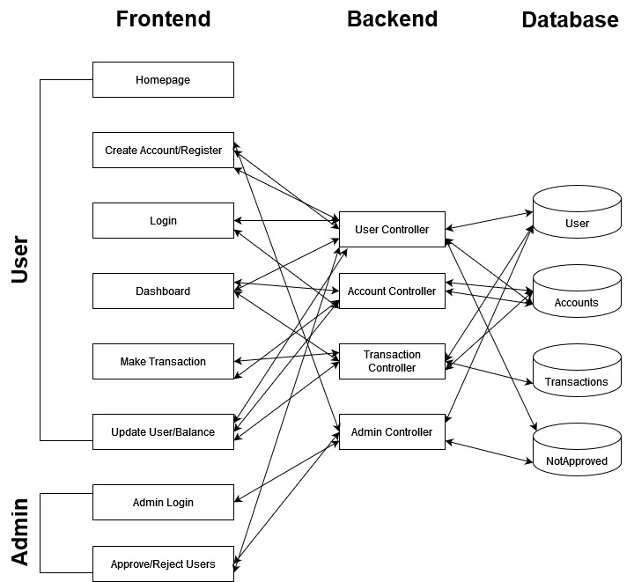
Application
Architecture

Slide 5
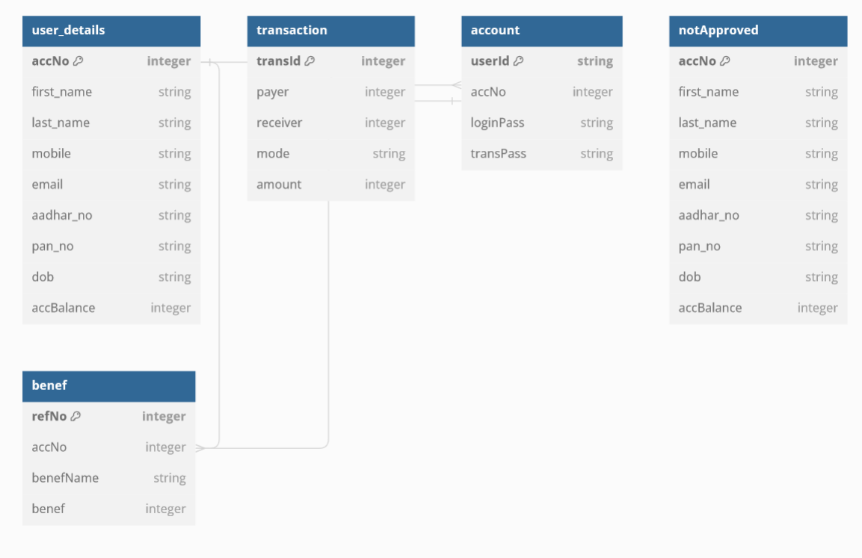
Database Schema

Slide 6






TECHNOLOGIES USED
FRONTEND:
React
React Router
Yup
Javascript
Axios
Material UI
React Hot Toast
Tailwind CSS

Slide 7







TECHNOLOGIES USED
BACKEND:
Spring Boot
Maven
Hibernate
Java
MariaDB
Spring Security
Lombok
Spring REST API
Spring Data JPA

Slide 8

Functionalities
Dashboard with user details, balance and
transaction history
New user registration
with all sorts of
validation
Fund transfer to registered
users with
necessary validations
Admin approval for account creation

Slide 9
Functionalities
Secure Login with JWT
authentication
Functionalities
Smooth navigation
between
pages on the frontend
Unit and Integration testing
Error handling with custom
exceptions at Backend

Slide 10
User
Admin
-> /api/userDashboard/{userId}
GET: To get the details of user.
->/api/userDashboard/fundTransfer/{userId}
POST: Fund transfer detail to given userId.
->/api/userDashboard/showTransactions/{userId}
GET : To get the transactions details.
->/api/userDashboard/addBeneficiary/{userId}
POST: To add beneficiary.
->/api/userDashboard/showBeneficiary/{userId}
GET: To get beneficiary details.
->/api/admin/userlist_requested
GET : List of user account that needs approval.
->/api/admin/userlist_approved
GET : List of user account that are approved.
->/api/admin/userlist_requested
POST : List of user account that needs approval.
->/api/admin/userlist_requested/{userId}
DELETE : Delete the user having given userId.
Endpoints

Slide 11
Transaction
Account
GET : A particular user
GET : All transactions details of a particular user
POST : Fund transfer details
POST : Withdrawal details
-> /api/register
POST : Register new account with user details
-> /api/login
POST: JWT token associated with the userId while login.
Endpoints

Slide 12


Password at least 8 characters with one special character
Email regex to match the format abc@mail.com
Mobile number validation
Aadhar number validation
Pan Card number validation
FRONTEND
Validations
Null and type checks in database
Valid request check for all the endpoints
Balance and account checks for transactions
BACKEND

Slide 13
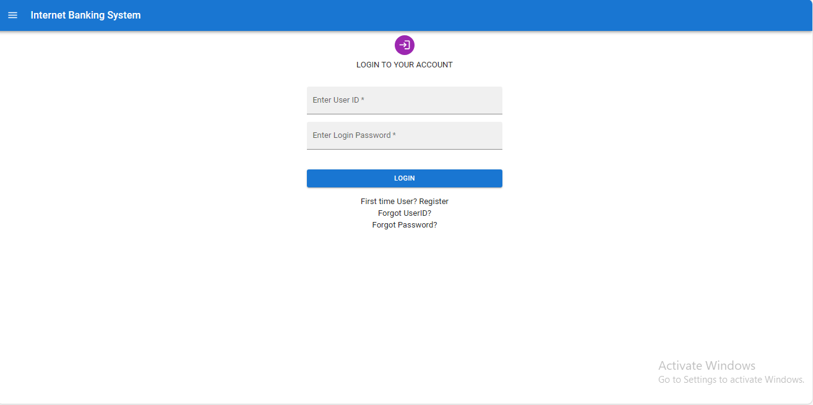
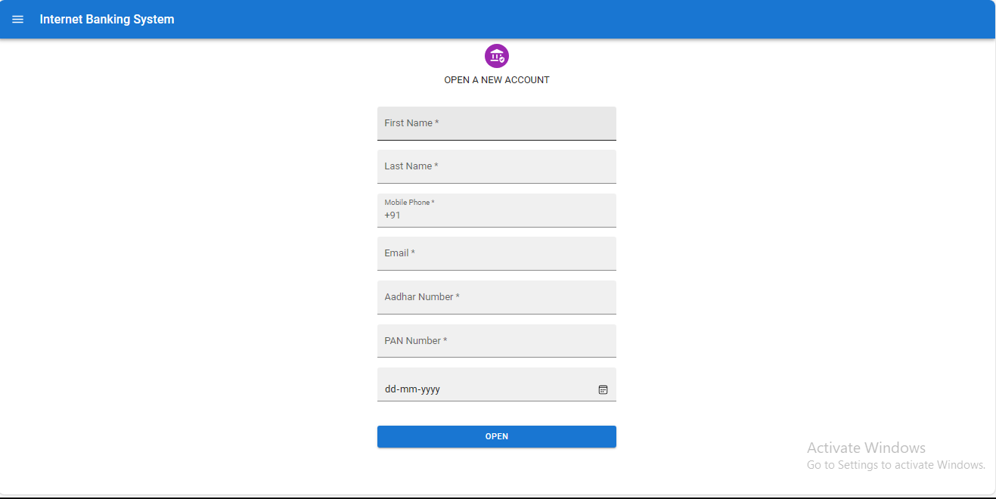
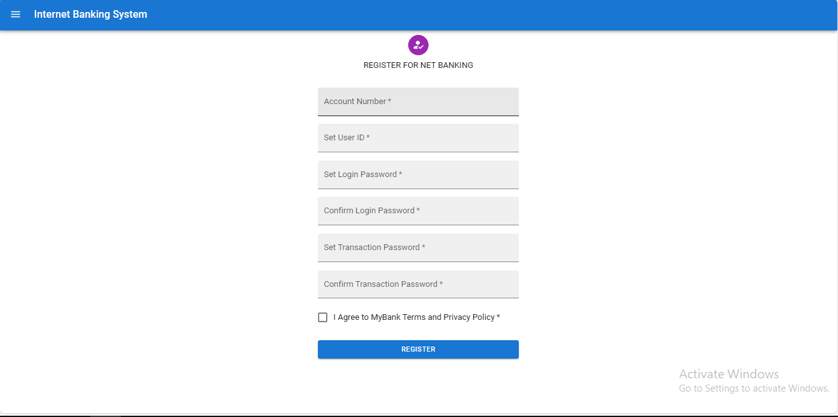
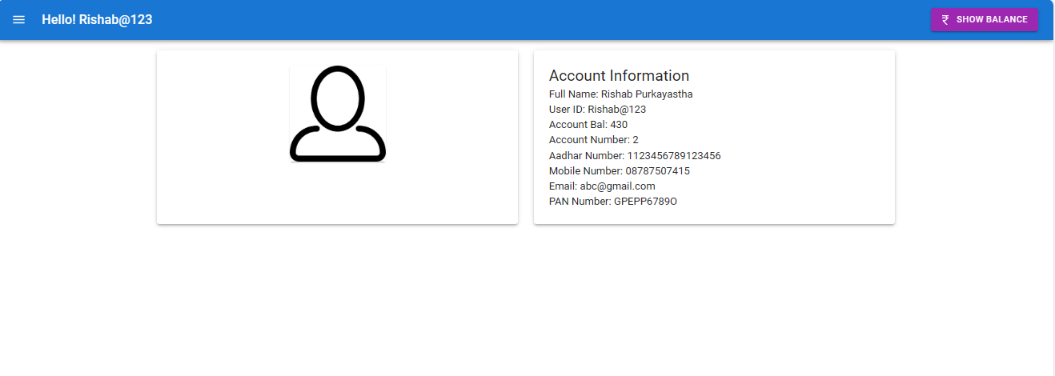
User UI

Slide 14
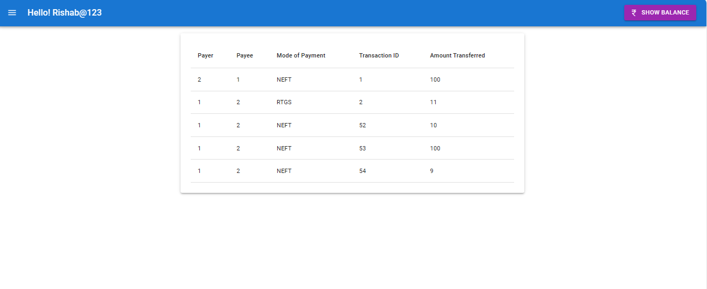
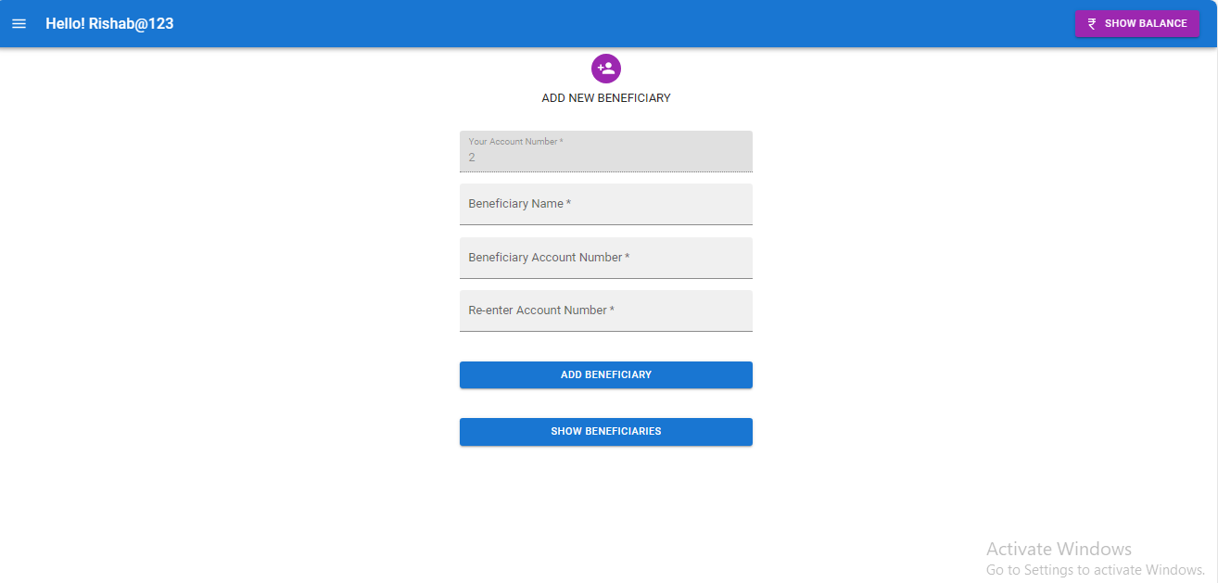
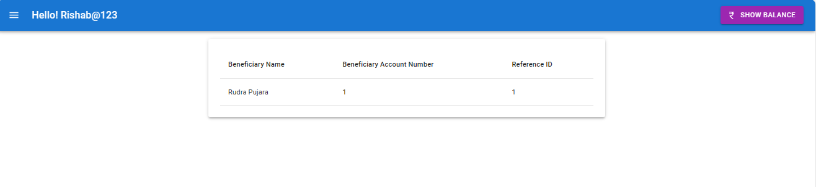
User UI

Slide 15
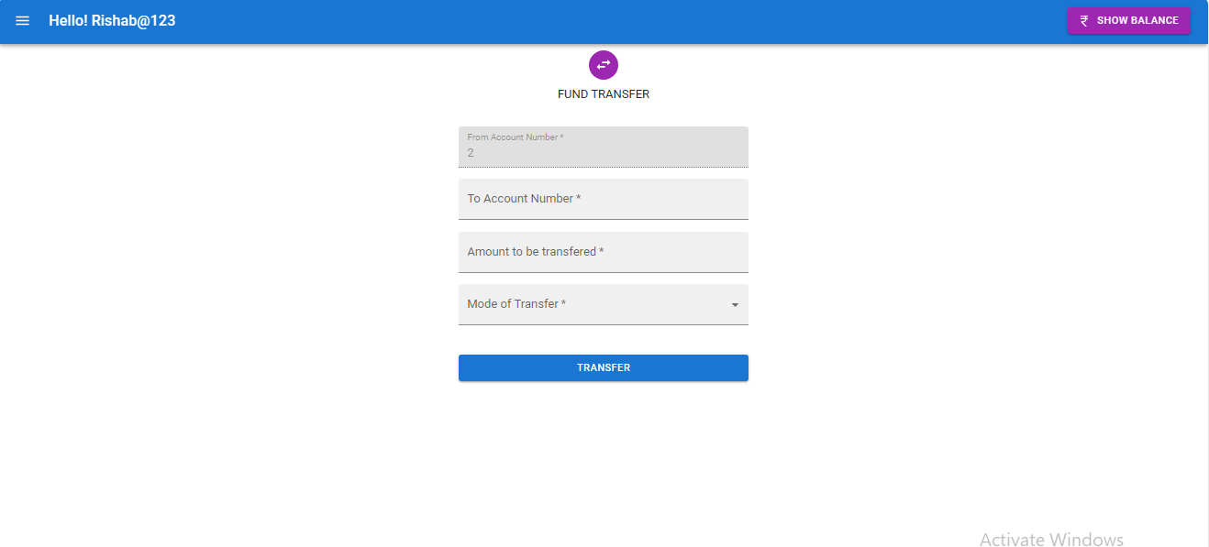
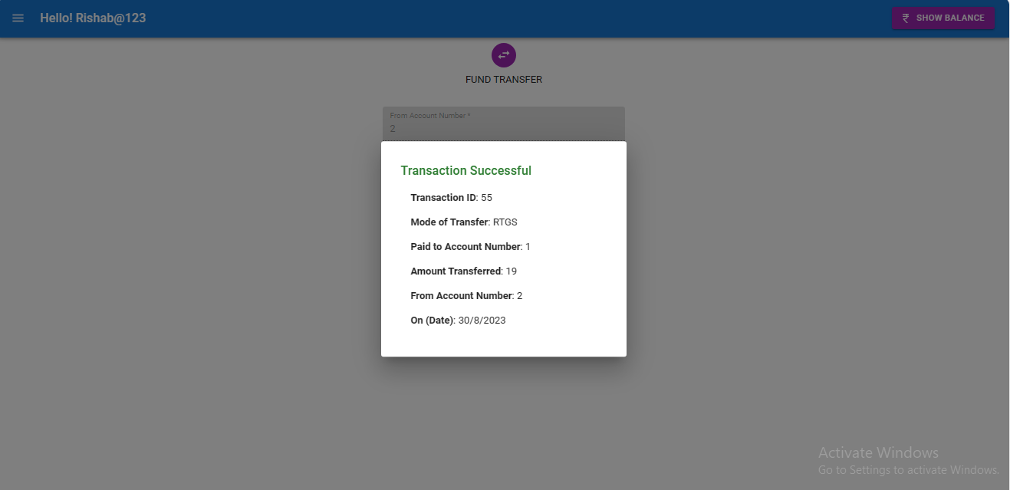
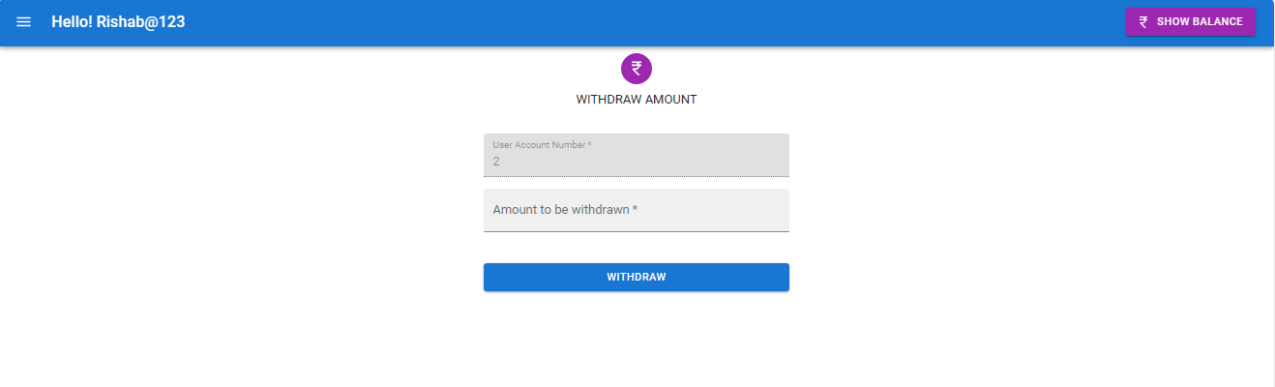
User UI

Slide 16
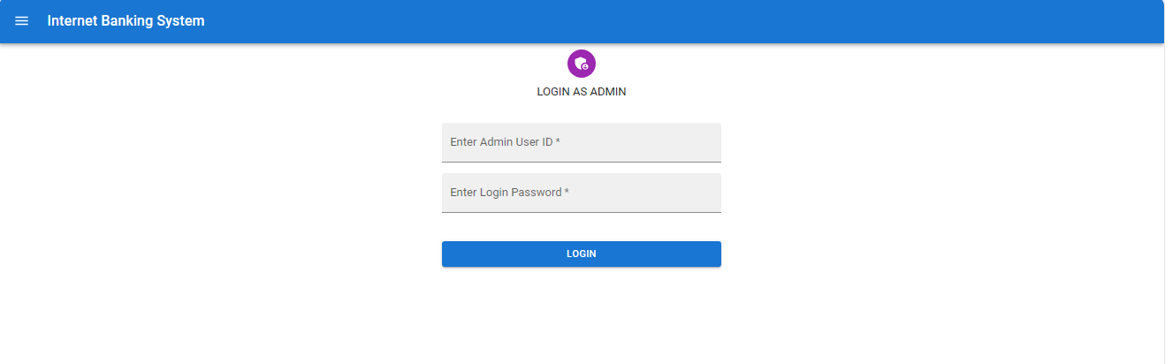
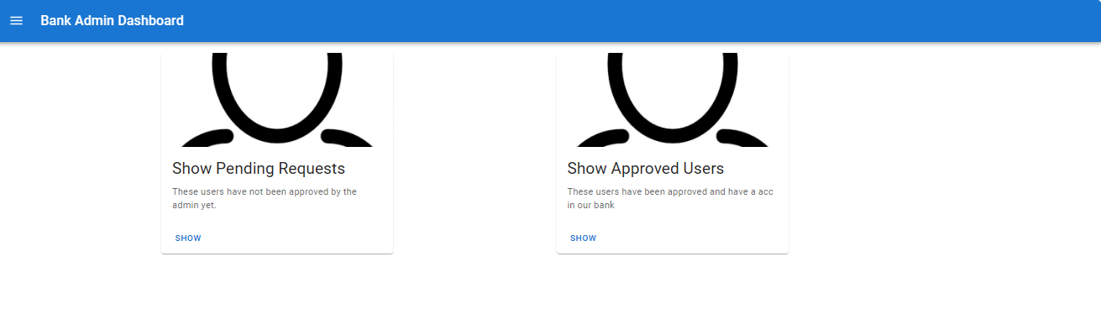
Admin UI

Slide 17
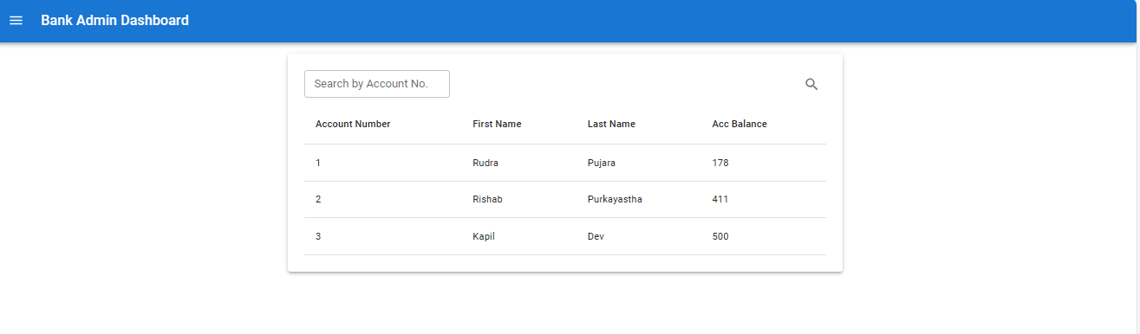
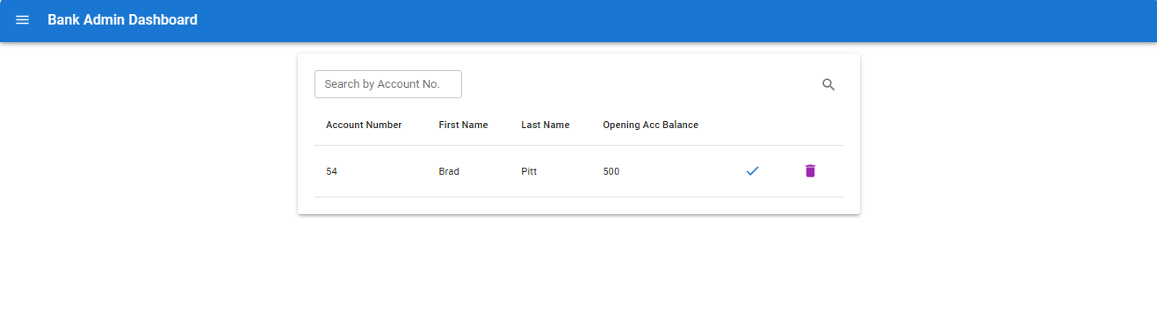
Admin UI

Slide 18
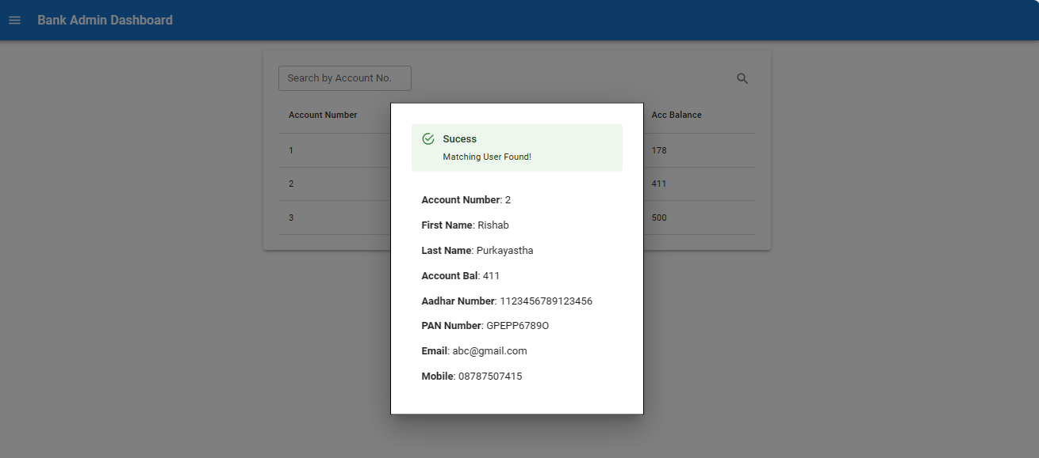
Admin UI

Slide 19


Challenges Faced
JWT Authentication Version and Bugs Issue
Management of timelines
and priorities
Errors while performing Unit Testing
Issues while performing exceptional handling
Version compatibility
Exposure to new technologies

Slide 20

FUTURE PERSPECTIVE
Cybersecurity advancements and practices to protect customer data.
Enhanced Security by using authentication methods like biometrics, multi-factor authentication and blockchain technology.
Cybersecurity Advancements
Cross-Channel Integration
Enhanced Security
Personalization
seamless experience when moving between online, mobile, and in-person banking channels
Usage of data analytics and AI to provide highly personalized financial advice and product recommendations to customers based on their transaction history and financial goals.

