Slide 1

Job Market Analysis
GROUP 8
Anshul Gairola
Isha Agrawal
Shikha Singh
Akanksh Shetty
Karan Salunkhe

Slide 2
Unit of Analysis
1. Job Postings Dataset (job_postings): Each job posting is treated as a unit of analysis, providing insights into job titles, qualifications, company details, location, and posting date.
2. Salaries Dataset (ds_salaries): Each salary record, which includes details about job titles, experience levels, employment type, salary figures, and company size, is analyzed to understand salary trends, variations by job title, company size, and employment type.
3. Salary by Experience Level Dataset (sal): This dataset focuses on salary variations based on experience levels within job titles, offering insights into salary progression for specific roles.

Slide 3
Source of Data
1. Job Postings Dataset :
Source: The data was collected through web scraping using Android Chrome packages and Beautiful Soup.
Data Type: Structured Data. The data consists of clearly defined columns (e.g., job title, company name, location, qualifications, posting date) that follow a tabular format, making it easy to analyze.
Missing Values: There are no missing values in this dataset.
2. Salaries Dataset :
Source: This dataset was sourced from Kaggle.
Data Type: Structured Data. The dataset contains well-organized columns (e.g., job title, salary, company size, employment type) in a tabular format.
Missing Values: There are no missing values in this dataset.
3. Salary by Experience Level Dataset :
Source: This dataset was sourced from Kaggle.
Data Type: Structured Data. The data is organized in a tabular format, with columns like job title, experience level, and salary.
Missing Values: There are no missing values in this dataset.

Slide 4
Constraints
Data Bias
Temporal Relevance
Role and Title Variations
Salaries and Benefits
Text Processing Limitations

Slide 5
Code Demonstration

Slide 6

Conclusion

Slide 7
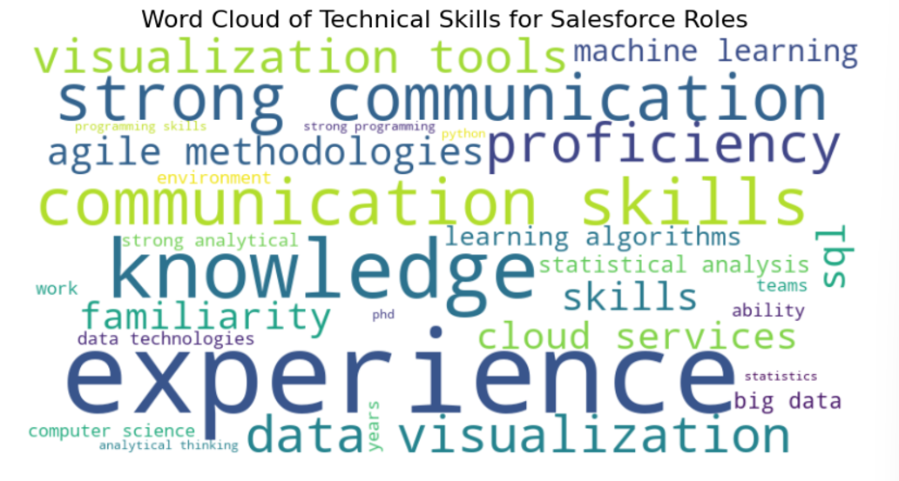
Skills in Demand by Salesforce

Slide 8
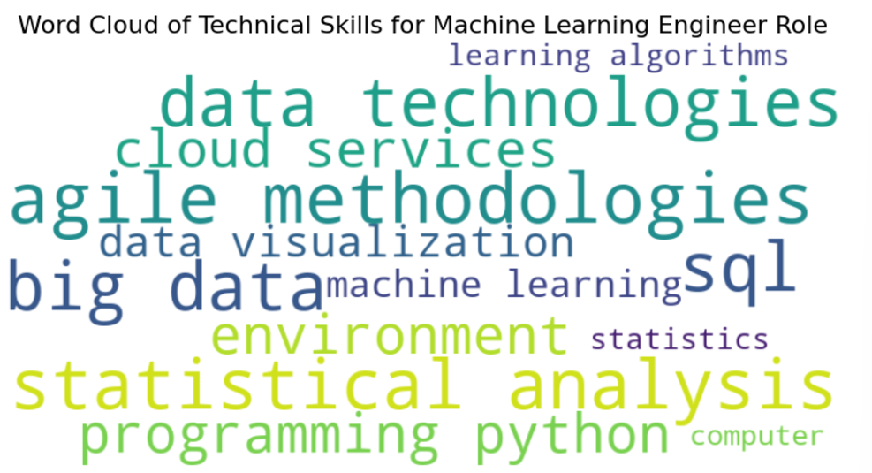
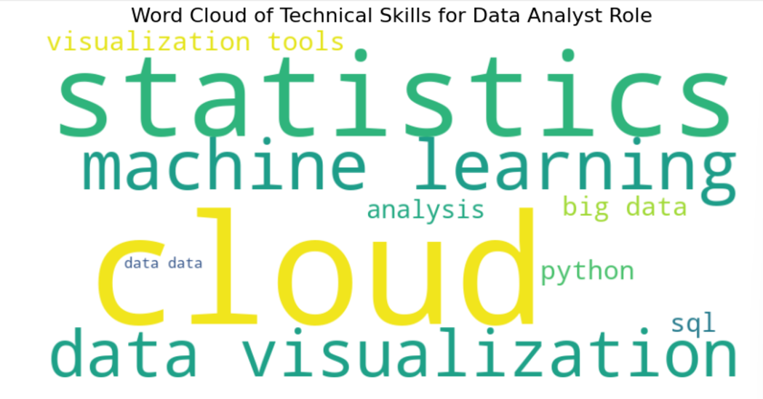
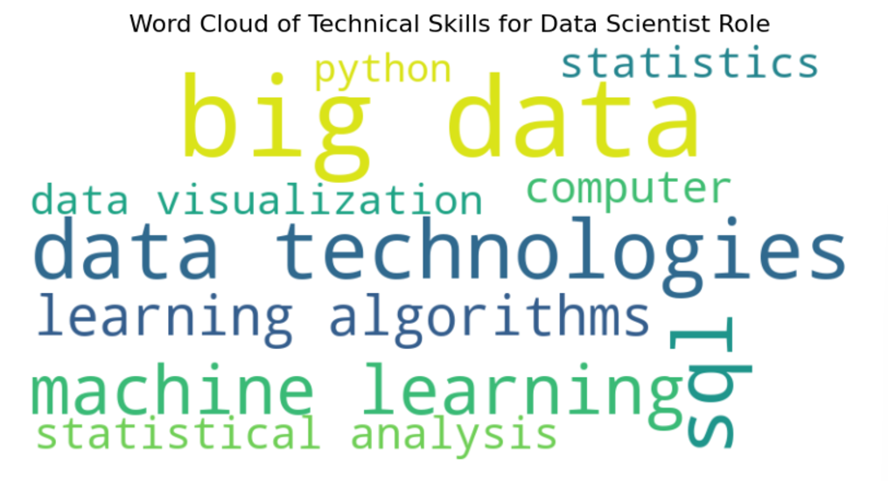
Essential Skills for Data Analyst, Data Scientist and Machine Learning Engineer Roles

Slide 9
Top Locations for Job Opportunities
Atlanta, GA: The Data Hub
Consistently leads in job openings across all major data roles:
Data Analyst: 36 openings
Data Engineer: 53 openings
Data Scientist: 50 openings
Research Scientist: 44 openings
Offers the most diverse opportunities for data professionals.
Philadelphia, PA, and Phoenix, AZ: Analyst Demand
Both cities host 30 Data Analyst openings each, making them competitive alternatives to Atlanta for analysts.
Dallas, TX, and Salt Lake City, UT: Data Engineering Opportunities
These cities stand out for Data Engineer roles, with 29 openings each, highlighting growing tech investments.
Phoenix, AZ, and New York, NY: Data Science Hubs
Phoenix offers 32 Data Scientist positions, while New York has 30, underscoring their significance in data science.
Pittsburgh, PA, and Austin, TX: Machine Learning Prospects
Pittsburgh (30) and Austin (29) are hotspots for Machine Learning Engineer roles, reflecting innovation in AI and automation.

Slide 10
Top Hiring Companies and Their Job Openings
Salesforce
Leads with 134 job openings, showcasing its dominance in hiring across various data-related roles.
Reflects Salesforce's growing focus on data-driven solutions and innovation.
Honeywell
Close behind with 131 openings, indicating a strong demand for data professionals to support its operations in industrial and technological sectors.
Square
Boasts 126 openings, emphasizing its need for talent in fintech and digital payment solutions.
Danaher
With 93 openings, highlights its expansion in healthcare and life sciences, leveraging data for research and diagnostics.
Starbucks
Matches Danaher with 93 openings, showcasing its push toward using data for operational efficiency and enhancing customer experiences.

Slide 11
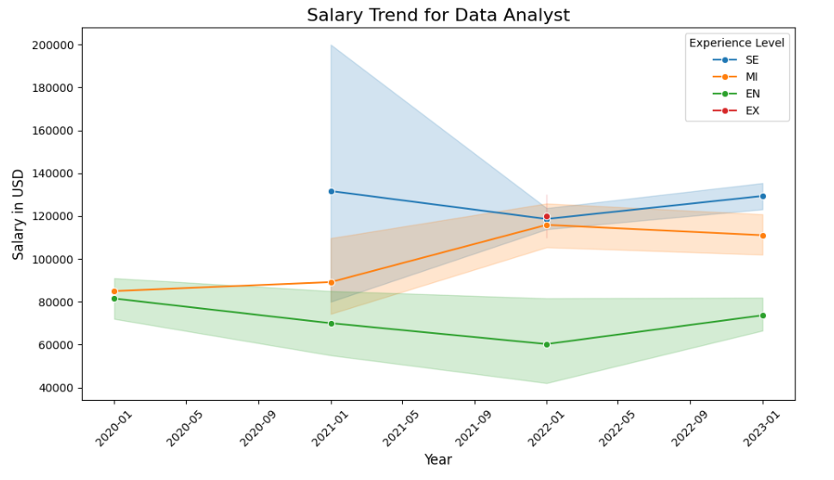
Salary Trends For Data Analyst Role

Slide 12
What Could You Do with This New Insight?
Targeted Skill Development: Focus on in-demand skills (e.g., machine learning, cloud services) to enhance employability.-
Geographical Strategy: Apply to job-rich locations, or consider relocation for better opportunities.
Salary Expectations: Set realistic salary goals based on trends and use data for effective negotiations.
Networking: Connect with professionals in high-demand roles to gain mentorship and insights.-
Career Path Strategy: Choose roles with the highest demand and growth opportunities.
Academic Projects: Use industry trends to guide research or data-driven academic work.

Slide 13
References

