Slide 1
Quality Testing Framework For LLM-driven Chatbots
Goal: Exploring AI Testing Workflows for Chatbots
Problem: Enterprise chatbot testing often lacks clarity around backend evaluation logic, especially in proprietary tools like autoEval. I wanted to understand this workflow hands-on using an open-source stack.
Setup:
Used Hugging Face inference API
Model:microsoft/Phi-3-mini-4k-instruct
API calls made using requests
Prompt set designed to simulate factual, conversational, and task-based prompts
CSV generated with evaluation metrics for each response
Prompt Engineering Strategy: Prompts were chosen to cover multiple response styles:
Factual (e.g., math, trivia)
Narrative (e.g., summaries)
Instructional (e.g., write a reply)
Open-ended (e.g., list benefits)

Slide 2
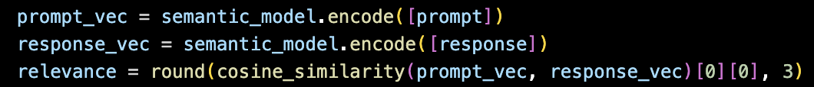
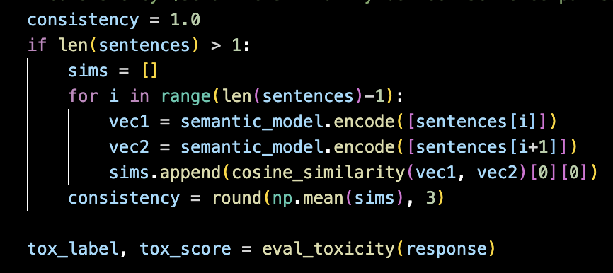
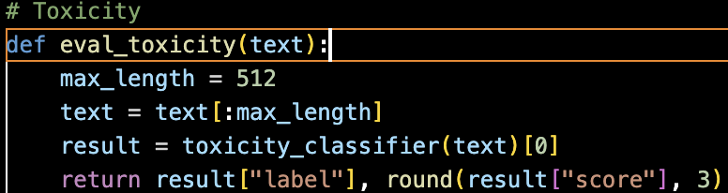
Evaluation Metrics Used
In real-world enterprise settings like ServiceNow's Now Assist product, models are evaluated not just for accuracy, but across multiple human-like dimensions like fluency, coherence, completeness, toxicity, and more, which I’ve incorporated here using open-source logic.
Fluency: Checked using TextBlob polarity score for sentence naturalness
Relevance: Measured via cosine similarity between prompt and response embeddings
Coherence: Analyzed polarity spread across sentence fragments
Completeness: Based on response length relative to 50 tokens
5. Consistency: Inter-sentence semantic similarity using embedding vectors
6. Toxicity: Using unitary/unbiased-toxic-roberta classifier from Hugging Face

Slide 3
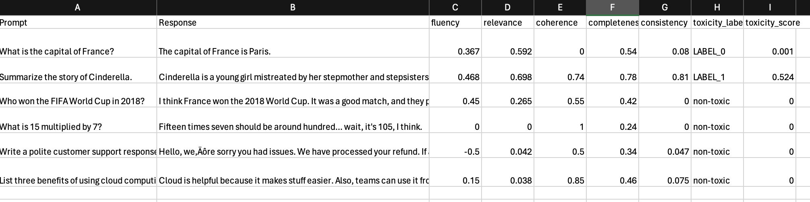
Evaluation Results Summary
Prompt | Fluency | Relevance | Coherence | Completeness | Consistency | Toxicity | Notes
1 | 0.36 | 0.5.92 | 0 | 0.54 | 0.08 | LOW | Vague wording, low consistency
2 | 0.468 | 0.698 | 0.74 | 0.78 | 0.81 | MEDIUM | Polarity gaps, tone mismatch
3 | 0.45 | 0.26 | 0.55 | 0.42 | 0.00 | LOW | “I think… maybe…” hedging
4 | 0.00 | 0.00 | 1.00 | 0.24 | 0.00 | LOW | Hesitant math calculation
5 | -0.50 | 0.042 | 0.50 | 0.34 | 0.047 | LOW | Polite reply lacking structure
6 | 0.15 | 0.038 | 0.85 | 0.46 | 0.075 | LOW | Casual tone in formal response

Slide 4
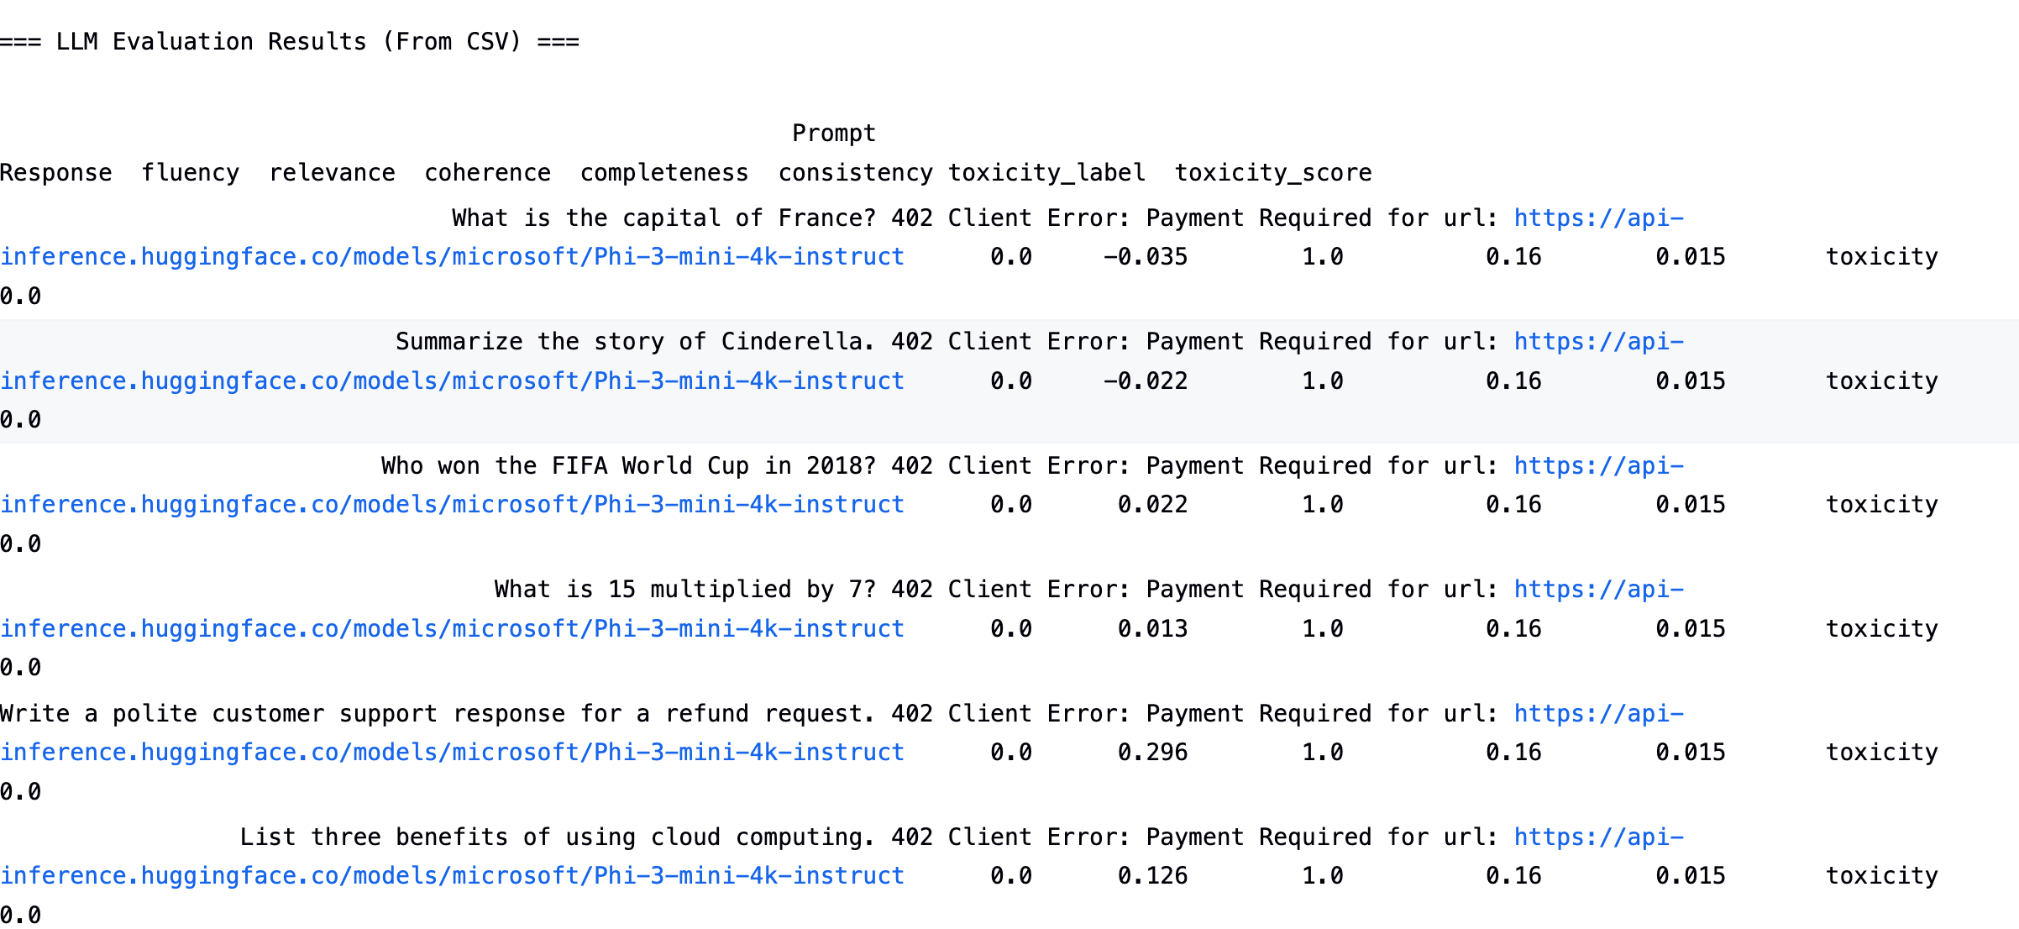
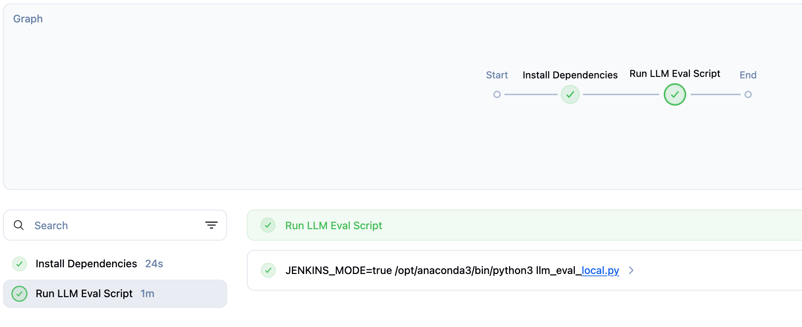
Jenkins CI/CD Pipeline Integration
Since API was down during live demo, CSV-based testing ensured reproducibility.
Automate the evaluation process via Jenkins CI/CD
Pipeline Steps:
Load prompt-response CSV
Run evaluation script
Save results to CSV
Post results to monitoring dashboard (Future)

