Slide 1
GENE EXPRESSION ANALYSIS USING CLASSIFICATION TECHNIQUES
Project Members :
Isha Chidrawar (4322)
Bhavana Ingole (4321)
Pratiksha Pabale (4340)

Slide 2
Problem Statement
To study and compare various classification algorithms for gene expression analysis.

Slide 3
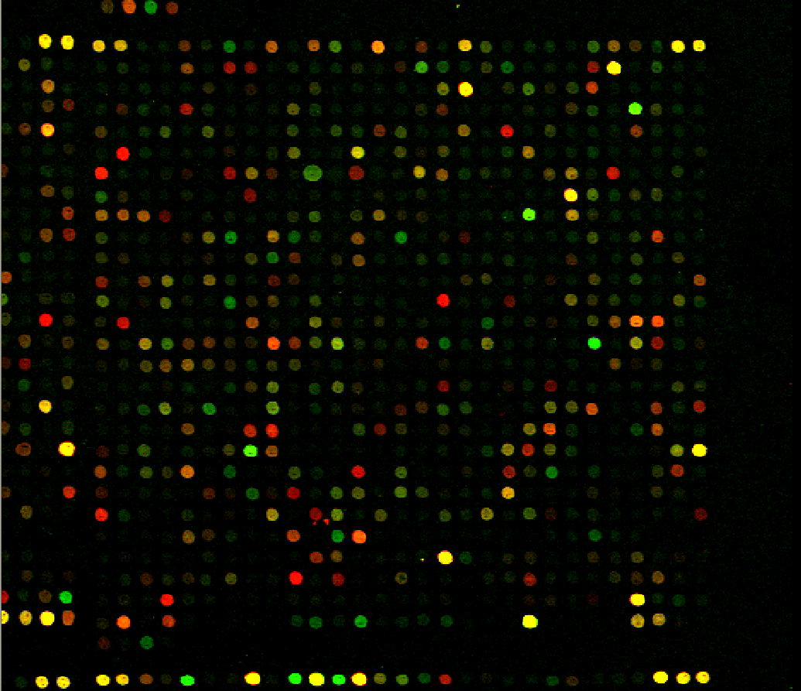
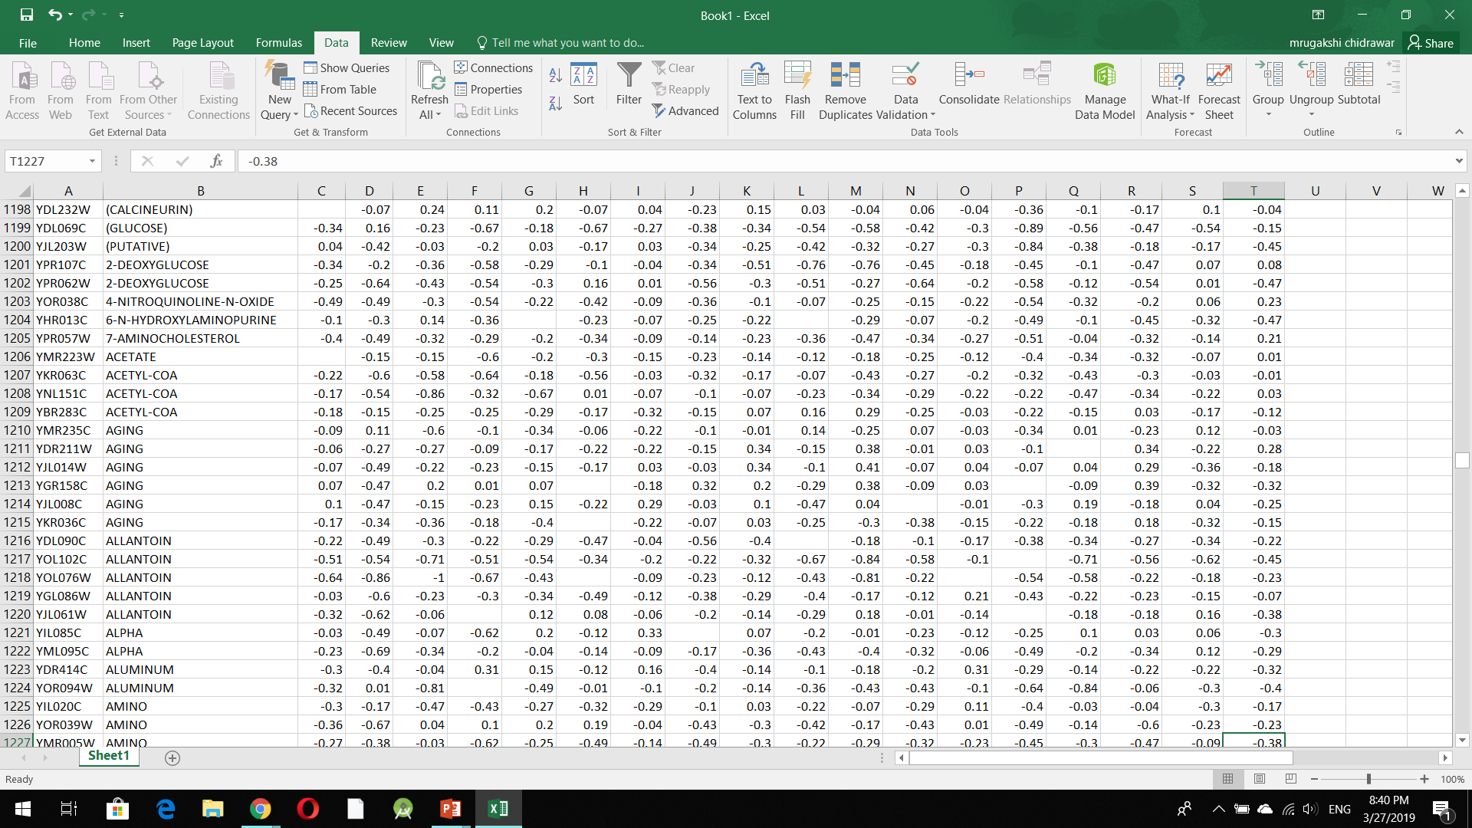
PREPROCESSING
Gene expression data
(After normalization)
Microarray

Slide 4
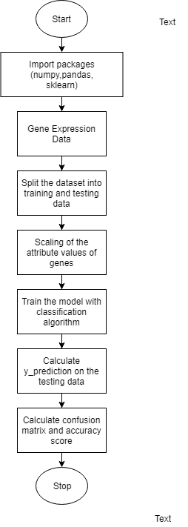
FLOW OF
MODEL

Slide 5
K-Nearest Neighbours Classifier
K-nearest neighbours is a simple algorithm that stores all available data points and classifies new data points based on a similarity measure (e.g., distance functions).
Algorithm
Store the training samples in an array of data points arr[].
This means each element of this array represents a tuple (x, y).
for i=0 to m:
Calculate Euclidean distance d(arr[i], p).
set S of K smallest distances obtained. Each of these distances corresponds to an already classified data point.
Make Return the majority label among S.

Slide 6
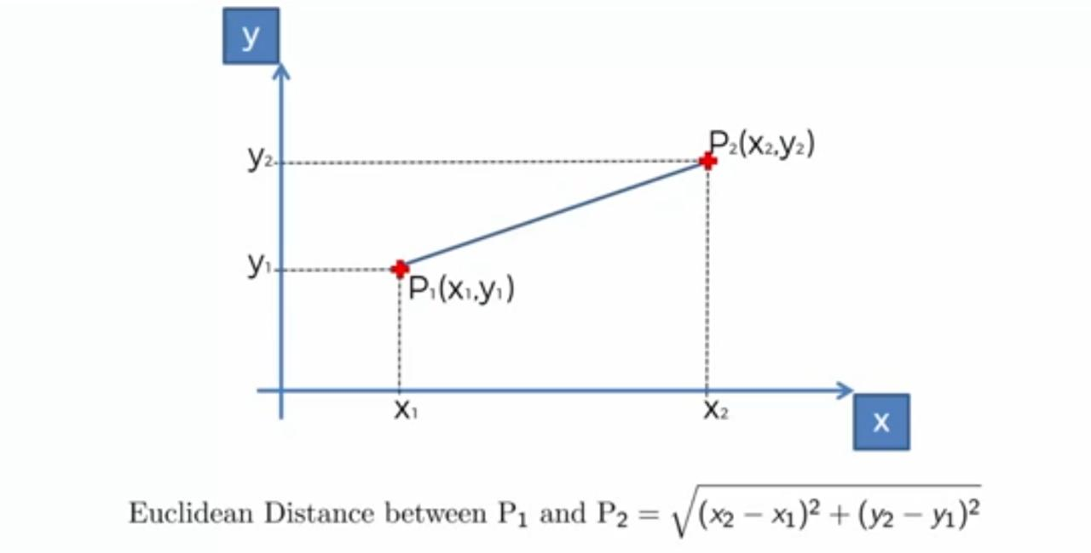
Euclidean Distance Formula
FIg No 1 : Euclidean Distance Formula

Slide 7
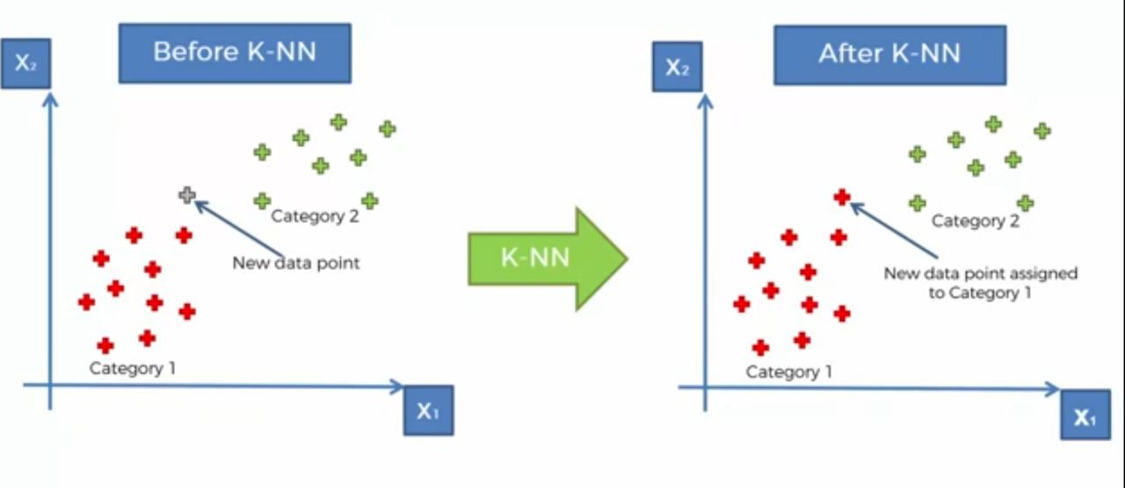
FIg No 2 : Working of KNN

Slide 8
Support Vector Machine
A Support Vector Machine (SVM) is a discriminative classifier defined by a separating hyperplane.
After plotting of data from the training dataset, the SVM determines the Maximum Margin Hyperplane which will be used to classify genes from the testing dataset into different functional classes based on which side of the hyperplane the gene value lies.

Slide 9
Decision Tree Classifier
Decision Tree builds classification models in form of a tree structure.
In our model, every gene from the test data traverses the decision tree created while training period and depending on the value of its attributes, it reaches a certain leaf node, which is finally it’s predicted function class.

Slide 10
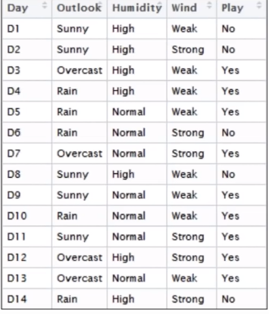
How Decision Tree Works
We have a dataset consisting of
Weather information of last 14 days
Whether match was played or not on that particular day
Now using decision tree we need to predict whether game will happen if the weather condition is
Outlook,Humidity or Wind

Slide 11
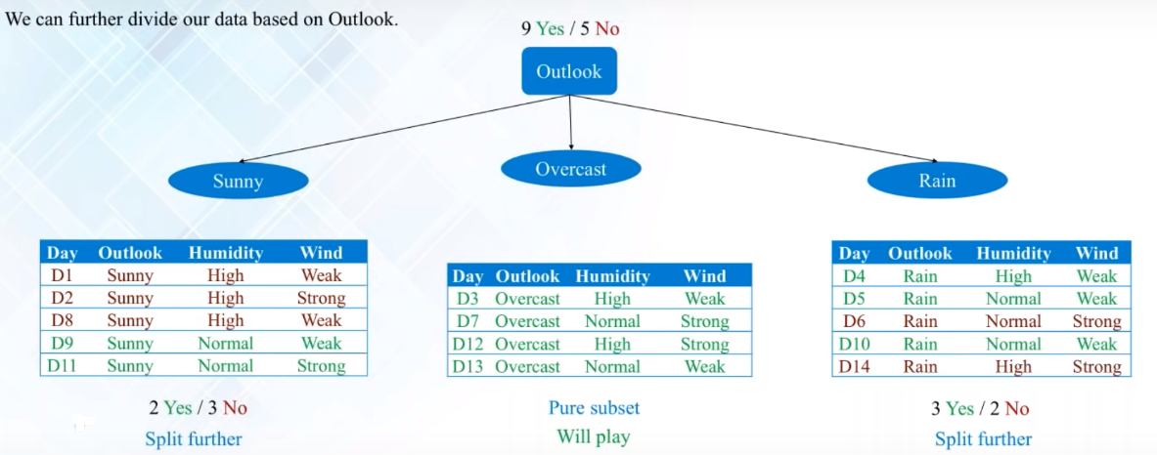
Decision Tree

Slide 12
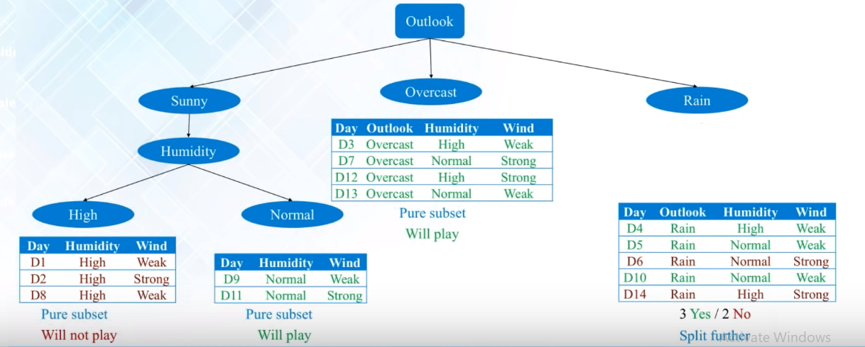

Slide 13
Random Forest
Random forest builds multiple decision trees and merges them together to get a more accurate and stable prediction.
Random k data points from the training set are chosen.
A decision tree is built with respect to these k data points.
Repeat the above steps for n number of times which will result in n number of decision trees.
Now, for every gene in our testing dataset, each of the decision tree will predict the functional class it belongs to. The final prediction will be that of the majority vote.

Slide 14
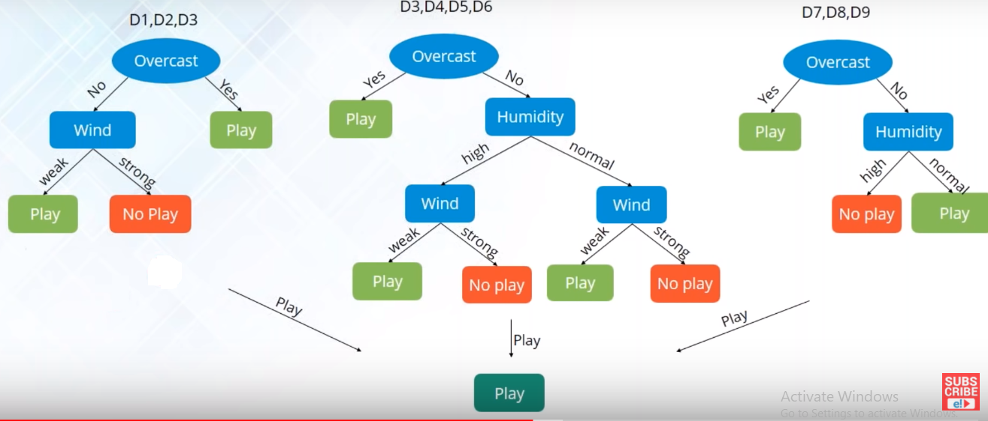
For Example

Slide 15
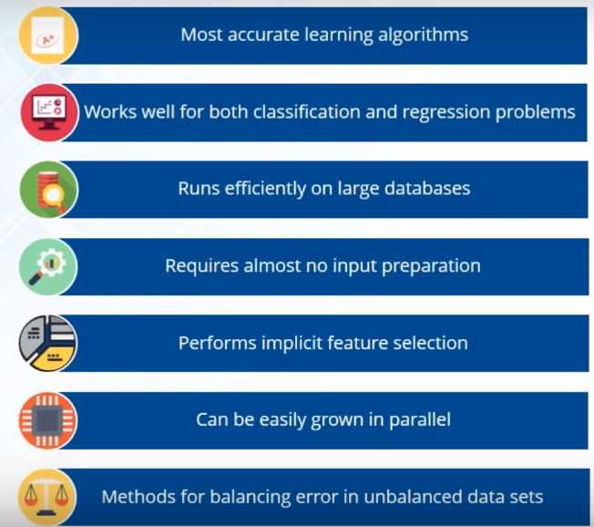
Features of Random Forest Algorithm

Slide 16
Implementation Results
<number>
Classification Model | Accuracy Score
K-NN | 0.5
SVM | 0.451
Decision Tree | 0.342
Random Forest | 0.491
Table 1: Comparison of Accuracy Scores of different Classification Models

Slide 17
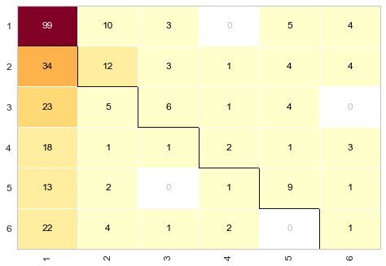
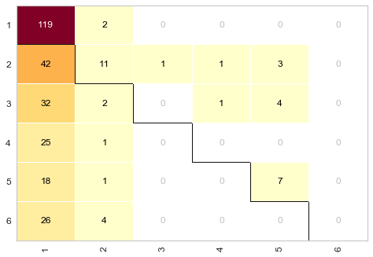
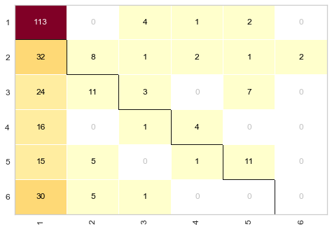
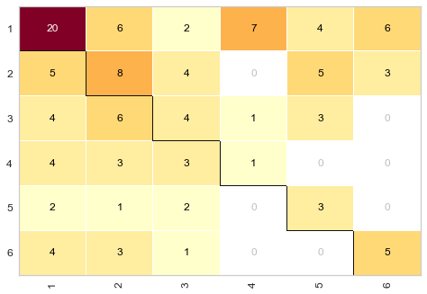
Confusion
Matrices
Fig 3: k-NN
Fig 4: SVM
Fig 5: Decision Tree
Fig 6: Random Forest

Slide 18
CONCLUSION
Following this study, we observed that various classification techniques are currently used to develop an appropriate methodology for effective gene expression data classification.
After studying 3 classification techniques, we can conclude that for the dataset that was used, k-NN performed the best.

Slide 19
REFERENCES
[1] P. C. H. Ma and K. C. C. Chan, "Incremental Fuzzy Mining of Gene Expression Data for Gene Function Prediction," in IEEE Transactions on Biomedical Engineering, vol. 58, no. 5, pp. 1246-1252, May 2011. doi: 10.1109/TBME.2010.2047724
[2] M. Aouf, L. Liyanage and S. Hansen, "Critical Review of Data Mining Techniques for Gene Expression Analysis," 2008 4th International Conference on Information and Automation for Sustainability, Colombo, 2008, pp. 367-371. doi: 10.1109/ICIAFS.2008.4783954
[3] Ramaswamy S, Tamayo P, Rifkin R, Mukherjee S, Yeang CH, Angelo M, Ladd C, Reich M, Latulippe E, Mesirov JP, et al. Multiclass cancer diagnosis using tumor gene expression signatures. Proc Natl Acad Sci USA. 2001;98:15149–15154. doi: 10.1073/pnas.211566398.
[4] Dudoit S, Fridlyand J, Speed TP. Comparison of discrimination methods for the classification of tumors using gene expression data. J Am Stat Assoc. 2002;97:77–87. doi: 10.1198/016214502753479248.
[5] Spellman Dataset- http://genome-www.stanford.edu/clustering/ , last cited on 27/03/2019.

Slide 20
THANK YOU !

