Slide 1

Cyclistic Bike’s Usage Analysis by Casual Riders and Member Riders
Created By:
Isha Dubey
Updated on:
March 12, 2022

Slide 2
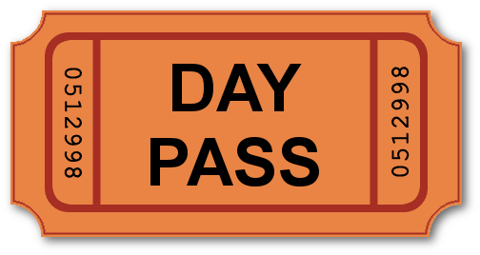

Knowing Casual and Member Riders
Casual Riders:
Customers purchasing single-day passes
Member Riders :
Customers purchasing annual membership

Slide 3
Things to do
Identify Usage Pattern of:
Casual Riders
Member Riders
Compare Casual Rider Pattern and Member Rider Pattern

Slide 4
About the Data
Data Source: Motivate International Inc.
Time Frame : January,2021 to January,2022

Slide 5
Details in data
The following details of riders are observed in the data:
Riding id
Starting Station Id and Name
Ending Station Id and Name
Ride’s Starting and ending date and time of ride
Starting and ending station’s latitude and longitude details

Slide 6
What we observed and calculated?
Observation:
Riding id
Ride’s Starting and Ending time.
Calculation:
Ride length for every riding id from January,2021 to January,2022
Mode for day of the week.
Average ride length for the member and casual riders,
Average ride length for riders based on bike type

Slide 7
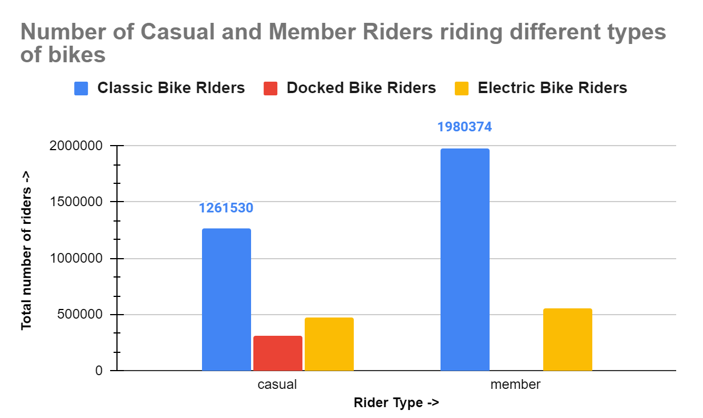
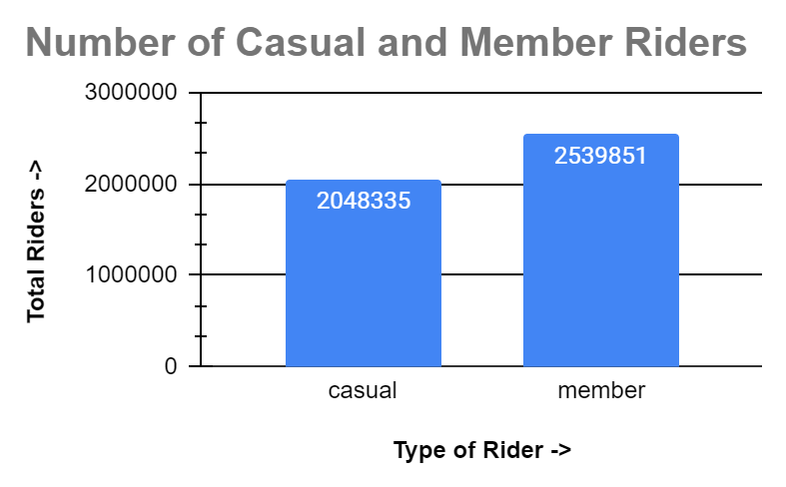
Analysis Result 1:
Count of bikers
(Chart 1a) (Chart 1b)

Slide 8
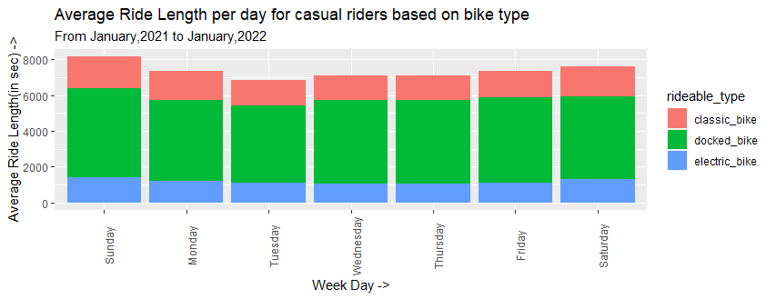
Analysis Result 1:
Usage Pattern of Casual Riders
(Chart 2)
Bike Type Maximum Ride Length (in sec) Day of ride
Classic_bike 1760.921 Sunday
Docked_bike 4986.416 Sunday
Electric_bike 1410.833 Sunday

Slide 9
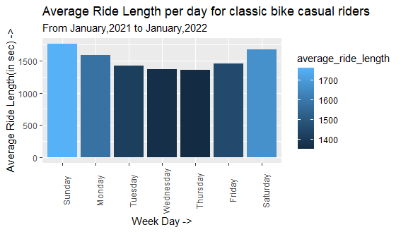
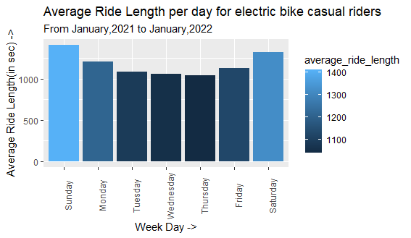
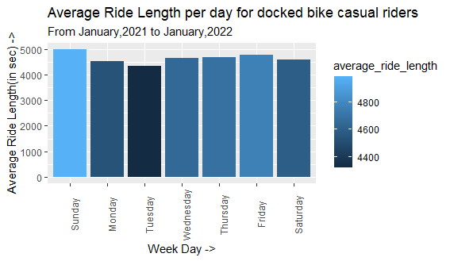
Analysis Result 1 Continued…
Usage Pattern Casual riders
(Chart 3 a) (Chart 3 b)
Maximum Usage:
Classic Bike 1700 sec
Docked Bike 4800 sec
Electric Bike 1400 sec
(Chart 3 c)

Slide 10
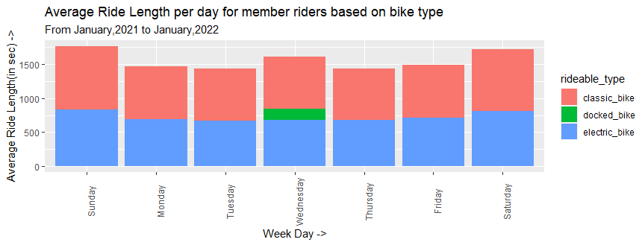
Analysis Result 2:
Usage Pattern of Member Riders
(Chart 4)
Bike Type Maximum Ride Length (in sec) Day of ride
Classic_bike 929.5961 Sunday
Docked_bike 158 Wednesday
Electric_bike 835.2217 Sunday

Slide 11
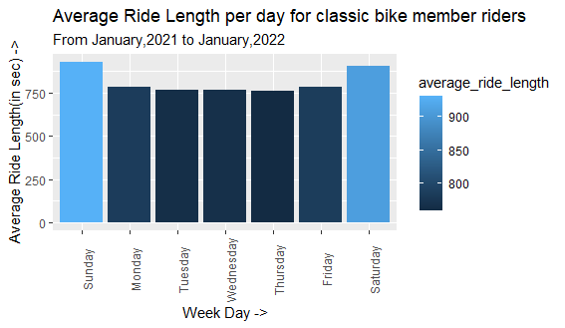
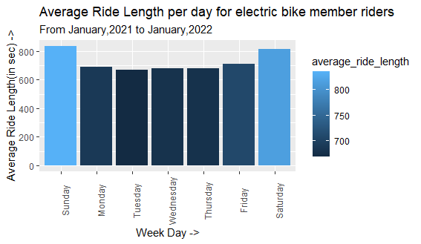
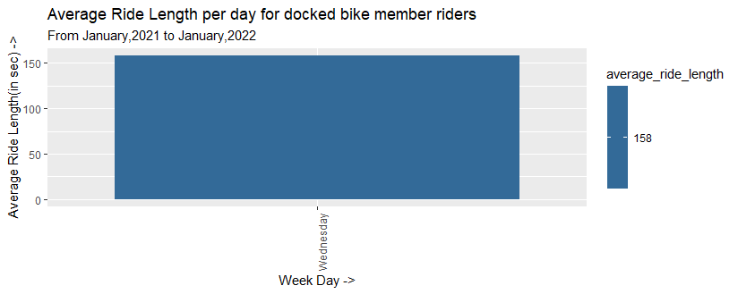
Analysis Result 2 Continued…..
Usage Pattern of Member Riders
(Chart 5a) (Chart 5b)
Maximum Usage:
Classic Bike 900 sec
Docked Bike 158 sec
Electric Bike 800 sec
(Chart 5c)

Slide 12
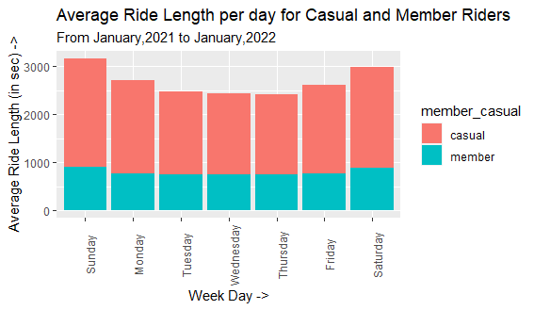
Analysis Result 3:
Casual Vs Member Rider Pattern
Casual Riders
Minimum Ride Length | 1680.6377 sec | Sunday
Maximum Ride Length | 2256.1716 sec | Thursday
Member Riders
Minimum Ride Length | 741.2177 sec | Sunday
Maximum Ride Length | 911.6555 sec | Thursday
(Chart 6)

Slide 13
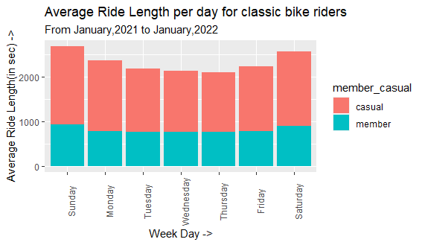
Analysis Result 3 Continued…
Casual Vs Member Rider (Riding Classic Bike):
Classic BIke Casual Riders :
Maximum Ride Length | 1,760.92 sec | Sunday
Minimum Ride Length | 784.67 sec | Tuesday
Classic BIke Member Riders :
Maximum Ride Length | 929.60 sec | Sunday
Minimum Ride Length | 759.92 sec | Thursday
(Chart 7)

Slide 14
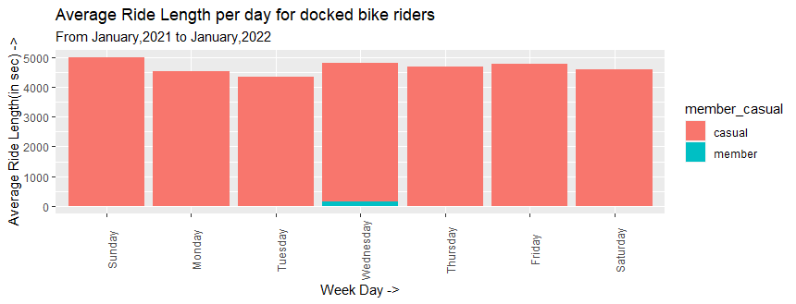
Analysis Result 3 Continued…
Casual Vs Member Rider (Riding Docked Bike):
Docked BIke Casual Riders :
Maximum Ride Length | 4986.416 | Sunday
Minimum Ride Length | 4322.297 | Tuesday
Docked BIke Member Riders :
Maximum Ride Length | 4687.892 | Wednesday
Minimum Ride Length | 4687.892 | Wednesday
(Chart 8)

Slide 15
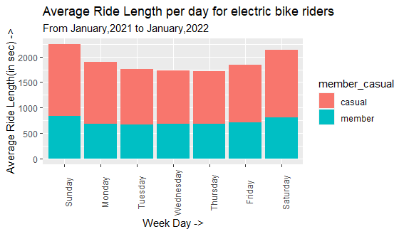
Analysis Result 3 Continued…
Casual Vs Member Rider (Riding Electric Bike):
Electric BIke Casual Riders :
Maximum Ride Length | 1410.8334 | Sunday
Minimum Ride Length | 1040.7319 | Tuesday
Docked BIke Member Riders :
Maximum Ride Length | 835.2217 | Sunday
Minimum Ride Length | 669.4227 | Thursday
(Chart 9)

Slide 16
Conclusion:
Number of Member Riders > Number of Casual Rider
Preference for type of bike of both Member and casual riders is as follows:
Classic Bike (Highest)
Electric Bike
Docked Bike (Lowest)
Casual Riders prefer docked bikes over classic bikes for long ride length rides.
Both Casual and Member Riders rides more on weekends especially Sunday.
Average ride length for Casual riders using any kind of bike is more as compared to Average ride length for Member riders using any kind of bike

Slide 17
Recommendation:
Casual Riders may buy annual membership if there are discounts/offers/schemes on annual membership based on the following:
ride length, since casual riders rides longer distances
docked bikes, since they use docked bikes for larger distances
Weekend, since they ride more during weekends
Number of entries, since they may be coming less number of times because of charges.

