Slide 1


Glucose Guru: A Machine Learning Project for Diabetes Detection
Glucose Guru is a machine learning project that aims to accurately detect detect whether an individual has diabetes using the Pima Indians dataset. dataset. The project involves data preprocessing, balancing, cross validation and training a variety of models to find the best performing one.
by Isha Kaushik

Slide 2
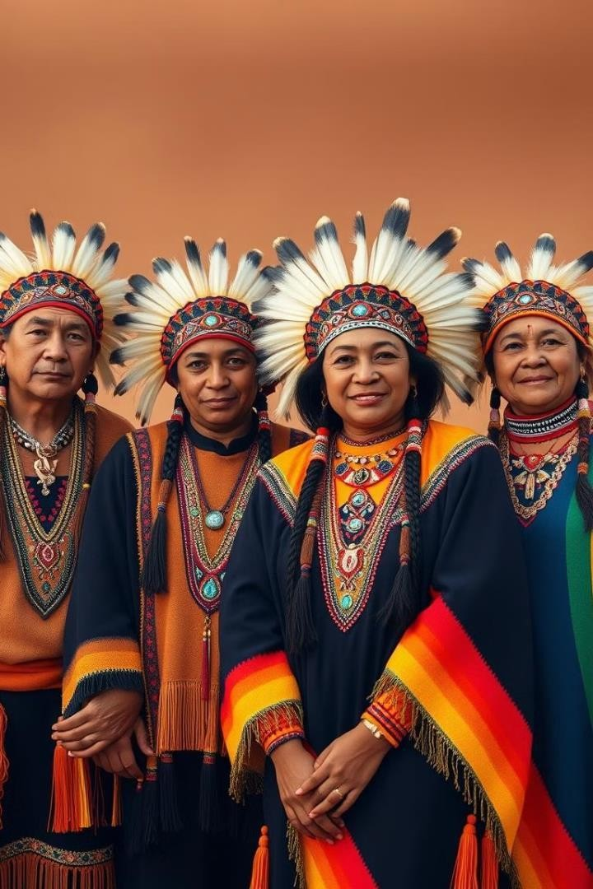
Introduction to the Pima Indians Dataset
1
Diabetes Prevalence
2
Predictive Features
The dataset contains 768
records and no missing values. All individuals in the dataset are females of Pima Indian heritage aged 21 or older.It is slightly imbalanced, with approximately 65% non-
diabetic (0) and 35% diabetic
(1) samples.
Clean and Preprocessed
The dataset contains eight clinical features such as glucose concentration, blood pressure, BMI, insulin levels, age, and more, which serve as predictors for diabetes diagnosis.
3
The dataset is well-organised, with no missing values, and includes features measured quantitatively, ensuring reliability for machine learning tasks.

Slide 3
Data Preprocessing and Visualisation
Data Inspecting
Balancing Dataset
Visualisation
Upon inspecting the dataset, no duplicate or null values were identified. Additionally, no outliers were detected.
The dataset was imbalanced, comprising 65% non-diabetic patients and 35% diabetic patients. To address this imbalance, SMOTE (Synthetic Minority Oversampling Technique) was applied to create a balanced dataset.
Exploratory data analysis was conducted using various visualisation techniques to gain insights.

Slide 4
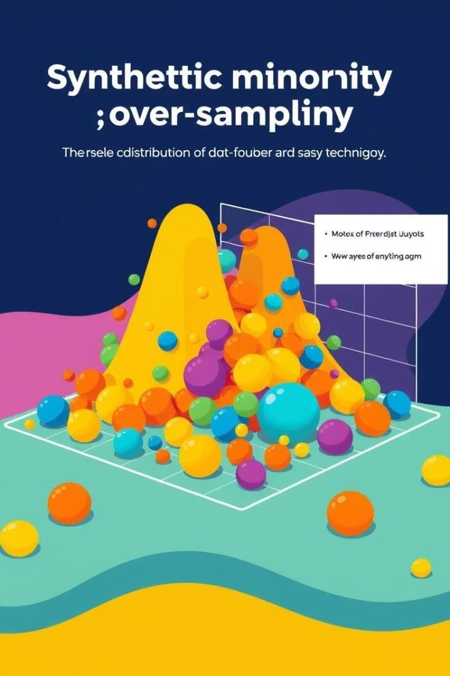
SMOTE Technique for Dataset Balancing
1
Imbalanced Dataset
The original dataset had a significant class imbalance, with fewer instances of the positive (diabetes) class.
2
SMOTE Technique
SMOTE was used to generate synthetic examples of the minority class, balancing the dataset.
3
Improved Performance
The balanced dataset led to improved performance of the machine learning models.

Slide 5

Evaluating 7 Machine Learning Models
1
Logistic Regression
2
Naive Bayes
A classic model for binary classification tasks.
A probabilistic model with strong assumptions about feature independence.
3
SVM
4
KNN
A powerful model that finds the optimal hyperplane to separate classes.
A non-parametric model that classifies based on the nearest neighbours.
5
XGBoost
6
Random Forest
A powerful gradient boosting algorithm that optimises decision trees sequentially to minimise errors and improve performance.
An ensemble of decision trees that combines their outputs to improve accuracy and reduce overfitting.
7
Decision Trees
A simple and interpretable model that splits data into subsets based on feature thresholds to make predictions.

Slide 6





Accuracy, Precision, Recall & F1 Score
Logistic Regression
Naive Bayes
Accuracy- 70%
Accuracy- 72%
Precision- 0.57
Precision- 0.58
Recall- 0.72
Recall- 0.72
F1 Score- 0.64
F1 Score- 0.65
SVM
KNN
Accuracy- 69%
Accuracy- 66%
Precision- 0.55
Precision- 0.52
Recall- 0.69
Recall- 0.69
F1 Score- 0.61
F1 Score- 0.59

Slide 7
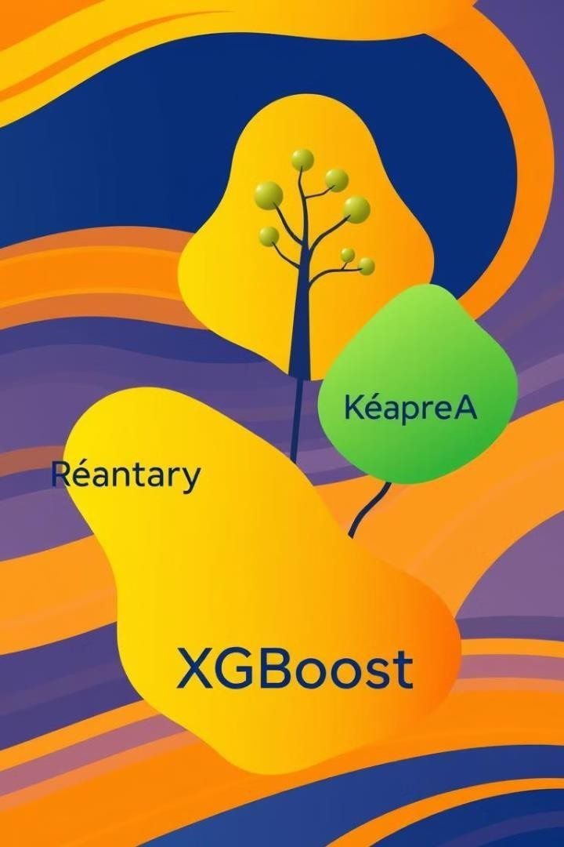
Accuracy, Precision, Recall & F1 Score
XGBoost
Random Forest
Accuracy- 71%
Accuracy- 75%
Precision- 0.57
Precision- 0.63
Recall- 0.72
Recall- 0.76
F1 Score- 0.64
F1 Score- 0.69
Decision Trees
Accuracy- 68%
Precision- 0.55
Recall- 0.6
F1 Score- 0.57

Slide 8
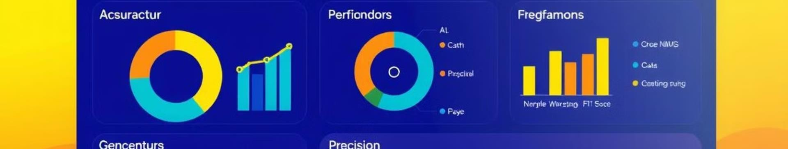
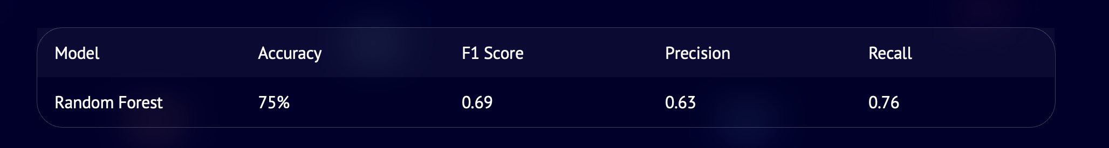
Conclusion: Random Forest as the Best Performing Model
Random Forest 75% 0.69 0.63 0.76
The Random Forest model along with SMOTE balancing technique emerged as the best performer, achieving an accuracy of 75%, an F1 score of 0.69, a precision of 0.63 and a recall of 0.76. This demonstrates the effectiveness of the Random Forest algorithm in detecting diabetes using the Pima Indians dataset.

Slide 9

Future Scope of Glucose Guru
Improved Model Accuracy
By implementing advanced deep learning architectures like neural networks and attention mechanisms, we aim to capture subtle patterns in patient data that traditional models might miss, potentially pushing accuracy above 85%.
Multi-Disease Prediction
We envision expanding Glucose Guru into a comprehensive health prediction platform that can assess risks for multiple chronic conditions simultaneously. By integrating validated datasets for conditions like cardiovascular disease, breast cancer, and kidney disease, we can provide users with a holistic health ri sk assessment.
Global Dataset Utilisation
To overcome potential demographic biases, we plan to incorporate diverse datasets from Asia, Africa, Europe, and the Americas. This global approach will ensure Glucose Guru can provide accurate predictions across different ethnic backgrounds, age groups, and lifestyles.
Continuous Learning
Our innovative feedback loop system will allow Glucose Guru to evolve dynamically. By analyzing user outcomes and incorporating new medical research data, the model will continuously refine its predictions, adapting to emerging health trends and population changes.

Slide 10
Thank You
Name: Isha Kaushik
Enrollment no.- E23CSEU0920

