Slide 1
Unveiling the Future:
SPSS Analysis Forecasts Diabetes Risk Factors

Slide 2
Diabetes infographic
Main types
Organs affected
Prevention
Type 1 diabetes, characterized by insufficient insulin production, and Type 2 diabetes, marked by insulin resistance and inadequate insulin utilization.
Prevention of diabetes involves adopting a healthy lifestyle with regular exercise, balanced diet, and weight management.
Symptoms
Treatment
Frequent urination, increased thirst, and unexplained weight loss are common symptoms of diabetes.
The treatment of diabetes typically involves lifestyle modifications, medication management, and regular monitoring of blood glucose levels.

Slide 3
About project
In this project, we delve into the intricate realm of diabetes prediction, utilizing advanced statistical techniques within IBM SPSS Statistics. Our journey begins with meticulous data preprocessing, where we meticulously replace missing values and meticulously curate the dataset by removing unwanted columns. With a refined dataset at hand, our focus shifts towards conducting detailed exploratory data analysis (EDA), unearthing valuable insights into the complex interplay of variables contributing to diabetes onset.

Slide 4
Diabetes infographic
77 M
TREATMENT
adults in India are currently living with diabetes
lifestyle modifications (diet, exercise), oral medications, insulin therapy, and regular monitoring of blood glucose levels
Diabetes affects individuals of all age groups, but prevalence increases with age.
unhealthy diet, sedentary lifestyle, obesity, genetic predisposition, and urbanization.
AREAS AFFECTED
Access to healthcare services and affordability of medications
Kidney
Heart
Sight
Brain
Feet
Ears

Slide 5
Steps
2
4
Data quality check
EDA
Checking duplicate ,missing values
Draw graphs
1
3
5
Data loading
Data cleaning
Training & testing
Load the dataset
Filling missing values,remove duplicates,etc.
Select model and aaply some tests

Slide 6
Data loading
Loading data into IBM SPSS Statistics is a fundamental step in conducting statistical analysis. This process involves importing datasets from various sources, such as Excel spreadsheets, CSV files, or databases, into the SPSS environment for further manipulation and analysis. To load data into SPSS, users typically navigate to the "File" menu, select "Open," and choose the appropriate data file from their computer or network. SPSS supports a wide range of file formats, making it versatile for importing data from different sources. Upon loading the data, SPSS automatically detects variable types, labels, and values, facilitating seamless data handling. Additionally, SPSS provides options for data transformation, cleaning, and restructuring, enabling users to prepare their data for analysis efficiently. Overall, the data loading process in SPSS is user-friendly and intuitive, empowering researchers and analysts to work with their datasets effectively and conduct robust statistical analyses.

Slide 7
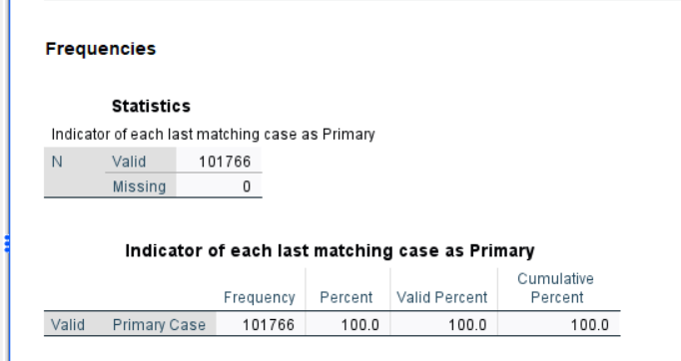
Data Quality checks
Data quality check is a crucial aspect of any statistical analysis, ensuring the reliability and validity of the findings. In IBM SPSS Statistics, data quality checks involve inspecting the dataset for inconsistencies, errors, missing values, and outliers. Users can utilize various tools and techniques within SPSS to assess data quality, such as summary statistics, frequency distributions, and graphical representations. Additionally, SPSS offers functionalities for identifying and handling missing data, detecting outliers, and assessing data distributions. By conducting thorough data quality checks, researchers can identify and rectify any issues in the dataset, thereby enhancing the integrity and accuracy of their analysis results. This proactive approach to data quality management in SPSS enables researchers to make informed decisions and draw meaningful conclusions from their data.

Slide 8
Data preprocessing
Data Preprocessing: Data preprocessing lays the foundation for our analysis, ensuring the integrity and quality of our dataset. We meticulously handle missing values, employing robust techniques such as mean imputation or advanced algorithms to fill in the gaps. Additionally, we conscientiously eliminate redundant or irrelevant columns that do not contribute meaningfully to our predictive model. This rigorous preprocessing sets the stage for robust and reliable analysis.
DROPPING ALL UNNECESSARY COLUMNS.

Slide 9
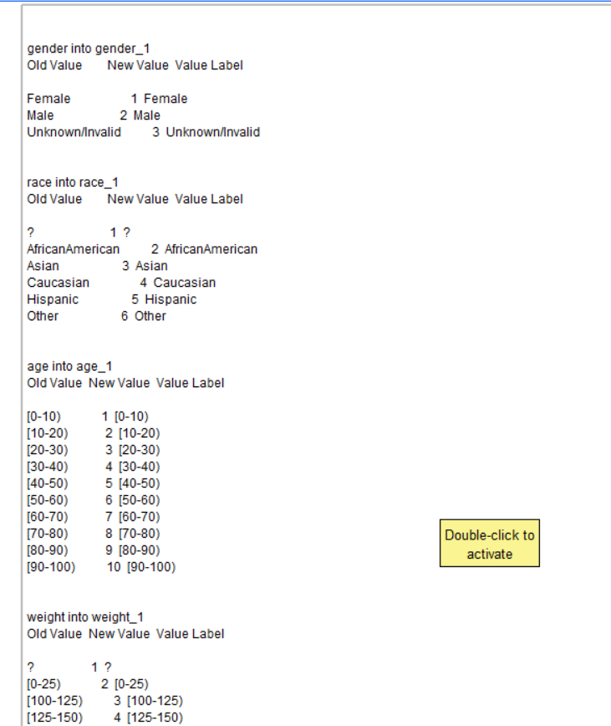
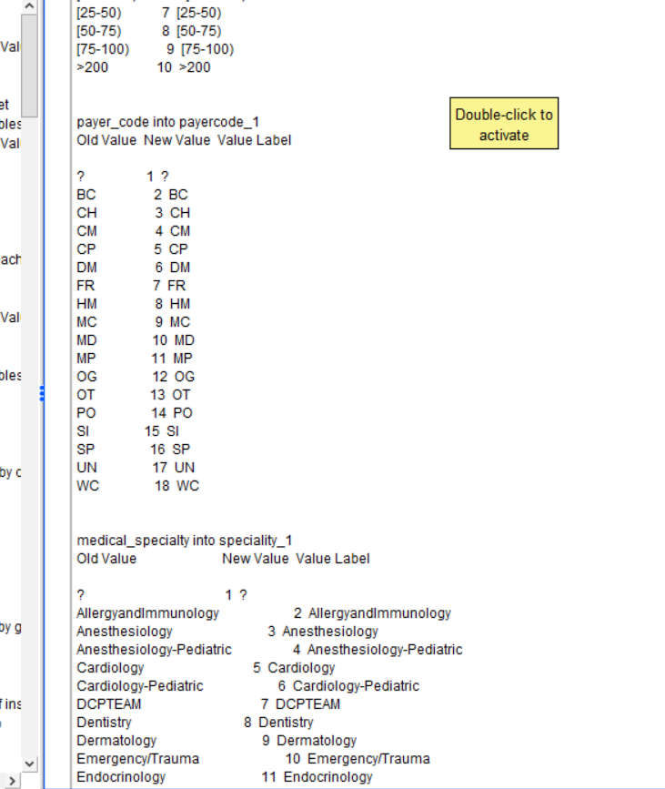
ENCODING

Slide 10
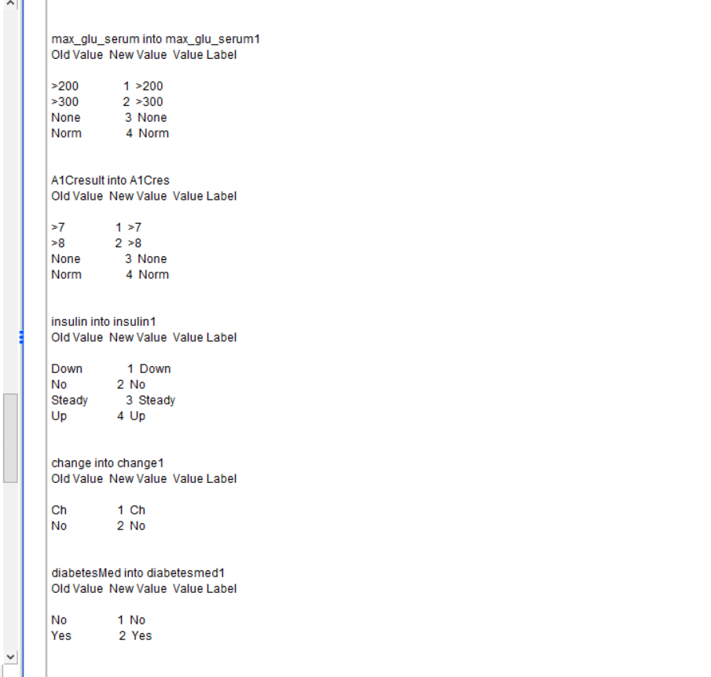

Slide 11
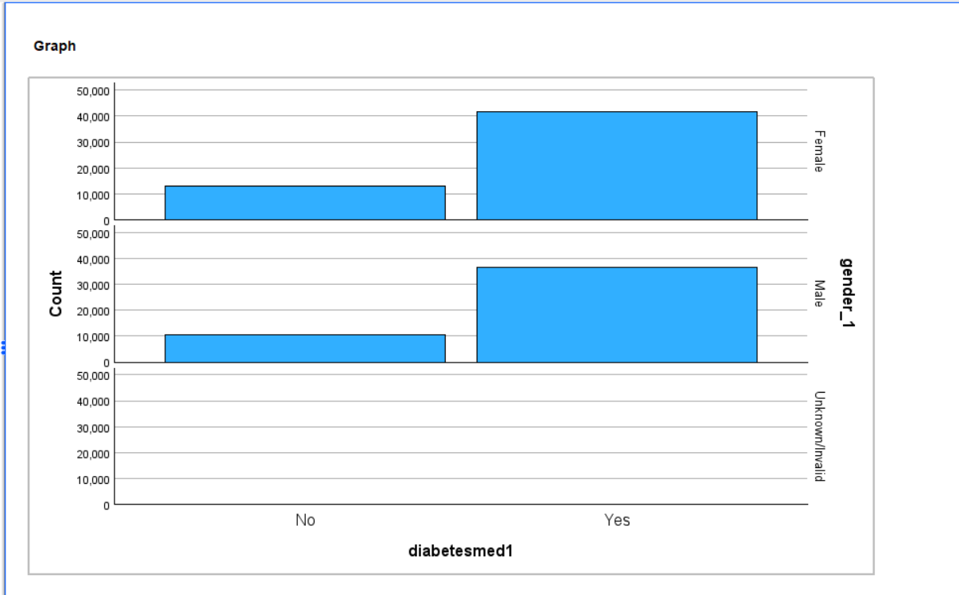
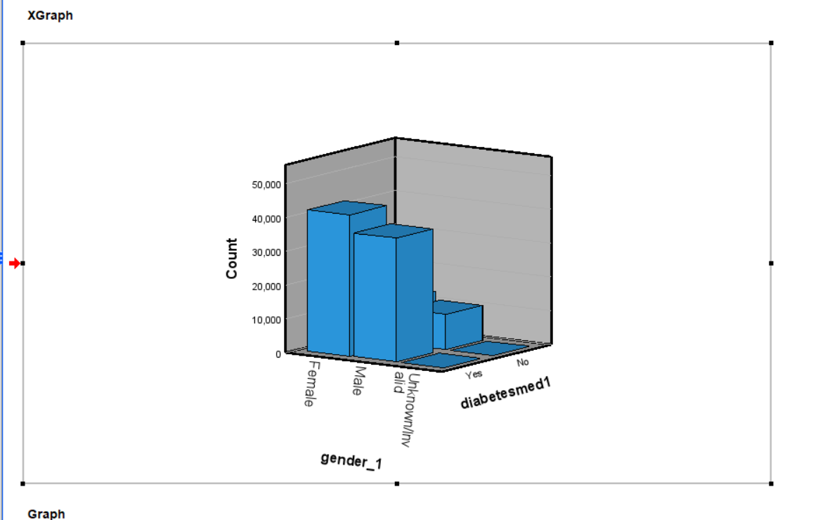
EDA
BAR PLOT

Slide 12
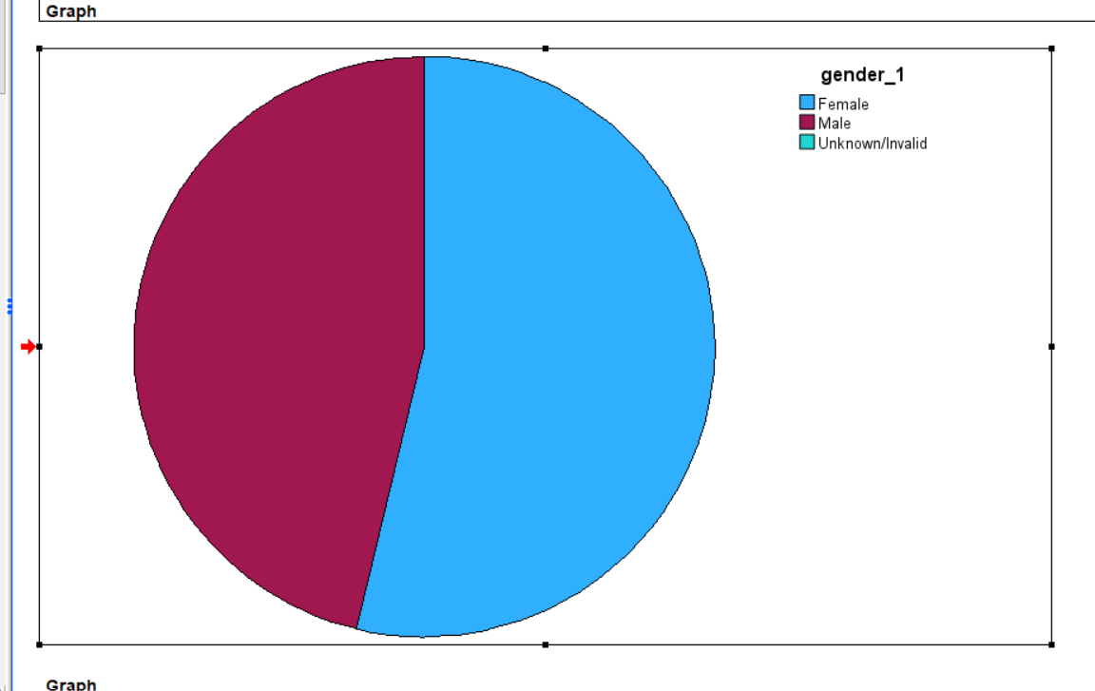
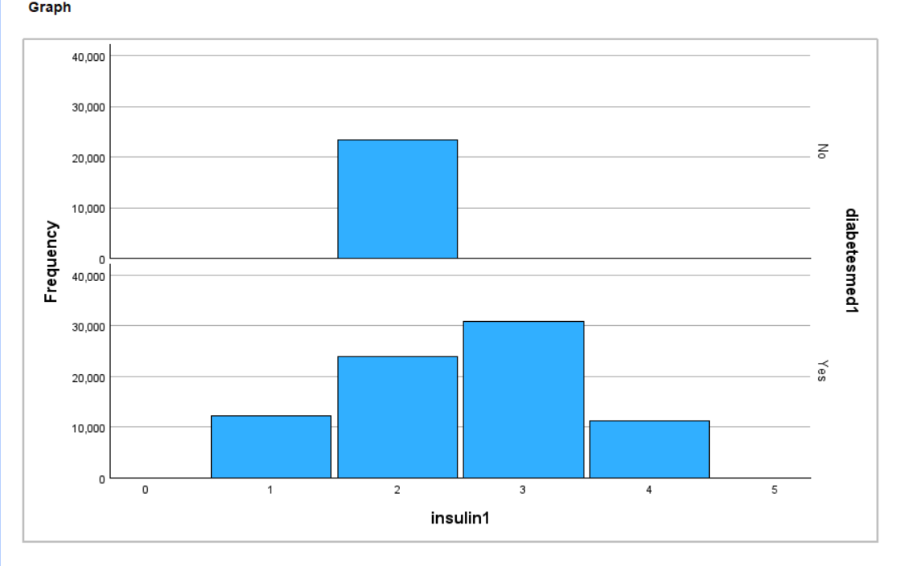
PIE CHART
HISTOGRAM

Slide 13
14%
Exploratory Data Analysis (EDA):
With a meticulously curated dataset, we embark on an enlightening journey through exploratory data analysis. Through visually captivating visualizations, we unravel intricate patterns, correlations, and distributions within our data. From insightful histograms and scatter plots to illuminating heatmaps and correlation matrices, each visualization tells a compelling story, shedding light on the underlying dynamics of diabetes prediction. We meticulously examine the relationships between predictor variables and the target variable, discerning key insights that guide our subsequent analysis.
33%
25%
28%

Slide 14
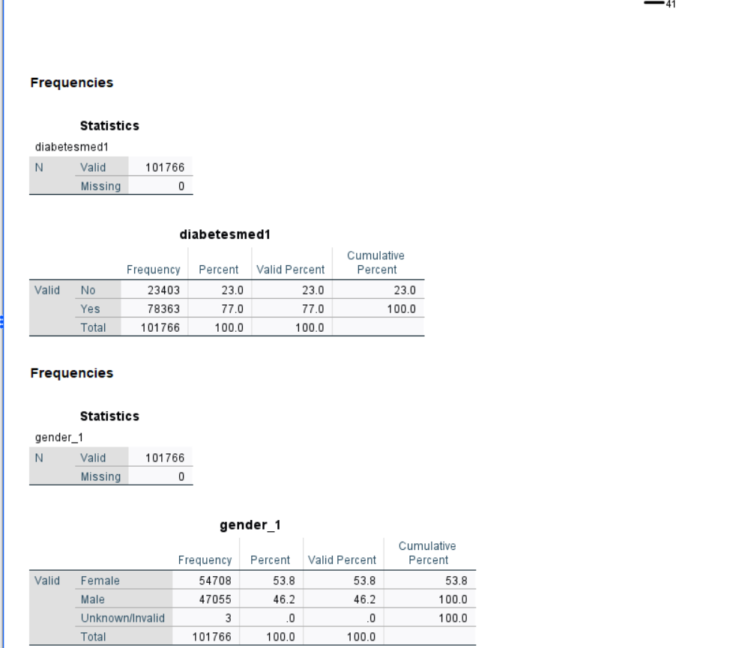

Slide 15
Inferential statistics
Inferential statistics involves using sample data to make inferences or predictions about a larger population, testing hypotheses, and drawing conclusions based on probability theory and statistical principles.

Slide 16
This statistical analysis, conducted using SPSS, focuses on predicting the number of medications a patient might require based on a dataset with 101,766 entries. The mean number of medications predicted per patient is approximately 16.022, with a standard deviation of 8.1276 and a standard error of the mean of 0.0255.
The one-sample test conducted with a test value of 0 reveals a statistically significant result (p < .001), indicating that the mean difference in predicted number of medications is significantly different from zero. This suggests that the model is effective in estimating the number of medications needed for patients.
Furthermore, the effect size measures, namely Cohen's d and Hedges' correction, provide insights into the magnitude of the difference observed. Cohen's d, which utilizes the sample standard deviation, yields a value of approximately 1.971, indicating a substantial effect size. Hedges' correction, which adjusts for potential bias, also yields a similar value of approximately 1.971. Both measures provide confidence intervals suggesting the reliability of the effect size estimates.
Overall, this analysis demonstrates the efficacy of the predictive model in estimating the number of medications required by patients, with a significant effect size indicating practical significance in clinical settings.
Prevention
Weight
Healthy
Exercise
Treatment
Insuline
Medicine
Control

Slide 17
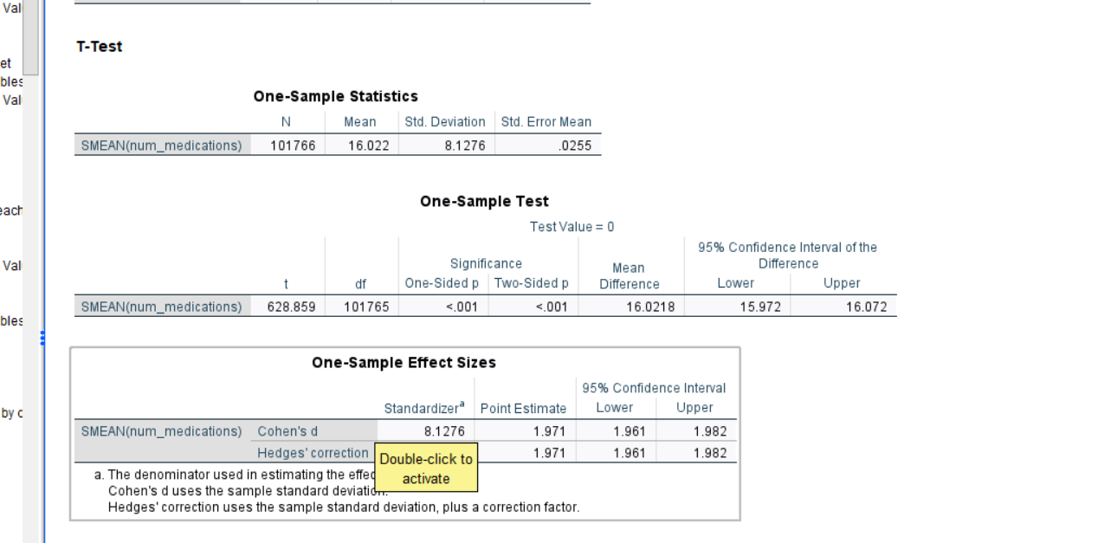
One-Sample T test

Slide 18
This statistical analysis, conducted using SPSS, focuses on predicting the number of medications a patient might require based on a dataset with 101,766 entries. The mean number of medications predicted per patient is approximately 16.022, with a standard deviation of 8.1276 and a standard error of the mean of 0.0255.
The one-sample test conducted with a test value of 0 reveals a statistically significant result (p < .001), indicating that the mean difference in predicted number of medications is significantly different from zero. This suggests that the model is effective in estimating the number of medications needed for patients.
Furthermore, the effect size measures, namely Cohen's d and Hedges' correction, provide insights into the magnitude of the difference observed. Cohen's d, which utilizes the sample standard deviation, yields a value of approximately 1.971, indicating a substantial effect size. Hedges' correction, which adjusts for potential bias, also yields a similar value of approximately 1.971. Both measures provide confidence intervals suggesting the reliability of the effect size estimates.
Overall, this analysis demonstrates the efficacy of the predictive model in estimating the number of medications required by patients, with a significant effect size indicating practical significance in clinical settings.

Slide 19
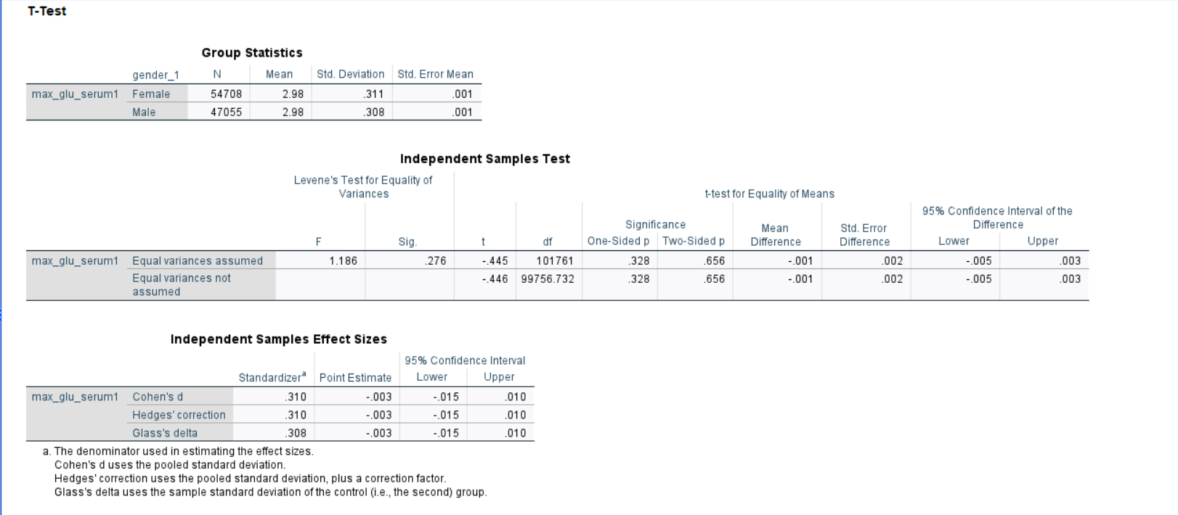
Independent Sample testing

Slide 20
This statistical analysis, also conducted using SPSS, compares the maximum glucose serum levels (max_glu_serum1) between male and female groups. The group statistics show that the mean max_glu_serum1 level is approximately 2.98 for both females and males, with slight differences in standard deviations and standard errors.
The independent samples t-test is used to assess whether there is a statistically significant difference in max_glu_serum1 levels between genders. The Levene's Test for Equality of Variances indicates that the assumption of equal variances is met (F = 1.186, p = .276). Therefore, the equal variances assumed row in the t-test results is considered.
The t-test results show that there is no significant difference in max_glu_serum1 levels between males and females (t = -0.445, df = 101761, p = .656). The mean difference is negligible, with a confidence interval ranging from -0.001 to 0.002.
The effect size measures, including Cohen's d, Hedges' correction, and Glass's delta, provide further insight into the magnitude of the observed differences. These measures suggest that the effect size is small, with values around 0.31 and confidence intervals close to zero.
In summary, the analysis indicates that there is no significant difference in max_glu_serum1 levels between male and female groups. While there may be slight variations, these differences are not practically significant according to the effect size measures.

Slide 21
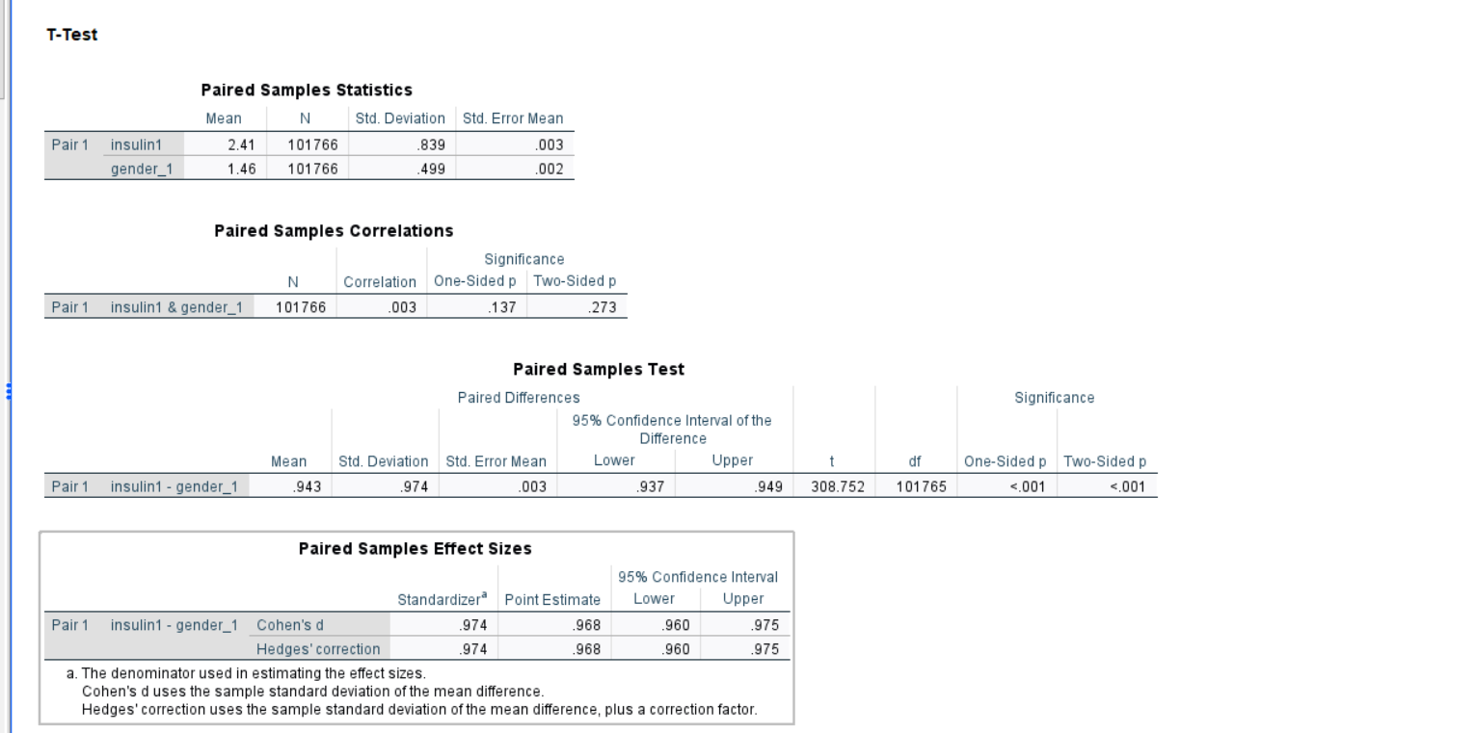
Paired T-Test

Slide 22
This paired samples analysis, conducted using SPSS, compares the levels of insulin1 and gender_1 within the same dataset.
The paired samples statistics show that the mean level of insulin1 is approximately 2.41, with a standard deviation of 0.839, while the mean level of gender_1 is approximately 1.46, with a standard deviation of 0.499. These statistics provide insights into the central tendency and variability of the variables being compared.
The paired samples correlations indicate a weak correlation between insulin1 and gender_1 (r = 0.003, p = .137). This suggests that there is a minimal association between the levels of insulin and gender in the dataset.
The paired samples test assesses whether there is a significant difference between the levels of insulin1 and gender_1. The results reveal a highly significant difference (p < .001), with a mean difference of approximately 0.943. The confidence interval for the difference ranges from 0.937 to 0.949, indicating a narrow range within which the true difference between the variables lies.
The effect size measures, including Cohen's d and Hedges' correction, provide insights into the magnitude of the observed difference. Both measures yield similar values of approximately 0.974, indicating a large effect size. The confidence intervals for the effect sizes are narrow, suggesting high precision in estimating the magnitude of the effect.
In summary, this analysis indicates a significant difference between the levels of insulin1 and gender_1 within the dataset, with insulin1 showing substantially higher levels compared to gender_1. Despite the weak correlation, the effect size measures highlight the practical significance of the observed difference.

Slide 23
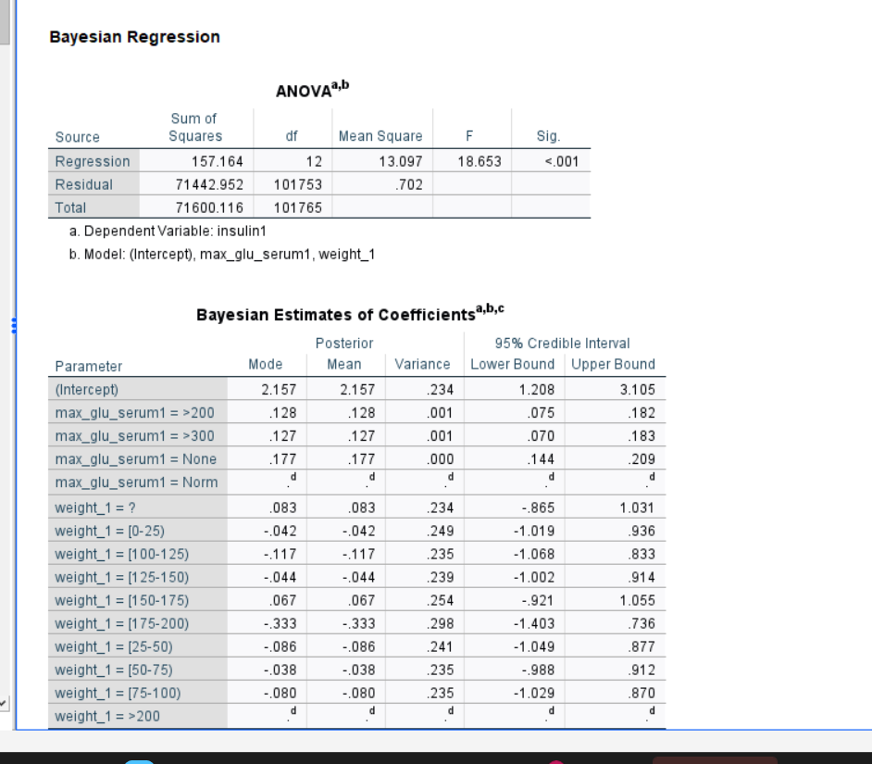
Model selection
This analysis seems to be an ANOVA (Analysis of Variance) and Bayesian estimation performed on a dataset related to diabetes medication (diabetesmed1) and insulin levels (insulin1), with predictors including max_glu_serum1 and weight_1.
ANOVA Results:
The ANOVA table indicates a significant effect of the predictors on the dependent variable (diabetesmed1), with a significant regression (F = 18.653, p < .001).
The model explains a significant portion of the variance in the dependent variable, as evidenced by the R-squared value of 0.070.
Bayesian Estimates of Coefficients:
Bayesian estimation provides estimates of coefficients along with their credible intervals.
For example, the coefficient for (Intercept) is estimated to be approximately 2.157, with a credible interval ranging from 1.208 to 3.105.
Similarly, coefficients for different levels of max_glu_serum1 and weight_1 categories are estimated, providing insights into their effects on the dependent variable.

Slide 24
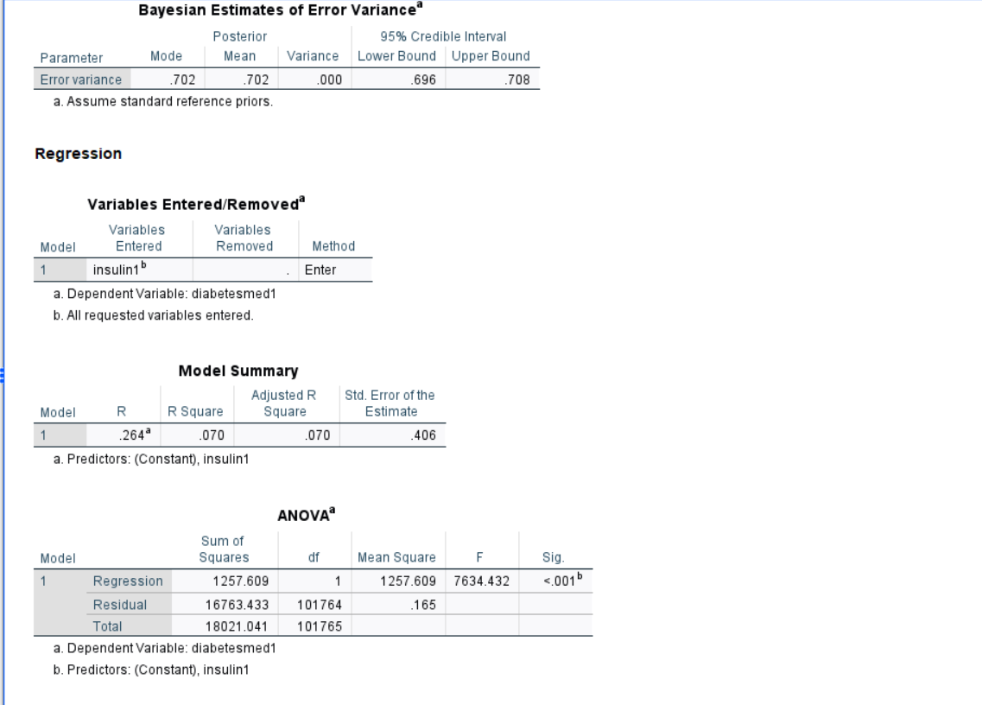
Bayesian Estimates of Error Variance:
This section provides estimates of error variance, with a mode and mean value of approximately 0.702 and credible interval ranging from 0.696 to 0.708.
Model Summary:
The model summary provides information about the overall fit of the regression model.
The R-squared value indicates that the model accounts for about 7% of the variance in the dependent variable.

Slide 25
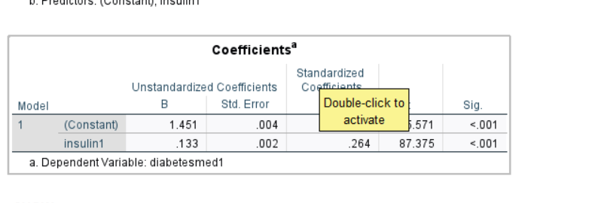
Coefficients:
This section presents unstandardized and standardized coefficients along with their significance levels.
For example, the coefficient for insulin1 is estimated to be approximately 0.133, with a high significance level (p < .001).
Overall, this analysis suggests that insulin levels significantly impact diabetes medication usage, as indicated by the ANOVA results and coefficients from the regression model. Bayesian estimation provides additional insights into the coefficients and their uncertainties, enhancing the interpretation of the results.

Slide 26
THANK YOU!!

