Slide 1
Wi-Fi Security

Slide 2
WEP ( Wired Equivalent Privacy )
Introduced in 1997 it was the first attempt at wireless protection.
WEP encrypts traffic using a 64- or 128-bit key in hexadecimal.
WEP’s main goals was to prevent Man-in-the-Middle attacks.
The Wi-Fi Alliance officially retired WEP in 2004.
It is still sometimes in use either because network administrators haven’t changed the default security on their wireless routers or because devices are too old to support newer encryption methods like WPA.

Slide 3
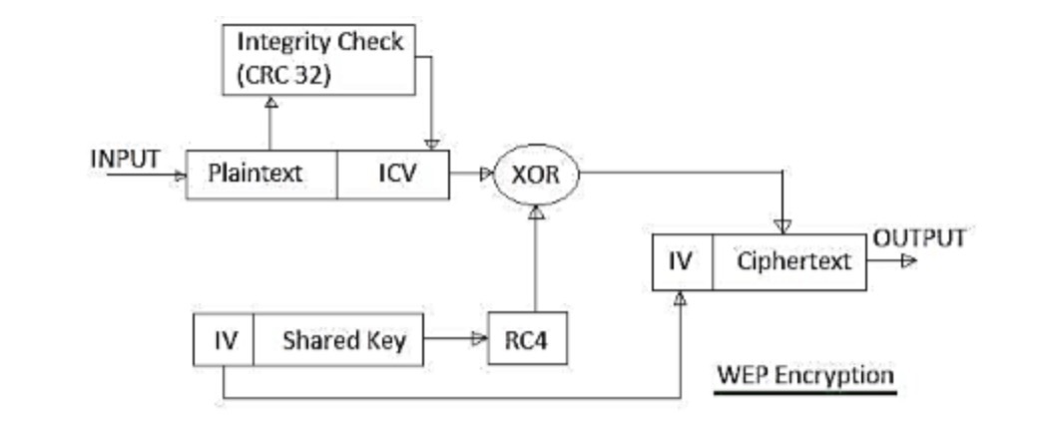

Slide 4
WPA ( Wi-Fi Protected Access )
Introduced in 2003 it was the replacement of WEP.
It shared similarities with WEP but offered improvements in how it handled security keys and the way users are authorized.
WPA uses the temporal key integrity protocol (TKIP), which dynamically changes the key that systems use. This prevents intruders from creating their own encryption key to match the one used by the secure network.
The TKIP encryption standard was later superseded by the Advanced Encryption Standard (AES).

Slide 5
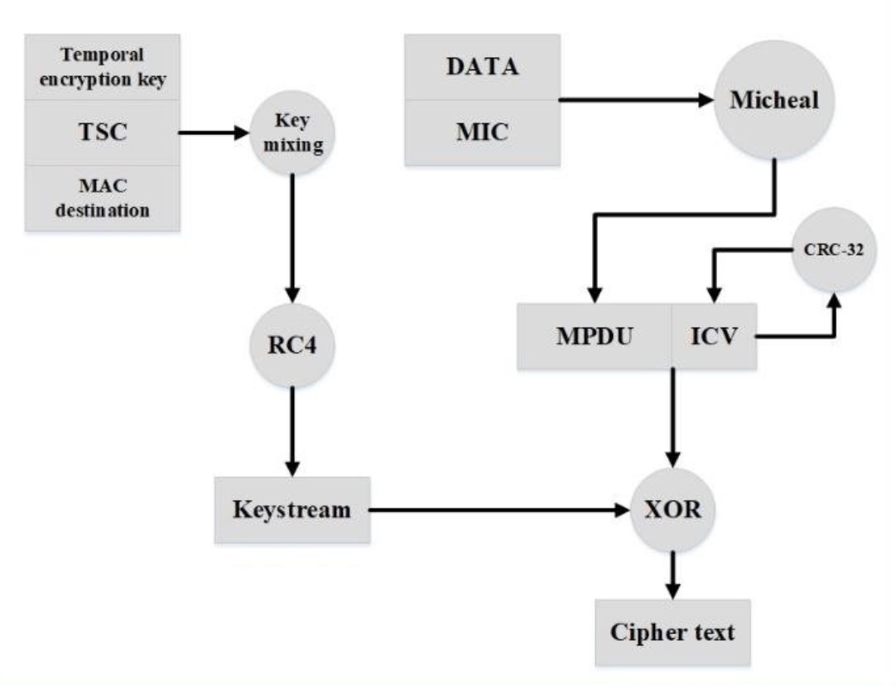

Slide 6
Wireless Lan threats
Denial of service attacks - where the intruder floods the network with messages affecting the availability of the network resources.
Spoofing and session hijacking - where the attacker gains access to network data and resources by assuming the identity of a valid user.
Eavesdropping - where unauthorised third parties intercept the data being transmitted over the secure network.

Slide 7
THANK you

