Slide 1
Fieldnote Health
Q3 2026 Board Meeting
October 2026 · Board & observers only

Slide 2
Q3 highlights
• Signed 4 new health systems; 38 now live
• Gross ARR reached $26.0M (+10% QoQ)
• Implementation backlog down to 9 weeks from 14
• Net burn improved to $0.95M/month; cash $31.0M

Slide 3
KPI scorecard
Metric | Q2 2026 | Q3 2026 | Q3 plan
Gross ARR¹ | $23.6M | $26.0M | $26.5M
Revenue (quarter) | $5.10M | $5.55M | $5.60M
Gross margin | 65% | 66% | 67%
Net burn (monthly avg) | $1.05M | $0.95M | $1.00M
Cash (period end) | $33.9M | $31.0M | $30.9M
Health systems live | 34 | 38 | 39
Headcount | 142 | 150 | 155
¹ Gross ARR includes contracted, not-yet-live implementations: $2.6M at Q2 and $3.2M at Q3. Net revenue retention will be reported once the new billing system cut-over completes.

Slide 4
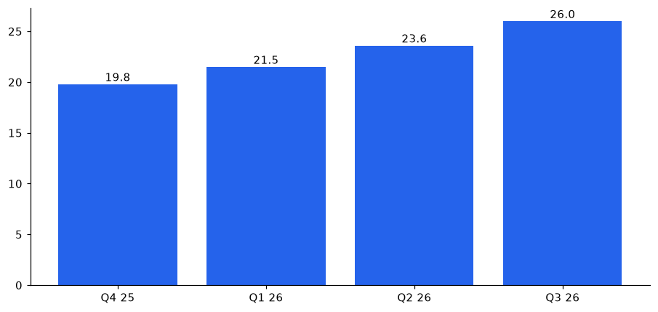
Gross ARR trend ($M)

