Slide 1

Host your next masterpiece with us
Benjamin Weymouth
Mohamed Berrachdi
Sadia Akbar
University of Toronto Fintech Bootcamp
February 2022
Notes:
Hi guys, welcome to AuctionPier! This is our new ethereum based solution to the NFT wave.
HI EVERYONE AND WELCOME. TODAY WE PRESENT TO YOU AUCTION PIER – OUR NEW ETHEREUM BASED SOLUTION TO THE NFT WAVE WHERE YOU ARE WELCOME TO HOST YOUR NEXT MASTERPIECE WITH US.

Slide 2

The purpose of this AuctionPIER project is to create a decentralized auction in Solidity, using HTML, JavaScript, CSS and Bootstrap for the Front End. This project has two different solidity files for the back end / decentralized portion of the app.
Art houses like OpenSea and other NFT sites can no longer be ignored both from a financial impact, the revolutionary nature of NFTs and the revenue that rivals traditional auction houses like Christies.
PROJECT SUMMARY
OVERVIEW
Notes:
WITH AUCTION PIER WE HAVE TRIED TO CREATE AND PRESENT A DECENTRALIZED AUCTION IN SOLIDITY, USING HTML, JAVASCRIPT, CSS AND BOOTSTRAP. THIS IS BECAUSE ART HOUSES LIKE THE OPENSEA AND VARIOUS NFT SITES DON’T HAVE LONG BEFORE THEY FACE THE FINANCIAL IMPACT CAUSE BY THE NFT REVOLUTION AND THE REVENUE COMPETITION FROM TRADITIONAL AUCTION HOUSES LIKE CHRISTIES

Slide 3
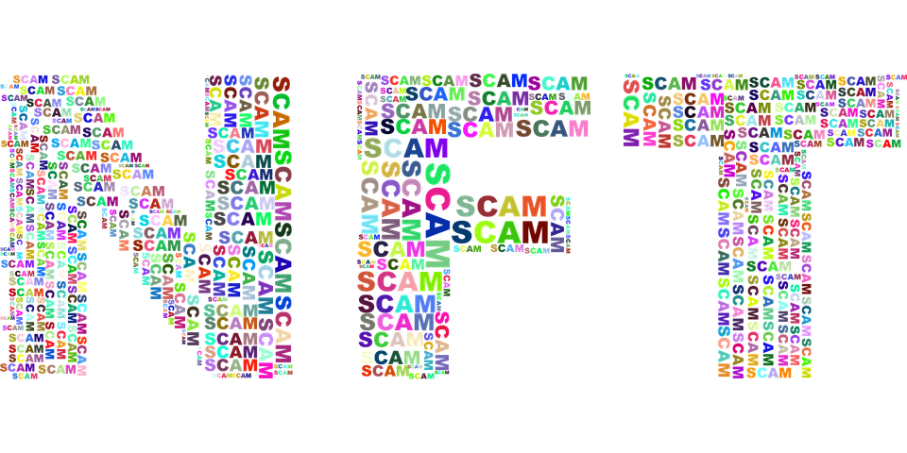
PROBLEM
Increase in fraudulent and unfair marketplaces for NFT’s discourages people from using it, making it a not so sustainable business model.
However, there are cryptographic and distributed systems solutions that would allow us to mitigate these types of threats.
Notes:
THROUGH AUCTIONPIER – AND WITH THE HELP OF CRYPTOGRAPHIC AND DISTRIBUTED SYSTEMS SOLUTIONS WE ARE TRYING TO ADDRESS AND EASE THE PROBLEM OF FRAUD, AND UNFAIRNESS OF MARKETPLACES SO THAT PEOPLE ARE LESS DISCOURAGED FROM USING A PLATFORM SUCH AS AUCTIONPIER.

Slide 4
SOLUTION
Blockchain is a shared, immutable ledger that simplifies recording transactions and tracking assets in a business network. This technology can be used to efficiently manage the NFT artwork.
WHY ?
People will not use a system if it’s not secure or fair
Some marketplaces do not utilize auction style pricing; however an auction can be considered as an equitable financial platform
Notes:
WE PROPOSE BLOCKCHAIN AS THE TECHNOLOGICAL SOLUTION TO THE PRECEDING PROBLEM MAINLY BECAUSE OF ITS FEATURES WHICH ALLOW IT TO BE A SHARED, UNCHANGEABLE LEDGER THUS SIMPLIFYING RECORDING AND TRACKING OF TRANSACTIONS AND ASSETS IN A BUSINESS NETWORK, MAKING IT FAIR, SECURE, AND AN EQUITABLE FINANCIAL PLATFORM.
BEN WILL NOW EXPLAIN HOW THE AUCTION WORKS BEFORE WE MOVE ONTO TO THE LIVE WALKTHROUGH OF AUCTIONPIER

Slide 5
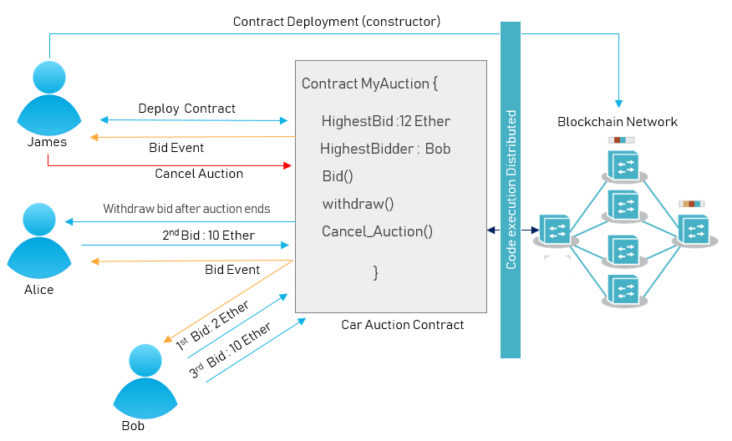
How does the auction work?

Slide 6
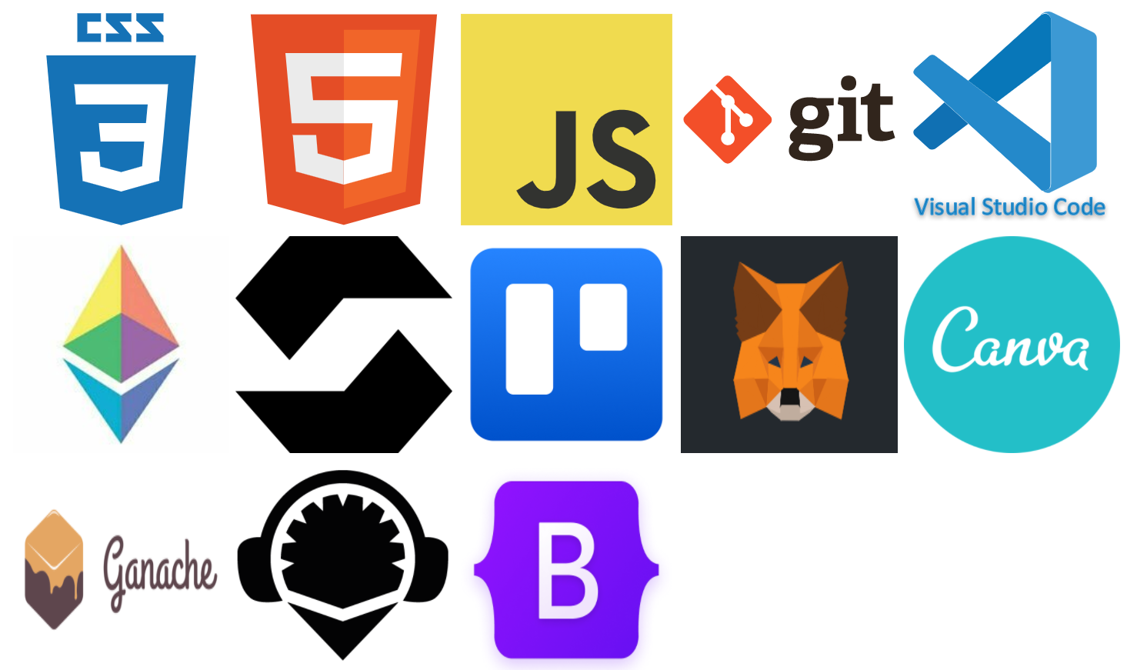
TECHNOLOGIES & LIBRARIES USED
We explored and worked through a number of different technologies and libraries to ensure our work was deployed successfully on the backend and the frontend:

Slide 7
Solutions and Next Steps
Monetize : Add features that allow the website to retain fees from finalized auctions
Live Website: deploy to AWS or Netlify
Challenges met and problems solved
Develop a fully functional front end in JS
Debug the JSON and ABI files
Fixed numerous errors on bootstrap grid with columns to display artwork nicely.
Notes:
Working on the website with the time allotted we were able to have it up and running, but for the next development steps we want to Monetize the website and allo the site owners to retain fees from the finalized auctions or the launch of new artwork, or

Slide 8
Conclusions
Blockchain technology is well-suited to Auctions because it is built specifically for recording transactions like auction purchases, Artwork ID numbers and utilizes tokens which assisted in facilitating our project goals.
Users who are part of the Ethereum community can utilize their ETH to bid on artwork and be part of an artistic and computing wave that is taking the world by storm.
Solidity and Smart Contracts are currently emerging but will spread in both popularity and utility. Auctions, gaming and cryptocurrencies are just the beginning.
Notes:
Blockchain technology is great for auctions
Ethereum community
Solidity is the new up and comer

Slide 9
Now let’s switch over and see the live site in action.
Please have your bids ready!

Slide 10
References
Blockchain By Example. (2018). Blockchain By Example. Retrieved February 4, 2022, from O’Reilly Online Learning website: https://learning.oreilly.com/library/view/blockchain-by-example/9781788475686/
Solidity by Example — Solidity 0.5.11 documentation. (2016). Retrieved February 4, 2022, from Soliditylang.org website: https://docs.soliditylang.org/en/v0.5.11/solidity-by-example.html#simple-open-auction
Bellomy, B. (2017, June 29). Solidity tutorial: building a simple auction contract. Retrieved February 4, 2022, from Medium website: https://medium.com/@bryn.bellomy/solidity-tutorial-building-a-simple-auction-contract-fcc918b0878a

