Slide 1




SMART INDIA HACKATHON 2026
TITLE PAGE
  Problem Statement ID - SIH26154
  Problem Statement Title - Gen AI Platform for Automated Content Transformation
  Theme - Blockchain & Cybersecurity
  PS Category - Software
  Team ID - 141630
  Team Name - Out of Tokens
Notes:
Team Out of Tokens (141630). Problem SIH26154 from NTRO: a Gen AI platform that turns one source into whatever deliverables the operator selects. Our platform is SpectraSource.

Slide 2
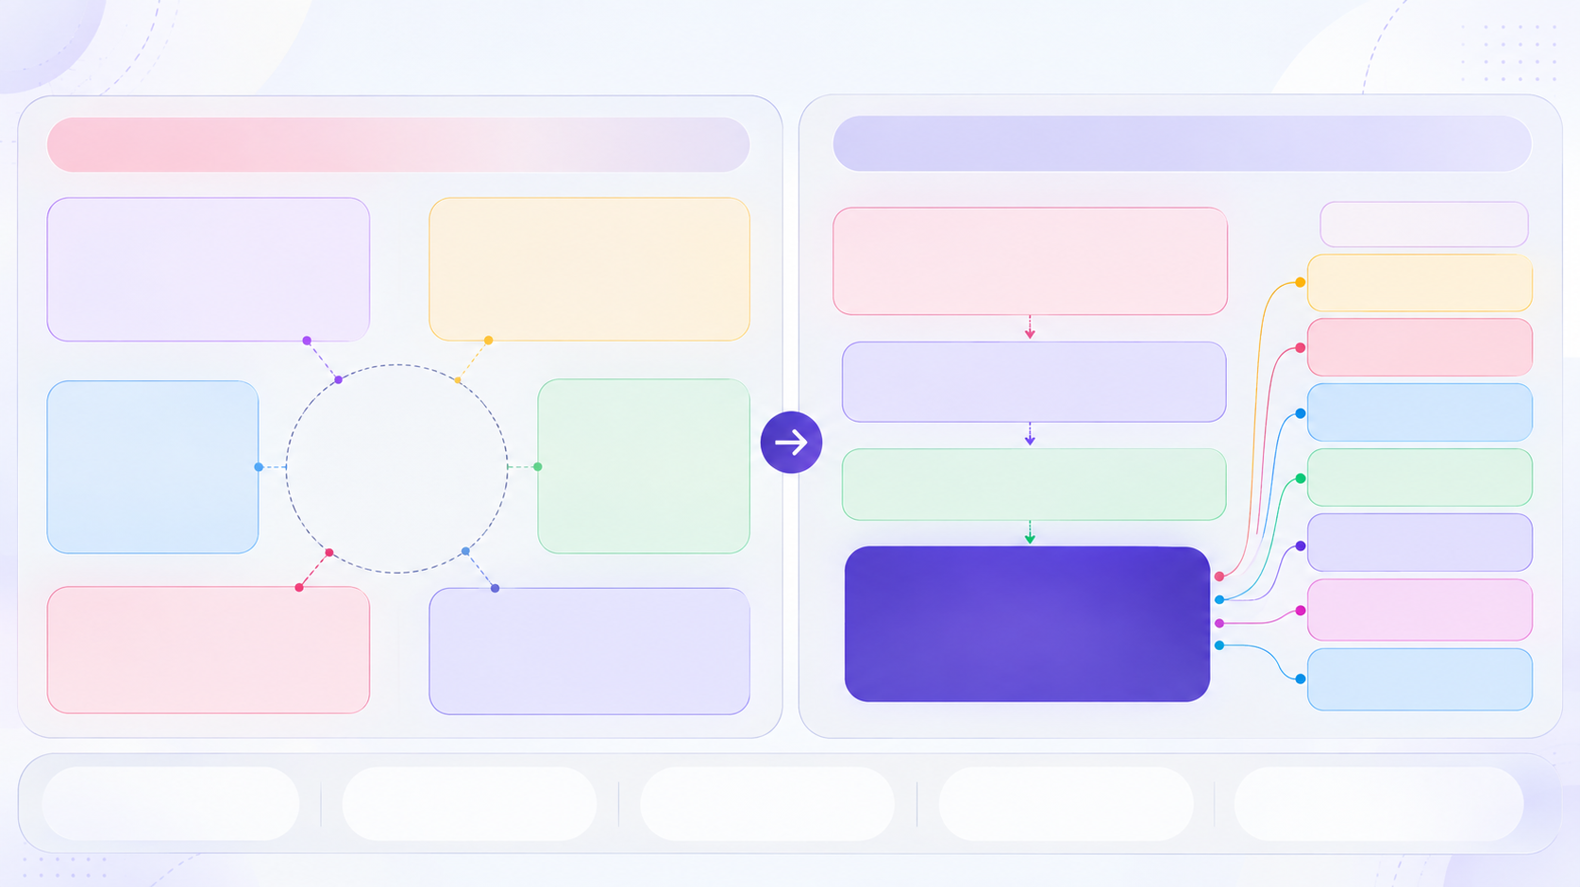


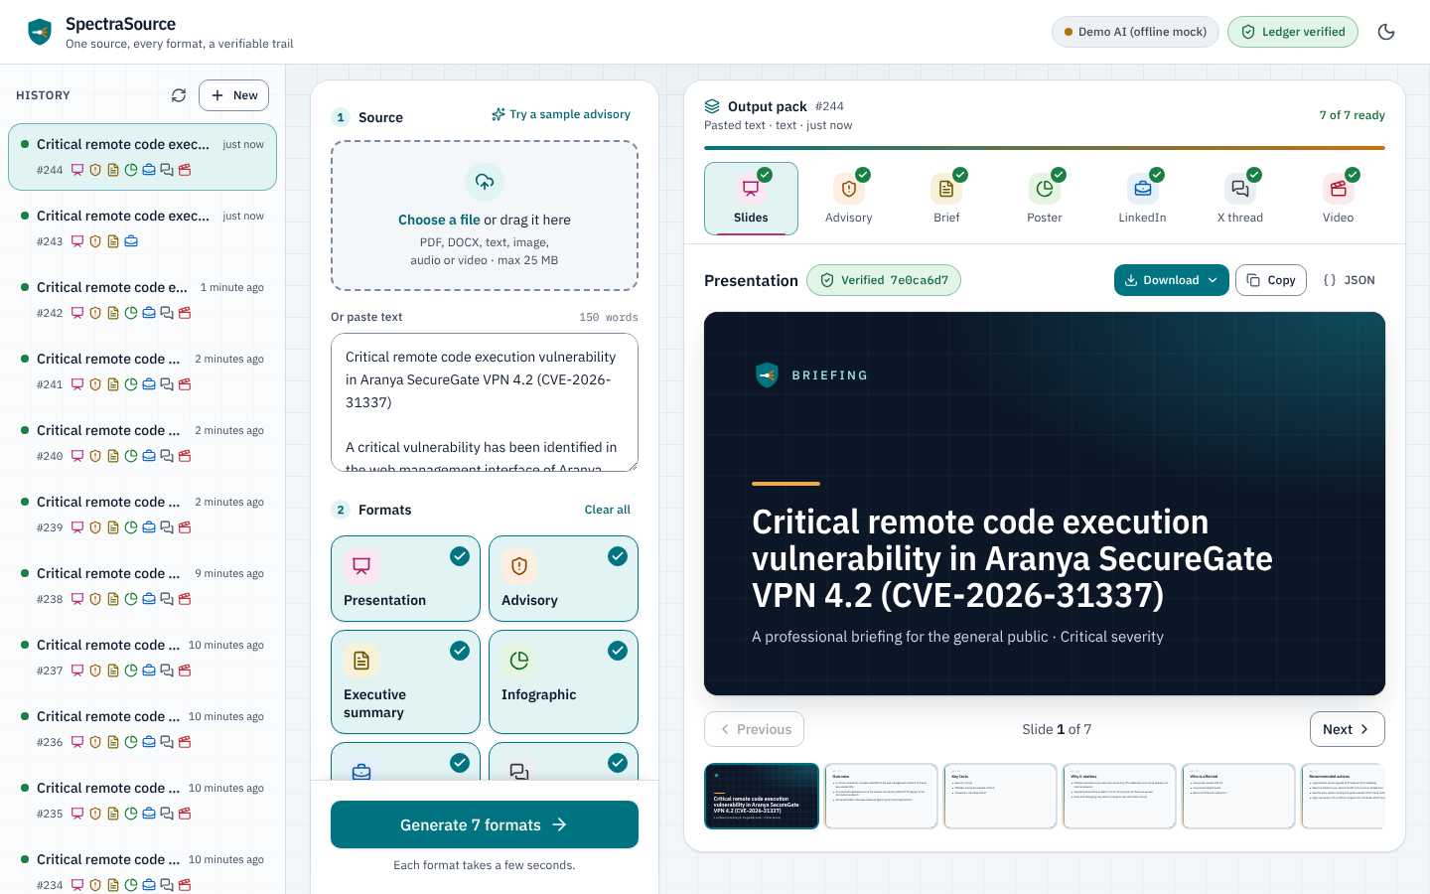





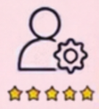





Problem And Proposed Solution
OUT OF TOKENS
The problem
Our Solution: SpectraSource
MULTIPLE SOURCE FORMATS
MANUAL ANALYSIS
Information arrives across diverse formats — reports, advisories, articles, images, videos and more.
Operators manually analyse content to extract relevant information and context.
TIME & RESOURCE INTENSIVE
CONTEXT & INTENT
Understanding audience, objective and context adds further manual effort
Repeated processing consumes significant time and resources.
EXPERTISE REQUIRED
FORMAT-SPECIFIC CREATION
Creating effective outputs often requires both domain and communication expertise
The same information must be recreated separately for every communication format
1
Upload
2
Pick
3
Tune
4
Export
Text, PDF, DOCX, image, audio or video
Any of the 7 output types, one or many
6 settings, from audience to tone
.pptx, .docx, .srt, HTML, Markdown, JSON
BENEFITS
Reduce manual effort
Improve consistency
Accelerate content creation
Enhance operational efficiency
@SIH Idea submission- Template
2
Notes:
The problem: the same information arrives as reports, advisories, articles, images and videos, and analysts rewrite it by hand for every channel and audience. That is slow, inconsistent and needs both domain and communication skill.
Our solution, SpectraSource: one dashboard. Upload text, a PDF or Word file, an image, audio or video; pick any of the seven outputs; set audience, tone, language, detail, objective and style; download ready files. The screenshot shows the live dashboard.

Slide 3





































Technical Approach
OUT OF TOKENS
MULTI-MODAL INPUT
INGESTION & PREPROCESSING
AI TRANSFORMATION ENGINE
OUTPUT
OUTPUT DELIVERY
Text and/or one file, up to 25 MB
Every input becomes one shared source text
One prompt per output; every answer is checked
Video
Review in the dashboard, then download:
Typed text
Script • Storyboard • Narration
Document Parsing
Prompt Builder
LinkedIn Post
Presentation
PDF documents
PDF via pypdf, DOCX via python-docx
Task spec per output type plus the 6 settings
.pptx
Twitter / X Post
Advisory, summary, video
Word (DOCX)
.docx
Vision & Speech
Schema Check
Advisory
TXT · MD · CSV · HTML
Pydantic schema per type; 1 retry if invalid
Video subtitles
Gemini reads images and transcribes video and audio
Infographic
.srt
Prompts
Images
LLM PROVIDER LAYER
Gemini by default; OpenAI, Groq or local Ollama
Executive Summary
HTML
Infographic
Injection Guard
Video & audio
Source sits in <source> tags and is treated as data
Presentation
.md .json
Every output
Slides + speaker notes
Contextual Information
DATA STORAGE AND MANAGEMENT
Data store
Jobs & artefacts
Audit hash chain
SQLite (zero setup) or PostgreSQL 16
Source, settings, JSON output, SHA-256 hash
Each event hashes the last; /api/audit/verify finds edits
PLANNED: anchor approved hashes on a blockchain
Frontend
Backend
AI Models & Data
Deploy & CI
React
TypeScript
Vite
Tailwind CSS
Python
FastAPI
Pydantic
Gemini
Ollama
PostgreSQL
SQLite
Docker
Render
Netlify
GitHub Actions
@SIH Idea submission- Template
3
@SIH Idea submission- Template
3
Notes:
Left to right is one job's path through the system.
1. Input: typed text and/or one file: PDF, Word, text formats, images, video or audio.
2. Ingestion turns everything into one source text: local parsers for PDF and DOCX, Gemini for images, video and audio. The source is wrapped in <source> tags so instructions hidden in it are treated as data.
3. The engine builds one prompt per selected output with the six settings. The model must return JSON that matches a Pydantic schema for that output, with one retry. The LLM layer is swappable: Gemini by default, or any OpenAI-compatible server including a local Ollama model.
4-5. Seven outputs, downloadable as .pptx, .docx, .srt, HTML, Markdown or JSON.
6. Jobs and artefacts are stored in SQLite or PostgreSQL. Every source and output gets a SHA-256 hash in a hash-chained audit log; /api/audit/verify detects any edited or deleted record.
Planned, not built: login with roles, a human approval step, anchoring approved hashes on a blockchain, and RAG with pgvector for long sources.

Slide 4




FEASIBILITY AND VIABILITY
OUT OF TOKENS
WHY WE CAN BUILD IT
Every part already exists. We joined them, and it runs today.
Proven, open-source stack
No model training needed
Our skills match the stack
Widely used parts, live on Netlify and Render
A hosted LLM (Gemini), steered with prompts and strict schemas. No GPUs needed.
Each layer has an owner on the team
React
Vite
TypeScript
Tailwind
Frontend React, Vite, TypeScript
Backend Python, FastAPI
GenAI Gemini, prompts, schemas
DevOps Docker, CI, Render, Netlify
Gemini
Prompting
Strict schemas
FastAPI
PostgreSQL
Docker
RAG with pgvector · planned
RISKS WE PLANNED FOR
WHY HASN'T ANYONE SOLVED IT YET?
RISK
LEVEL
HOW WE HANDLE IT
STATUS
Existing tools were built for a different job.
AI states a wrong fact
HIGH
Facts only from the source; strict output schema
BUILT
WHAT OTHERS DO
WHAT WE DO DIFFERENTLY
Sensitive data reaches the LLM
HIGH
One setting swaps to a local Ollama model
Built for marketing copy
→
Built for security teams
BUILT
One prompt, one format
→
One source, 7 formats, same facts
Prompt injection in uploads
MEDIUM
Source treated as data inside <source> tags
BUILT
Public SaaS, no audit trail
→
Self-hostable, hash-chained log
Model API slow or down
MEDIUM
Timeouts, clear errors, swappable provider
BUILT
No org workflows or controls
→
Roles + approval (planned)
No traceability of output
HIGH
SHA-256 per output in a hash-chained audit log
BUILT
Unauthorised access
HIGH
Login with roles: operator, reviewer, admin
WHY IT IS VIABLE?
Scalable
Reusable
Cost-aware
PLANNED
Unchecked content goes out
HIGH
Human approval, then hash anchored on a blockchain
One source → multiple audiences
→ consistent facts
PLANNED
@SIH Idea submission- Template
4
Notes:
Why we can build it: every part is proven open source, and the platform already runs end to end: dashboard on Netlify, API on Render, with automated tests, lint and build on every push.
No model training: Gemini does the work, steered by prompts and a strict schema per output. The provider is a setting, so the same build can run on a local Ollama model when data must not leave the network.
Risks: green rows are handled in the code today; amber rows are on the roadmap (login with roles, human approval, blockchain anchoring of approved hashes).

Slide 5







IMPACT AND BENEFITS
OUT OF TOKENS
WHO BENEFITS?
HOW WE WILL MEASURE IMPACT?
Every link in the communication chain gains
From the analyst who writes it to the citizen who reads it
< 5 min
Upload to every format
Analysts & Comms Teams
Decision Makers
  One upload, up to 7 formats
  More time for analysis, less for formatting
  Same facts in every channel
  Faster decisions during an incident
Drafts used with minor edits
80%+
100%
Outputs in the verifiable audit log
Citizens & the Public
The Organisation
  Plain posts, threads and videos
  Warnings arrive while they still matter
  Runs on its own servers
  Tamper-evident audit log
  Roles (planned)
5+
Output languages in the pilot
Key research findings
40%
Professionals finished writing tasks 40% faster with AI help.
26%
Grounding answers in real sources cut made-up answers by 26%.
68%
68% of organisations worry about data leaking to the public or competitors.
Our approach: all 7 formats in one job
Our approach: facts only from your source
Our approach: self-host, with a local model
Noy & Zhang, MIT, 2023
Journal of Empirical Legal Studies (Wiley)
Cisco Data Privacy Benchmark, 2024
@SIH Idea submission- Template
5
Notes:
Who benefits: analysts spend time on analysis instead of formatting; leaders get the same facts in every channel; citizens get plain posts and videos while warnings still matter; the organisation keeps a tamper-evident record and can self-host.
How we will measure it: time from upload to every format, share of drafts used with minor edits, share of outputs in the verifiable audit log, and output languages in the pilot.
Research sources:
- Noy & Zhang, Experimental evidence on the productivity effects of generative AI: economics.mit.edu/sites/default/files/inline-files/Noy_Zhang_1.pdf
- https://onlinelibrary.wiley.com/doi/full/10.1111/jels.12413
- Cisco 2024 Data Privacy Benchmark: https://www.cisco.com/c/dam/en_us/about/doing_business/trust-center/docs/cisco-privacy-benchmark-study-2024.pdf
Other references:
- Monolingual Text Summarization for Indic Languages using LLMs: https://aclanthology.org/2024.icon-1.11
- LoFTI: Localization and Factuality Transfer to Indian Locales: https://arxiv.org/html/2407.11833v1
- NITI Aayog, Principles of Responsible AI: https://www.niti.gov.in/node/326

