Slide 1
Backend Engineering Project
NeuroSync AI
Ishaan Rai, 2310991933
Swapnil Gaur, 2310991222
Harshit Gupta, 2310991927
Class Group: G-22
Submitted To : Faculty:
Mr. Rohit Kumar Dr. Gurtej Kaur
Designation
Department of Computer Science Engineering

Slide 2
Problem Statement
Mental health challenges such as stress, anxiety, and depression are on the rise globally, yet access to timely and affordable professional help remains limited. Traditional therapy is often expensive, stigmatized, and not available 24/7. Many individuals struggle without guidance, lack personalized support, and have no reliable way to track their emotional well-being in real time. There is a clear need for a secure, AI-powered solution that provides continuous emotional support, early detection of mental health issues, and immediate crisis intervention.

Slide 3
Introduction
NeuroSync AI
(Mental Health Support App)
NeuroSync is an AI-powered mental health companion designed to provide personalized emotional support, real-time mood analysis, and 24/7 crisis intervention. Built with Next.js, Tailwind CSS, and integrated with advanced AI models, NeuroSync aims to bridge the gap between technology and mental well-being. It empowers individuals with secure, accessible, and responsive tools to track progress, receive guided therapy, and improve overall mental health.

Slide 4
Features
User-Centric Features
🤖 AI Therapy Chat – Empathetic conversations powered by LLAMA 3
📊 Real-time Emotion Analysis – Detects and understands user mood instantly
🆘 24/7 Crisis Support – Immediate assistance in high-risk situations
🎯 Personalized Mental Health Guidance – Tailored advice and coping strategies
📈 Progress Tracking – Monitors emotional growth and mental health journey
📱 Responsive Design with Dark Mode – Seamless experience across all devices

Slide 5
Features
Technical Features
🔒 Secure User Authentication – JWT-based login & bcrypt password hashing
🗂 MongoDB Database Integration – Reliable storage for user data and insights
⚡ Next.js Performance Optimization – Fast and scalable frontend framework
🎨 Tailwind CSS Styling – Clean, modern, and responsive UI design
🧠 AI Integration – LLAMA 3 for chat + custom emotion detection algorithms

Slide 6
Tech Stack
Frontend
Next.js – React-based framework for server-side rendering & routing
React – Component-based UI development
Tailwind CSS – Utility-first CSS framework for responsive design
Next.js Image Optimization – Efficient media handling
Backend
Node.js – Runtime environment for server-side logic
Express.js (via Next.js API routes) – Handling APIs & middleware
MongoDB – NoSQL database for storing user data
Mongoose – ODM for MongoDB schema and queries

Slide 7
Tech Stack
Authentication & Security
JWT (JSON Web Tokens) – User authentication & session management
bcrypt – Password hashing for secure login
Environment Variables – Secure storage of sensitive credentials
AI & Analytics
LLAMA 3 – Conversational AI for therapy chat
Custom Emotion Analysis Algorithms – Detects and interprets user emotions
Real-time Mood Detection – AI-driven sentiment and tone analysis
Deployment
Git & GitHub/GitLab – Version control and collaboration

Slide 8
Future Enhancements
🧠 Integration with Wearables – Collect heart rate, sleep, and stress level data for deeper emotional insights
🎙️ Voice & Sentiment Analysis – Detect tone and mood from speech for more natural interactions
🌍 Multilingual Support – Expand accessibility with multiple languages for global users
🤝 Human-AI Hybrid Therapy – Option to connect with certified therapists when needed
📲 Mobile App Development – Dedicated Android & iOS apps for on-the-go support
🔔 Smart Notifications & Reminders – Gentle nudges for mental health check-ins and self-care activities
📊 Advanced Analytics Dashboard – Deeper visualization of emotional trends and progress
🧩 Third-Party Integrations – Connect with platforms like Google Fit, Apple Health, or EHR systems
🛡 Enhanced Data Privacy – End-to-end encryption and compliance with HIPAA/GDPR standards

Slide 9
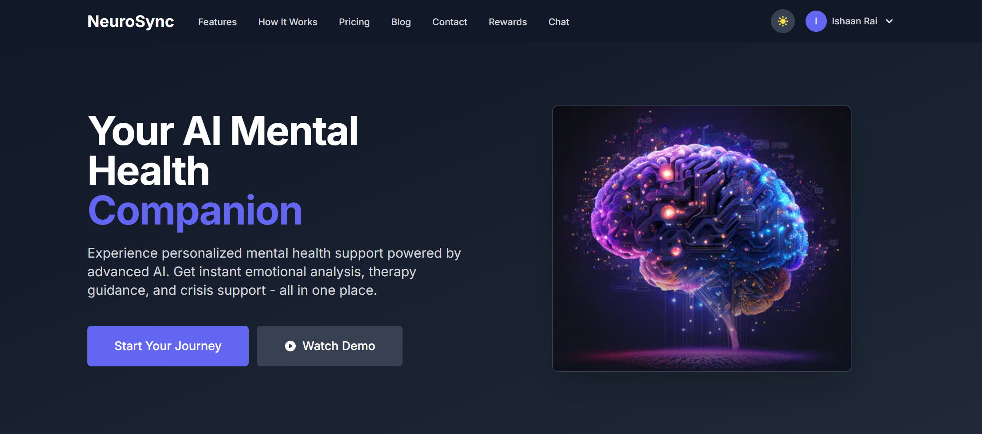
Project Screen Shots

Slide 10
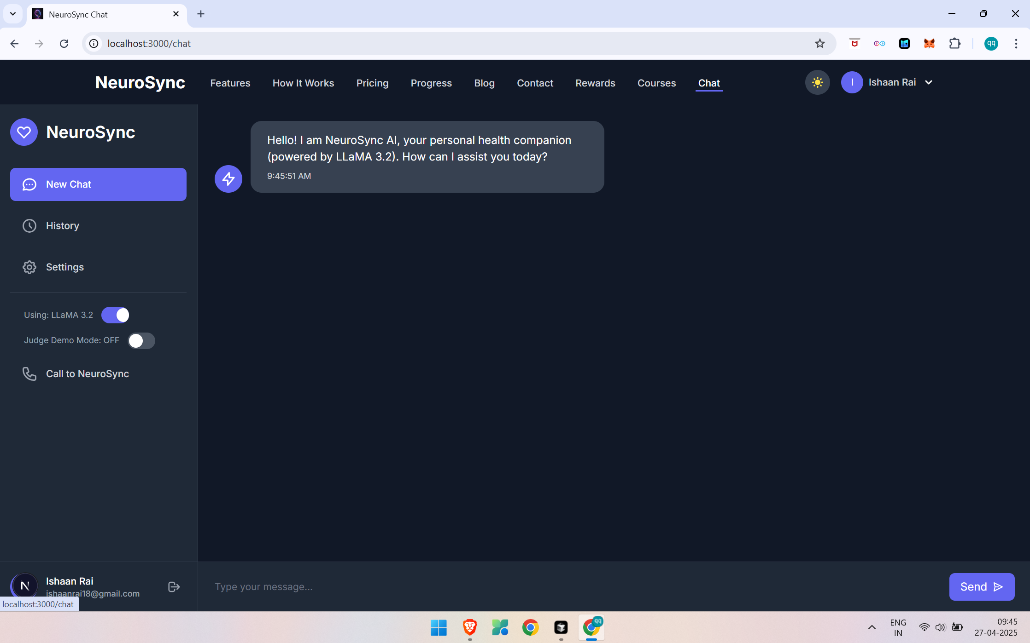
Project Screen Shots

Slide 11
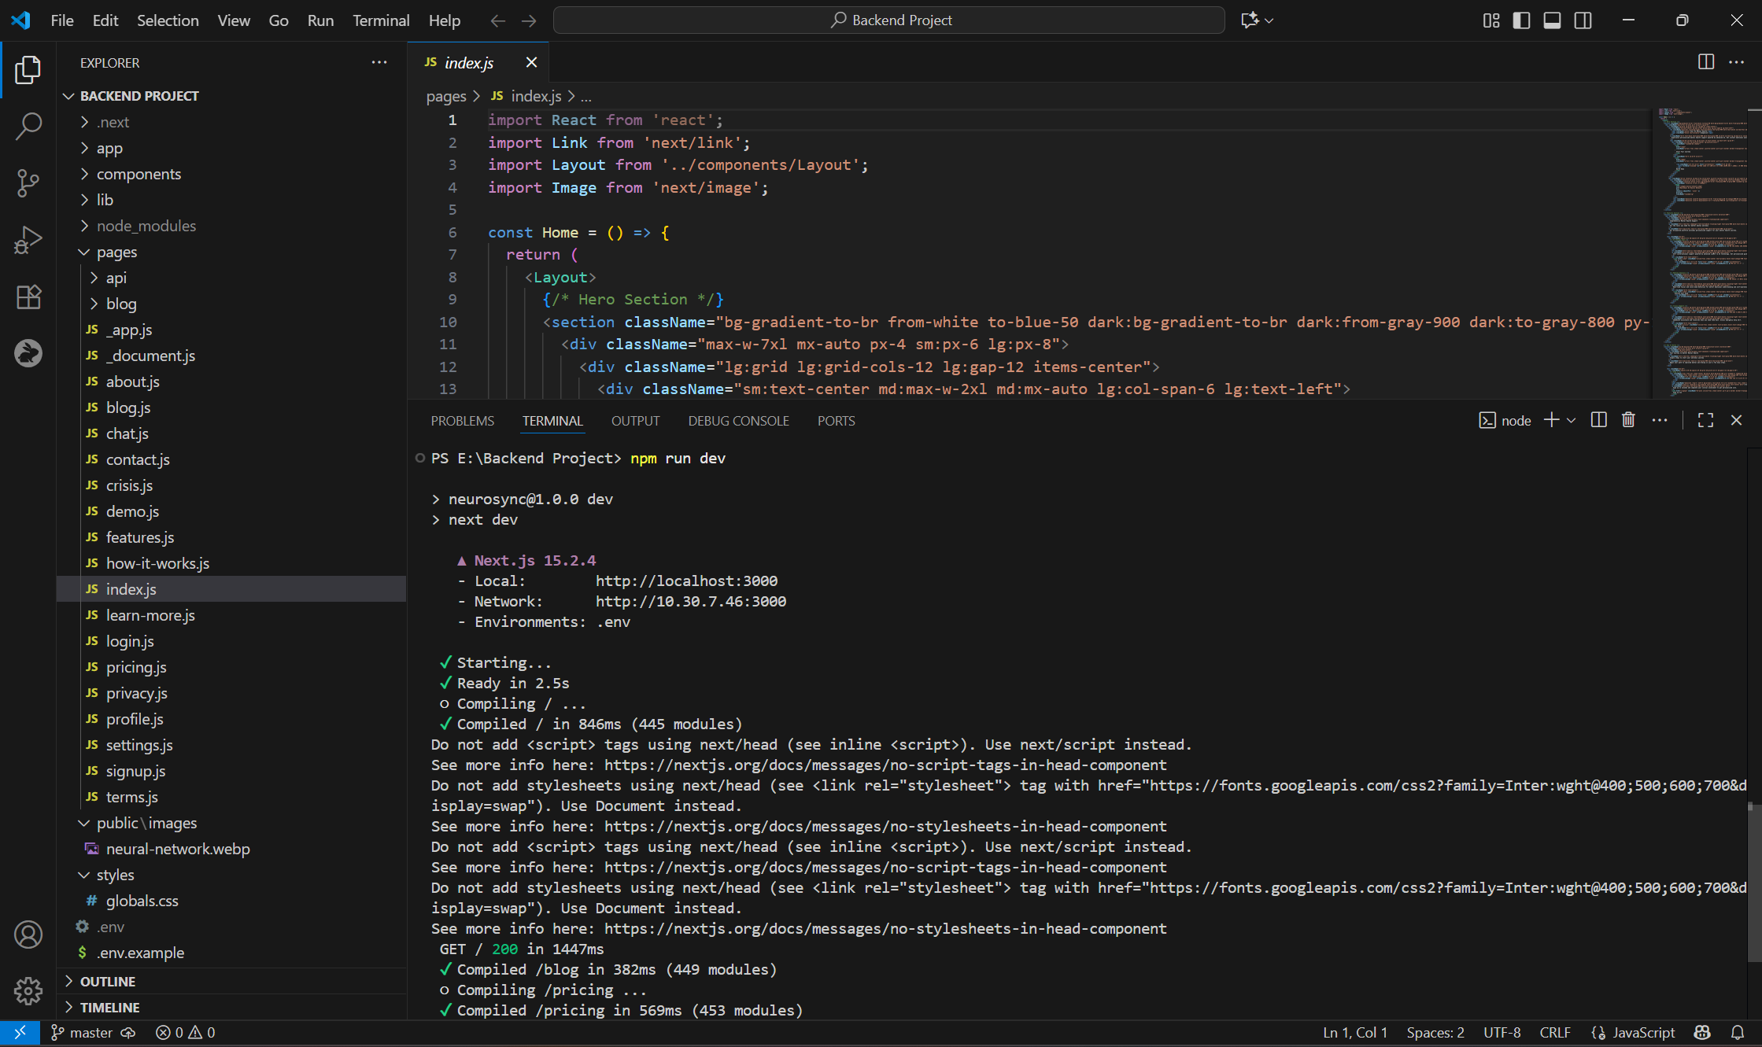
Code Snippets

Slide 12
Thank You

