Slide 1
Muskan Khandelwal 2017UCO1596
Spam Classifier
Ishaan Rawat 2017UCO1644
– Using the Naïve-Bayes Approach!
Shrey Jain 2017UCO1647
Anish Jangra 2017UCO1654

Slide 2
What, Why, How & Wow of Our Project
“ Spam is a waste of the receivers’ time, and, a waste of the sender’s optimism. ”
What & Why?
How?
Wow (Conclusion)
1
What: Naïve-bayes Spam Classifier
NB classifier, using NB algorithm, a popular statistical technique of e-mail filtering
They use bag of words features to identify spam email
Preprocessing the Data
What Did We Learn?
Learned the NB algorithm
Teamwork, collaborating & collating results together as a team
2
Training the naïve-bayes spam classifier
Why: NB Vs The Spam-Menace
Spam emails responsible for >77% of the global email traffic
Naïve Bayes algorithm predominantly famous in business-related and open-source spam filters
3
What Next?
How to further improve the model?
Where to use the model?
How is the Problem Evolving?
Testing the trained AI model
4
Obtaining & Quoting relevant results
Exec-Summary
Preprocessing
Training & Testing
Results
Conclusion
| 01

Slide 3
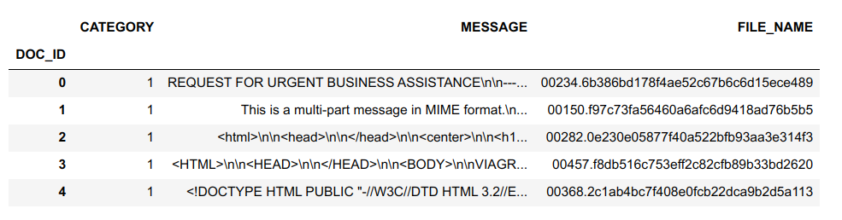
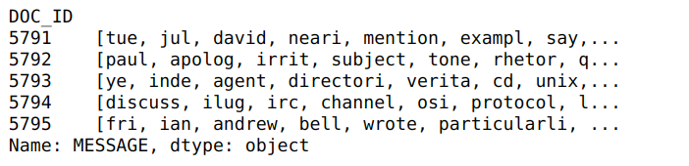
Steps in Preprocessing the Data: Sourcing & morphing the data
1
2
3
Data set from SpamAssassin public mail corpus containing around 1900 spam emails and 3900 legit emails
Extract the email body from the email
Remove the null values and create a data frame of the emails
4
Using the natural language processing toolkit remove the stop words, stem the words to their normal form and remove the html tags from the body of the email
Data Frame
List of words in the emails after cleaning
Exec-Summary
Preprocessing
Training & Testing
Results
Conclusion
| 02

Slide 4
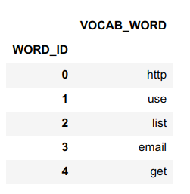
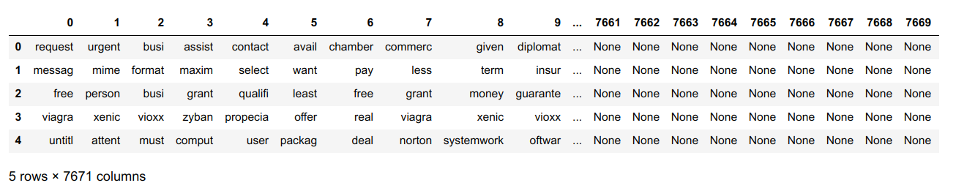
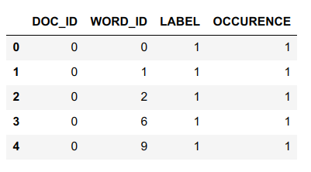
Steps in Preprocessing the Data: Getting the data ready for processing
5
Create the vocabulary for training the classifier using 2500 most common words in the emails in the data set
6
Generate the features for the emails in the data set
7
70:30 Split the data into training and test set
8
Create a sparse matrix for training and test data
Sparse matrix for test data
Exec-Summary
Preprocessing
Training & Testing
Results
Conclusion
| 03

Slide 5

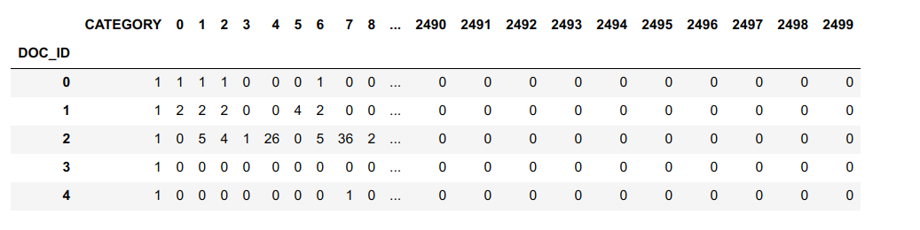
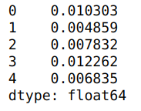
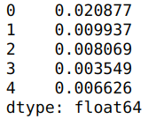
Training the Naïve-Bayes Classifier
Convert the sparse matrix of training data into a full feature matrix. It consists of the frequency of each word in the vocabulary in the emails in the training data
Bayes Theorem
We need the following values form our training data:
1. Probability of the words in the vocabulary in ham mails
2. Probability of the words in the vocabulary in the spam emails
3. Probability that the word occurs in overall training set
4. Priori: Probability that an email is spam. It gives the probability of an email being spam without taking any evidence into account.
The values will be calculated by summing across the axis of the matrix for ham and spam emails respectively in the training data
Using the above calculated values we will classify an email as ham or spam in our test data
Full feature matrix
Prob words in spam email
Prob of words in ham emails
Exec-Summary
Pre-processing
Training & Testing
Results
Conclusion
| 04

Slide 6
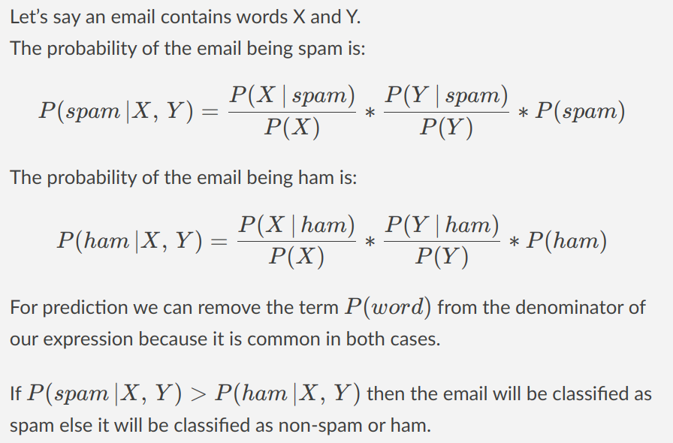
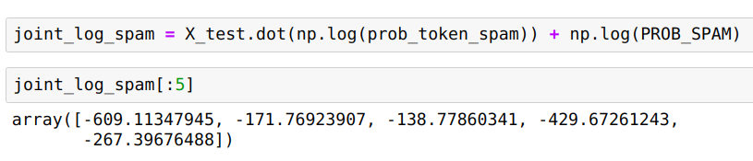
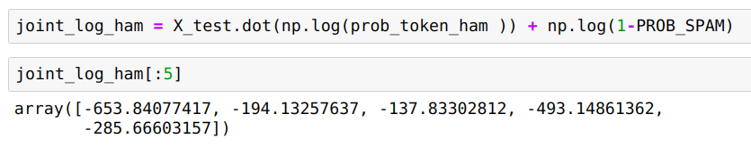
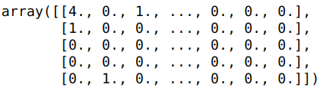
Testing the Naïve-Bayes Classifier
The test data is in the form of a matrix
The probabilities are converted to log form (to avoid errors during calculations)
Calculate the probability of an email being spam or ham using the matrix inner product
The test matrix has 2500 columns and the probability matrix has 2500 rows
The product of the two matrices gives the probability of the mail being spam or ham
Email classified as spam if value of inner product with spam probability matrix is greater than the value of the inner product with the ham probability matrix
Test data matrix
Exec-Summary
Pre-processing
Training & Testing
Results
Conclusion
| 05

Slide 7
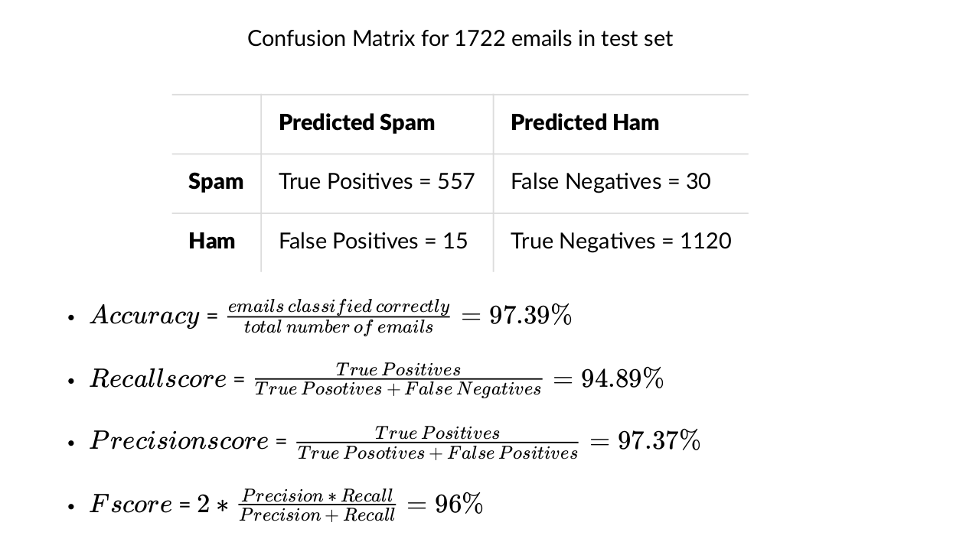
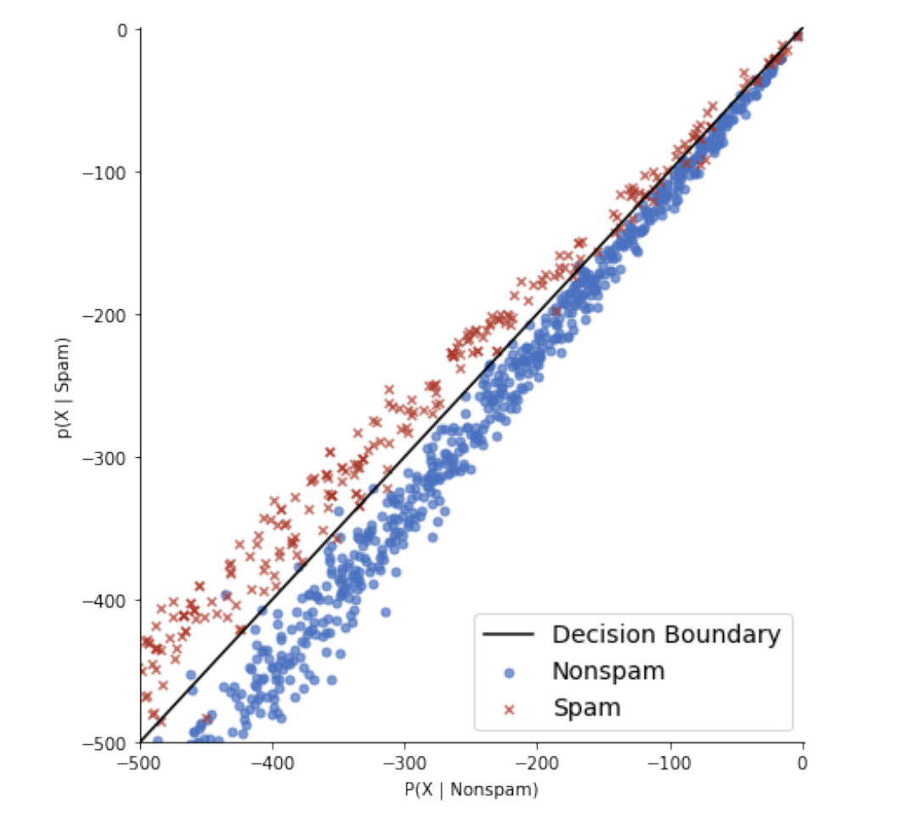
Significant Results We Obtained
Exec-Summary
Pre-processing
Training & Testing
Results
Conclusion
| 06

Slide 8
What we Learnt & our Project’s Future Prospects
What’s Next?
What else did we learn?
What else could be done?
Feature Selection: We analysed only using body of the email, we could also use subject line, domain name of the sender, IP address of the sender, time of receiving the mail, images/links in the body etc.
Using different features, performance can be enhanced
Other application of naïve-bayes classification algorithm
Fraud detection
Credit approval analysis
Medical diagnosis
Treatment effectiveness analysis
Weather forecasting
Ever evolving problem
Spam mails are ever-evolving, new types like image spam & blank spam have surfaced
Simple classifiers based on textual analysis are not enough to detect spam mail anymore, AI techniques like CNN & RNN are necessary to make an adaptive spam detector
Teamwork
While building the project together, collaborating in both serial and parallel manner
We discussed what and why of every step involved in the project
This helped us understand the concepts better as the collective knowledge is better
Exec-Summary
Pre-processing
Training & Testing
Results
Conclusion
| 07

