Slide 1
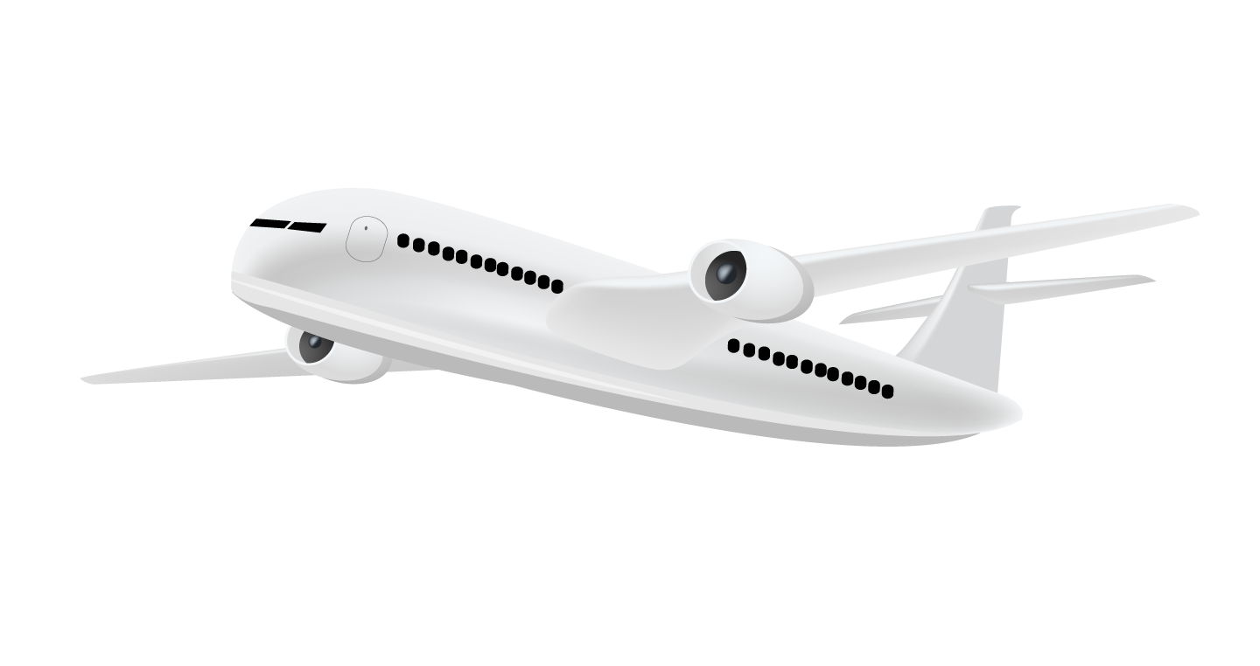
Airline Price Optimization
Presented by: Team Adelaide

Slide 2
Contents
Executive Summary | A brief summary of the project
Industry Overiew | An overview of the Aviation industry and the challenges it faces
Introduction | An introduction to the Airline Pricing problem
Problem Description | A description of what challenge our client is facing and the problem we need to solve
Model Overview | The objective, decision variables, constraints and other factors involved
Strategies | Three pricing strategies used: Linear, Adaptive, and Dynamic Pricing
Model Result | A summary of the model results
Benefits & Potential value | The potential advantages of undertaking this project
Implementation Plan | How to implement the model in a real-world scenario
Risks and Solutions (Next Steps) | Factors that can negatively affect our model. Future steps of improvement.

Slide 3

Executive Summary
Canada Jetlines, one of Canada’s homegrown airline has hired Team Adelaide to overhaul its current Management System
Airline industry uses dynamic inventory pricing hence we’ll build a revenue optimization model which would help our client maximize overall revenue
We would also build a demand model to simulate customer demand in order to enhance our revenue optimization engine
As per our model, dynamic pricing generates is the optimized revenue during the simulation period

Slide 4
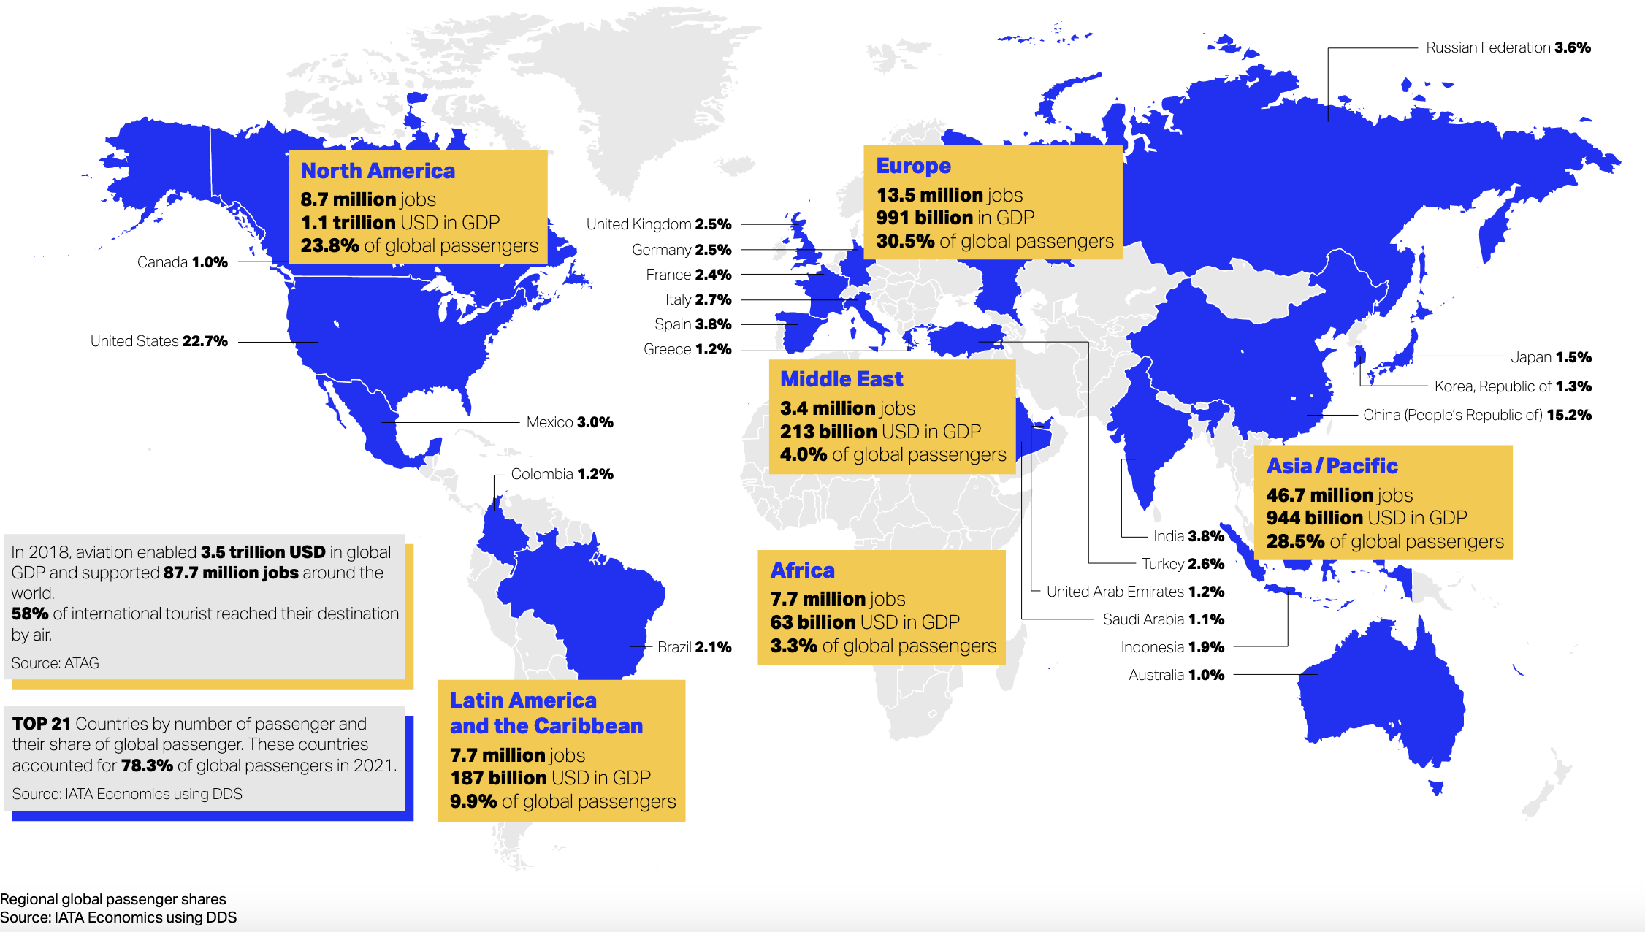
Aviation by the numbers

Slide 5
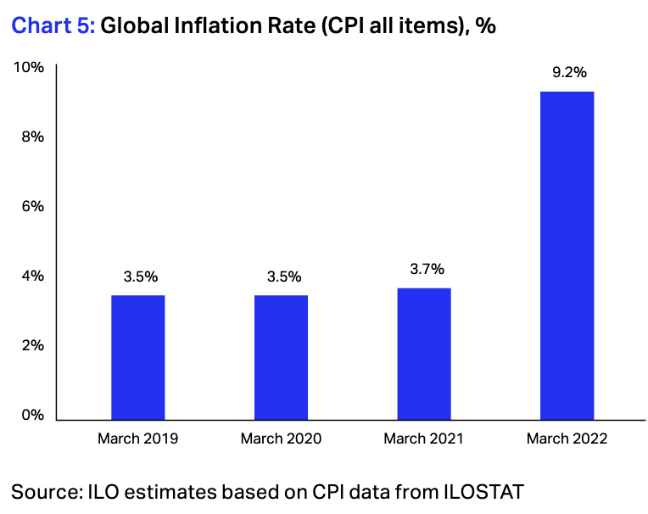
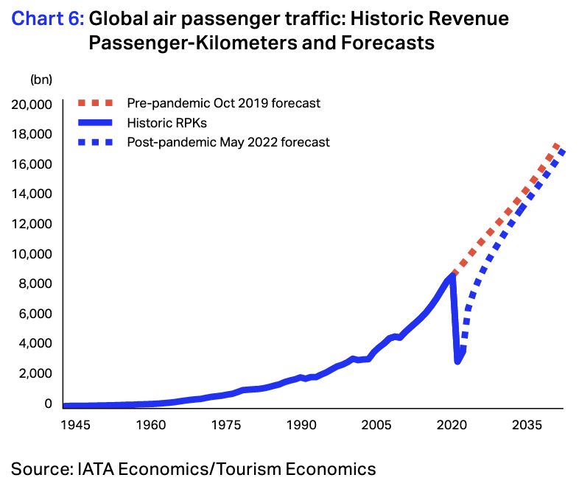
Introduction
Chart 1:
Chart 2:

Slide 6
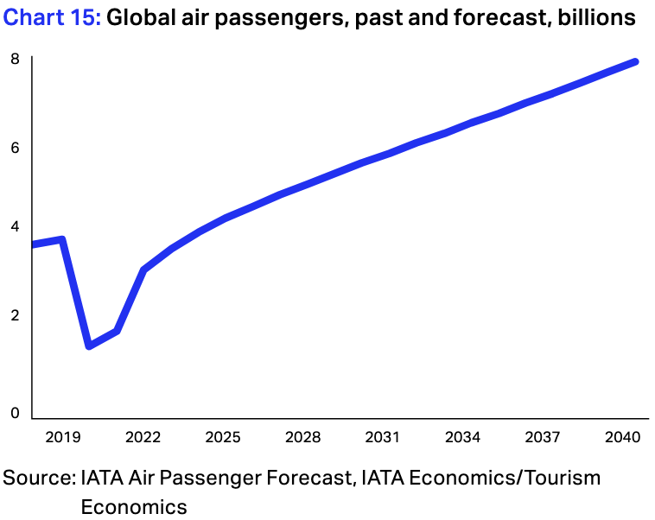
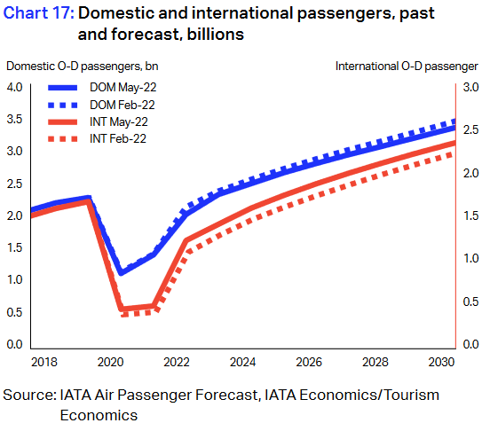
Introduction
Chart 3:
Chart 4:

Slide 7
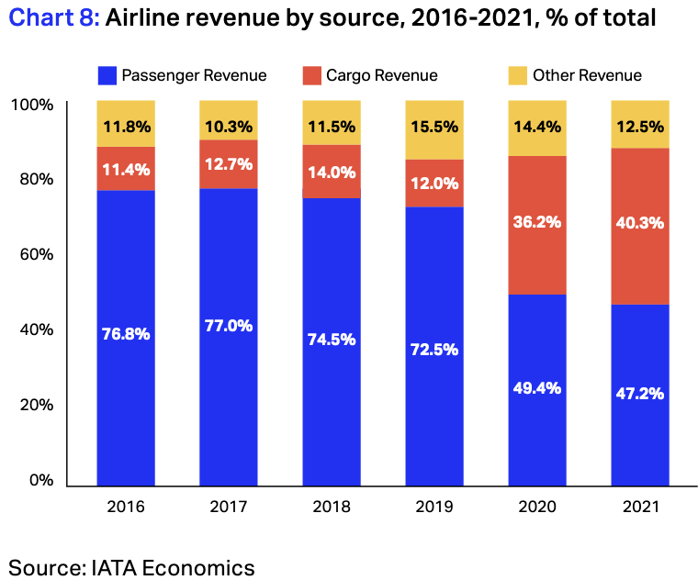
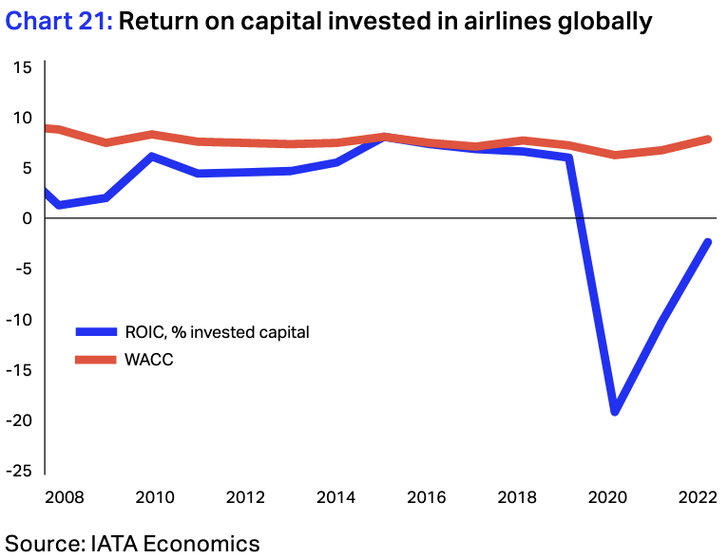
Introduction
Chart 5:
Chart 6:

Slide 8
Problem Description
Currently our client uses static pricing
Fare structure is created using a limited number of price points based on reservation booking designators
Each price point is developed for a specific customer segment and demand situation
Our client, can’t effectively segment passengers beyond the typical “business or leisure” scenario
In order to address the above issue, we test different pricing model and select the best revenue generating model

Slide 9
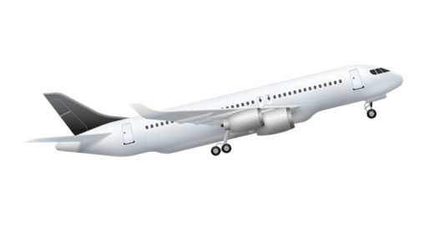

Model Overview
Objective: Maximize Revenue
100 seats to sell in 100 days
Daily demand: Uniform[100, 200]
Demand is realized at the starting of the day
Quantity sold: Q = Demand – Price
Elasticity of price is 1

Slide 10
Strategies
Linear Pricing
Disregards Demand
Adjusted Pricing
Considers current demand
Disregards future demand
Dynamic Pricing
Considers current and future demand
For each approach, we ran 10,000 simulations of the selling period

Slide 11
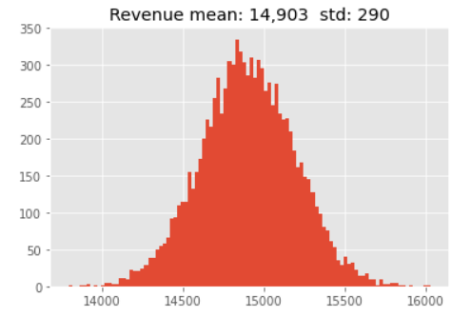
Linear Pricing
Equal number of tickets sold everyday
1 ticket per day
Pros
Extremely easy to implement
Cons
Does not take demand or any other factor into account
Lowest return

Slide 12
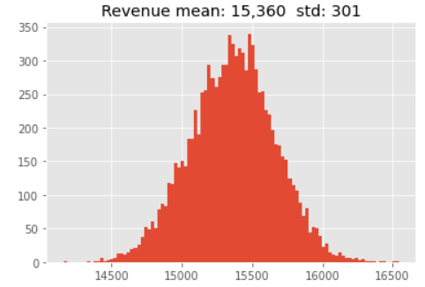
Adaptive Pricing
Adjust price according to demand
Price is higher when demand is high
Pros
Takes demand fluctuations into account
Cons
Does not consider other factors
Does not take the future value of resources into account

Slide 13

Dynamic Pricing
Treat each day as a separate selling phase.
Dynamically price for each day
Finds expected revenue for the last day and moves backwards
Pros
Takes demand fluctuations into account
Takes seats and days remaining as input
Factors in future expected value
Cons
Complex. Requires memory and computational power.

Slide 14
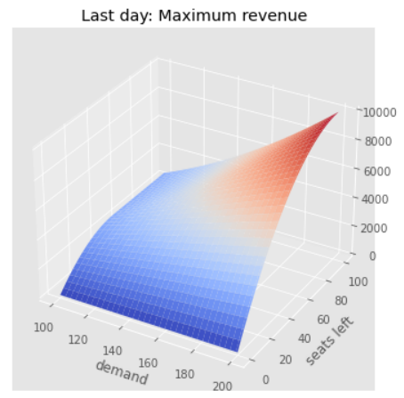
Example: 2-Day Selling Period
Step 1
Calculate last-day maximum expected revenues
Step 2
Calculate current-day maximum expected revenues
Step 3
Maximize sum of revenues

Slide 15
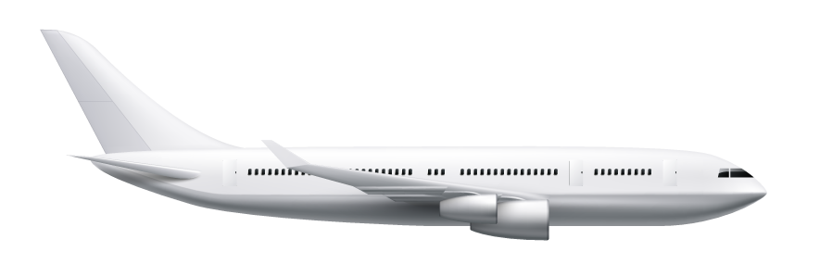
First 10 Days Sales
Day | Tickets Left | Demand | Price | Sales
1 | 100 | 163 | 163 | 0
2 | 100 | 160 | 160 | 0
3 | 100 | 187 | 183 | 4
4 | 96 | 185 | 182 | 3
5 | 93 | 102 | 102 | 0
6 | 93 | 163 | 163 | 0
7 | 93 | 101 | 101 | 0
8 | 93 | 168 | 168 | 0
9 | 93 | 148 | 148 | 0
10 | 93 | 159 | 159 | 0

Slide 16

Revenue for different Selling Periods
Selling Duration | Revenue | Average Ticket Price | Tickets sold
2 | $12,731.00 | $137 | 92
3 | $13,779.00 | $149 | 92
4 | $14,389.38 | $155 | 92
5 | $14,824.37 | $159 | 93
6 | $15,161.71 | $162 | 93
7 | $15,435.36 | $165 | 93
8 | $15,664.12 | $167 | 93
9 | $15,859.95 | $168 | 94
10 | $16,029.65 | $170 | 94

Slide 17
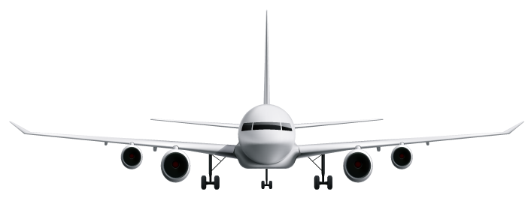
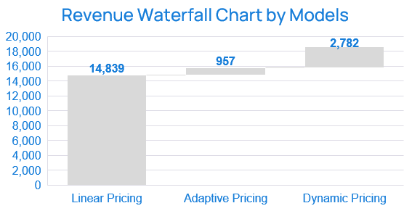
Model Result
Avg Ticket Price
Linear
$148
Adaptive
$158
Dynamic
$189
Notes:
Thank you Ishaan. Now let’s look at our final results and some business takeaways from our model. The forecasted revenue from our initial linear pricing model is 14839 dollars cumulatively, with an average ticket price at around $148. as Ishaan mentioned, we then implemented our model with adaptive pricing method, which increases our predicted revenue by 957 dollars, and average ticket price increased by 10 dollars to 158. we do see a huge improvement on our final model, which is dynamic pricing model, and the predicted revenue increased by around 2800 dollars to 18578 total revenues, and the average ticket price increased by over thirty dollars to 189.
The dynamic pricing model generates most revenue as it captures real time fluctuation in demand and remaining tickets for sale, and reflect such chages on pricing instantly which best fit the market.

Slide 18
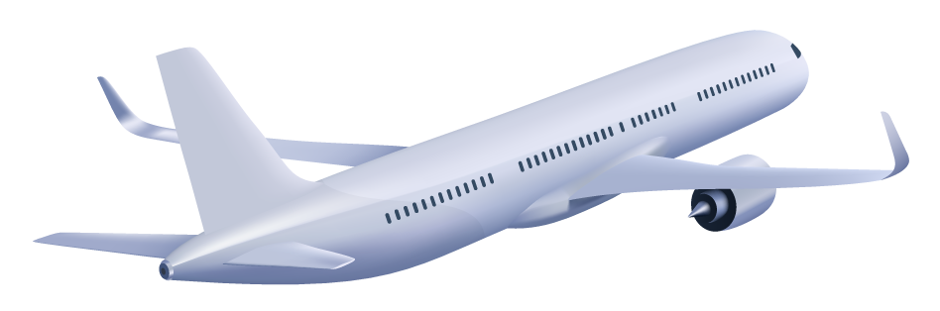
Benefit and Potential Value
Profitability
Competitiveness
Growth in revenue, profit and occupancy rate
Increasing market share by enhancing brand image
Customer Profiling
Flexibility
Build customer profile by purpose of travel, price affordability;
Better future marketing strategies
Modify model with market movement;
freedom to focus on other aspects of the business
Notes:
The benefit of our dynamic pricing model are shown as below, and it would bring huge potential value to the business due to several reasons.
First, dynamic pricing model maximizes the profitability of our business because it provides a venue for us to sell more and earn more. With the use of dynamic pricing, we could increase prices on the tickets when demand have risen, and we are able to sell all available seats at the optimum prices. Therefore it brought considerable growth in the revenue, profit and occupancy rate.
Dynamic pricing also improve our competitiveness in the market. The rising competition in the aviation industry gives carriers good enough reasons to not overcharge customers. However, they must be careful not to undercharge customers as well. As our prices are adjusted with demands, customers can easily find a cheap price from our business when demand is low. This helps us attract more customers, increase market shares, as well as solid our brand image as a company provide good service along with reasonable price.
Dynamic pricing also helps build better customer profile by purpose of travel, demographic info and price affordability. Based on current model, we can further improve it by adding into customer behaviour data, and would bring significant value for marketing strategies as well.
Last but not the least, as you can tell, dynamic pricing is very flexible. Not only because we can modify our model constantly to capture market movement at its best, but also provides the freedom for us to focus on other aspects of business with the additional profit.
Now I’ll walk through our implementation plan for this pricing model.

Slide 19

Implement Plan
Model Building
Deployment
Monitoring
Test on one airline, one seat class
Optimize model based on outcome
Expand to company wide flights
Add in customer profile
Continuous monitoring and optimization
Tracking demand, revenue and profit
Notes:
We’ve already finished our phase 1 of implement plan, which is the initial model building process. We tested on one airline and one seat class as of now, and we tuned and optimized our model based on the result.
As a next step, we will further improve and deploy our model to a wider range of flights, and seat classes, so that we can enhance the profit for the company. We can also add in customer profile data into our model, to better understand the movement of demands, and provide more value to the company.
Then we will continuously monitor and implement our model, track the demand, realized revenue and profit, and compare it with our predicted value, so that to further improve this pricing model.

Slide 20
Risks and Solutions (Next Steps)
Extra Service Pricing
Competitor’s Price
Little Consideration on pricing and inclusiveness of additional service like baggage, meals, internet
Solution:
Account into revenue management implementation
Highlight of services during booking process
Lack of visibility of competitor’s price
Solution:
Build in competitor’s price tracking into model building
Differentiate based on flight schedule, target customers
Notes:
There is also some risks associated with our model. First, it did not taken into extra services into consideration, such as baggage allowance, meals and wifi, etc, which could also play a big role with customers are choosing their flights. As our next steps, we will quantify the value for each service, and build that into our model. We can also optimize our websites’ user experience, to highlight features and services provided by the company, so that to attract more customers.
As of now, we’re only focusing on the dynamic demand in our model, but neglected its relationship with competitor’s prices. We lack the visibility of competitor’s prices which could bring some bias to our model. Thus we will also add in competitor’s price tracking into our model in future, and also take flight schedule and target customers into consideration.
That concludes our presentation and thank you for your time.

Slide 21
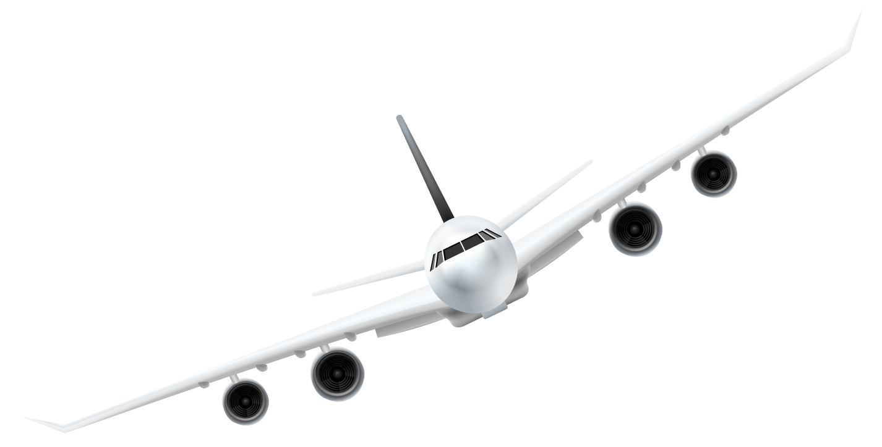
Thank You

Slide 22
Appendix

Slide 23
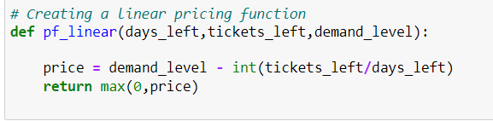
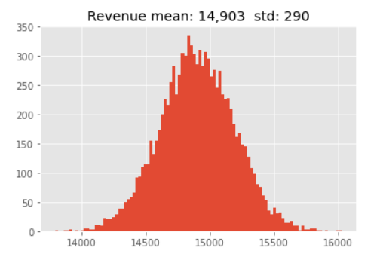
Linear Pricing
Max expected revenue = $16,030

Slide 24
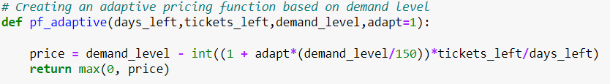

Adaptive Pricing
Max expected revenue = $16,544

Slide 25
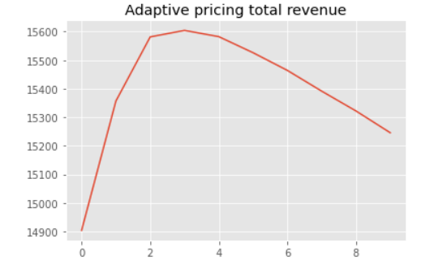
Adaptive Pricing
Best value of Adapt = 3
Expected Revenue for the value of ‘Adapt’

Slide 26
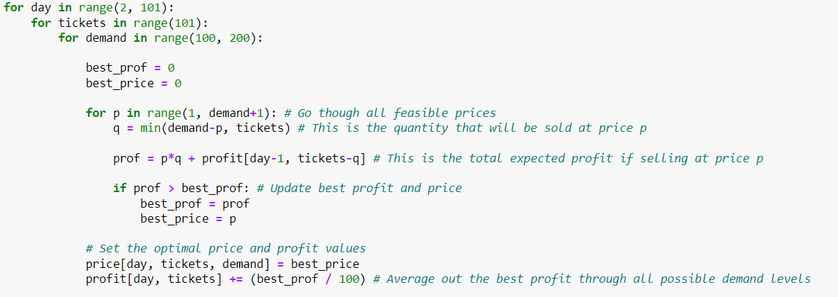
Dynamic Pricing
Max expected revenue = $19,116

Slide 27
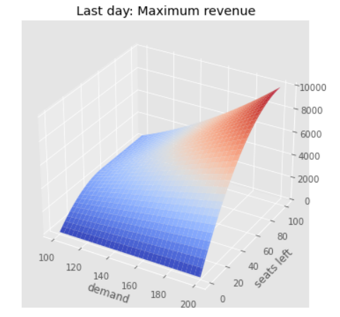

Dynamic Pricing
Maximum revenue in all the simulations
Expected maximum revenue on last day for all prices

Slide 28
References
https://www.travelweek.ca/news/latest-iata-stats-show-brighter-2022-outlook-for-global-airline-industry/
https://www.iata.org/en/iata-repository/publications/economic-reports/airline-industry-economic-performance---june-2022---report/
https://www.iata.org/en/pressroom/2022-releases/2022-06-20-02/
https://www.globenewswire.com/en/news-release/2022/06/28/2470107/28124/en/Global-Airlines-Market-Report-2022-A-Severely-Battered-Aviation-Industry-Struggles-to-Revive.html
https://www.atpco.net/airline-dynamic-pricing
https://www.altexsoft.com/blog/dynamic-pricing-airlines/
https://www.mckinsey.com/industries/travel-logistics-and-infrastructure/our-insights/how-airlines-can-gain-a-competitive-edge-through-pricing#0

