Slide 1
Mobile Price Classification
Submitted by: Team Adelaide​
Ishaan Sinha - 20is38@queensu.ca
Marshal Yuan - 21yy40@queensu.ca
Kripa Nayak - 21ksn1@queensu.ca​
Fiona Bai - 21jb69@queensu.ca​
Rachel Chen - 21jc69@queensu.ca
Oluwaseun Adelana - 21oa9@queensu.ca​
​

Slide 2
Contents
Executive Summary
Introduction
Data Description
Approach
Model Results
Conclusion

Slide 3
Executive Summary
TEAM ADELAIDE
New entrant in the Smartphone industry.
Offering different types of smartphones, for instance, dual sim vs single sim.
Offer smartphones at the most competitive prices.
Use predictive modeling to classify smartphones into different price ranges using currently available data from the market.
Objective -> Determine the most popular features in smartphones at different price ranges.

Slide 4
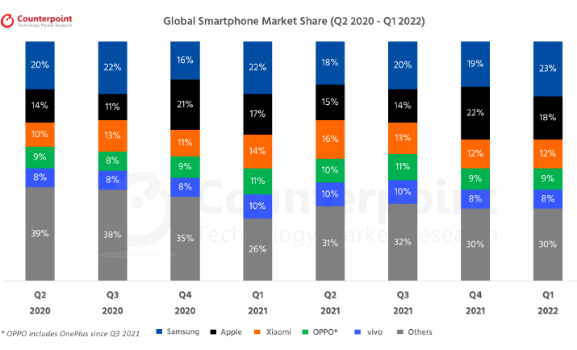

Smartphone Industry
Global Smartphone market was valued at USD 273.9 Billion in 2021.
Forecasted to reach USD 520.7 Billion by 2030.
According to Statista, Samsung, Apple, and Xiaomi occupy 53% of the market share.

Slide 5







Introduction of the New Smartphone Firm
Needs an effective pricing strategy so that these can be put into a rational and accurate segment
Data collected from over 2000 smartphones on the market through research and survey
Classify different combination of features into different price ranges
iPhone
iPhone Pro
iPhone Pro MAX

Slide 6















Data Description
Data Collection
Data was collected on various cell phone attributes through publicly available data for current cell phone manufacturers
Variable Selection
Twenty-one variables were selected for data collection which resonated with our product features
Observations
Dataset included 2,000 observations with 14 numerical and 7 categorical variables
Data Structure
Dataset was evenly distribution across the four price categories which we were targeting i.e., Low, Medium, High and Very High

Slide 7


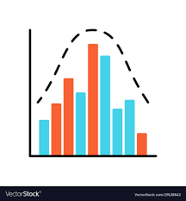

Data Description (Cont’d)
01
03
Missing Values
Dummy Variables
Dataset was checked for missing/NULL values and imputed via missing value imputation
Categorical variables were transformed into dummy variable for ease of analysis
02
04
Data Distribution
Multicollinearity
We analyzed distribution pattern of each variable to understand their properties and frequency
Correlation matrix was created between variables to check for multicollinearity

Slide 8
Approach
Base Model: Multinomial Logistic Regression
X - All independent variables: 70% training set, 30% testing set
Y - Price Range (0, 1, 2, or 3)
Feature Scaling
Principal Component Analysis Transformation
L2 Regularization

Slide 9
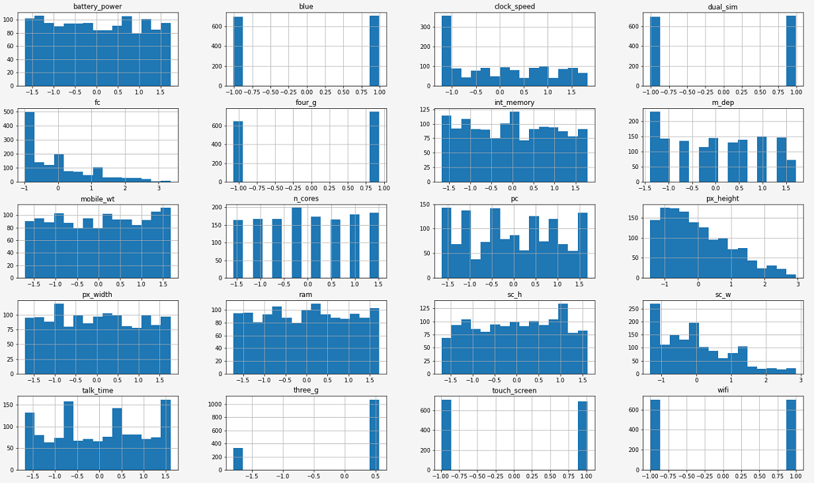
Approach – Feature Scaling
Standardization
Common scales
Mean = 0
Distance =
Z-score

Slide 10
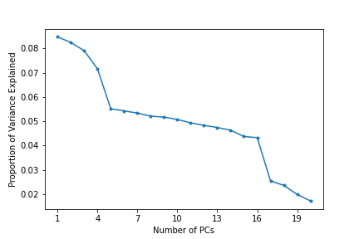
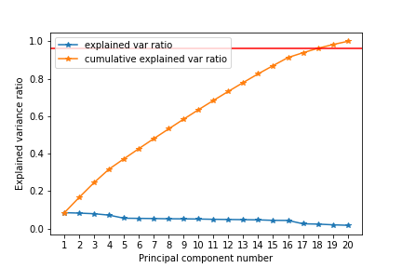
Approach – Principal Component Analysis
Eliminating the impact of multi-collinearity
Selected 18 components in final model to represent 96% of cumulative portion
Notes:
# Choosing the number of components is somewhat subjective; there is a clear break after the 18th principal component(s), so we can choose the first 18 components
Ridge regression shrinks every dimension by the same proportion.

Slide 11
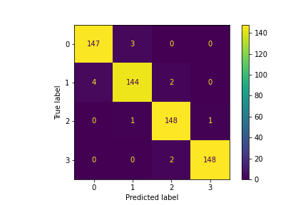
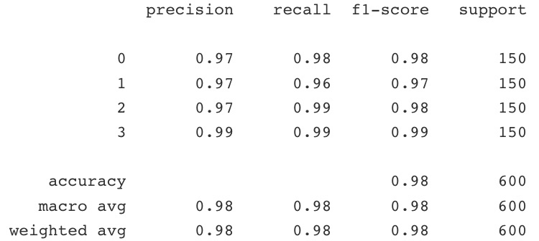
Model Results - Model Evaluation
Model Score
98.7% accuracy on the train set
97.8% accuracy on the test set
Confusion Matrix
Classification Report
Notes:
Thank you, Fiona. Let’s evaluate the model.
Our testing score is very close to the training score, and the overall accuracy of our prediction is 97.8%. Our precision, recall and f1 scores also perform quite well for each category, we have a precision of over 97% in each category. That being said, the model has done a good job across all the classes according to the classification report and confusion matrix. Next, let’s look at the coefficients of the model.

Slide 12
Model Results – Regression Coefficients
Component | Low (0) | Medium (1) | High (2) | Very High (3)
PC01 | 2.56 | 0.74 | -0.74 | -2.57
PC02 | 7.09 | 2.38 | -2.14 | -7.34
PC03 | -7.06 | -2.34 | 2.21 | 7.19
PC04 | -1.29 | -0.42 | 0.57 | 1.14
PC05 | -5.34 | -1.66 | 1.71 | 5.29
PC06 | -24.05 | -7.70 | 7.86 | 23.89
PC07 | 2.60 | 0.74 | -0.84 | -2.50
PC08 | 5.69 | 1.85 | -1.80 | -5.75
PC09 | -2.25 | -0.75 | 0.82 | 2.19
PC10 | 21.49 | 7.03 | -7.09 | -21.44
PC11 | 6.10 | 2.04 | -2.16 | -5.98
PC12 | 18.73 | 6.06 | -6.06 | -18.73
PC13 | -1.12 | -0.25 | 0.46 | 0.91
PC14 | 22.60 | 7.31 | -7.28 | -22.64
PC15 | -8.64 | -2.68 | 2.70 | 8.61
PC16 | -15.61 | -4.84 | 5.24 | 15.21
PC17 | -2.99 | -0.68 | 0.67 | 3.01
PC18 | 0.30 | -0.15 | 0.08 | -0.23
Notes:
From the coefficient chart, we can see that high values for PC6 increase the likelihood that the mobile price is higher, which is the opposite of PC14. Let’s take a closer look to the loadings for PC6 and PC14.

Slide 13
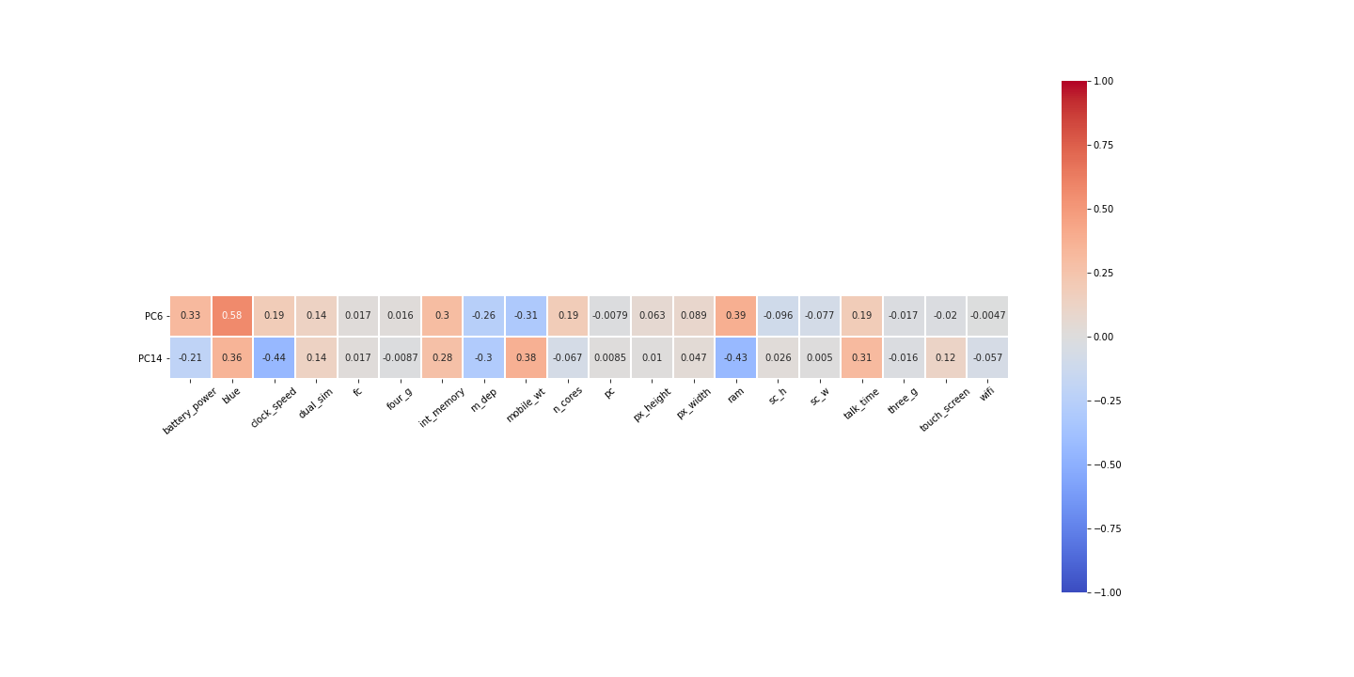
Model Results - Principal Component Loadings
Conclusion:
High values for PC6 increase the likelihood that the mobile price is super high
Observations which would have higher values of PC6 likely have larger battery power and ram
Notes:
From the heatmap, we can see that PC6 is positively correlated with features such as Battery power, internal memory, and Ram.
While PC 14 is positively correlated with features such as mobile weight, and battery lasting time when talking which means those features have less impact on the phone’s price increasing.
In conclusion, customers tend to spend more money on a phone with larger batter power, internal memory and Ram.

Slide 14

Conclusion
Key Outcomes
Collect and process large data from different sources to predict the market value of mobile devices.
Gain insight into what potential customers consider value for money based on comparable features.
Inform the development of an optimized pricing strategy.
Next steps
Time series model to predict the performance of mobile devices over time.
Notes:
Pricing systems have evolved from simply adding standard markup to the cost of production. People spend time especially in today’s digital world comparing product characteristics and the price of the product.
As a new entrant with unique features to offer our customers in a very competitive space, We consider this an investment for our consumers since mobile devices have become integral to the lives of people, so setting the best price is beneficial for both parties.
With this model we are able do three things:
First, we were able to collect and process large data from different sources to predict the market value of mobile devices. This helps us understand how our product fits in the value chain or how it can be priced. Is it in the low, medium, or high price category? Is it a luxurious or regular product and should we aim to maximize profit or minimize cost?
Secondly, we narrow down what our potential customers may consider value for their money based on the comparable features of our mobile device with other products in the market, basically answering the question, how much is this product worth to a customer or how much they are willing to path with for this product?
Lastly, we can inform the development of an optimized pricing strategy – that is we are able to use data to set the right price such that the product is not underpriced or overpriced, not too cheap or too expensive. Set a price that not only covers the cost of production but generates a substantial return, avoids missed customers, gains the right customers, and offers them a price that portrays a good bargain and value for money.
In the next phase of this project, we would like to use a time series model to predict the performance of these mobile devices over time.
Thank you for listening, we’ll be happy to answer any questions you may have.

Slide 15
Thank You

Slide 16
Q&A

Slide 17
Appendix

Slide 18
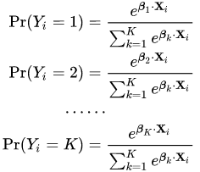
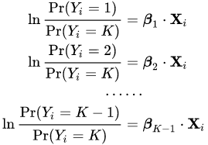
Model Approach – Multinomial Logistic Regression
Multinomial logistic regression is used to model nominal outcome variables, in which the log odds of the outcomes are modeled as a linear combination of the predictor variables.
https://stats.oarc.ucla.edu/stata/dae/multinomiallogistic-regression/
Notes:
it is a model that is used to predict the probabilities of the different possible outcomes of a categorically distributed dependent variable, given a set of independent variables

Slide 19
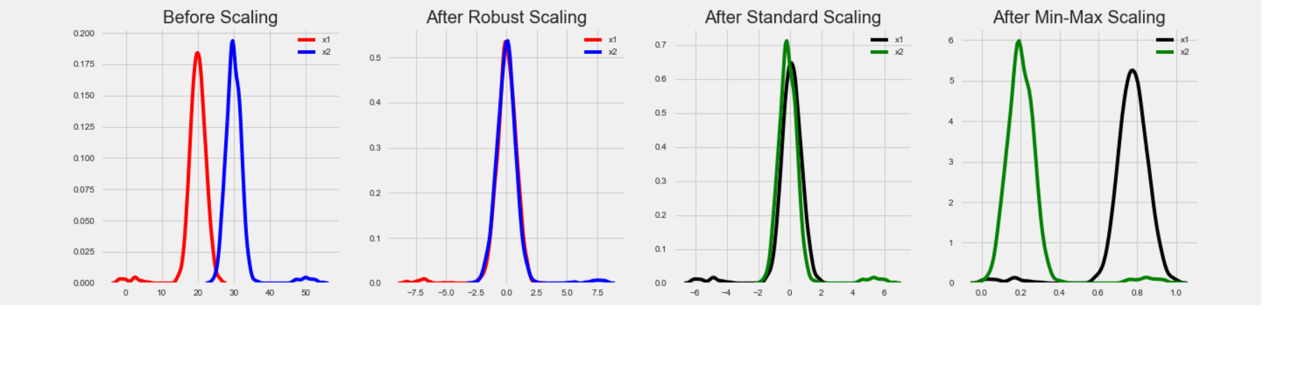
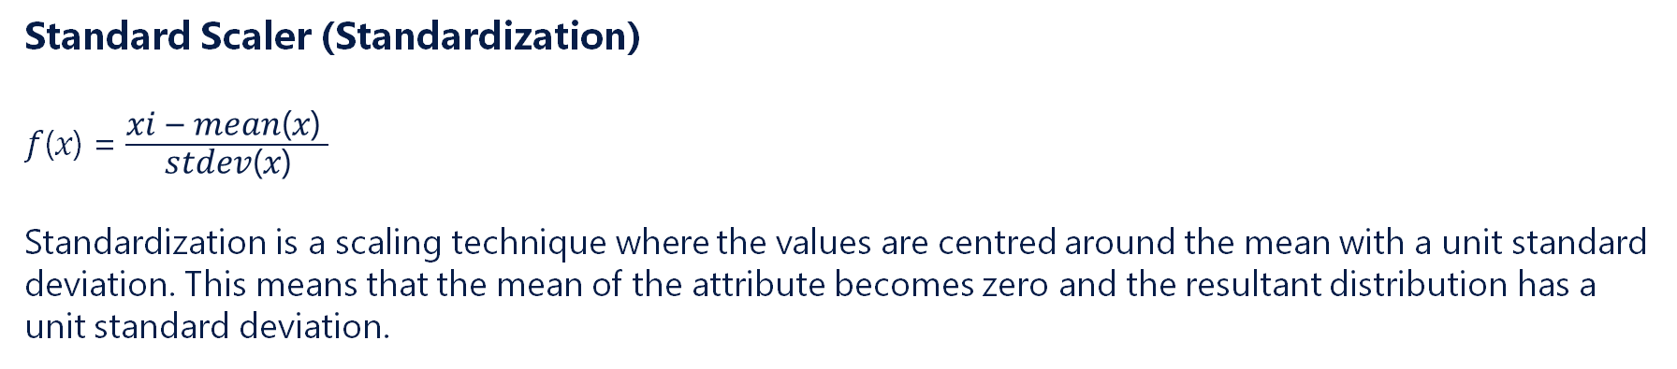
Model Approach– Standard Scaler
Standard Scaler (Standardization)
𝑓(𝑥) = $\frac{\text{xi}\text{ – }\text{mean}\text{(}\text{x}\text{) }}{\text{stdev}\text{(}\text{x}\text{)}}$
Standardization is a scaling technique where the values are centred around the mean with a unit standard deviation. This means that the mean of the attribute becomes zero and the resultant distribution has a unit standard deviation.
https://www.geeksforgeeks.org/standardscaler-minmaxscaler-and-robustscaler-techniques-ml/

Slide 20
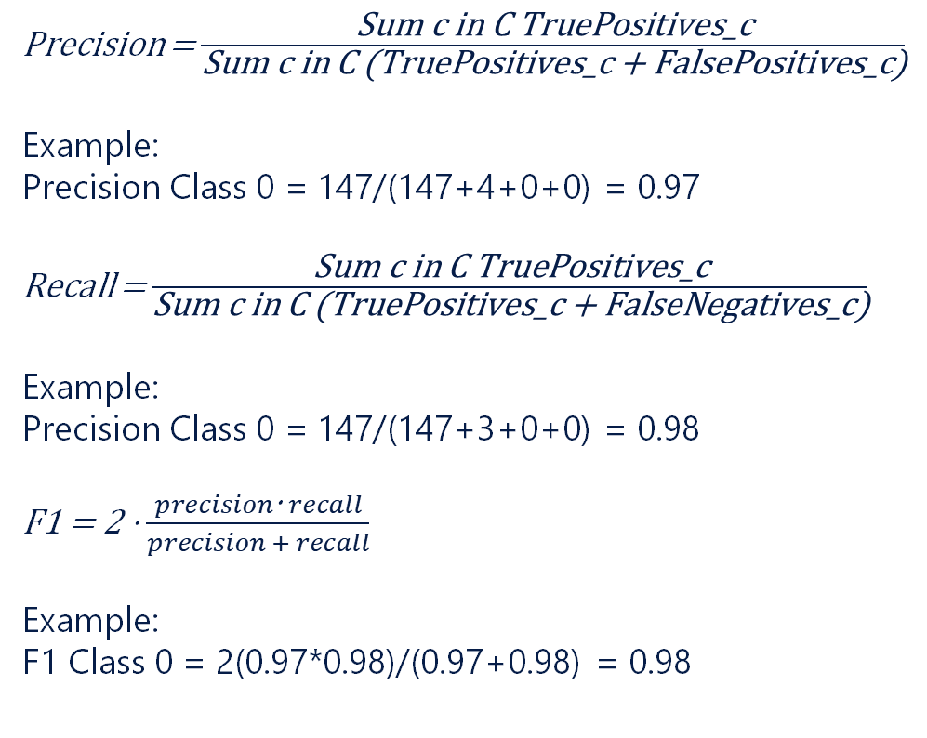
Model Results – Classification Report
Precision = $\frac{\text{Sum} \text{c} \text{in} \text{C} \text{TruePositives}\text{_}\text{c}}{\text{Sum} \text{c} \text{in} \text{C}\text{ (}\text{TruePositives}\text{_}\text{c}\text{ + }\text{FalsePositives}\text{_}\text{c}\text{)}}$
Example:
Precision Class 0 = 147/(147+4+0+0) = 0.97
Recall = $\frac{\text{Sum} \text{c} \text{in} \text{C} \text{TruePositives}\text{_}\text{c}}{\text{Sum} \text{c} \text{in} \text{C}\text{ (}\text{TruePositives}\text{_}\text{c}\text{ + }\text{FalseNegatives}\text{_}\text{c}\text{)}}$
Example:
Precision Class 0 = 147/(147+3+0+0) = 0.98
F1 = 2 ⋅ $\frac{precision\text{⋅} recall}{precision + recall}$
Example:
F1 Class 0 = 2(0.97*0.98)/(0.97+0.98) = 0.98

Slide 21
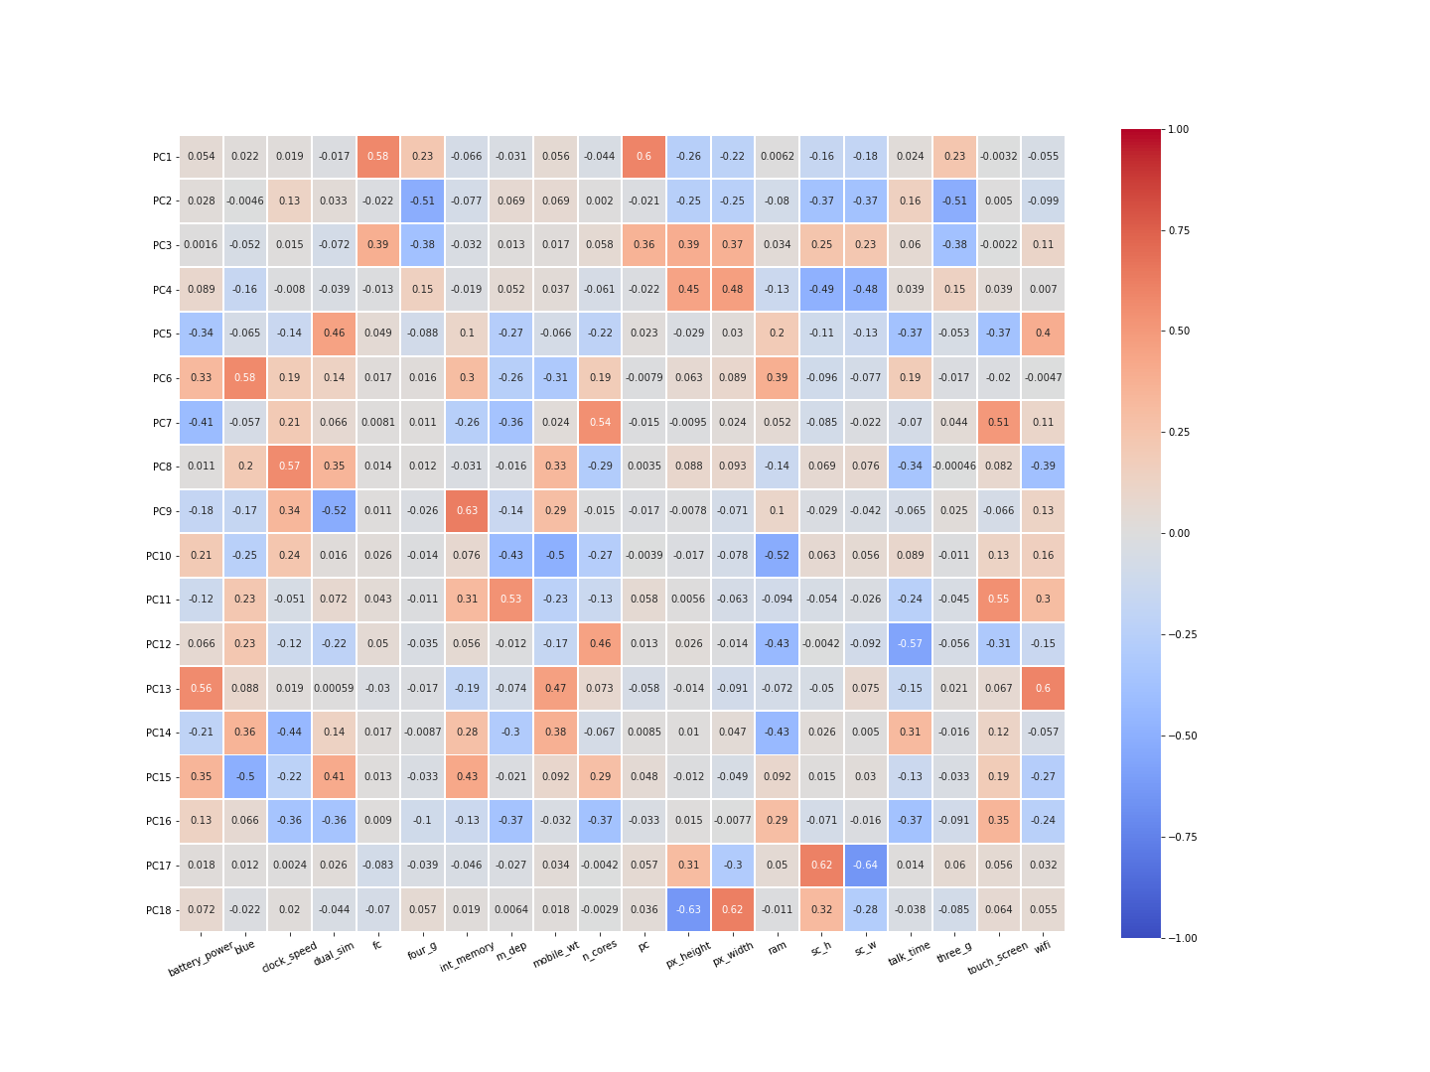
PC Loadings

