Slide 1
Review Intelligence Agent
Week 1 Review — Data Understanding & First EDA
DS Group AI/ML Engineering Internship | Amazon Fine Food Reviews

Slide 2
Dataset Overview
Amazon Fine Food Reviews — Kaggle (snap/amazon-fine-food-reviews)
568,454
10
1999–2012
74,258
Raw reviews collected
Original columns
Time span covered
Unique products
Core columns
A full data dictionary documenting every column
(name, type, meaning, role) was completed as part of
Day 3 of the plan.
ProductId, UserId — identify what's being reviewed and by whom
Score (1–5) — the target rating
Summary, Text — the review content (main NLP input)
HelpfulnessNumerator / Denominator — review quality signal

Slide 3
Data Quality Issues Found & Fixed
174,562 duplicate reviews removed
Same review (UserId + Time + Text) posted under multiple ProductIds — likely different flavors/sizes of the same product
2 broken helpfulness rows removed
Rows where HelpfulnessNumerator exceeded HelpfulnessDenominator — logically invalid
BEFORE
AFTER CLEANING
568,454
393,890
raw rows
clean, unique rows
Why this matters
Counting the same opinion multiple times would bias sentiment analysis and let duplicated reviews dominate model training. Removing them ensures every insight reflects a genuinely unique customer opinion.
Post-cleaning validation
All Score values fall within the valid 1–5 range (0 invalid rows)
Helpfulness columns pass sanity checks — no negative or malformed values

Slide 4
Sentiment Label Design
How star ratings are converted into positive / negative / neutral labels
1–2 stars
3 stars
4–5 stars
Negative
Neutral
Positive
Why treat 3 stars as neutral?
A 3-star rating is genuinely ambiguous — it doesn't cleanly signal satisfaction or dissatisfaction. Forcing it into positive or negative would introduce label noise into the sentiment model rather than reduce it.

Slide 5
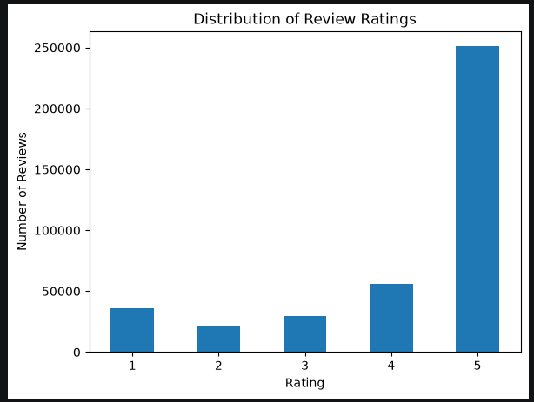
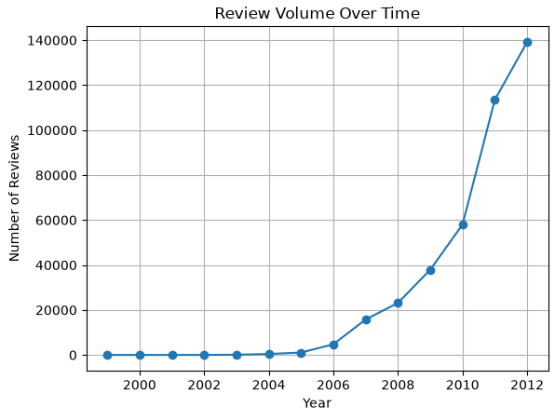
Key EDA Findings
Ratings are heavily skewed positive — roughly two-thirds are 5-star, only ~5% are 2-star. This class imbalance means the sentiment model will need class weighting, and accuracy alone would be misleading.
Review volume grew massively after 2007 and is dominated by 2011–2012 — most of the data is recent by the dataset's own standards, worth noting as a limitation later.

Slide 6
Next Week — NLP Exploration
1
2
3
4
Text Cleaning
N-gram Analysis
Helpfulness Insight
First Dashboard
Build a reusable pipeline: lowercase, remove punctuation/HTML, strip stop words
Compare common words/phrases between positive and negative reviews
Study how helpfulness_ratio relates to rating, length, and review age
Build initial Streamlit views: KPIs, rating trend, sentiment mix
Week 1 status: dataset cleaned, validated, and documented — on track for the 45-day plan.

