Slide 1
Amazon Fine Food Reviews
AI Review Intelligence Analyst
Week 5 — Agent Integration, Semantic Retrieval, Sentiment Inference & Guardrails
CLEAN REVIEWS
BEST CLASSIFIER
MACRO-F1
GUARDRAILS
393,890
DistilBERT
0.9504
32 / 32
deduplicated
281k training partition
untouched test
passed
From validated ML experiments → working review intelligence application
Ishaan Sharma • B.Tech AI/ML • DS Group Internship
1

Slide 2
Week 5 — Completed Work
Integration and application layer built around the validated models.
01
Semantic Search
02
Sentiment Inference
100k MiniLM-L6-v2 embeddings + FAISS IndexFlatIP.
Fine-tuned DistilBERT + calibrated confidence.
03
AI Analyst
04
Guardrails
Read-only Search, KPI and Predict tools.
32/32 safety cases passed; writes blocked.
Reviews → Clean data → Models → Retrieval / Prediction → Agent → Dashboard
2
DS Group Internship • Week 5 • Ishaan Sharma
2

Slide 3
Data & Problem Definition
Amazon Fine Food Reviews after cleaning and sentiment construction.
RAW REVIEWS
DUPLICATES REMOVED
CLEAN REVIEWS
BINARY REVIEWS
568,454
174,562
393,890
364,122
• Sentiment mapping: 4–5 stars → positive; 1–2 stars → negative; 3 stars → neutral.
• Clean sentiment distribution: 77.95% positive, 14.50% negative, 7.56% neutral.
• Binary sentiment model uses positive vs negative; neutral is excluded from classifier training.
• 0/0 helpfulness-vote cases are excluded for helpfulness-ratio calculation because the ratio is undefined.
Goal: combine predictive sentiment intelligence with review-level semantic evidence.
3
DS Group Internship • Week 5 • Ishaan Sharma
3

Slide 4
Leakage-Safe Evaluation
Group-based 80/20 split using full review text as the grouping key.
TRAIN
TEST
EXACT OVERLAP
SEED
291,276
72,846
0
42
80%
20%
train ↔ test
fixed
• GroupShuffleSplit prevents identical review text from appearing across train and test.
• Class proportions were checked after splitting and remained approximately 84/16.
• 5,000 × 5,000 sampled near-duplicate diagnostic: only 3 pairs at ≥0.90 cosine similarity.
• The held-out test set was kept untouched during model selection.
Selection → validation / CV | Final reporting → one untouched test evaluation
4
DS Group Internship • Week 5 • Ishaan Sharma
4

Slide 5
Final Sentiment Model
DistilBERT selected after validation-based hyperparameter experiments.
ACCURACY
MACRO-F1
ROC-AUC
NEGATIVE RECALL
97.39%
0.9504
0.9930
91.38%
test
test
test
test
Model
distilbert-base-uncased
Learning rate
2e-5
Batch size
16
Epochs
2
Weight decay
0.01
Max length
128
Experiments included learning rate, batch size, epochs, class weighting and a second-seed check.
5
DS Group Internship • Week 5 • Ishaan Sharma
5

Slide 6
Class Weighting — Additional Ablation
4× negative-class weighting was tested and rejected.
UNWEIGHTED MACRO-F1
4× MACRO-F1
UNWEIGHTED ACCURACY
4× ACCURACY
0.9504
0.9378
97.39%
96.72%
Metric
Unweighted
4× negative
Change
Macro-F1
0.9504
0.9378
−0.0126
Accuracy
97.39%
96.72%
−0.67 pp
Negative recall
91.38%
89.62%
−1.76 pp
ROC-AUC
0.9930
0.9899
−0.0031
Decision: keep the original unweighted model — weighting did not improve the minority class or Macro-F1.
6
DS Group Internship • Week 5 • Ishaan Sharma
6

Slide 7
Classifier Benchmark
DistilBERT outperformed the tuned TF-IDF + Linear SVM baseline.
LINEAR SVM MACRO-F1
DISTILBERT MACRO-F1
IMPROVEMENT
0.9253
0.9504
+0.0251
Accuracy
96.17%
97.39%
+1.22 pp
Macro-F1
0.9253
0.9504
+0.0251
ROC-AUC
0.9854
0.9930
+0.0076
Negative recall
84.44%
91.38%
+6.94 pp
DistilBERT provides stronger contextual representations than sparse TF-IDF features.
7
DS Group Internship • Week 5 • Ishaan Sharma
7

Slide 8
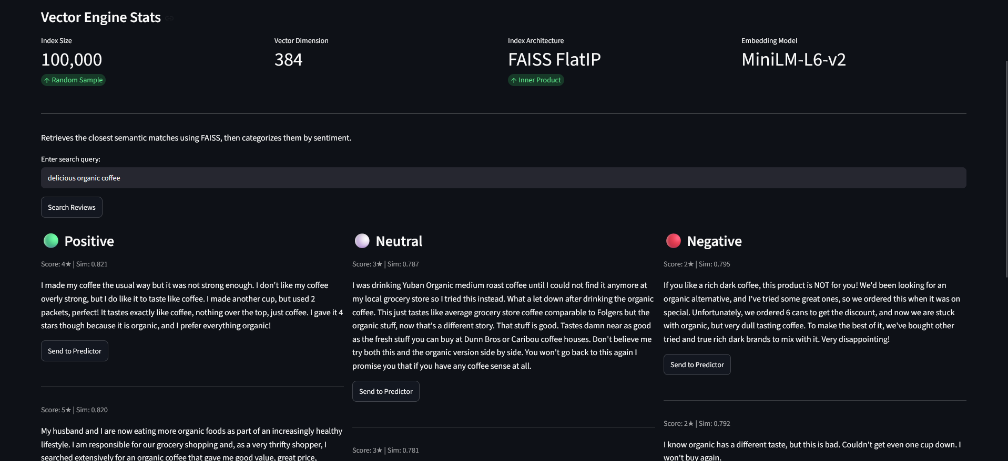
Semantic Search & Vector Engine
Retrieval is a separate component from sentiment classification.
INDEXED REVIEWS
DIMENSION
EMBEDDING
INDEX
100,000
384
MiniLM-L6-v2
FAISS FlatIP
random sample
vectors
pretrained
inner product
Query → MiniLM embedding → FAISS search → review metadata → sentiment context
8
DS Group Internship • Week 5 • Ishaan Sharma
8

Slide 9
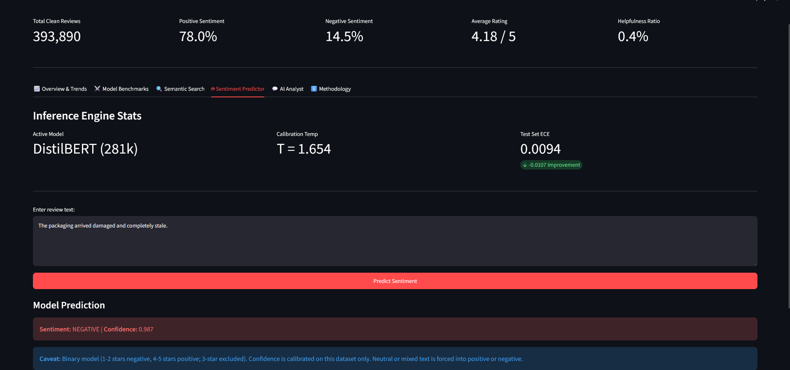
Calibrated Sentiment Inference
Temperature scaling improves probability reliability without changing predicted classes.
ACTIVE MODEL
TEMPERATURE
TEST ECE
DistilBERT
T = 1.654
0.0094
281k partition
fit on validation
raw: 0.0201
Dashboard confidence uses the calibrated output.
9
DS Group Internship • Week 5 • Ishaan Sharma
9

Slide 10
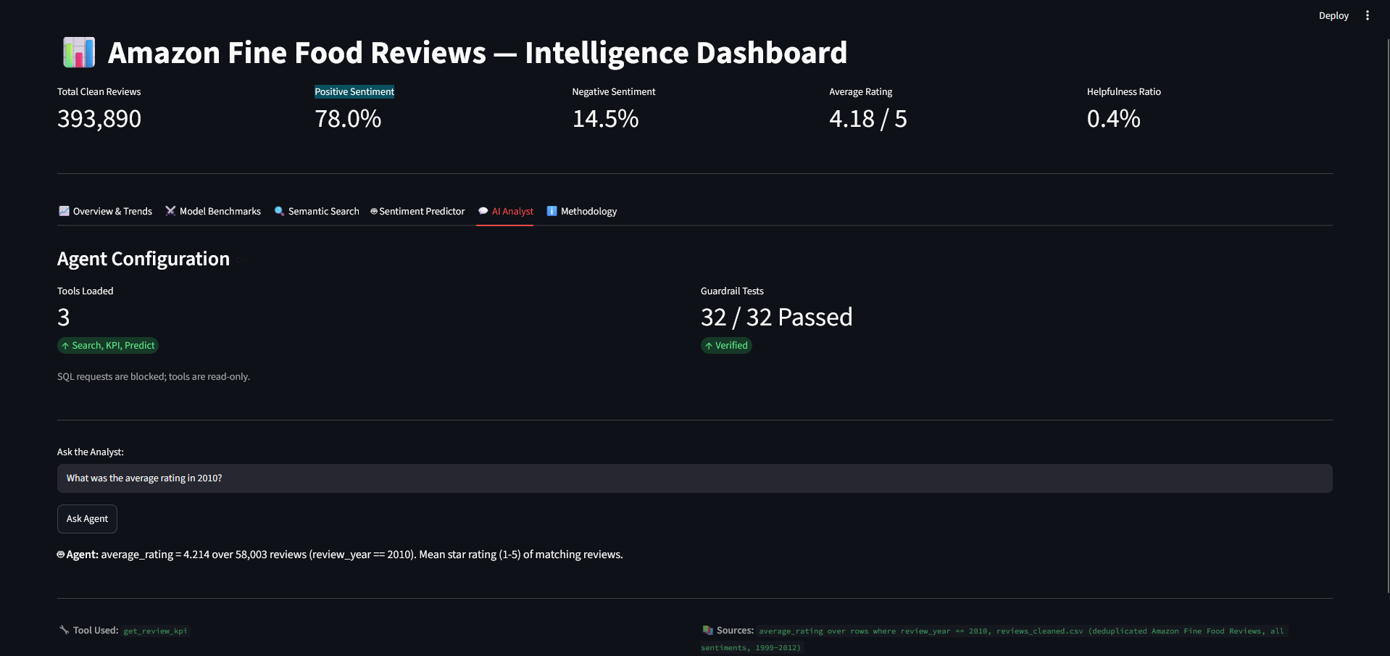
AI Review Analyst
A read-only tool layer connects natural-language questions to grounded analytics.
User question
→
Tool routing
→
Search / KPI / Predict
→
Source-grounded answer
Example: average rating in 2010 → 4.214 over 58,003 reviews → source and tool shown.
10
DS Group Internship • Week 5 • Ishaan Sharma
10

Slide 11
Guardrails & Reliability
The analyst is intentionally constrained to analysis rather than arbitrary actions.
TOOLS LOADED
GUARDRAIL TESTS
WRITE ACTIONS
3
32 / 32
Blocked
Search • KPI • Predict
passed
read-only
• SQL write requests are blocked; exposed tools are read-only.
• Answers are grounded in tool outputs and visible source context.
• Predictor limitation is explicit: 1–2 stars negative, 4–5 positive; 3-star reviews excluded.
• Mixed or neutral free-form text is still forced into the binary model output, and the UI states that limitation.
Principle: useful enough to answer questions, constrained enough to avoid unsafe actions.
11
DS Group Internship • Week 5 • Ishaan Sharma
11

Slide 12
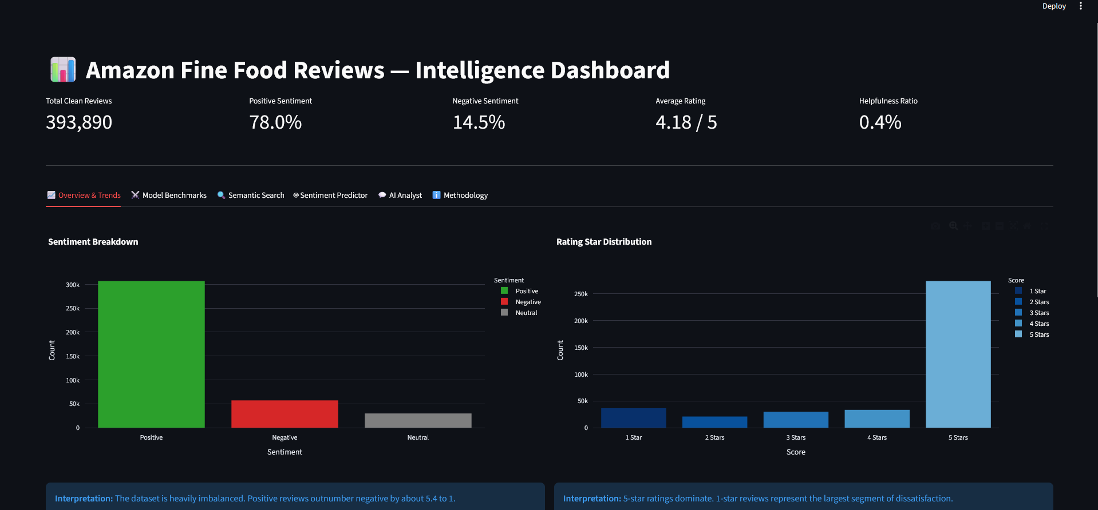
Integrated Dashboard
One interface for dataset intelligence, model evaluation, retrieval, prediction and the agent.
Overview & Trends
Model Benchmarks
Semantic Search
Sentiment Predictor
AI Analyst
12
DS Group Internship • Week 5 • Ishaan Sharma
12

Slide 13
Week 5 — Final Deliverables
Status of the integrated AI Review Analyst.
✓
Dataset intelligence
393,890 clean reviews + KPI/trend analysis
✓
Final sentiment model
97.39% accuracy • 0.9504 Macro-F1 • 0.9930 AUC
✓
Class-weight ablation
4× tested and rejected: 0.9378 Macro-F1
✓
Semantic retrieval
100k MiniLM vectors + FAISS IndexFlatIP
✓
Calibration
T=1.654 • ECE 0.0201 → 0.0094
✓
AI analyst
3 read-only tools: Search / KPI / Predict
✓
Guardrails
32/32 tests passed
✓
Dashboard
Integrated Streamlit intelligence application
Week 5 implementation complete — ready for final demonstration and presentation.
13
DS Group Internship • Week 5 • Ishaan Sharma
13

Slide 14
Key Takeaways
The project moved from model experiments to a defensible review intelligence system.
1
Evidence-driven model selection
DistilBERT was selected through validation experiments.
2
Class weighting was tested
4× negative weighting underperformed and was rejected.
3
Retrieval ≠ classification
MiniLM + FAISS finds evidence; DistilBERT predicts sentiment.
4
Confidence was calibrated
T=1.654 reduced test ECE to 0.0094.
5
Agent is read-only
Three tools answer analytical questions with guardrails.
Thank you
14
DS Group Internship • Week 5 • Ishaan Sharma
14

