Slide 1
VOTING SURVEY FORM

Slide 2

FRONT END ENGINEERING-1 PROJECT
Submitted to - Submitted by -
Mr. Anil Dhawan Kanan Bajaj -2210991732
Kanan Gupta - 2210991733
Kanhaiya Saini - 2210991734
Kanika - 2210991735

Slide 3
TABLE OF CONTENTS
INTRODUCTION
PROBLEM STATEMENT
TECHNICAL DETAILS
KEY FEATURES
PROJECT HIGHLIGHT
CONCLUSION
REFERENCES

Slide 4

Introduction
The introduction of a voting survey form should provide a brief overview of the purpose of the survey and why the respondents' opinions are important. It should also explain how the survey results will be used and any potential benefits of participating in the survey. The survey are completely anonymous and the results are only used for research purposes. The results of the survey are used to make improvements where necessary.

Slide 5
PROBLEM STATEMENT
Low voter turnout: A voting survey form may aim to understand the reasons why people are not voting in elections and to identify strategies to increase voter turnout.
Voter satisfaction: A voting survey form may aim to measure voter satisfaction with the voting process and identify areas where improvements can be made
Accessibility: A voting survey form may aim to identify barriers to voting for people with disabilities or other accessibility issues and to develop solutions to make voting more accessible
Voter education: A voting survey form may aim to assess the level of voter education and awareness about the election process and to develop strategies to improve voter education
Voter fraud: A voting survey form may aim to identify the level of concern about voter fraud and to develop strategies to prevent and detect fraud.

Slide 6
TECHNOLGY AND METHOD USED
HTML (Hypertext Markup Language) : HTML is a markup language used to create the structure and content of web pages. It defines the basic structure of a webpage, such as headings, paragraphs, links, and images.
CSS (Cascading Style Sheets) : CSS is a styling language used to add visual design to web pages. It is used to define the layout, fonts, colors, and other visual elements of a webpage.
JavaScript: JavaScript is a scripting language used to add interactivity and dynamic functionality to web pages. It is commonly used to create animations, interactive forms, and other interactive elements on a webpage.

Slide 7
KEY FEATURES
Clear and concise questions: The questions should be easy to understand and concise, to ensure that respondents understand the questions and can answer them accurately.
Privacy and confidentiality: The survey form should ensure the privacy and confidentiality of the respondents' answers. This can be achieved by providing an option for respondents to submit their responses anonymously.
Accessible and user-friendly: The survey form should be accessible to all respondents, regardless of their technical skills or abilities. It should be user-friendly and easy to navigate, with clear instructions and prompts.
Demographic questions: Demographic questions, such as age, gender, and occupation, can help researchers understand the characteristics of the population being surveyed and how responses differ across groups.

Slide 8
PROJECT HIGHLIGHT

Slide 9
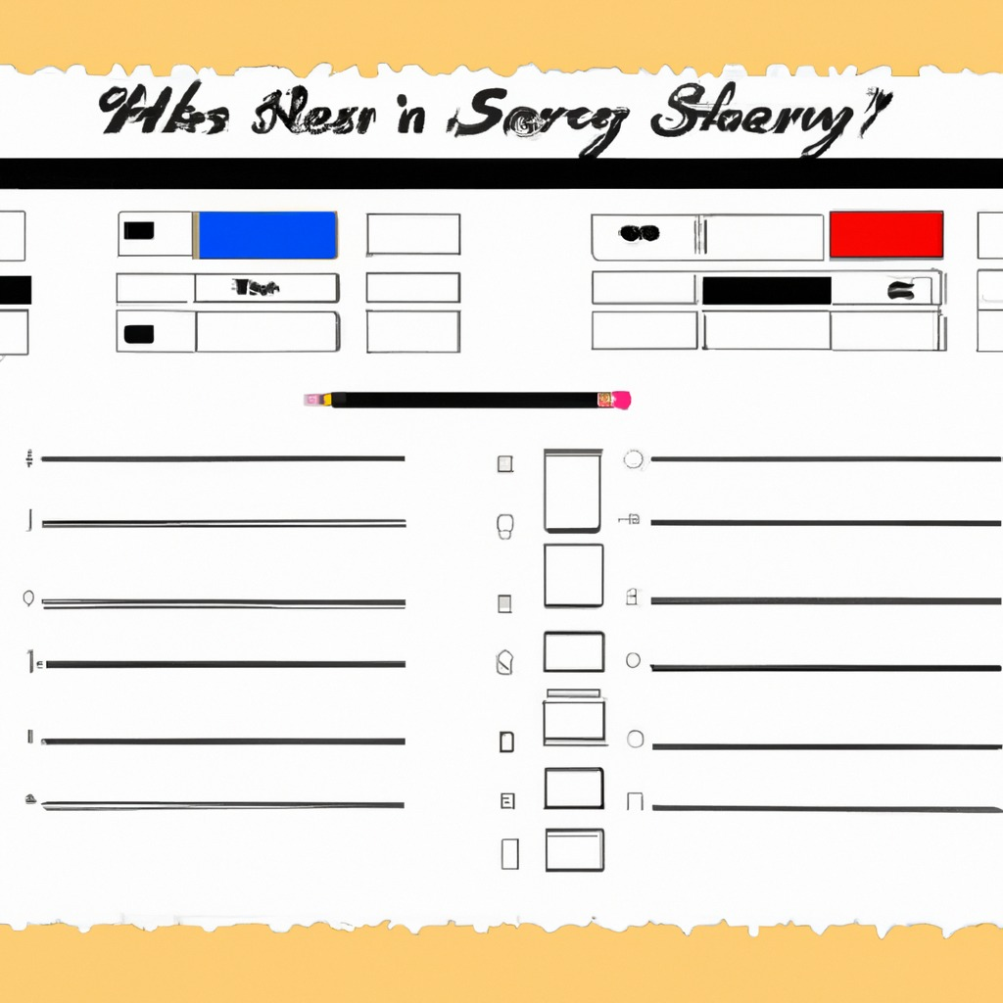
CONCLUSION
Overall, the conclusion or result of a voting survey form is to provide valuable information that can guide decision-making and help organizations or individuals achieve their goals. However, it is important to note that the accuracy and reliability of the survey results depend on factors such as the sample size, survey methodology, and data analysis techniques used. Therefore, it is crucial to ensure that the survey is designed and executed effectively to yield accurate and reliable results.

Slide 10
REFERENCE
www.Wikipedia.com
www.jotform.com
www.surveyform.com
www.typeform.com
www.strawpoll.com

Slide 11
Thank you

