Slide 1
Project Presentation of Ptoject
On
CulinaryCrafts : A Food App
Submitted By:
Ishaan Singla (2210992582)
Sanya Bajaj (2210992255)
Ishneet (2210991681)
Submitted To:
Dr. Preeti Saini

Slide 2

Introduction
Culinary Crafts is a dynamic platform for food enthusiasts to explore, create, and connect. More than just a recipe site, it offers features like a Recipes Section for discovering and editing recipes, a Socials Section for sharing pictures and chatting, and an Ingredients Section for buying essentials.
With tutorials, categorized recipe searches, and an inviting interface, Culinary Crafts makes cooking accessible and fun for everyone, from beginners to seasoned chefs. Join us to redefine your culinary journey and celebrate the joy of food!

Slide 3
PROBLEM STATEMENT
In the modern era, food enthusiasts seek platforms that combine learning, social interaction, and convenience in one place. However, existing food apps often lack real-time social engagement, seamless integration of multiple features, and robust backend systems to support diverse user needs. Users demand a platform where they can explore recipes, interact with like-minded individuals, and shop for ingredients efficiently, all while enjoying a smooth and reliable experience.
The lack of a unified solution that offers dynamic recipe management, real-time social communication, and efficient shopping functionality creates a gap in the market. Additionally, the backend infrastructure of such applications must be scalable, secure, and optimized to handle large volumes of user data and interactions without performance issues.
Culinary Crafts aims to address these challenges by developing a comprehensive platform that integrates recipe exploration, real-time social communication using WebSockets, and ingredient shopping, supported by a robust backend infrastructure built with modern technologies. This solution seeks to provide users with a seamless, interactive, and engaging experience tailored to their culinary needs.

Slide 4
SOLUTION APPROACH
Our approach for this project is focused on developing a robust backend using:
  Backend Development : Utilizing Node.js.
    Frameworks and Libraries: Express.js for building the server, Mongoose for MongoDB integration, and bcrypt for secure login functionalities.
  Frontend Connection: Integrating the backend with a React frontend.
    Frontend Technologies: React.js, HTML/CSS, JavaScript.
  Routes:
    Home Page: Displays general information and navigation.
    Social (Chat): Allows users to chat with others in real-time.
    Recipe: Provides a to-do list for cooking tutorials.
    Cart: Manages the shopping cart for kitchen essentials.

Slide 5
Key Features & Functionalities
Dynamic Recipe Management: Users can explore, edit, and personalize recipes
across various categories. Step-by-step tutorials help beginners learn new cooking
techniques and improve their skills.
Real-Time Social Interactions: Culinary Crafts integrates live chat functionality using
WebSockets, enabling seamless communication. Users can share photos, comment
on posts, and engage in interactive discussions in the Socials Section, fostering a
vibrant community.
Ingredient Shopping Made Easy: The app allows users to purchase kitchen
essentials directly. Ingredients can be browsed based on recipes, added to a cart,
and conveniently checked out, simplifying the cooking process.
Recipe Search and Categorization: Users can search for recipes by cuisine,
ingredients, or difficulty level. The app also provides personalized recommendations
and quick filters for finding meals that suit specific needs, such as healthy or festive
options.
User-Friendly Interface: Culinary Crafts features an intuitive and responsive design,
ensuring a seamless experience across devices. The simple navigation makes
browsing recipes, chatting, and shopping enjoyable for all users.
Secure and Scalable Backend: The robust backend is built using Express.js,
Node.js, and MongoDB, offering scalability to handle large user interactions while
ensuring privacy and data security.

Slide 6
SYSTEM ARCHITECTURE
FRONTEND
(React.js)
BACKEND
(Express.js)
DATABASE
(MongoDB)
-- UI interaction
-- Handle requests
-- Store/retrieve user/recipes/Ingredients
-- State Management
-- API Routes
-- Axios Requests
-- Middleware (JWT)
(Data Handling)
(Backend: Process requests, Data Validation, Auth)
(User Actions: explore recipes, order Ingredients, chat)

Slide 7
Challenges & Solution
Challenge 1: Managing Real-Time Data with HTTP
Solution: Efficiently handling real-time data through regular HTTP requests, pushing updates to MongoDB.
Challenge 2: Secure Data Storage and Management
Solution: Using bcrypt for encryption and Mongoose for effective database management.
Challenge 3: Scalability and Performance
Solution: Optimizing code, employing efficient data handling practices, and ensuring the system can handle increasing loads.
Challenge 4: Ensuring Data Integrity
Solution: Use backend validation and Mongoose schema validation to ensure correct data formatting and prevent corruption.

Slide 8
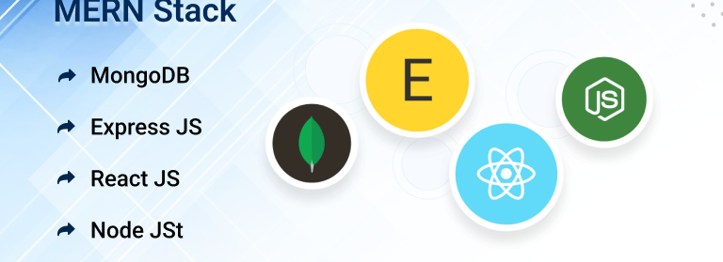
TECH - STACK
.
Back-End : Node js, Express js
Data Base : MongoDB

Slide 9
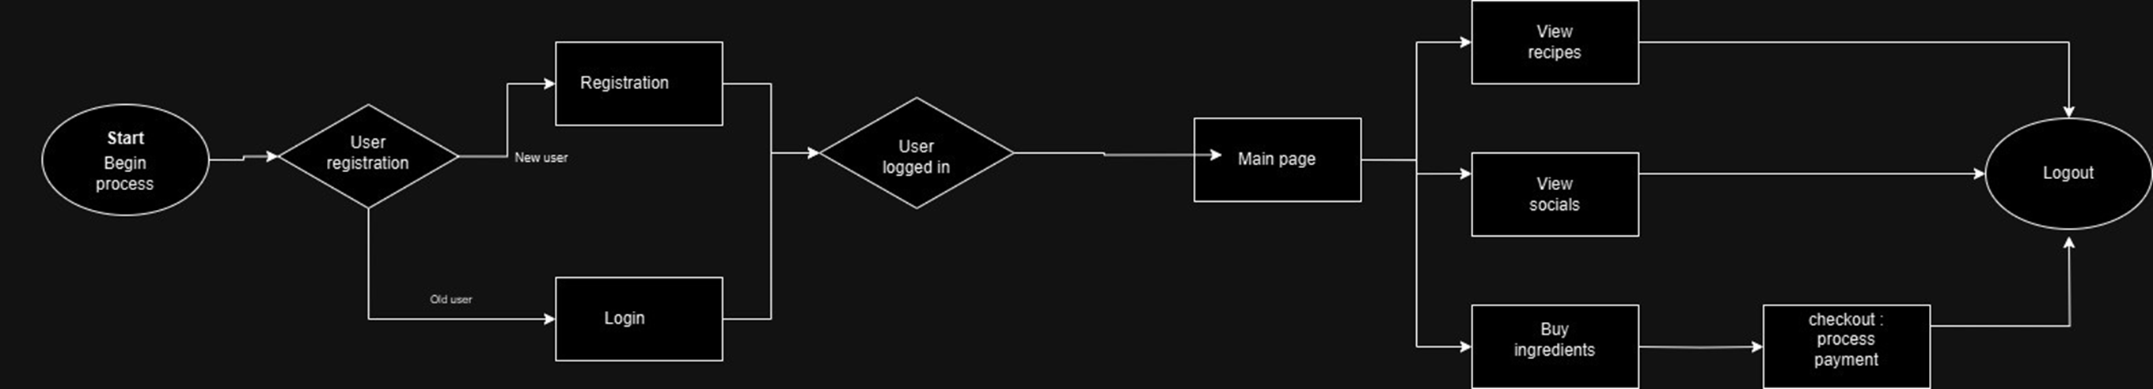
ARCHITECTURE
.
  Explanation:
    Start/Begin Process: Entry point for the application.
    User Registration: Decision point for new or returning users. New users go through Registration, and existing users proceed to Login.
    Main Page: After logging in, users reach the main page with options to:
      View Recipes
      View Socials (Chat)
      Buy Ingredients (which leads to Checkout/Process Payment)
    All paths eventually lead to Logout.

Slide 10
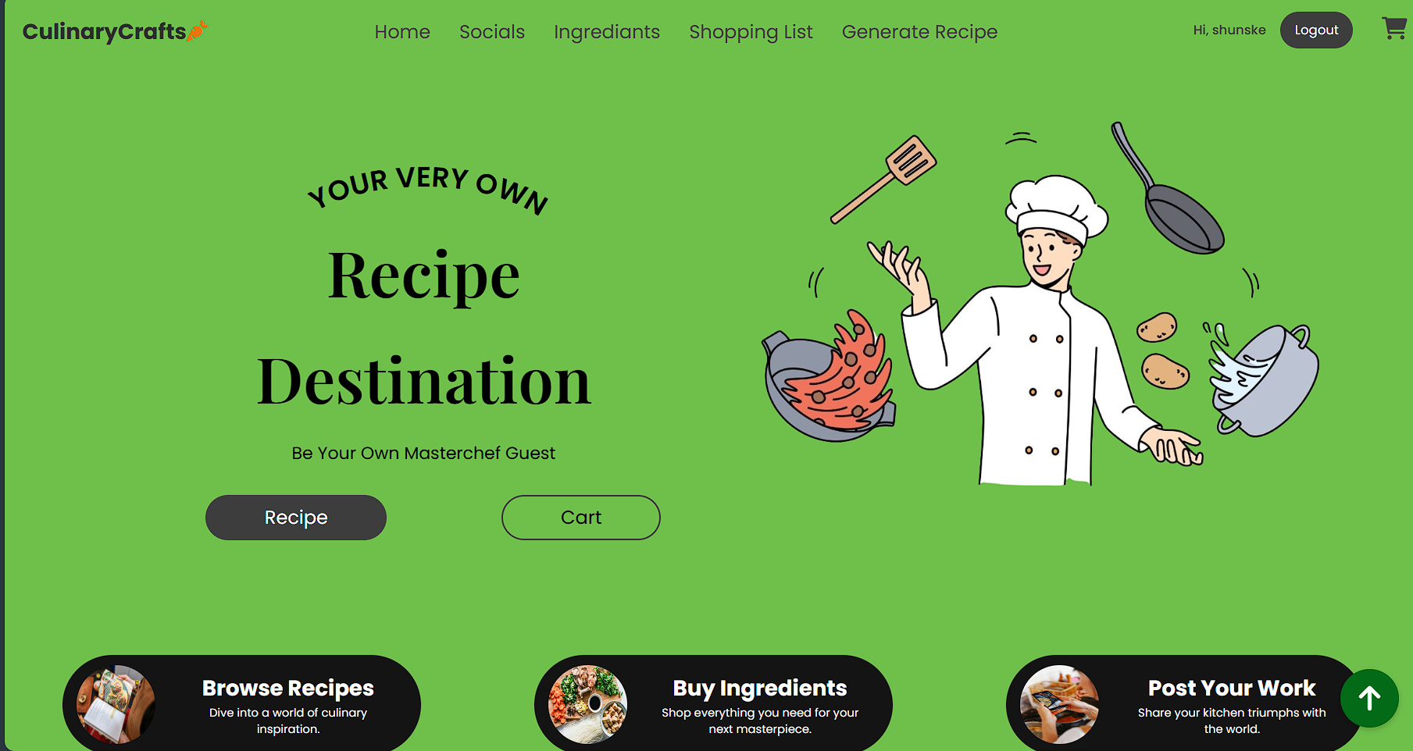
Screenshot

Slide 11
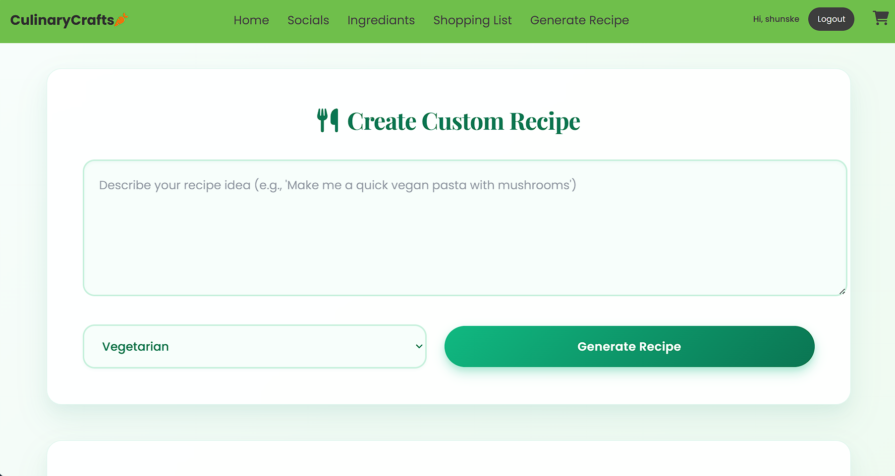

Slide 12
CONCLUSION
"Culinary Crafts" is an ambitious project that aims to provide an engaging and seamless user experience while addressing key challenges in real-time data handling, security, scalability, and media management. By implementing efficient solutions such as leveraging MongoDB's for storing large media files, using encryption for secure data storage, and optimizing performance with techniques like image compression and lazy loading, the platform will offer users a rich and interactive food-related experience. With a focus on security, performance, and scalability, the project is well-equipped to handle growth and evolving user demands, ensuring a robust and future-proof platform.
12

Slide 13
REFERENCE
  ·https://nodejs.org/en/learn/getting-started/introduction-to-nodejs
  ·https://netninja.dev/p/node-js-crash-course
  ·https://www.mongodb.com/docs/
  ·https://www.npmjs.com/
  ·https://mongoosejs.com/
  ·https://www.mongodb.com/atlas
13

Slide 14
Thank You
14

