Slide 1
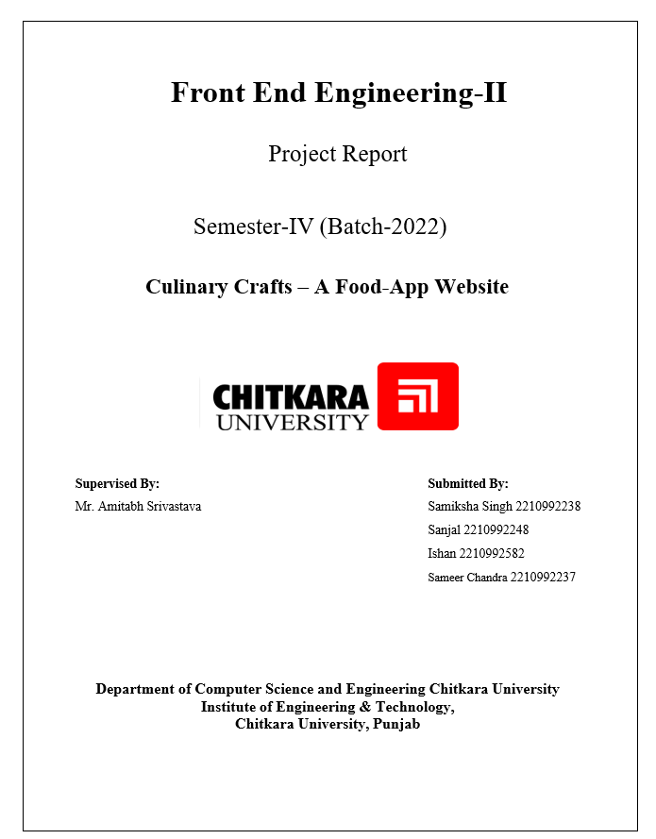



Mrs. Harpreet Kaur

Slide 2

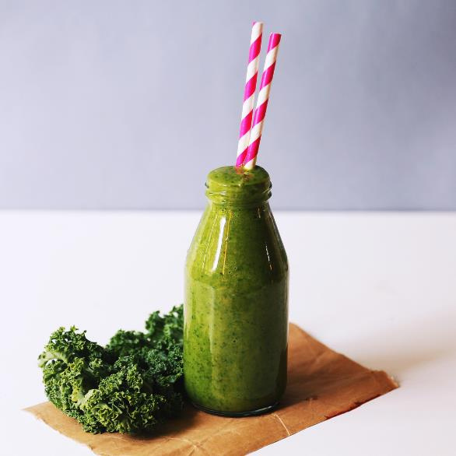

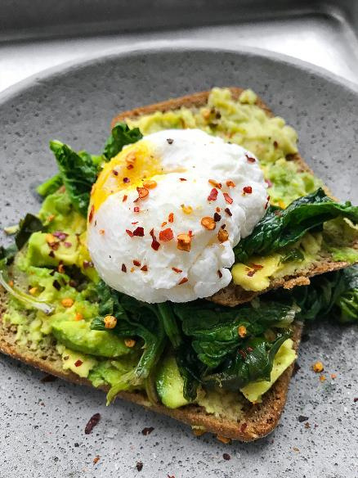
Problem statement
In today's fast-paced world, there is a growing demand for seamless and efficient backend systems to support dynamic and user-friendly applications. Our project aims to develop a robust backend for a food app that enables users to learn cooking, engage in social interactions, and shop for kitchen essentials, all on a single platform

Slide 3



Project Aim
The aim of our project is to develop a backend system that:
Efficiently manages user data and interactions.
Supports interactive tutorials and video lessons.
Facilitates real-time chat functionality for community engagement.
Integrates a secure and scalable e-commerce platform for purchasing kitchen essentials.

Slide 4
Solution Approach
Our approach for this project is focused on developing a robust backend using:
Backend Development : Utilizing Node.js.
Frameworks and Libraries: Express.js for building the server, Mongoose for MongoDB integration, and bcrypt for secure login functionalities.
Frontend Connection: Integrating the backend with a React frontend.
Frontend Technologies: React.js, HTML/CSS, JavaScript.
Routes:
Home Page: Displays general information and navigation.
Social (Chat): Allows users to chat with others in real-time.
Recipe: Provides a to-do list for cooking tutorials.
Cart: Manages the shopping cart for kitchen essentials.

Slide 5

Tech Stack
Frontend
Backend:
Security:
Development Tools:
Cloud Services:
React.js
Node.js, Express.js, Mongoose for MongoDB
bcrypt for secure login functionalities
VS Code, Git
MongoDB atlas

Slide 6
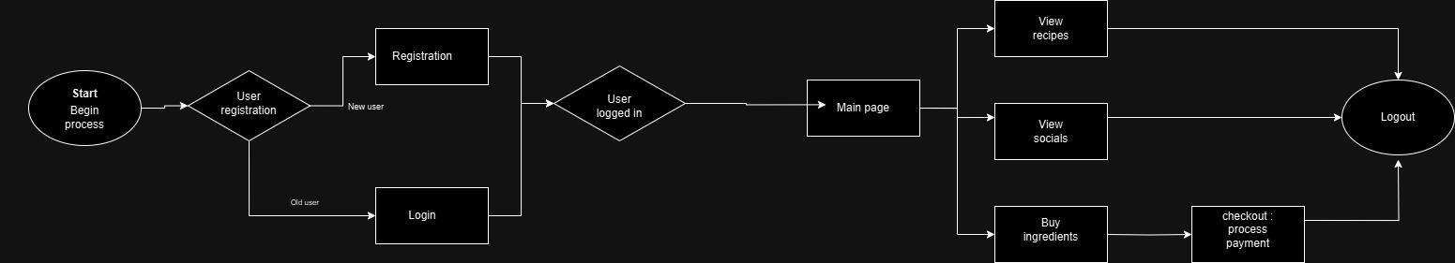
Architecture
Diagram :
Explanation:
Start/Begin Process: Entry point for the application.
User Registration: Decision point for new or returning users. New users go through Registration, and existing users proceed to Login.
Main Page: After logging in, users reach the main page with options to:
View Recipes
View Socials (Chat)
Buy Ingredients (which leads to Checkout/Process Payment)
All paths eventually lead to Logout.

Slide 7
key features
User Authentication and Authorization: Secure login and sign-up using bcrypt.
HTTP-based Data Handling: Managing real-time interactions through regular HTTP requests, storing data in MongoDB.
Interactive Cooking Tutorials: Managed through the Recipe route.
E-commerce Integration: Facilitating purchases through the Cart route.
Data Management and Storage: Efficient handling of user data with MongoDB and Mongoose.

Slide 8
Challenges and Solutions
Challenge 1: Managing Real-Time Data with HTTP
Solution: Efficiently handling real-time data through regular HTTP requests, pushing updates to MongoDB.
Challenge 2: Secure Data Storage and Management
Solution: Using bcrypt for encryption and Mongoose for effective database management.
Challenge 3: Scalability and Performance
Solution: Optimizing code, employing efficient data handling practices, and ensuring the system can handle increasing loads.

Slide 9
Reference
·https://nodejs.org/en/learn/getting-started/introduction-to-nodejs
·https://netninja.dev/p/node-js-crash-course
·https://www.mongodb.com/docs/
·https://www.npmjs.com/
·https://mongoosejs.com/
·https://www.mongodb.com/atlas

Slide 10

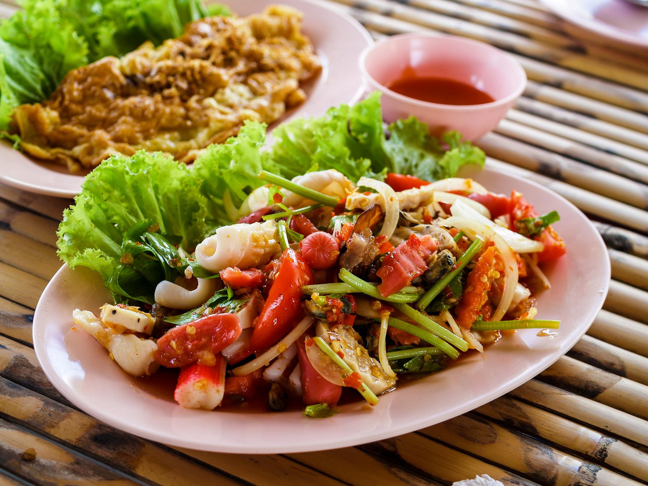


THANK YOU

