Slide 1
Project Presentation
On
DevInsights
Sanskriti - 2210992252
Sanya – 2210992255
Ishaan Singla – 2210992582
Nutan – 2210992005
Supervised By
Ms. Lekha Rani
Department of Computer Science and Engineering,
Chitkara University, Punjab

Slide 2
Problem Statement
Developers struggle to track and manage code changes in large repositories.
Manually reviewing commits and searching code is time-consuming & inefficient.
Need for an AI-powered tool to:
🔍 Summarize commits & provide meaningful insights
🗂️ Enable natural language code search
🤖 Answer developer queries about project files
2

Slide 3
Introduction
Dev Insights – An AI-powered tool for GitHub repo analysis.
Summarizes project updates & commit histories
Provides insightful answers to user queries
Understands code & answers questions about files
Uses AI/ML to simplify project monitoring & trend analysis
Helps developers, managers, and contributors quickly understand project progress

Slide 4
KEY FEATURES INCLUDE:
Effortless Project Summarization – Instantly generates a concise, AI-driven summary of any GitHub repository, eliminating the need for manual exploration.
Deep Commit Analysis – Tracks and analyzes commit history, offering clear insights into code changes, feature additions, and contributions from team members.
Smart AI-Powered Q&A – Enables users to ask questions about the project and receive intelligent, data-backed responses, enhancing accessibility and understanding.
Seamless Code Change Interpretation – Helps developers quickly grasp the impact of their commits by summarizing modifications and highlighting critical updates.

Slide 5
Boosts Productivity and Efficiency – Saves valuable time by automating project analysis, allowing developers to focus on building and innovating.
Enhanced Collaboration & Transparency – Provides a clear overview of contributions, making teamwork more efficient and ensuring transparency across the development process.
Empowered Informed Decision-Making – Equips project managers, developers, and stakeholders with actionable insights to track progress and optimize development strategies.
Simplifies Onboarding for New Developers – Offers a structured project summary, making it easier for newcomers to understand the codebase and contribute effectively.
Automated Transcription: Converts meeting discussions into text using AI for better documentation and accessibility.

Slide 6
Tech Stack
Bun -- Fast JavaScript runtime & package manager
Next.js -- React framework for Server Side rendering & static sites
TypeScript -- Typed superset of JavaScript for safer code
Prisma – Database Management
Gemini API -- Google’s AI model for NLP tasks
Assembly API– For generating Meeting Summary
GitHub API -- Interface for repo & data access
LangChain – Framework for AI-driven applications
TailwindCSS – Utility-first CSS framework for styling
ShadCN – Prebuilt UI components for React
SupaBase—For Storing Files of the meetings

Slide 7
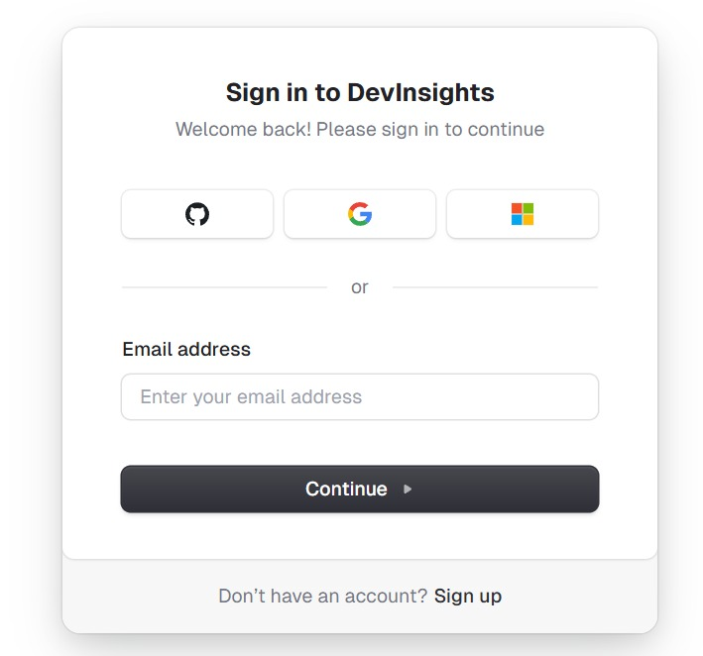
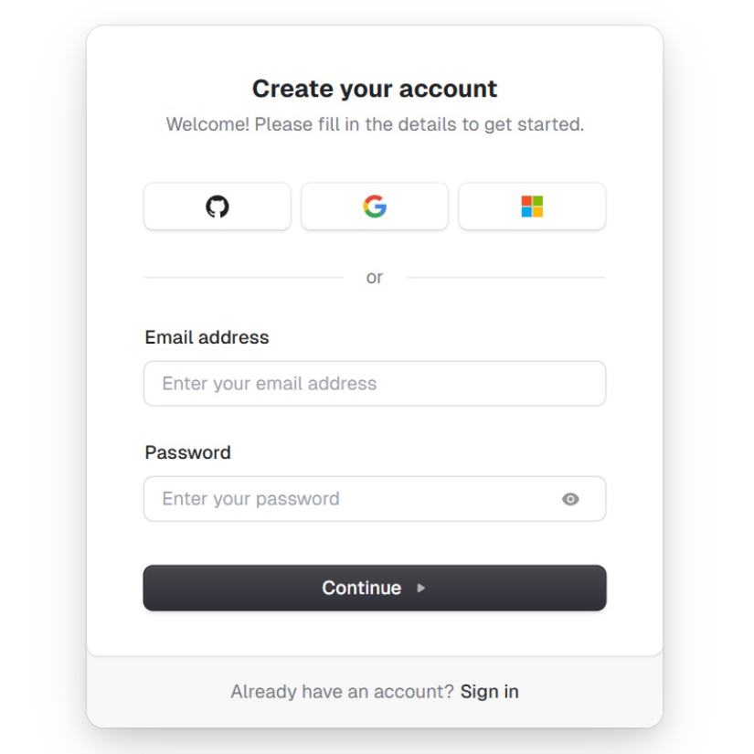
Project Demo

Slide 8
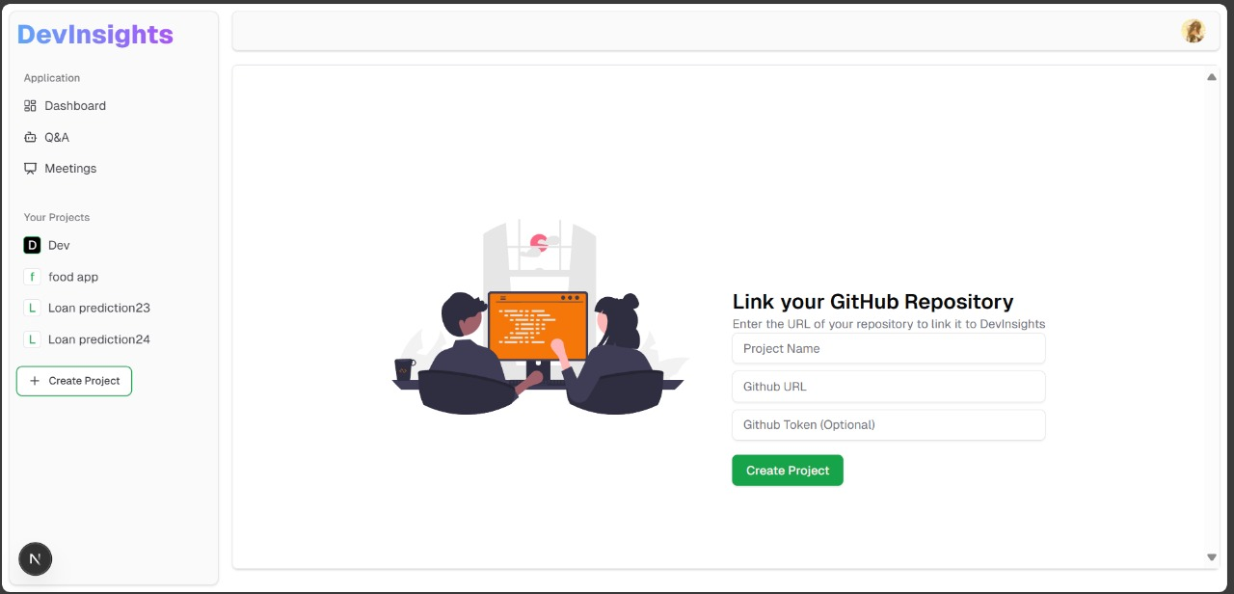
Project Demonstration

Slide 9
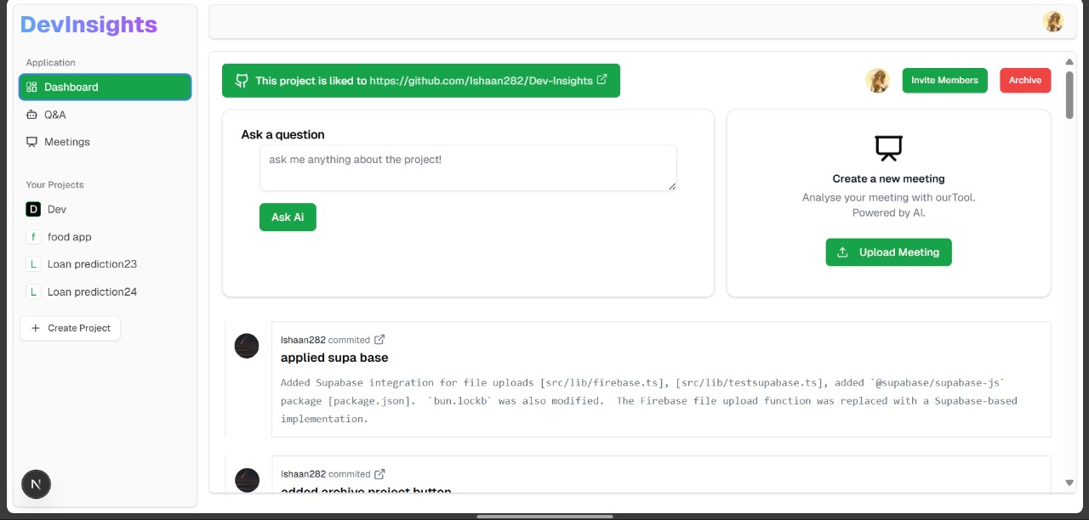

Slide 10
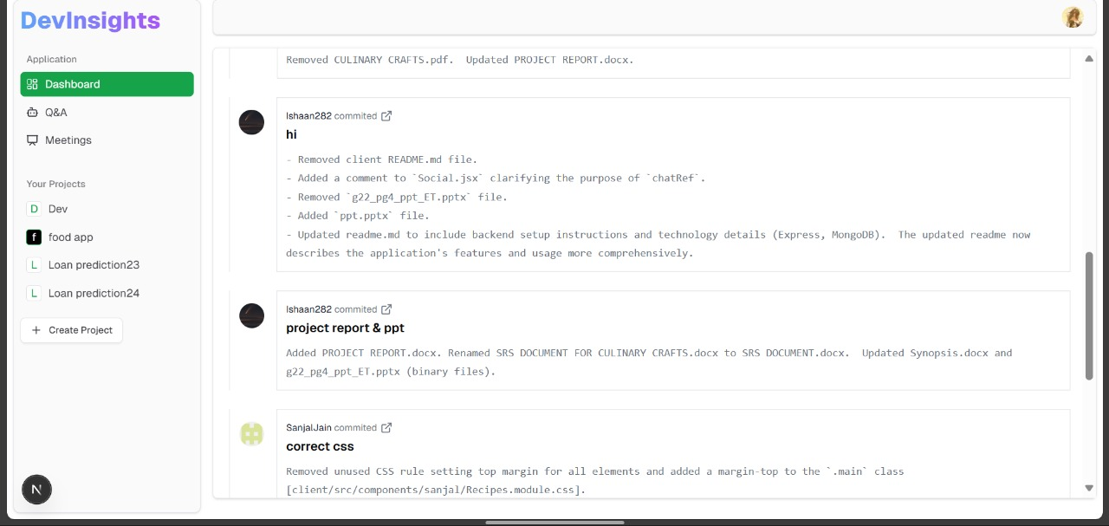

Slide 11
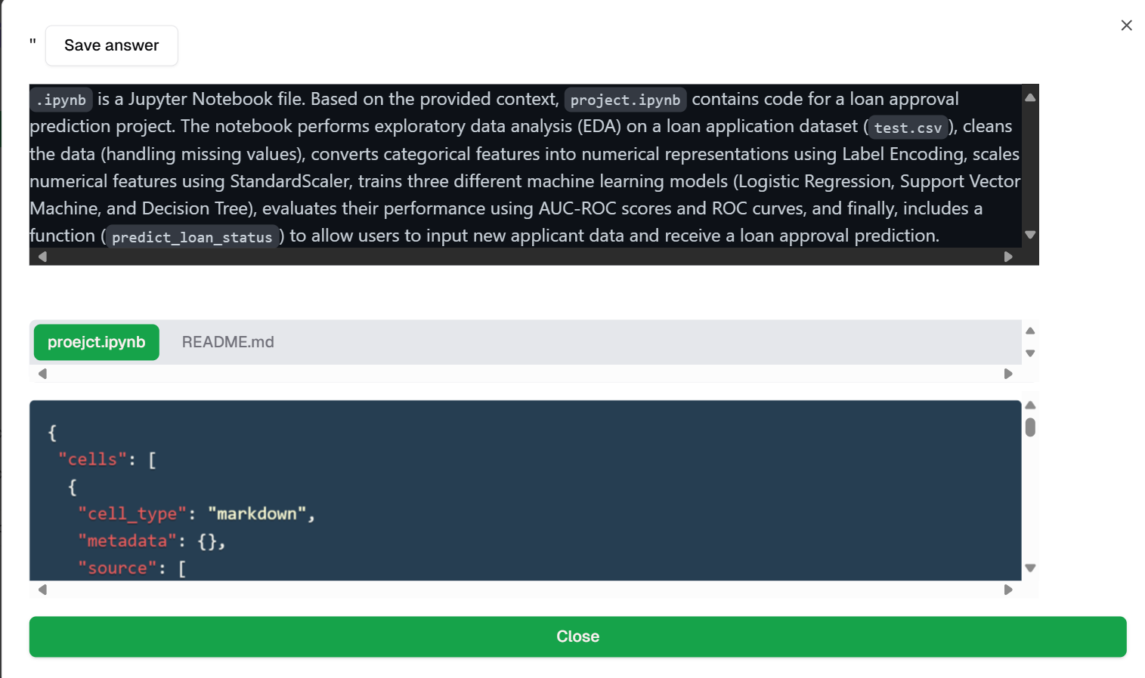

Slide 12
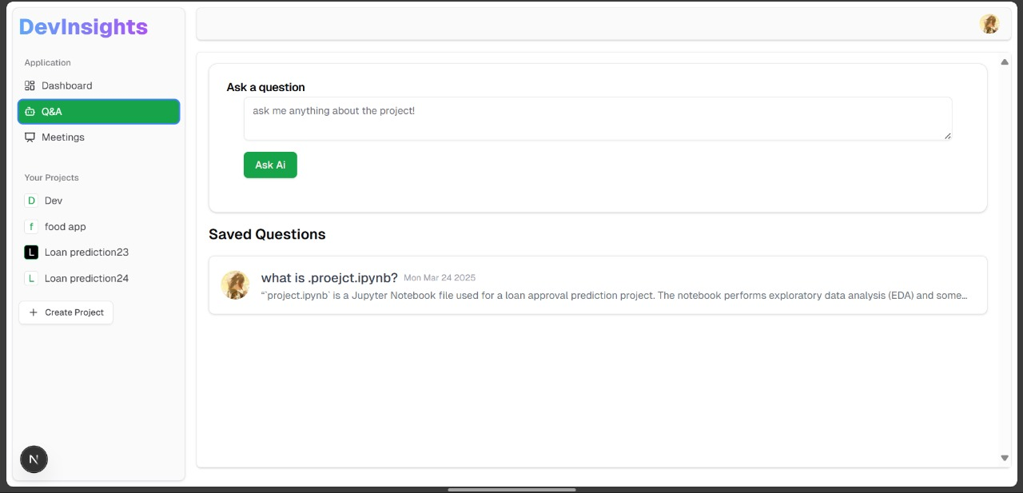
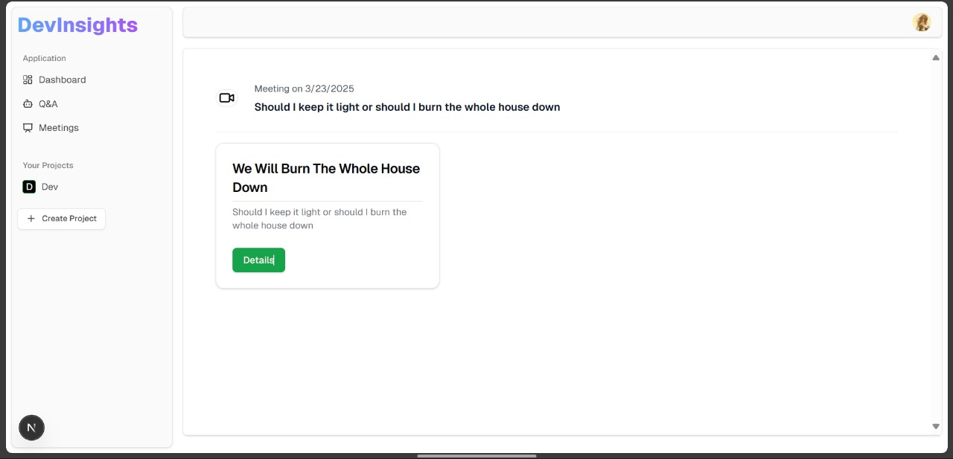

Slide 13
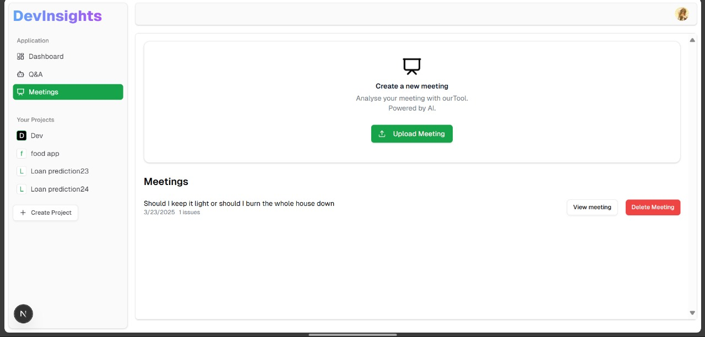

Slide 14
Advantages
Saves Time – No need to manually go through commit logs. Boosts Productivity – AI-assisted code search & commit summaries. Improves Collaboration – Meeting insights & searchable transcriptions. Easy Integration – Works with GitHub for seamless project management. Seamless Integration with GitHub - Syncs with GitHub repositories in real-time.

Slide 15
Future Scope:
AI Chatbot for Project Queries
Develop an interactive AI assistant that can answer repository-related queries, suggest best practices, and even debug code snippets.
2. Multi-Platform Support
Extend support to other version control platforms like GitLab, Bitbucket, and Azure DevOps to reach a broader audience.
Enable seamless integration with CI/CD pipelines to track deployment insights.
3. AI-Based Auto-Generated Documentation
Automate detailed and structured documentation for repositories, making it easier for new developers to onboard.
Generate release notes and changelogs based on commit history.
4. Enhanced Collaboration Features
Introduce real-time developer activity tracking to monitor contributions across different repositories.
Provide automated pull request summaries to speed up code reviews.

Slide 16
Thank You

