Slide 1
CUSTOMER CHURN ANALYTICS
Power BI Dashboard Design
Data model • Fields • DAX measures • Chart mapping • Page layout

Slide 2
Objective
Why this dashboard exists and what it needs to answer
1
Overview
See the headline at a glance — customers, churn rate, tenure and revenue — and how churn splits by contract and churn status.
DASHBOARD SNAPSHOT
4
2
Demographics
Report pages
Compare churn across gender, senior citizen status, partners and dependents to see which customer groups leave most.
23
3
Services
Analytic visuals
Show which internet and streaming services customers use, how churn differs across them, and how many have tech support.
11
DAX measures
4
Financial impact
2
Quantify the revenue lost to churn, compare payment methods and contracts, and surface the highest-value churned accounts.
Data tables
Customer Churn Analytics — Dashboard Design
2

Slide 3
From Raw Data to Dashboard
The build sequence this deck follows
2
15
11
4
Data Tables
→
Fields Used
→
DAX Measures
→
Dashboard Pages
Customers and
Services (Unpivoted)
14 from Customers plus
Service Type — slicers,
axes, legends, table columns
10 on Customers and 1 on
Services (Unpivoted):
churn, revenue, service KPIs
Overview, Demographics,
Services, Financial Impact
Every page is a 1280 × 720 fit-to-page canvas with three dropdown slicers (Contract, Internet Service, Senior Citizen) and a page navigator.
Customer Churn Analytics — Dashboard Design
3

Slide 4
Fields Used in the Dashboard
Columns that drive the slicers, axes, legends and tables — 14 from Customers, 1 from Services (Unpivoted)
Field | How the dashboard uses it
Contract | Slicer on every page; axis of Churn Rate and Revenue Lost to Churn by Contract; table column
InternetService | Slicer on every page; axis of Churn Rate by Internet Service
Senior Citizen Label | Slicer on every page; matrix row under gender
Churn | Yes / No slices of the Customers by Churn Status donut; filter on the top-20 table
gender | Axis of Churn Rate by Gender; matrix row
Partner | Axis of Churn Rate by Partner
Dependents | Axis of Churn Rate by Dependents
Field | How the dashboard uses it
StreamingTV | Pie slices of Churn Rate by Streaming TV
StreamingMovies | Pie slices of Churn Rate by Streaming Movies
PaymentMethod | Axis of Churn Rate by Payment Method
CustomerID | Table column; selects the top-20 churned customers
tenure | Top-20 table column
MonthlyCharges | Top-20 table column
TotalCharges | Table column; ranks the top 20 churned customers
Service Type Services (Unpivoted) | List slicer (visible on Services, hidden elsewhere); axis of Service Adoption
Customer Churn Analytics — Dashboard Design
4

Slide 5
DAX Measures — Customers & Churn
Who the customers are, who left, and how long they stay
Measure | Table | Used in | Role
Total Customers | Customers | Overview KPI card and donut | Base customer count for every split
Churn Rate | Customers | Overview KPI card; every “Churn Rate by …” chart; Demographics matrix | Headline churn KPI (colour-coded)
Senior Citizen Churn Rate | Customers | Demographics KPI card | Churn rate of senior customers (colour-coded)
Non-Senior Churn Rate | Customers | Demographics KPI card | Churn rate of non-senior customers (colour-coded)
Avg Tenure (Months) | Customers | Overview KPI card | Typical customer lifetime, in months
Customer Churn Analytics — Dashboard Design
5

Slide 6
DAX Measures — Revenue & Services
What churn costs, and how widely services are used
Measure | Table | Used in | Role
Total Revenue | Customers | Overview KPI card | Headline revenue figure
Monthly Recurring Revenue | Customers | Financial Impact KPI card | Recurring monthly revenue base
Revenue Lost to Churn | Customers | Financial Impact KPI card (red); Revenue Lost to Churn by Contract waterfall | Revenue lost from customers who churned
% Revenue Lost | Customers | Financial Impact KPI card (red) | Lost revenue as a share of the total
% Customers with Tech Support | Customers | Services KPI card | Share of customers with tech support
Customers with Service | Services (Unpivoted) | Services — Service Adoption bar chart | Customers subscribed to each service
Customer Churn Analytics — Dashboard Design
6

Slide 7
Chart Usage Mapping
Which visual carries which measure, and why
Insight | Chart | Why
10 headline numbers, e.g. Total Customers, Churn Rate, Total Revenue | KPI cards | Single numbers read fastest at a glance
Customers by Churn Status | Donut chart | Clean part-to-whole split with only two slices (Yes / No)
Churn Rate by Contract, Internet Service, Partner, Dependents, Payment Method | Clustered bar | Same measure on every chart, so categories compare like for like
Churn Rate by Gender | Clustered column | Two categories side by side on a common baseline
Churn Rate by Streaming TV and Streaming Movies | Pie chart | Compact view of how churn differs across a service’s few options
Insight | Chart | Why
Churn Rate: Gender × Senior Citizen | Matrix | One measure across two dimensions in a compact grid
Service Adoption (Customers with Service) | Clustered bar | Puts every service on one common axis
Revenue Lost to Churn by Contract | Waterfall chart | Builds up how each contract adds to the total revenue lost
Top 20 Churned Customers | Table | Row-level detail filtered to Churn = Yes and ranked by TotalCharges
Contract, Internet Service, Senior Citizen, Service Type | Slicers | Dropdowns on every page; the Service Type list shows on Services only
Customer Churn Analytics — Dashboard Design
7

Slide 8
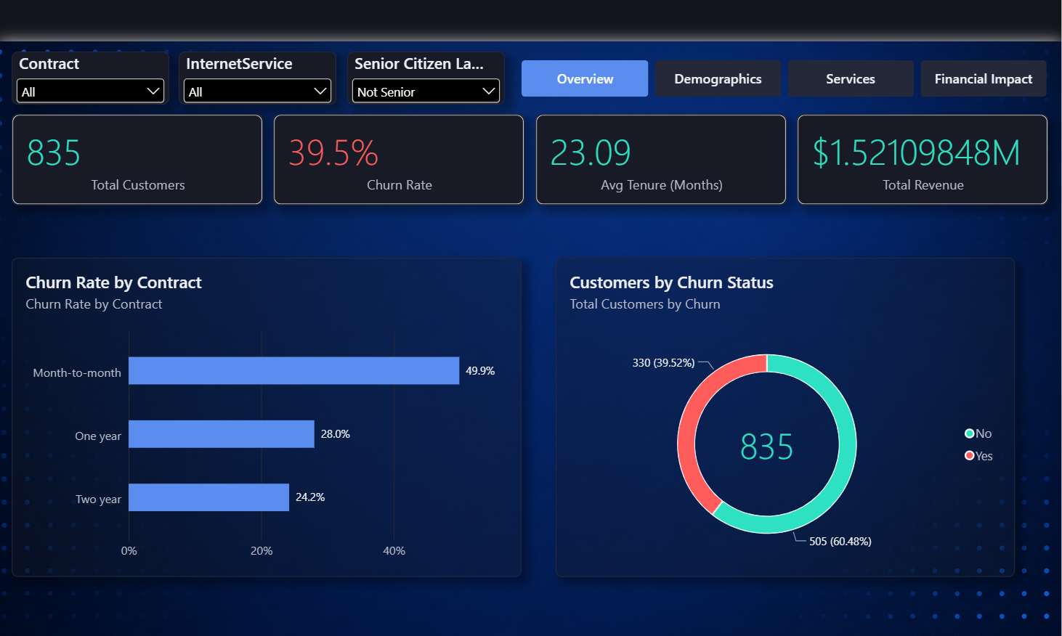
PAGE 1
Overview
Layout render from the .pbix — schematic, no data values
Customer Churn Analytics — Dashboard Layout
8

Slide 9
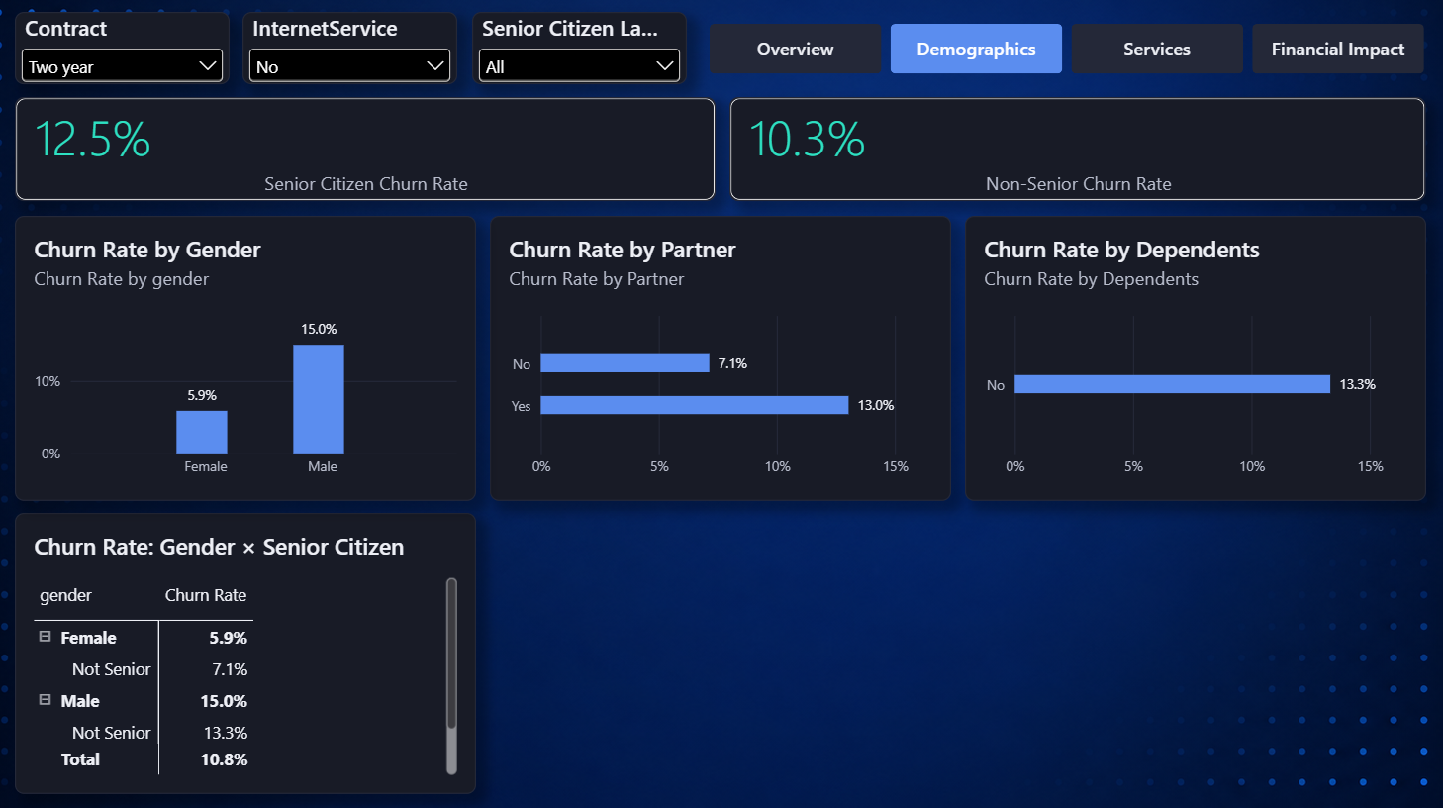
PAGE 2
Demographics
Layout render from the .pbix — schematic, no data values
Customer Churn Analytics — Dashboard Layout
9

Slide 10
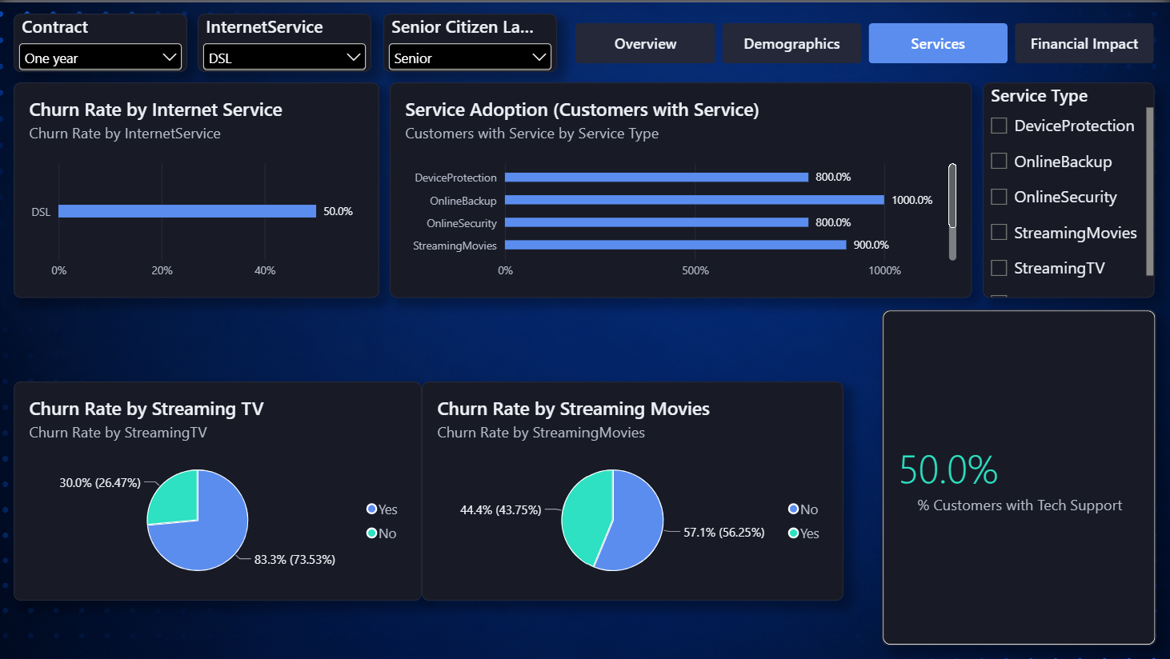
PAGE 3
Services
Layout render from the .pbix — schematic, no data values
Customer Churn Analytics — Dashboard Layout
10

Slide 11
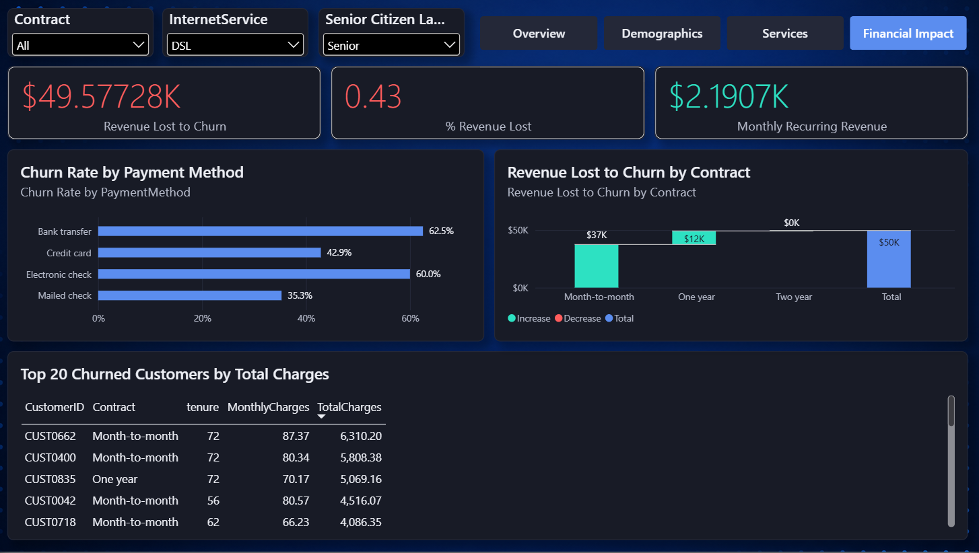
PAGE 4
Financial Impact
Layout render from the .pbix — schematic, no data values
Customer Churn Analytics — Dashboard Layout
11

Slide 12
Recommended Page Order
How a viewer moves through the report
1
2
3
4
Overview
Demographics
Services
Financial Impact
Land here first — headline KPIs, the churn status split, and churn rate by contract.
→
Who churns — gender, senior citizen, partner and dependents, plus the gender × senior matrix.
→
What they use — internet type, service adoption, streaming churn and tech support.
→
Close on the money — revenue lost by contract, recurring revenue, payment methods and the top 20 churned accounts.
Customer Churn Analytics — Dashboard Design
12

Slide 13
Build Order
1
Import customer_churn_dataset.csv, alongside Services (Unpivoted), and confirm data types: tenure/SeniorCitizen as whole numbers, Contract/PaymentMethod as text
2
Add the Senior Citizen Label calculated column next — it drives the slicer on every page and the gender × senior matrix.
3
Build the 11 DAX measures, grouped as Customers & Churn (slide 5) and Revenue & Services (slide 6)
4
Build the four 1280 × 720 pages in the order on the previous slide, using the chart choices from the mapping table.
5
Add the Contract, Internet Service and Senior Citizen dropdown slicers and a page navigator to every page; keep the Service Type slicer visible on Services and hidden elsewhere.

