Slide 1
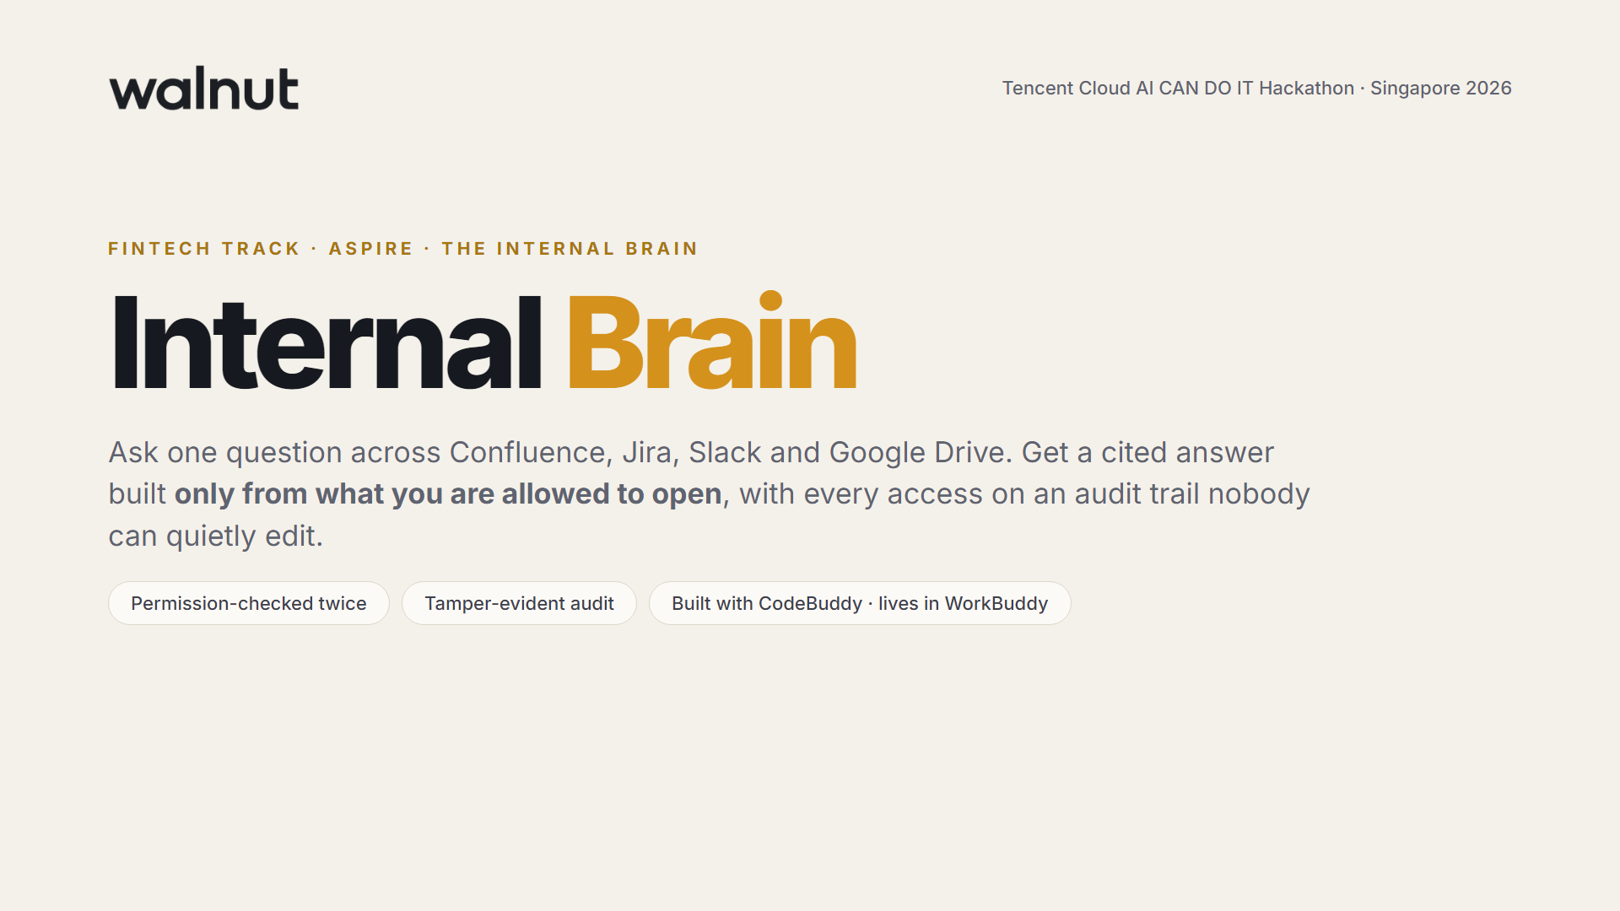
Notes:
Hi, we are Walnut. This is the Internal Brain, our entry for Aspire's FinTech challenge: one place to ask questions across the company's tools, answered only from what you are allowed to see, with every access on an audit trail.

Slide 2
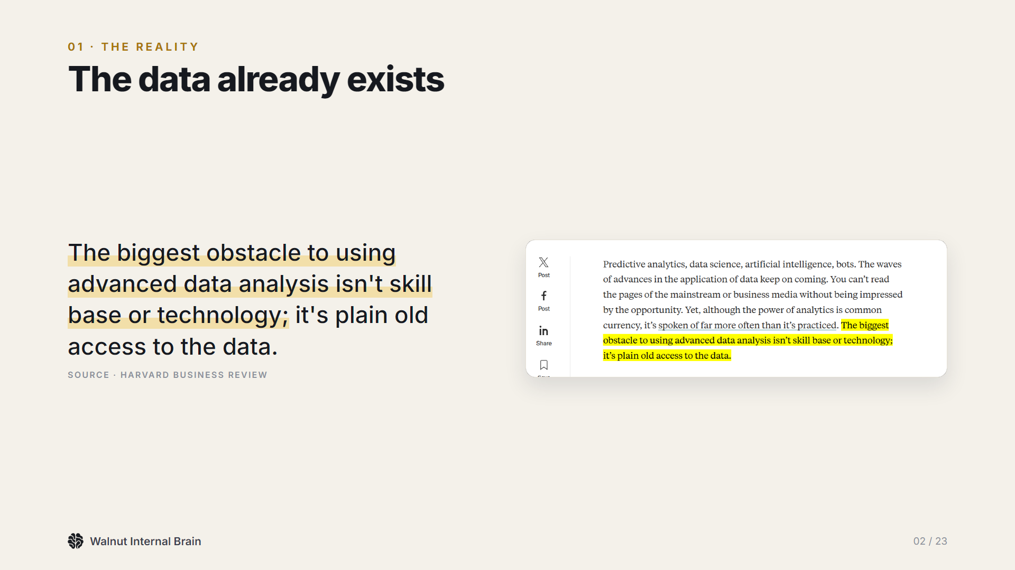
Notes:
Every company already has the answers. The problem, as Harvard Business Review puts it, is plain old access.

Slide 3
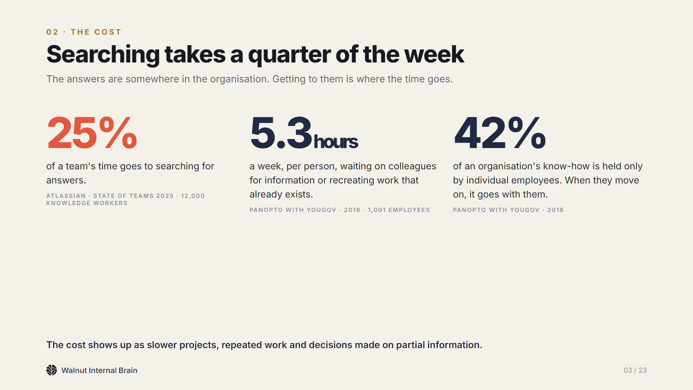
Notes:
A quarter of the week goes on searching. Over five hours a week waiting on colleagues. And 42 percent of know-how sits in people's heads.

Slide 4
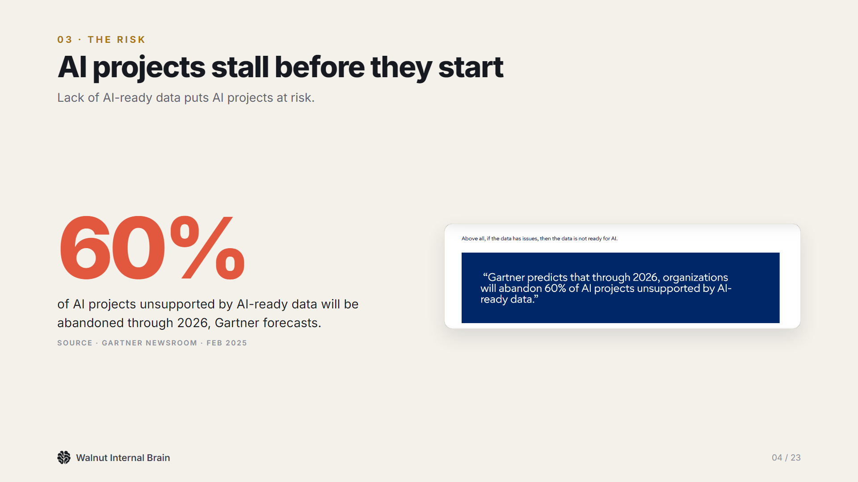
Notes:
And AI does not fix it on its own: Gartner expects most AI projects without AI-ready data to be abandoned.

Slide 5
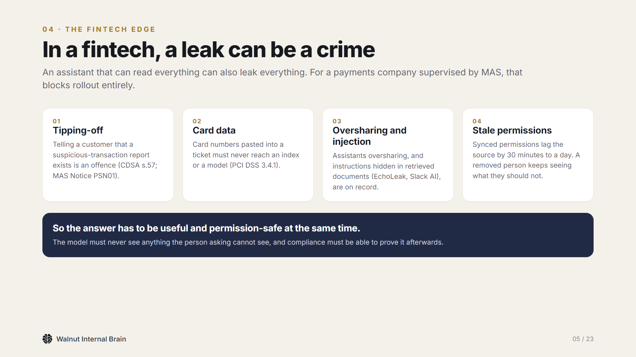
Notes:
In a fintech there is a second edge. A careless assistant can tip off a customer, leak card data or follow instructions hidden in a document. That is the problem Aspire set.

Slide 6
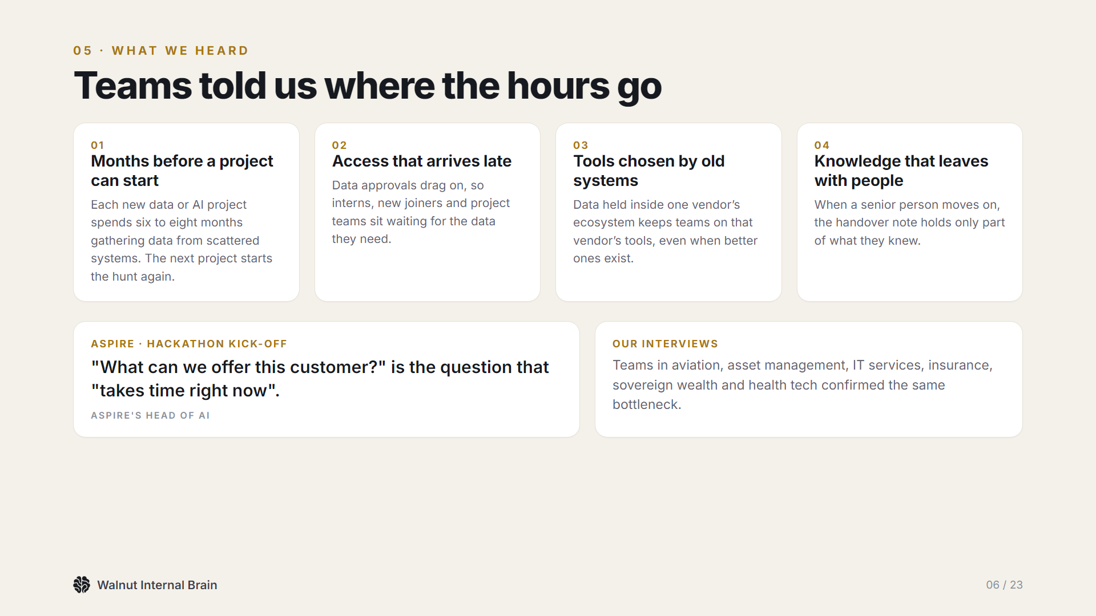
Notes:
We heard the same thing from teams across finance and beyond, and Aspire said it directly at the kick-off: answering 'what can we offer this customer' takes time right now.

Slide 7
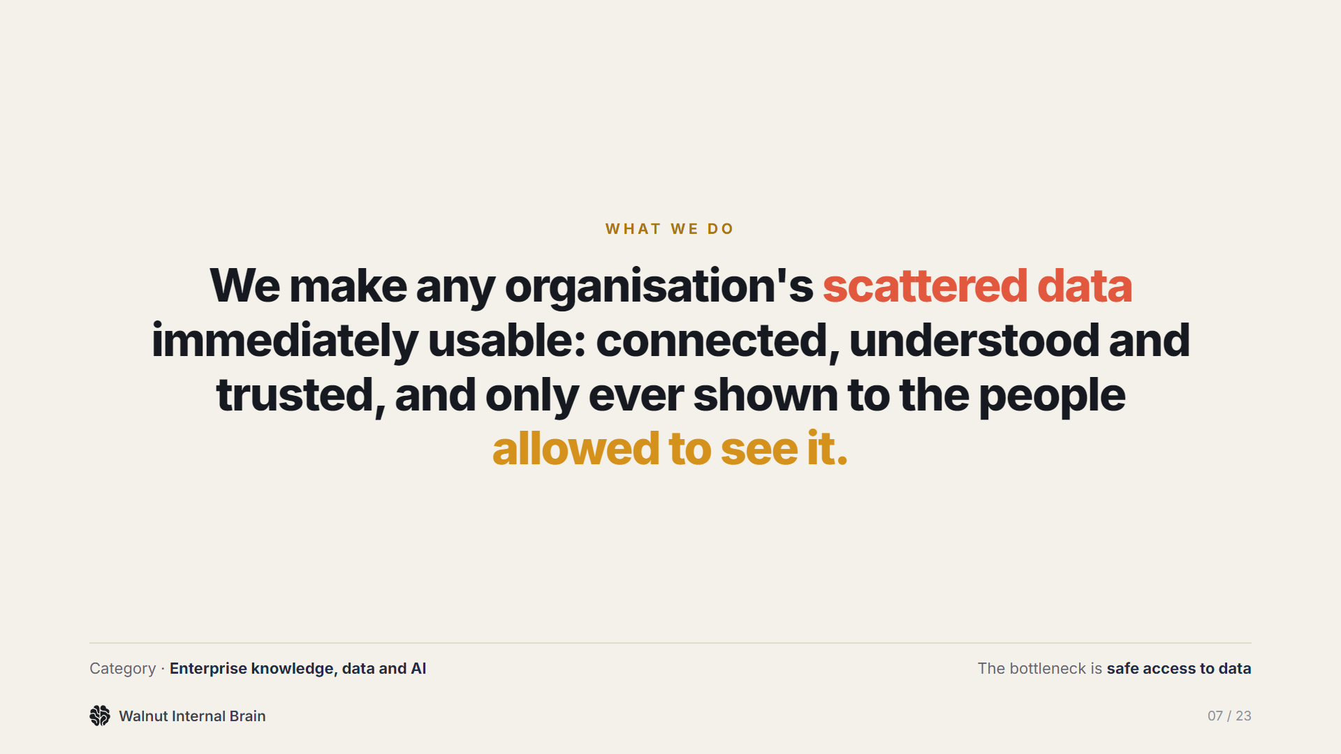
Notes:
That is what Walnut does: it makes scattered data usable, and in a fintech, safe to ask.

Slide 8
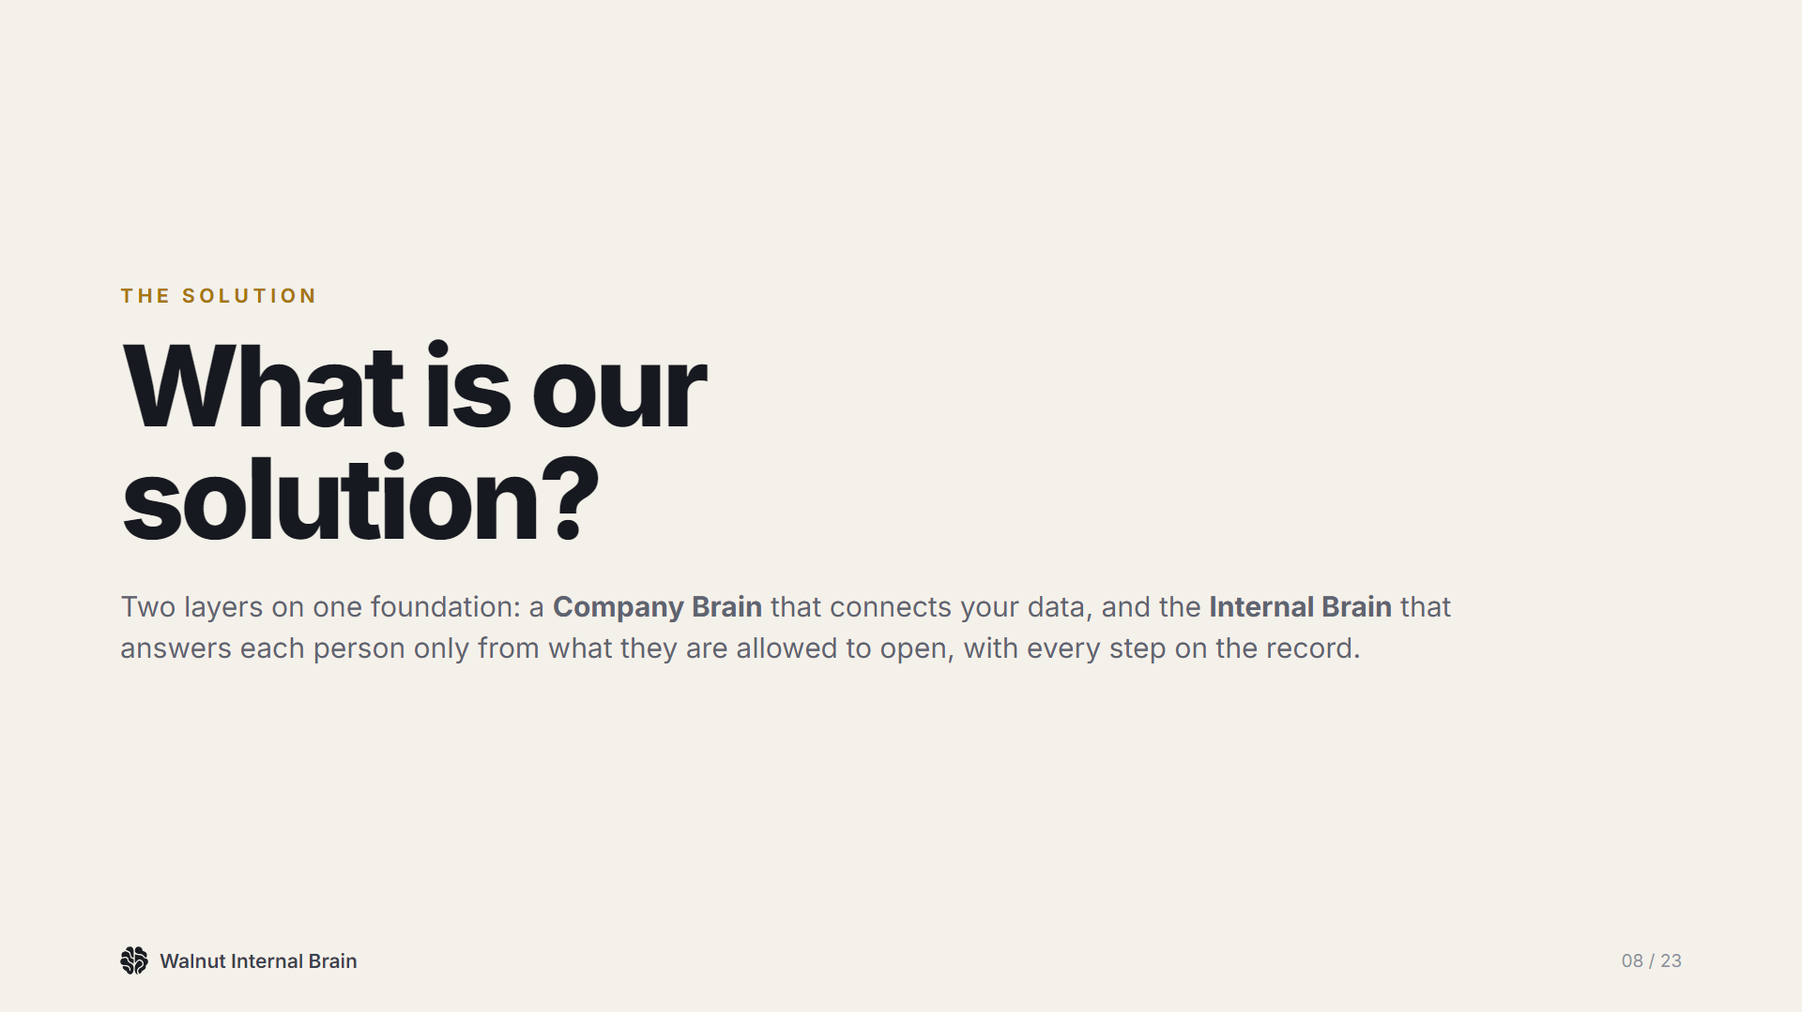
Notes:
Two layers on one foundation: the company brain underneath, and the Internal Brain on top.

Slide 9
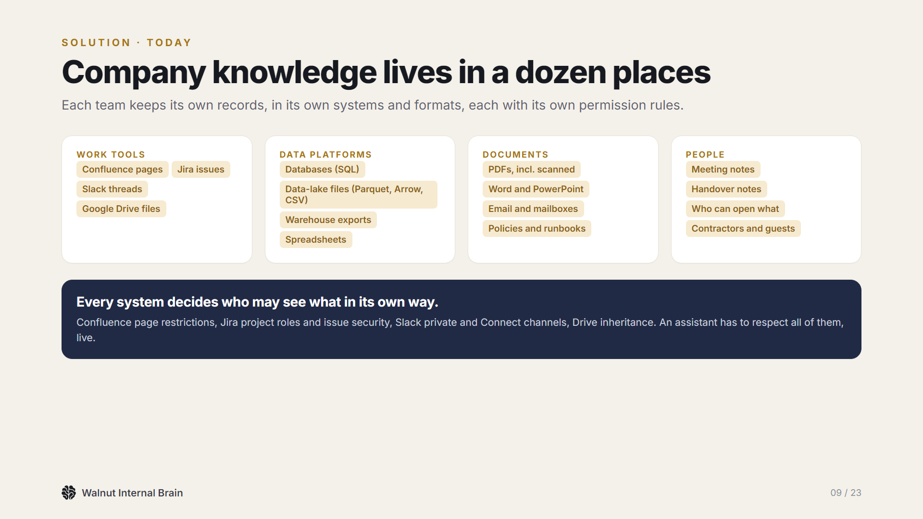
Notes:
Today knowledge sits in a dozen places, each with its own permission model. That is what makes a safe assistant hard.

Slide 10
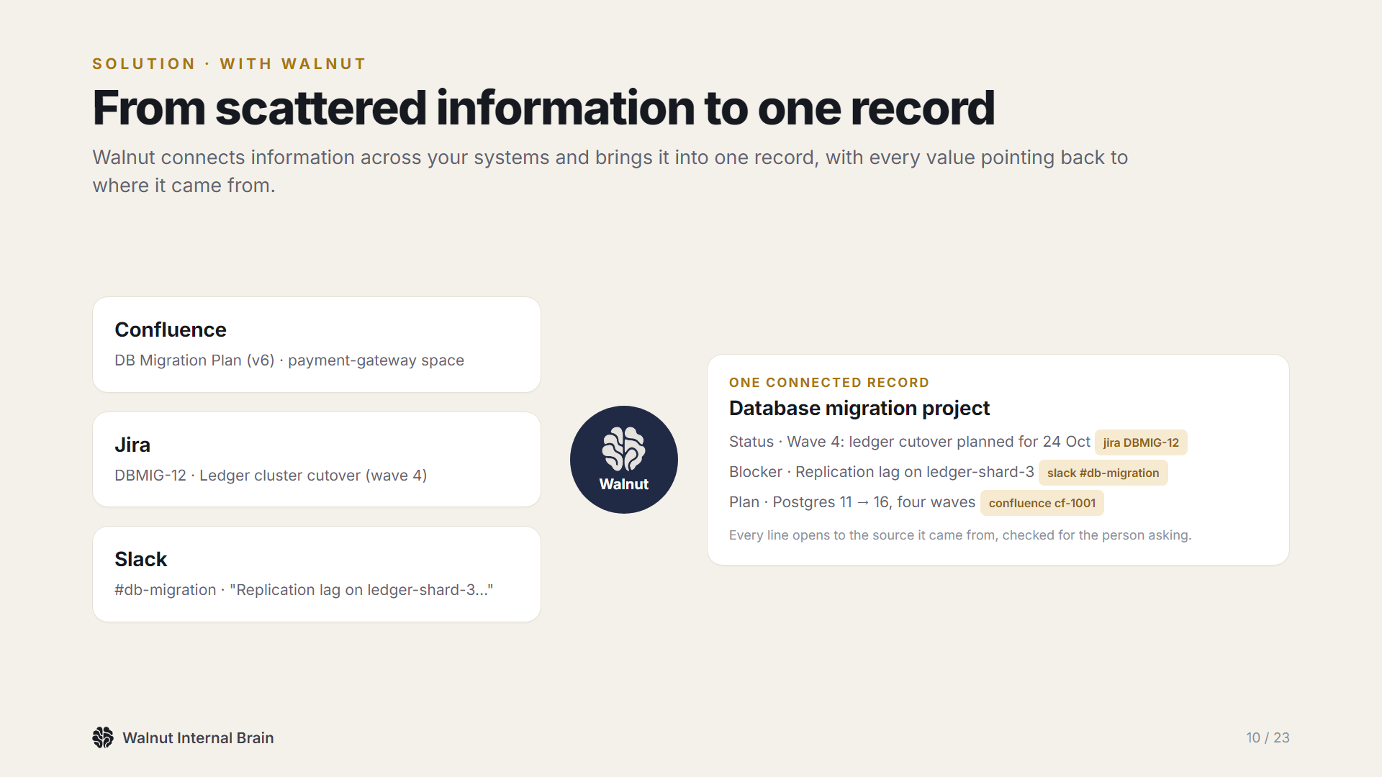
Notes:
Walnut pulls those pieces into one record. Here, a database migration: the plan from Confluence, the ticket from Jira, the blocker from Slack, each linked to its source.

Slide 11
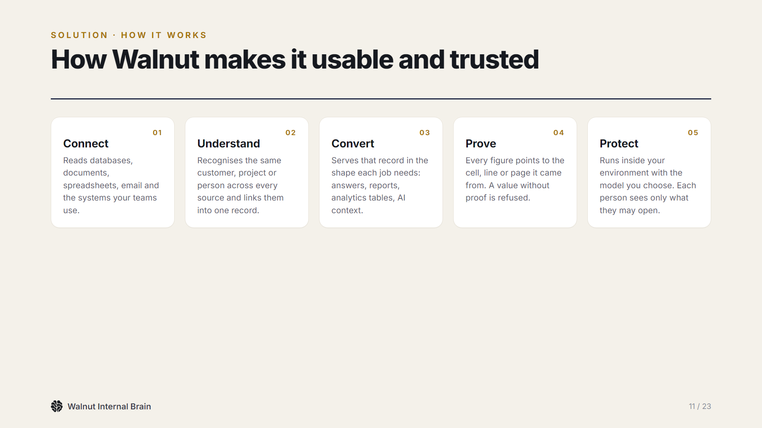
Notes:
Five steps: connect, understand, convert, prove and protect. The last two are what a fintech needs most.

Slide 12
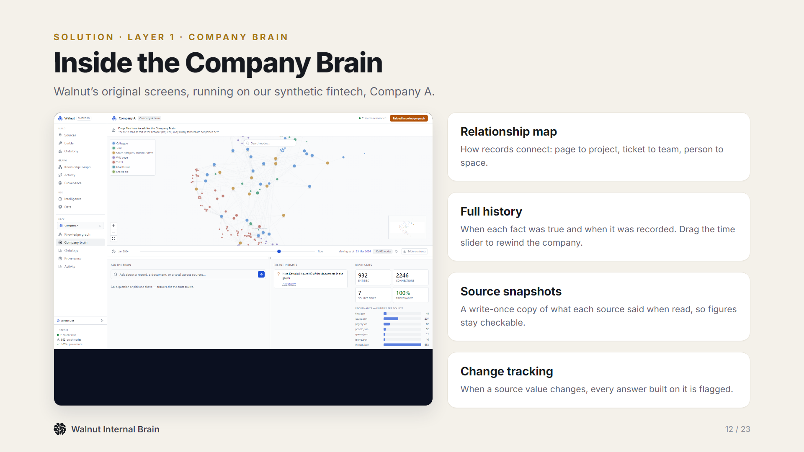
Notes:
This is the company brain itself: a relationship map, full history you can rewind, source snapshots and change tracking. It is Walnut's original engine, reused unchanged.

Slide 13
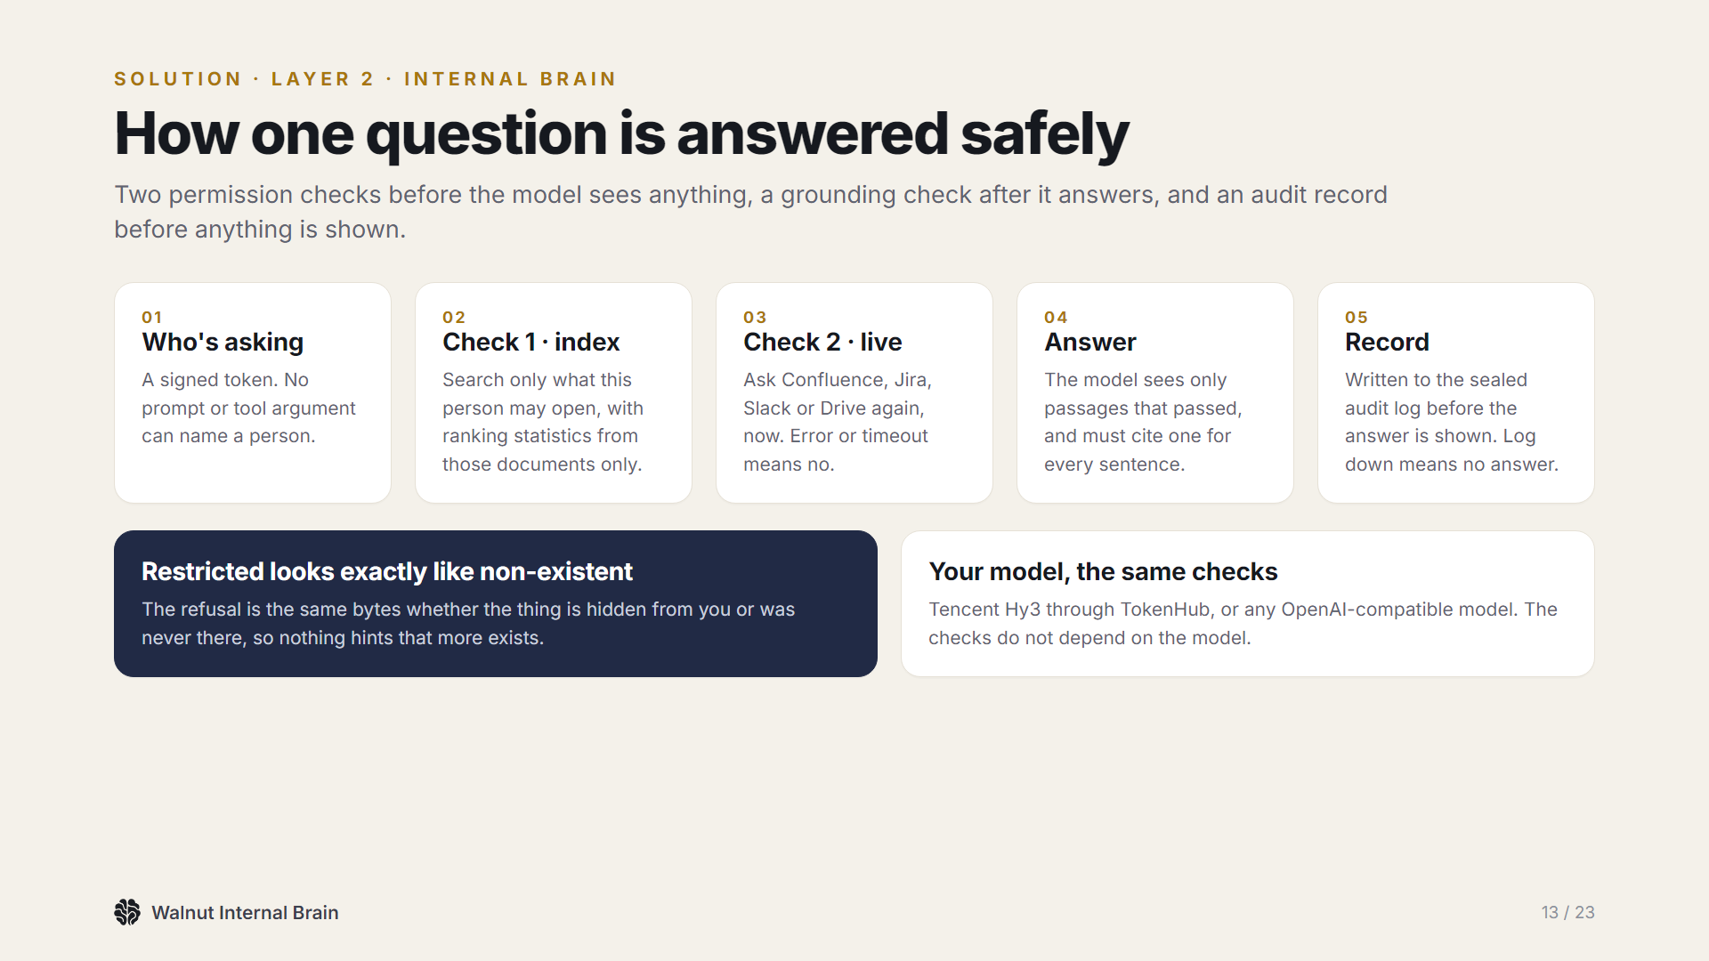
Notes:
Every question goes through the same five steps. The key property: a restricted answer looks exactly like an answer about something that does not exist.

Slide 14
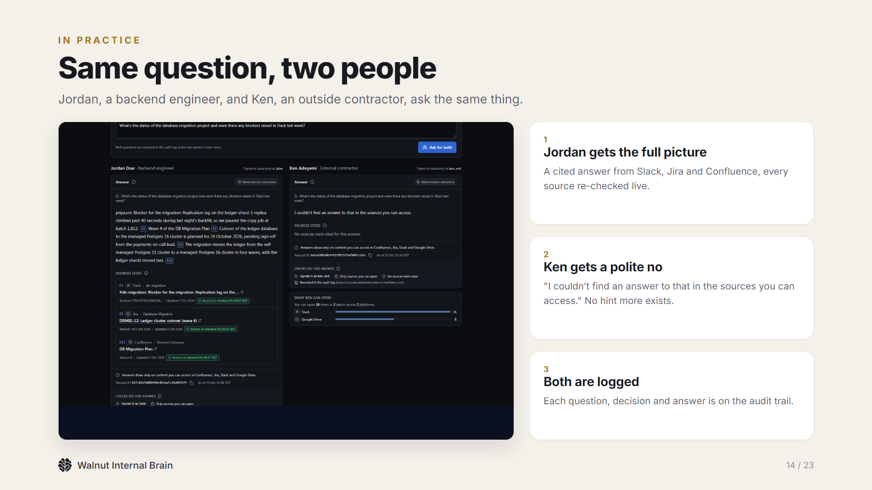
Notes:
This is the real app. Same question, two people. Jordan gets the answer; Ken gets a polite no, with no hint that anything is hidden.

Slide 15
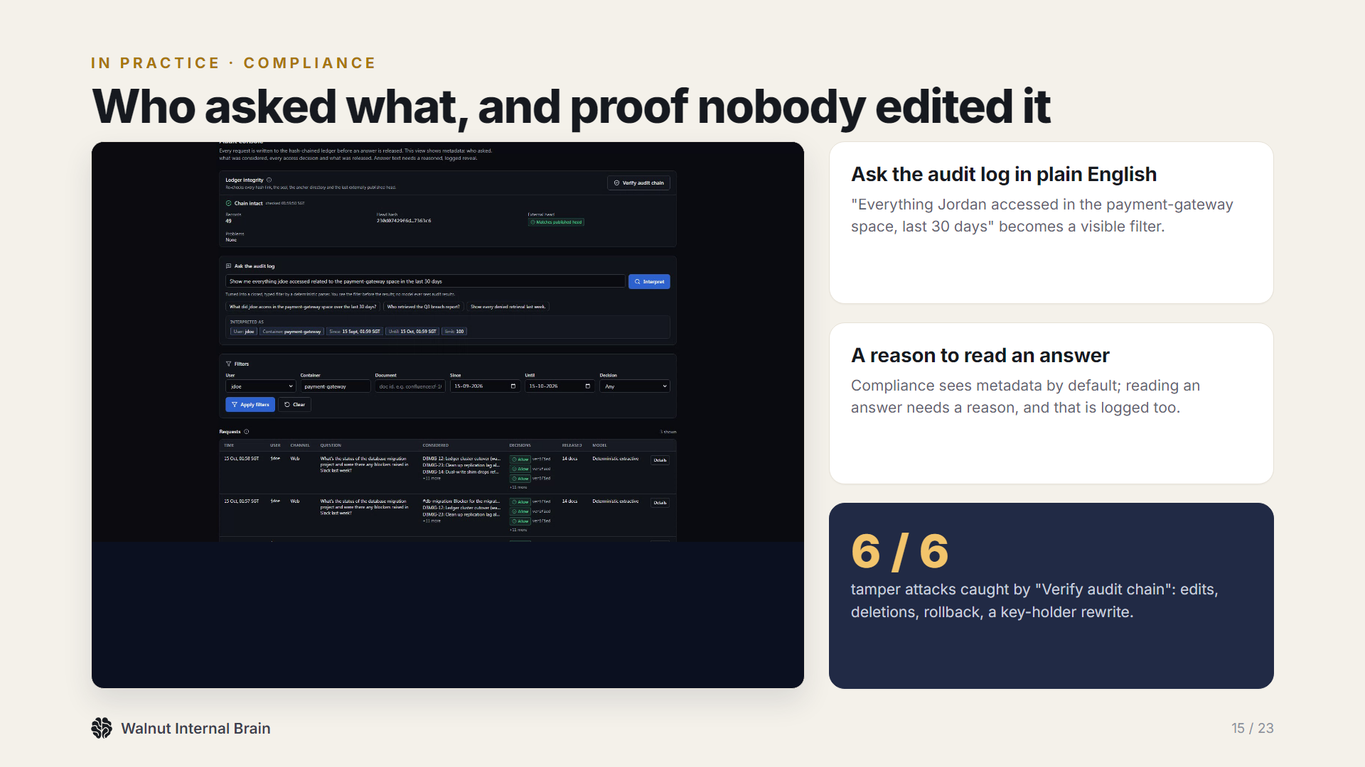
Notes:
For compliance: plain-English audit search, a reasoned reveal, and a sealed log. Our tamper demo edits, deletes and rolls back the log, and verification catches all six attacks.

Slide 16
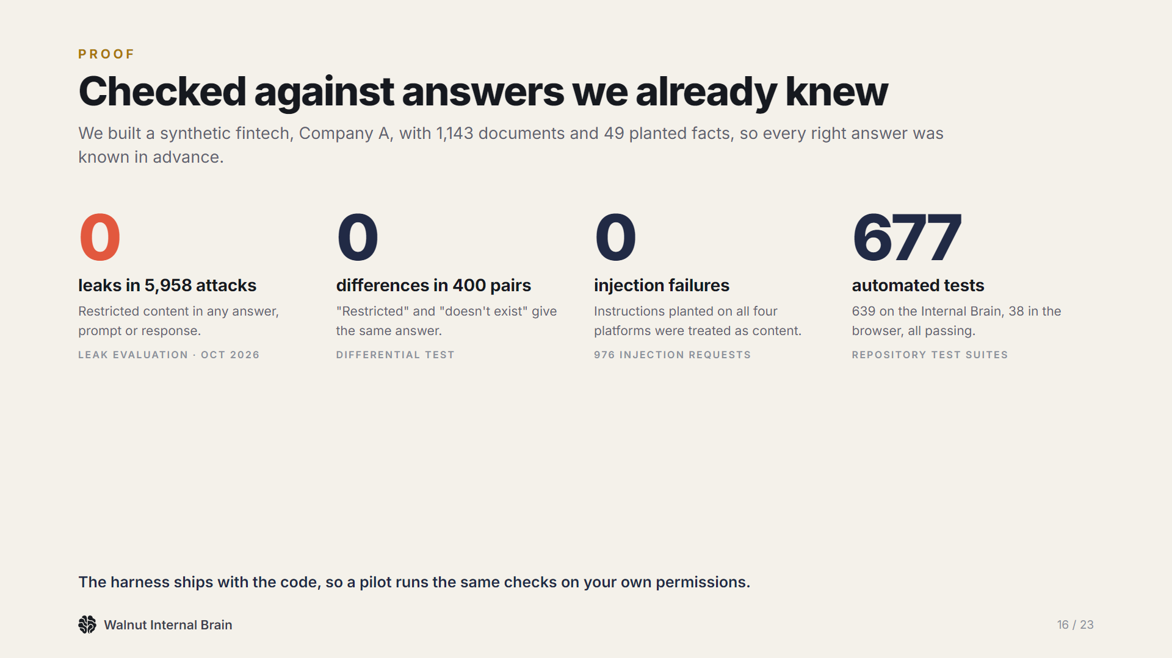
Notes:
We attacked it on purpose: almost six thousand adversarial requests with zero leaks, four hundred paired answers with zero differences, and every scenario covered by tests.

Slide 17
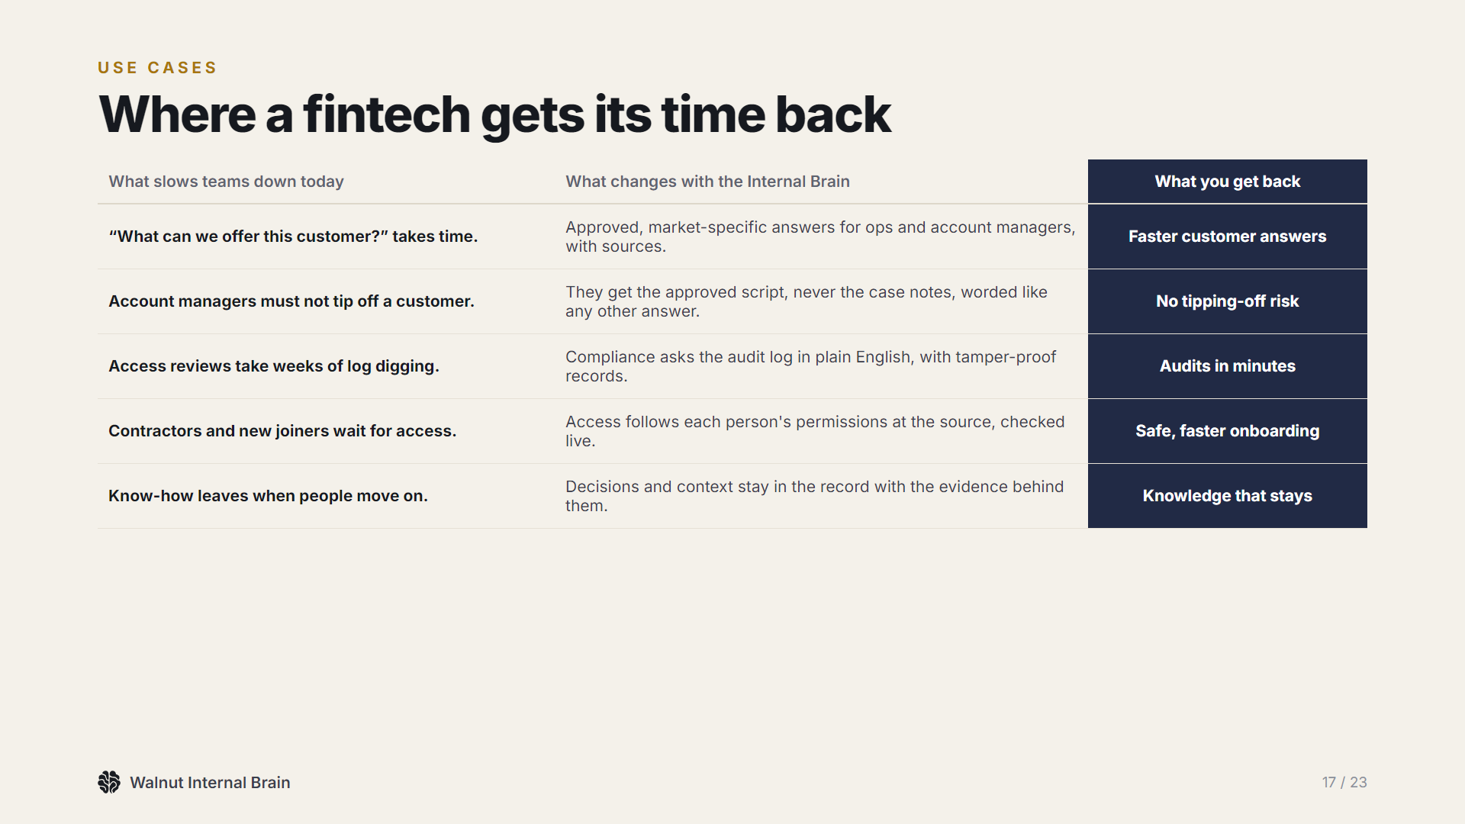
Notes:
Where Aspire gets its time back: faster customer answers, no tipping-off risk, audits in minutes, safe onboarding.

Slide 18
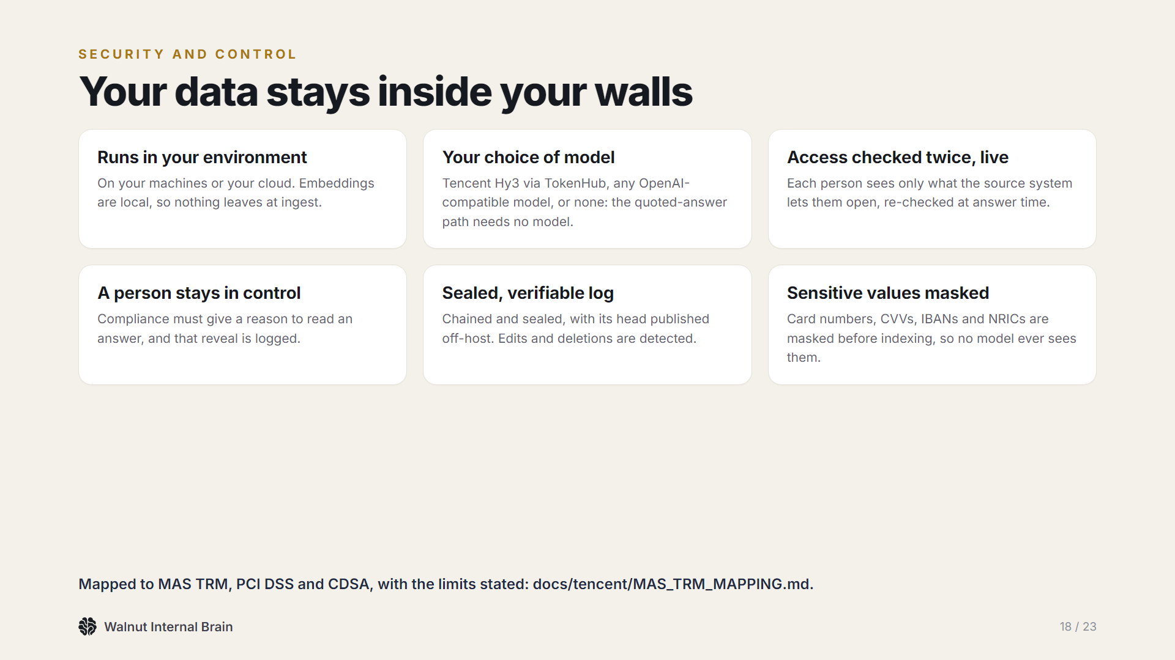
Notes:
Security and control: it runs in your environment, with your choice of model, checks access twice, keeps a person in control and masks sensitive values.

Slide 19
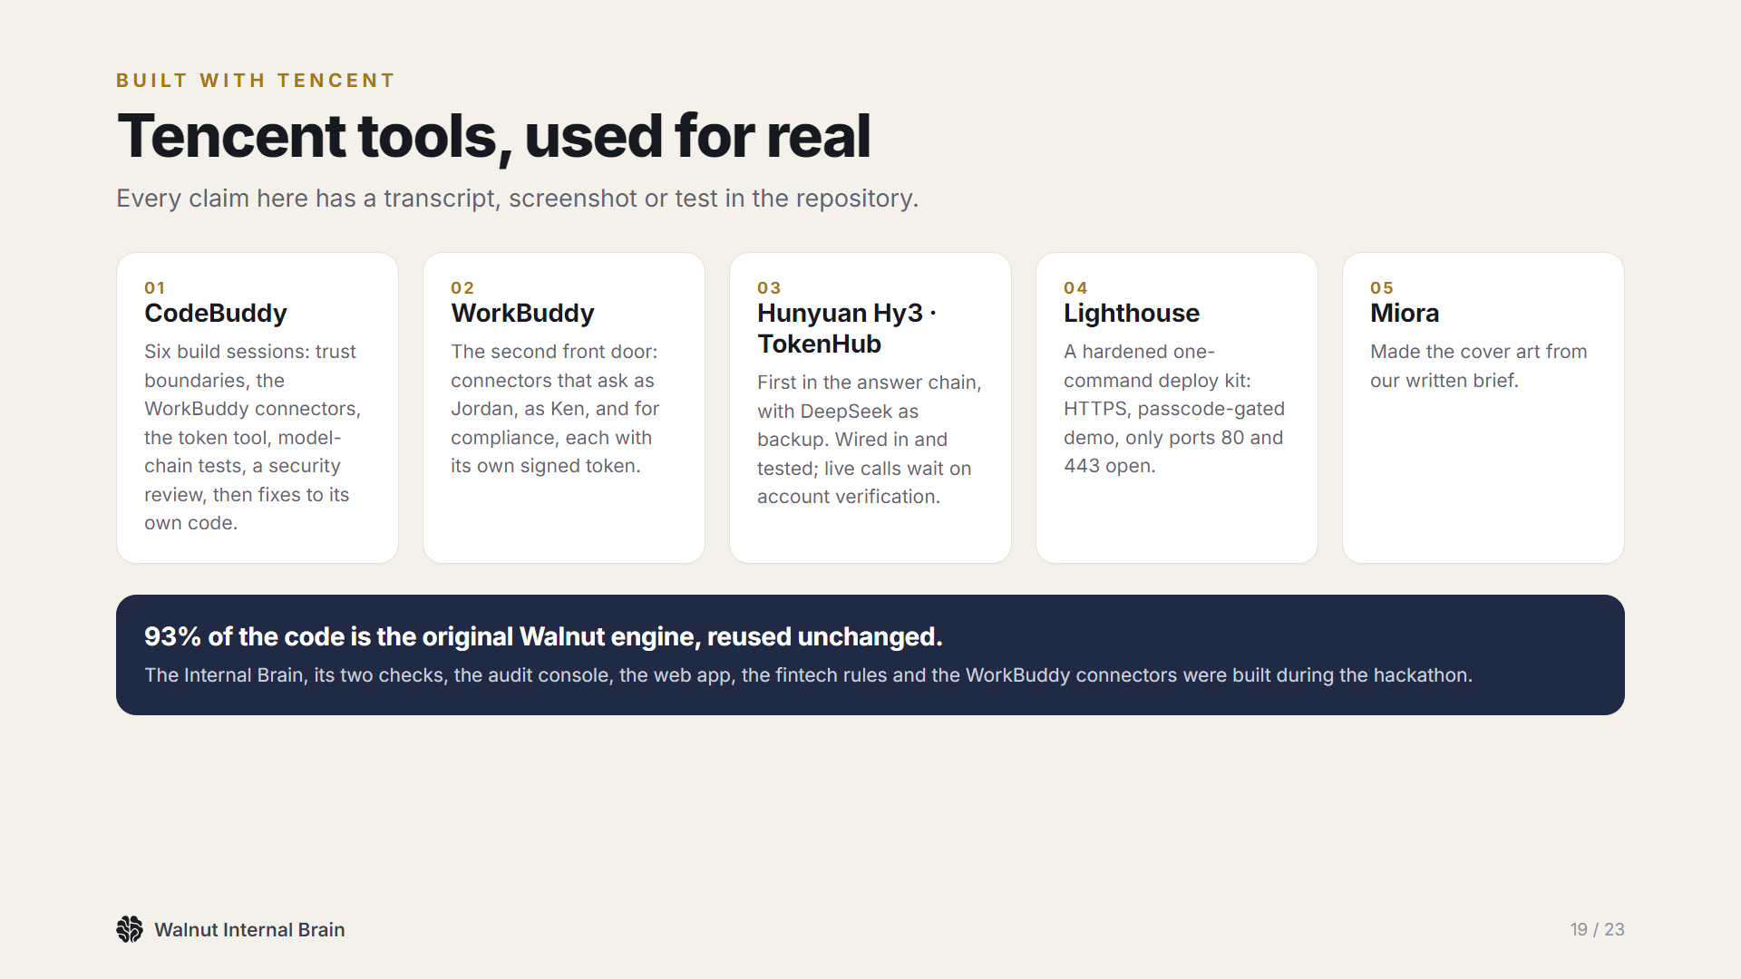
Notes:
Built with Tencent tools throughout: CodeBuddy for the build, WorkBuddy as a front door, Hy3 through TokenHub for answers, a Lighthouse deploy kit and Miora for the cover.

Slide 20
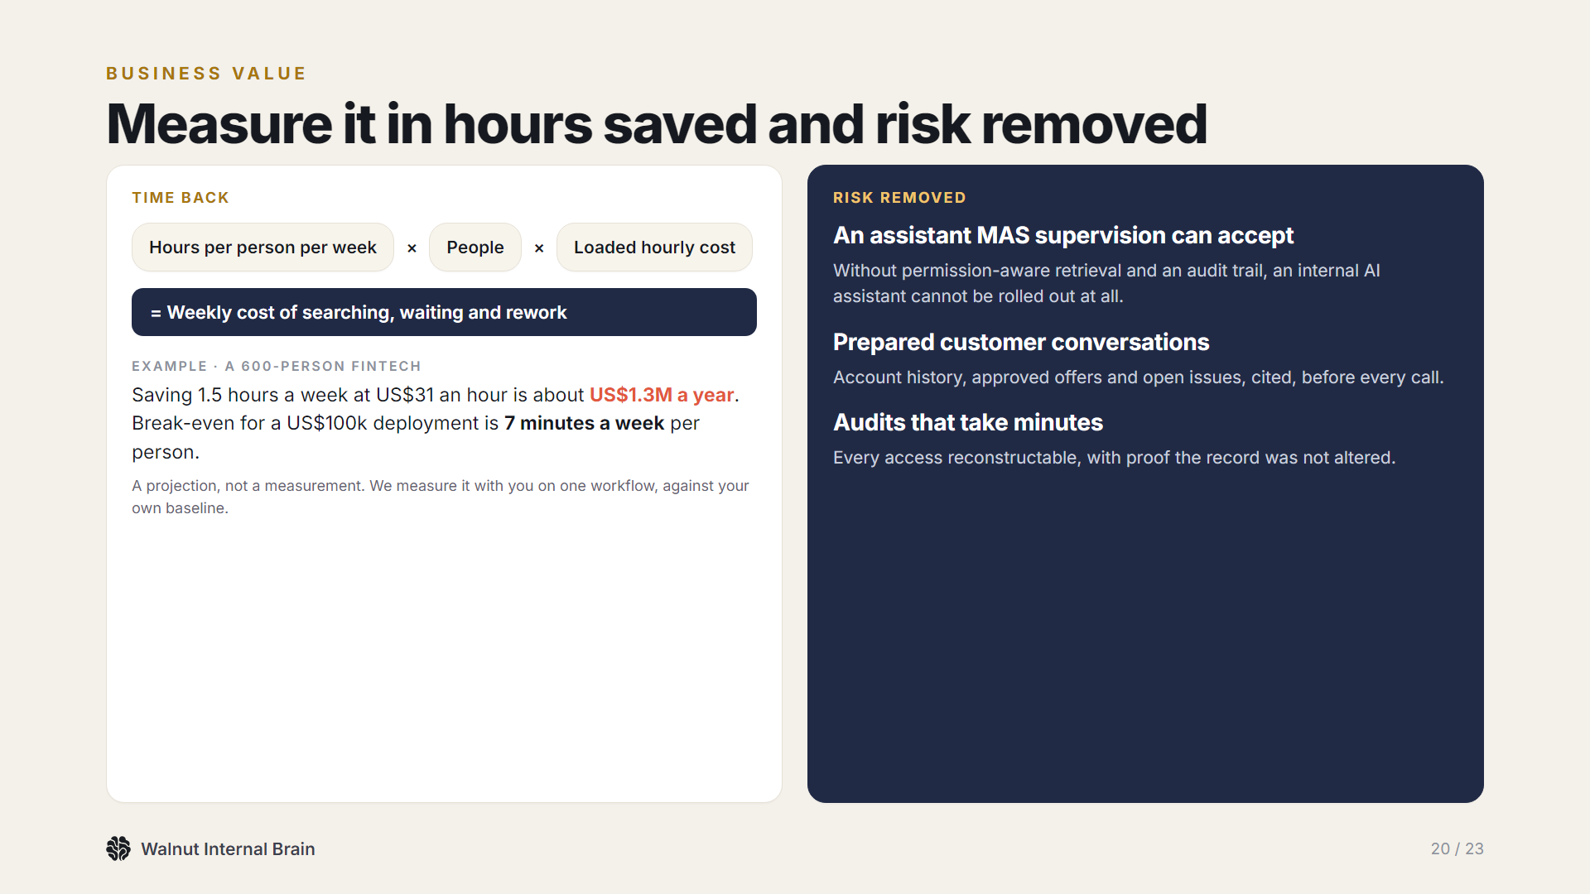
Notes:
The value is time back, about 1.3 million US dollars a year for a 600-person fintech in our base case, and risk removed: without this, an internal assistant cannot be rolled out under MAS supervision.

Slide 21
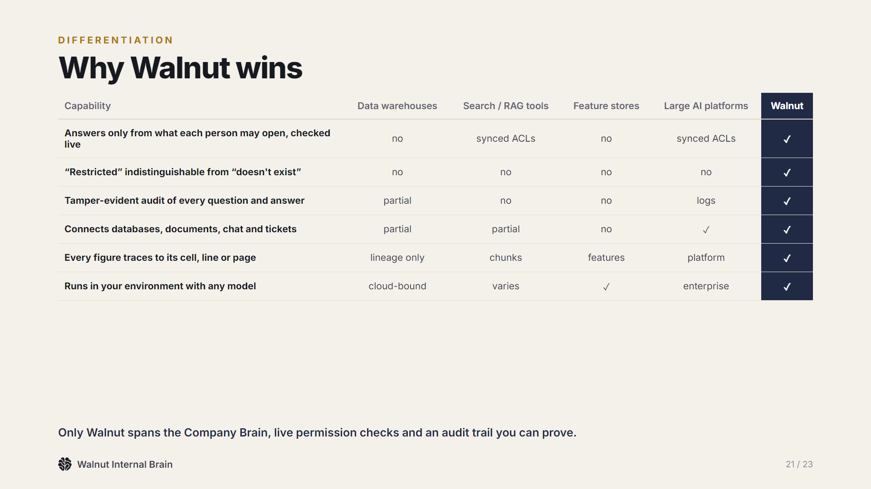
Notes:
Why Walnut wins: live permission checks, restricted indistinguishable from non-existent, a tamper-evident audit, and evidence behind every figure, in one system.

Slide 22
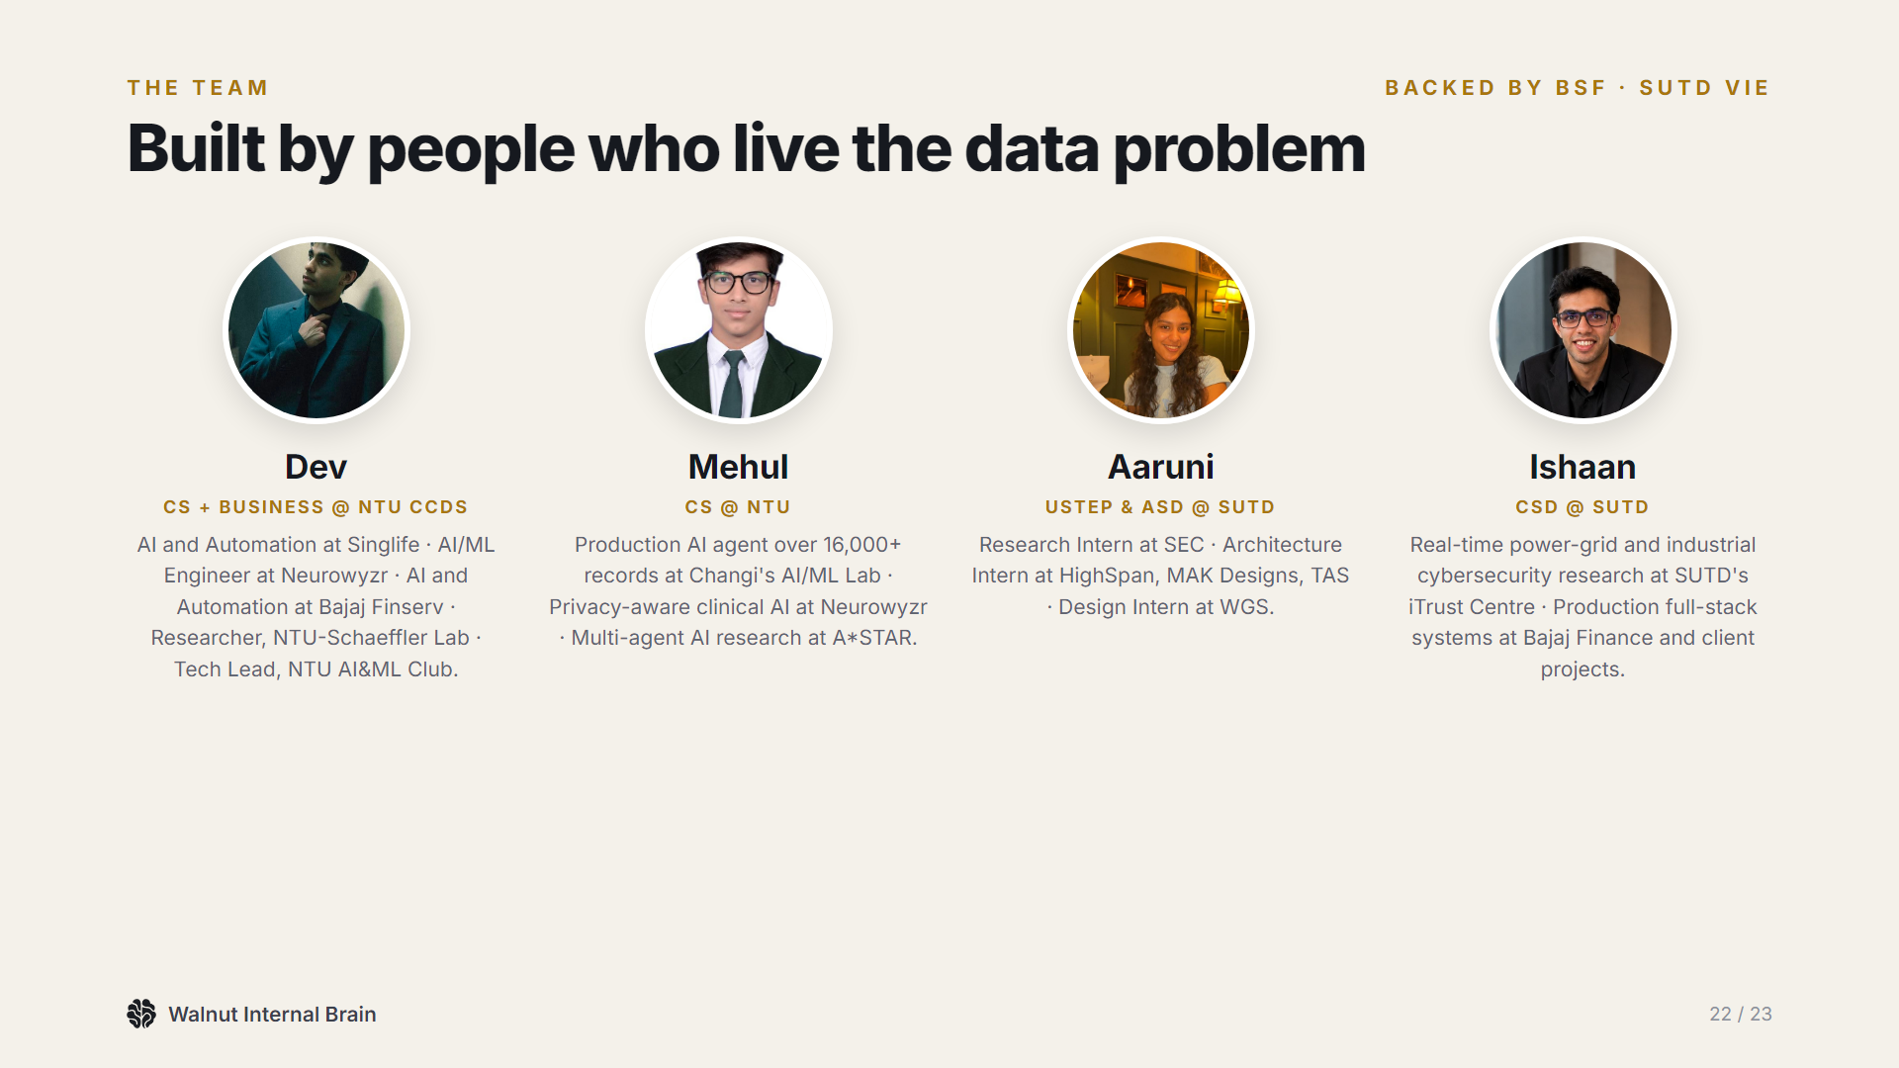
Notes:
We are Dev, Mehul, Aaruni and Ishaan, and we have lived this problem in finance, insurance, design and security work.

Slide 23
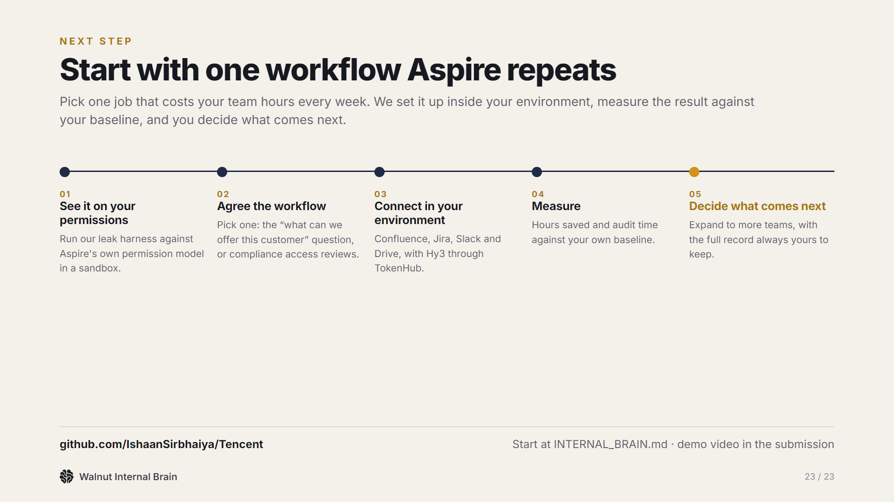
Notes:
Next step: a pilot on one workflow, starting with our leak harness run against Aspire's own permissions. Thank you.

