Slide 1
Machine Learning and Artificial Intelligence

Slide 2
“Programming agents by hand can be very tedious; some more expeditious method seems desirable.”
—Alan Turing, 1950

Slide 3
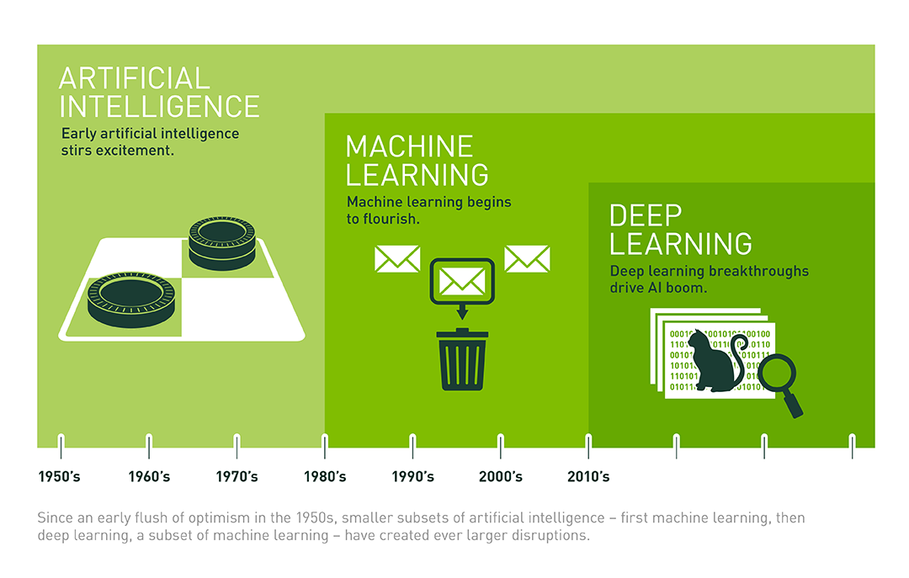
ML and AI
Artificial Intelligence
Computational rationality
Decision making under uncertainty
Machine Learning (ML)
Finding patterns in data
Source

Slide 4
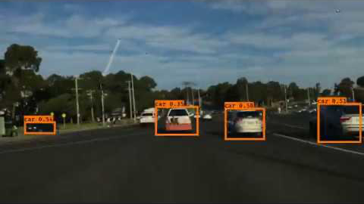
Autonomous Driving

Slide 5
Autonomous Driving
Object identification
Object detection
Object tracking/prediction
Route planning
Fully autonomous driving

Slide 6
Autonomous Driving
Object identification | Image → Label
Object detection | Image → Object bounding boxes
Object tracking/prediction | Video → Moving bounding boxes
Route planning | Video, Map, Coordinates → Actions
Fully autonomous driving | Video, Map, Coordinates, Ethics, … → Actions

Slide 7
Autonomous Driving
Artificial Intelligence
Object identification | Image → Label
Object detection | Image → Object bounding boxes
Object tracking/prediction | Video → Moving bounding boxes
Route planning | Video, Map, Coordinates → Actions
Fully autonomous driving | Video, Map, Coordinates, Ethics, … → Actions

Slide 8
Autonomous Driving
Classical Machine Learning
Object identification | Image → Label
Object detection | Image → Object bounding boxes
Object tracking/prediction | Video → Moving bounding boxes
Route planning | Video, Map, Coordinates → Actions
Fully autonomous driving | Video, Map, Coordinates, Ethics, … → Actions

Slide 9
Supervision
Defining Machine Learning is like hitting a moving target
Important to understand supervision
Supervised learning (inputs, labels)
Unsupervised learning (inputs)
Reinforcement learning (inputs, eventual rewards)
Different kinds of supervision yield different kinds of ML

Slide 10
Machine Learning and Artificial Intelligence

Slide 11
Course Overview

Slide 12
Machine Learning Is Going Mainstream
“Data is the new oil.”
“AI is the new electricity.”
“Privacy is the new luxury.”
“Machine learning is the future.”

Slide 13
Course Goals
Practical introduction to the machine learning field
Building blocks and theory of neural networks
Useful programming tools (including Tensorflow)
Learn how to stay current as the field changes

Slide 14
Python Notebooks
Weekly notebooks are the interactive textbook of this course
Options for running the code
Run locally using Jupyter (need to install libraries)
Run using Google’s Colab (everything is installed)

Slide 15
Course Work
Weekly notebook exercises
Final project
Small groups
Choose from approximately three Kaggle competitions
Run experiments
Write a summary report and present to class

Slide 16
Course Overview
Notes:
Q: What do you hope to get out of this course?

Slide 17
What Is a Function?

Slide 18
What Is a Function?
Input
Function
Output
x
f(x)
y

Slide 19
What Is a Function?
Mapping between sets: for each input item, there is one corresponding output item.
Input
Function
Output
x
f(x)
y
X₁
X₂
X₃
X₄
Y₁
Y₂
Y₃

Slide 20
Function Examples

Slide 21
Function Examples
add_six(number)
get_prime_factors(number)
upper_case(string)
convert_time(loc1, time, loc2)
is_it_raining(weather_report)

Slide 22
Function Examples
add_six(number)
get_prime_factors(number)
upper_case(string)
convert_time(loc1, time, loc2)
is_it_raining(weather_report)
height_from_shoe_size(shoe_size)
is_cat(image)
is_positive_movie_review(text)
text_from_audio(audio)
will_it_rain_tomorrow(weather_report)

Slide 23
Learned Functions (Models)
How would you write this function: height_from_shoe_size(shoe_size)

Slide 24
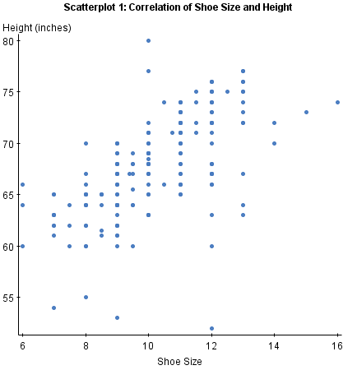
Learned Functions (Models)
How would you write this function: height_from_shoe_size(shoe_size)
Does this help?

Slide 25
Learned Functions (Models)
How would you write this function: height_from_shoe_size(shoe_size)
Does this help?
Data
Input
Function
Output
x
f(x)
y

Slide 26
What Is a Function?
Notes:
[True/False] A model is a learned function that predicts outputs y from inputs x.
A: True

Slide 27
Function Testing

Slide 28
Function Testing
def add_six_test():
???

Slide 29
Function Testing
def add_six_test():
assertEqual(add_six(-3), 3)
assertEqual(add_six(3), 9)
Testing logic
Check edge cases

Slide 30
Function Testing
def add_six_test():
assertEqual(add_six(-3), 3)
assertEqual(add_six(3), 9)
def height_from_shoe_size_test():
???
Testing logic
Check edge cases

Slide 31
Function Testing
def add_six_test():
assertEqual(add_six(-3), 3)
assertEqual(add_six(3), 9)
def height_from_shoe_size_test():
???
Testing logic
Check edge cases
Statistical testing
Check average performance

Slide 32
Evaluating Performance

Slide 33
Evaluating Performance
Need labeled examples
Size: 9, Height: 61
Size: 12, Height: 66
Etc.

Slide 34
Evaluating Performance
Need labeled examples
Size: 9, Height: 61
Size: 12, Height: 66
Etc.
Compare function output (predictions) to labels
“Error” or “Loss” or “Cost”

Slide 35
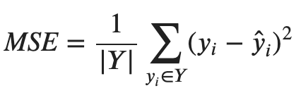
Evaluating Performance
Need labeled examples
Size: 9, Height: 61
Size: 12, Height: 66
Etc.
Compare function output (predictions) to labels
“Error” or “Loss” or “Cost”

Slide 36
Function Testing
Notes:
Q: A loss function compares _____ to _____.
A: predictions, labels

Slide 37
Generalization

Slide 38
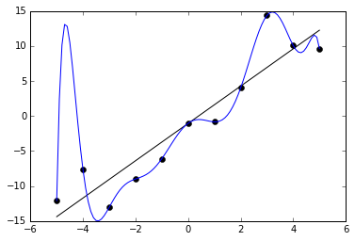
Predictions
Suppose the points are the labeled examples

Slide 39
Predictions
Suppose the points are the labeled examples
Are both black and blue lines possible models?

Slide 40
Predictions
Suppose the points are the labeled examples
Are both black and blue lines possible models?
Which is better?

Slide 41
Predictions
Suppose the points are the labeled examples
Are both black and blue lines possible models?
Which is better?
How do they perform with some new data?

Slide 42
The Train/Test Split
Models are useful for making new predictions
This is called generalization

Slide 43
The Train/Test Split
Models are useful for making new predictions
This is called generalization
Simulate this by splitting data into train and test
Could be a random split
Could depend on other properties of the data

Slide 44
The Train/Test Split
Models are useful for making new predictions
This is called generalization
Simulate this by splitting data into train and test
Could be a random split
Could depend on other properties of the data
Blue model is an example of overfitting

Slide 45
Generalization
Notes:
Q: [True/False] Test data is useful for assessing generalization.
A: True

Slide 46
Machine Learning Framing

Slide 47
Summary So Far
You’re already familiar with logical functions
Outputs are typically deterministic
Testing is logical and typically checks extreme cases
ML is about learning statistical functions from data
Outputs are predictions
Testing is statistical and typically checks average case
ML depends on labeled data
Behavior of the model reflects the data
Need separate test data to evaluate generalization

Slide 48
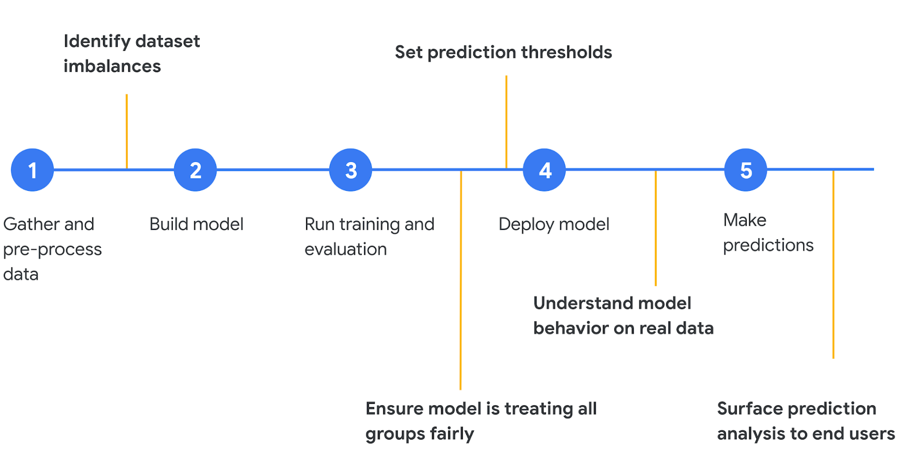
Machine Learning Framing
Google Cloud

Slide 49
Machine Learning Framing
Google Cloud

Slide 50
Framing: Defining a Task
What are the inputs and outputs?
What is the labeled data?
Considerations for train/test split?
How will your function be used?
How will you evaluate predictions?
What is a baseline predictor?

Slide 51
Machine Learning Framing
Notes:
Q: [True/False] A baseline should help ground expectations for modeling experiments.
A: True

Slide 52
Lung Cancer Screening
Example One

Slide 53
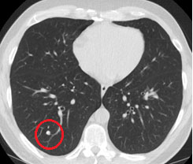
Lung Cancer Screening
What are the inputs and outputs?
What is the labeled data?
Considerations for train/test split?
How will your function be used?
How will you evaluate predictions?
What is a baseline predictor?
Google

Slide 54
What are the inputs and outputs?
Input: CT images
Output: cancer probability
Output: image regions and probabilities
Google

Slide 55
What is the labeled data?
Scans annotated by human experts
Google

Slide 56
Considerations for train/test split?
No patient with scans in both train and test
Google

Slide 57
How will your function be used?
By doctors
By patients
By insurance companies
Does training population match usage population?
Google

Slide 58
How will you evaluate predictions?
Classification accuracy
Google

Slide 59
What is a baseline predictor?
Always predict ‘no cancer’
Google

Slide 60
Lung Cancer Screening
Notes:
Q: [True/False] Training data population in unlikely to cause bias in the classifier
A: False

Slide 61
Sports Outcomes
Example Two

Slide 62
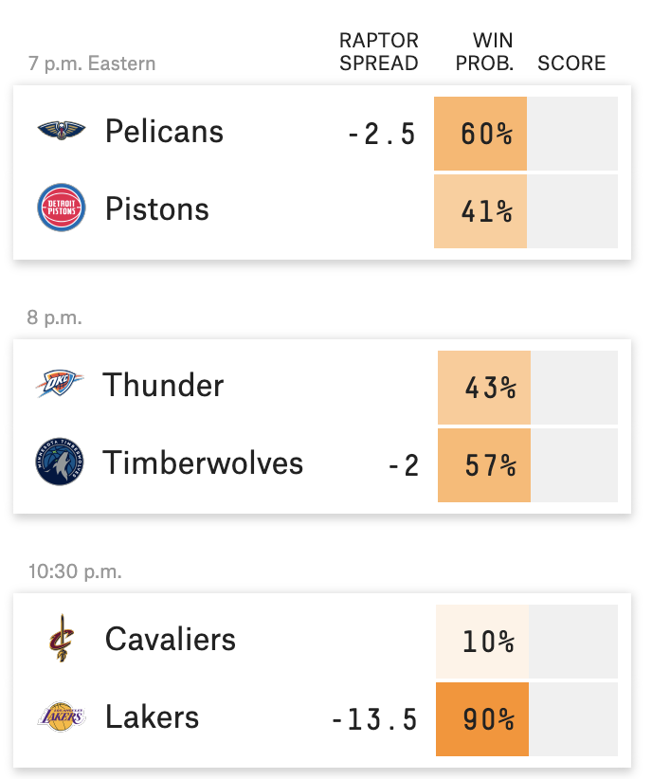
Basketball Predictions
What are the inputs and outputs?
What is the labeled data?
Considerations for train/test split?
How will your function be used?
How will you evaluate predictions?
What is a baseline predictor?
FiveThirtyEight

Slide 63
What are the inputs and outputs?
Inputs: team1 and team2
Outputs: win/loss
Outputs: point difference
FiveThirtyEight

Slide 64
What is the labeled data?
Previous games and results (from the current season)
FiveThirtyEight

Slide 65
Considerations for train/test split?
Use past games to predict future results (rolling predictions)
FiveThirtyEight

Slide 66
How will your function be used?
Gambling: setting lines
FiveThirtyEight

Slide 67
How will you evaluate predictions?
Accuracy, MSE
FiveThirtyEight

Slide 68
What is a baseline predictor?
Team win/loss records
FiveThirtyEight

Slide 69
Sports Outcomes
Notes:
Q: [True/False] As described, these prediction models are useless for the first game of a new season.
A: True

Slide 70
Energy Usage
Example Three

Slide 71
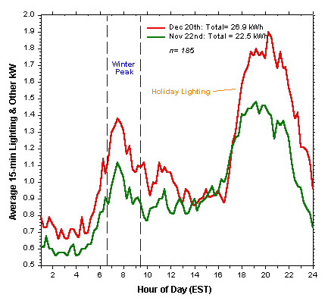
Energy Usage
What are the inputs and outputs?
What is the labeled data?
Considerations for train/test split?
How will your function be used?
How will you evaluate predictions?
What is a baseline predictor?
FSEC

Slide 72
What are the inputs and outputs?
Inputs: date, time, weather (15-minute intervals)
Outputs: energy usage
FSEC

Slide 73
What is the labeled data?
Previous observations
FSEC

Slide 74
Considerations for train/test split?
Rolling predictions
FSEC

Slide 75
How will your function be used?
Coordinating mixture of power sources
FSEC

Slide 76
How will you evaluate predictions?
MSE
FSEC

Slide 77
What is a baseline predictor?
Average usage
FSEC

Slide 78
Energy Usage
Notes:
Q: [True/False] A model trained with data from San Francisco should work well for other similarly sized cities.
A: False

Slide 79
Review

Slide 80
Review
What is a function?
What is a model?
What is meant by generalization?
What is overfitting?
Why do we need a train/test split?
Why do we want a baseline?

Slide 81
Review

