Slide 1
Git revert & Git reset

Slide 2
Why Git revert is imp?
The git revert command is used for undoing changes to a repository’s commit history.

Slide 3


Slide 4
Why Git reset is imp?
The git reset command is used to undo the changes in your working directory and get back to a specific commit while discarding all the commits made after that one

Slide 5
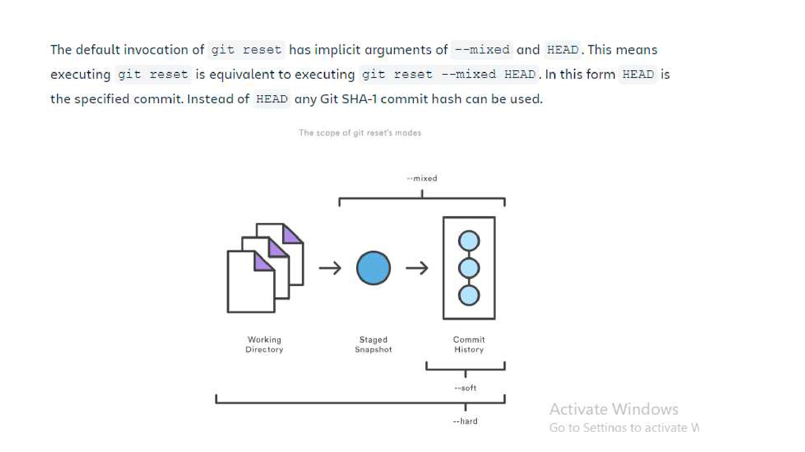

Slide 6
Types of Modes in Git reset
Mixed cmd: git reset –mixed <commit hash>
Soft cmd: git reset –soft <commit hash>
Hard cmd: git reset –hard<commit hash>

Slide 7
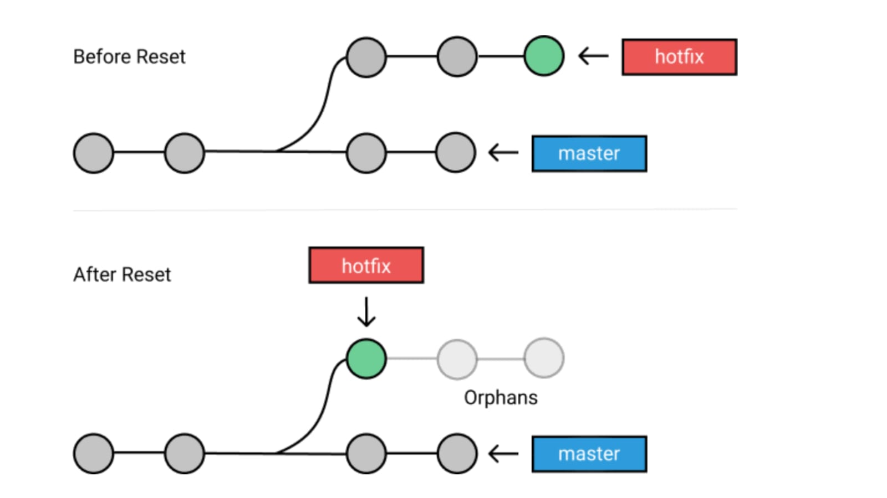

Slide 8
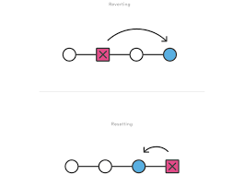
Difference Between Git reset & Git revert?

Slide 9
Git Cherry-pick
Cherry picking is the act of picking a commit from a branch and applying it to another.
cmd: git cherry-pick <FileName>

Slide 10
Git cherry pick
Cherry picking is the act of picking a commit from a branch and applying it to another

Slide 11
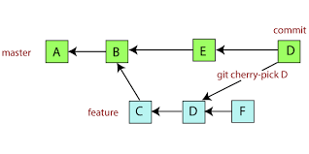

Slide 12
Thank You For Being a
Good Listeners

