Slide 1
Customer Churn Analysis
Submitted by: Isha Course: Data Analysis Date: 5 April 2026

Slide 2
Introduction
Customer churn refers to the loss of customers over a period of time. It is a major concern for businesses because losing customers directly impacts revenue and growth.
This project focuses on analyzing customer data to understand the reasons behind churn and to suggest effective solutions.

Slide 3
Problem Statement
Businesses are facing a high rate of customer churn.
The main challenges are:
Identifying why customers leave
Understanding patterns in customer behavior
Reducing churn and improving retention

Slide 4
Objectives
The main objectives of this project are:
To calculate the churn rate
To analyze customer behavior
To identify factors affecting churn
To provide data-driven recommendations

Slide 5
Dataset Overview
The dataset used in this project contains customer-related information such as usage patterns and churn status.
Number of records: Approximately 500
Contains both numerical and categorical data
Target variable: Churn

Slide 6
Data Cleaning
Data cleaning was performed to ensure accuracy and consistency.
The following steps were taken:
Removed missing values
Removed duplicate records
Standardized column names
Converted categorical data into numerical format

Slide 7
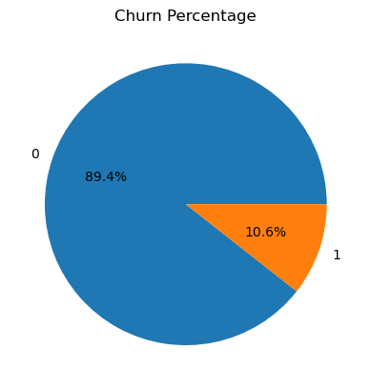
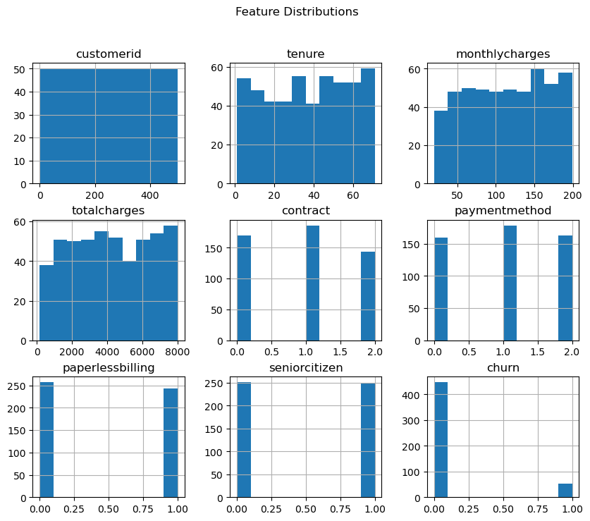
Exploratory Data Analysis
Exploratory Data Analysis (EDA) was performed to understand the data.
The following were analyzed:
Distribution of churn and non-churn customers
Patterns in customer behavior
Relationships between variables

Slide 8
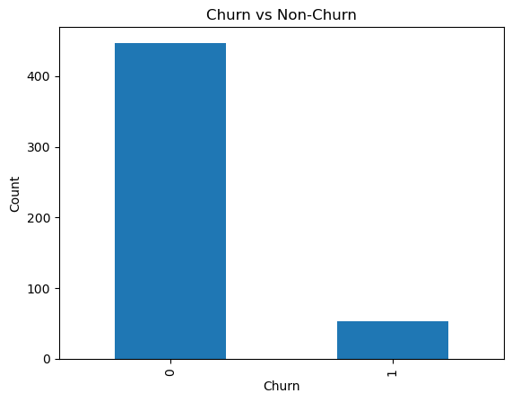
Churn Distribution
The churn distribution shows the number of customers who stayed and those who left.
Key observation: A significant portion of customers have churned, indicating a need for improvement in retention strategies.

Slide 9
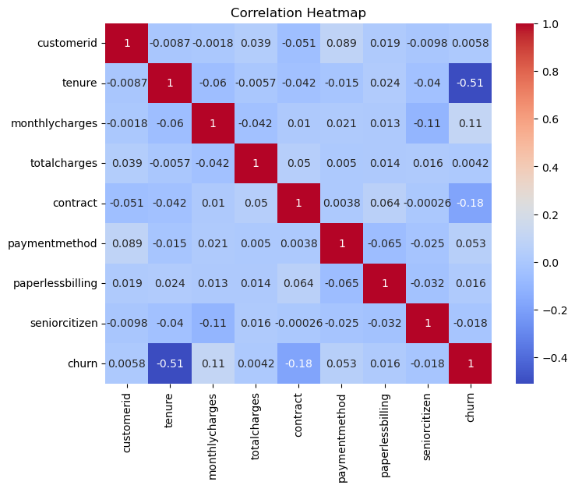
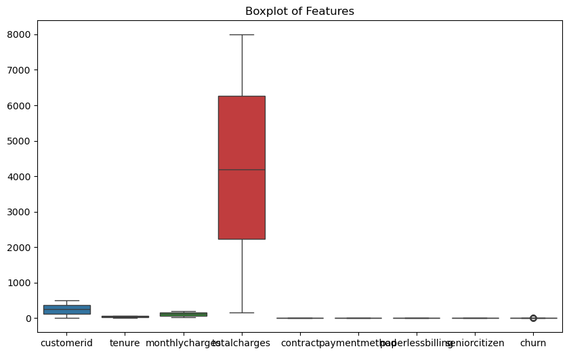
Data Visualization Insights
Various visualizations were used to understand data patterns:
Histograms to study feature distribution
Boxplots to detect outliers
Heatmap to analyze correlation

Slide 10
Key Analysis
The analysis included:
Group comparison of churn vs non-churn customers
Correlation analysis to identify key influencing factors
Hypothesis testing to validate assumptions

Slide 11
Key Findings
The main findings from the analysis are:
Churn rate is significant
Customers with lower usage are more likely to churn
Some features strongly influence churn
Customer engagement plays an important role

Slide 12
Insights
Important insights derived from the data:
Customer activity level directly impacts churn
Highly engaged customers are less likely to leave
Data can help identify at-risk customers early

Slide 13
Recommendations
Based on the analysis, the following recommendations are suggested:
Provide special offers to low-usage customers
Improve customer engagement strategies
Introduce loyalty and reward programs
Use predictive models to identify potential churn

Slide 14
Business Impact
Implementing these recommendations can result in:
Reduced customer churn
Increased customer retention
Improved revenue
Better decision-making using data

Slide 15
Conclusion
This project successfully analyzed customer churn using a structured data analysis approach.
Key factors affecting churn were identified, and practical recommendations were provided to improve customer retention and business performance.

