Slide 1
Analyzing the Effect of Noise on Quantum Algorithms
Ishan Thoke 21328
Rahul Pandey 21213

Slide 2

Problem Statement
Implement and analyze the performance quantum algorithms such as, the Deutsch-Jozsa, Bernstein-Vazirani and Simon’s Algorithm under different types and levels of noise. The goal is to understand how noise impacts the reliability and accuracy of these algorithms.

Slide 3

Approach
This project explores the impact of noise on three foundational quantum algorithms: Deutsch-Jozsa, Bernstein-Vazirani, and Simon's Algorithm. These algorithms showcase quantum speedup, solving specific problems more efficiently than classical algorithms. However, quantum systems are inherently noisy, and this noise can significantly affect the algorithms' performance.
Objective: To analyze how different types of noise—bit flip, phase flip, and depolarizing noise—impact these quantum algorithms’ accuracy and assess their robustness under real-world conditions.
Methodology: Each algorithm was implemented in PennyLane and tested under various noise settings. For each algorithm, we compared the outputs from ideal (noiseless) conditions to results obtained with different types and levels of noise.
The results highlight the importance of error correction and noise mitigation in quantum computing. Noise, especially depolarizing noise, significantly degrades the accuracy of quantum algorithms. For practical applications, robust error-handling techniques are essential to leverage the full potential of quantum speedup in real-world quantum systems.

Slide 4
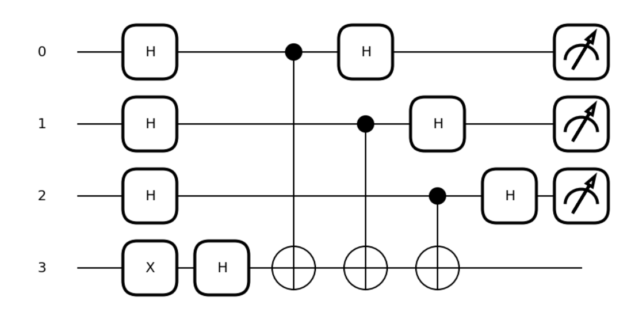

"The Deutsch-Jozsa Problem"
Deutsch-Jozsa Circuit with Balanced Oracle:
Expected Output and Analysis
No Noise:
Ideal output peaks at all-zero state (e.g., [1. 0. 0. 0...]) for constant; shows the distribution for balanced.
Bit Flip Noise:
Randomly flips qubits, spreading probability across states.
Reduces the likelihood of measuring the correct answer.
Phase Flip Noise:
Flips qubit phases, disrupting interference.
May not affect immediate measurement but impacts multi-qubit probabilities.
Depolarizing Noise:
Combines bit flip, phase flip, and no effect.
Strongest impact; creates mixed state, reducing accuracy

Slide 5
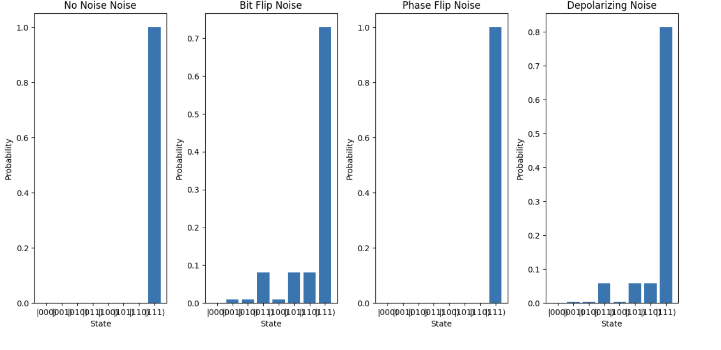
"The Deutsch-Jozsa Problem"
Conclusions
Sensitivity to Noise:
Quantum algorithms (e.g., Deutsch-Jozsa) are highly sensitive to noise, especially in maintaining coherence and superposition.
Depolarizing Noise:
Most disruptive; combines bit and phase noise, scrambling quantum information and leading to random outputs.
Bit Flip Noise:
Manageable at low levels but decreases result certainty.
Phase Flip Noise:
Affects interference patterns, potentially misleading results without direct measurement impact.
Need for Error Correction:
Highlights the importance of error correction and noise mitigation, as even small noise can make algorithms unreliable, especially for complex circuits.
.

Slide 6
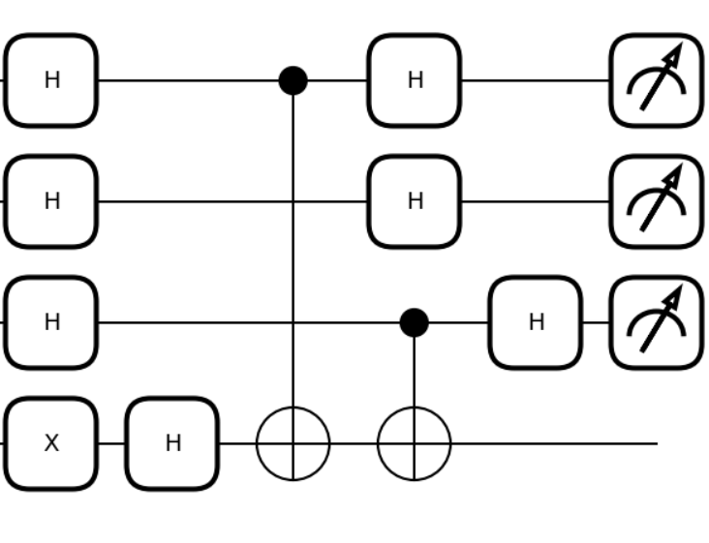
Bernstein-Vazirani Algorithm
Interpretation of Results
No Noise (Baseline):
Expected output matches ideal values; algorithm correctly identifies the hidden bitstring.
Bit Flip Noise:
Randomly flips qubits from 0 to 1 (or vice versa), causing random deviations in output.
Result deviates depending on which qubits are affected.
Phase Flip Noise:
Disrupts phase relationships, affecting interference patterns without directly altering measurement.
Low noise levels have minor impact, but high levels cause significant deviations.
Depolarizing Noise:
Mix of bit flip, phase flip, and no-op, leading to high disruption.
Randomizes qubit states, causing substantial errors and deviation from expected output.

Slide 7
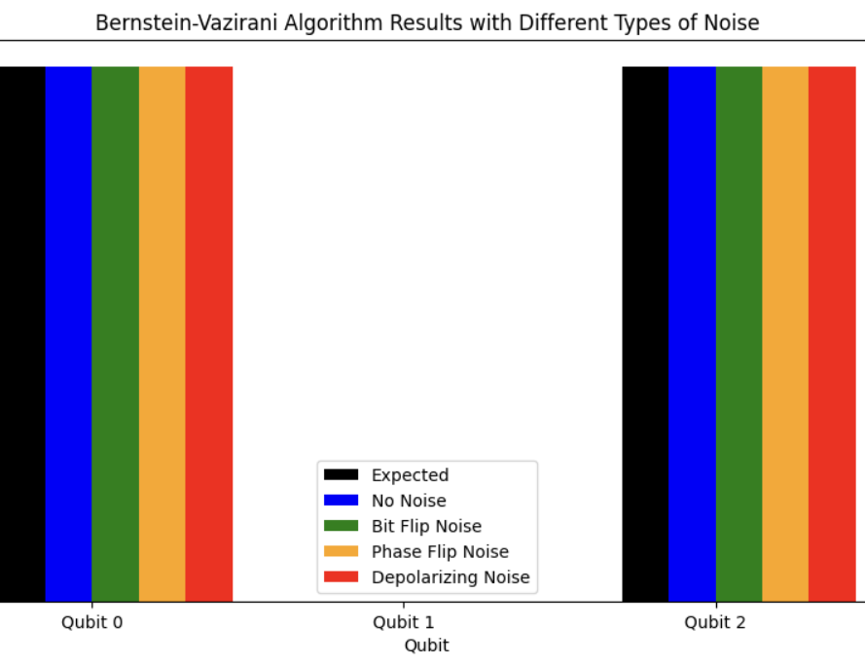
Bernstein-Vazirani Algorithm
Conclusion
Bit Flip Noise: Causes random errors in individual qubits, leading to minor deviations.
Phase Flip Noise: Affects interference, potentially causing incorrect bit values.
Depolarizing Noise: Most disruptive, creating significant deviation in results.
Importance: Highlights the sensitivity of quantum algorithms to noise and the need for error correction and noise mitigation in quantum computing.

Slide 8
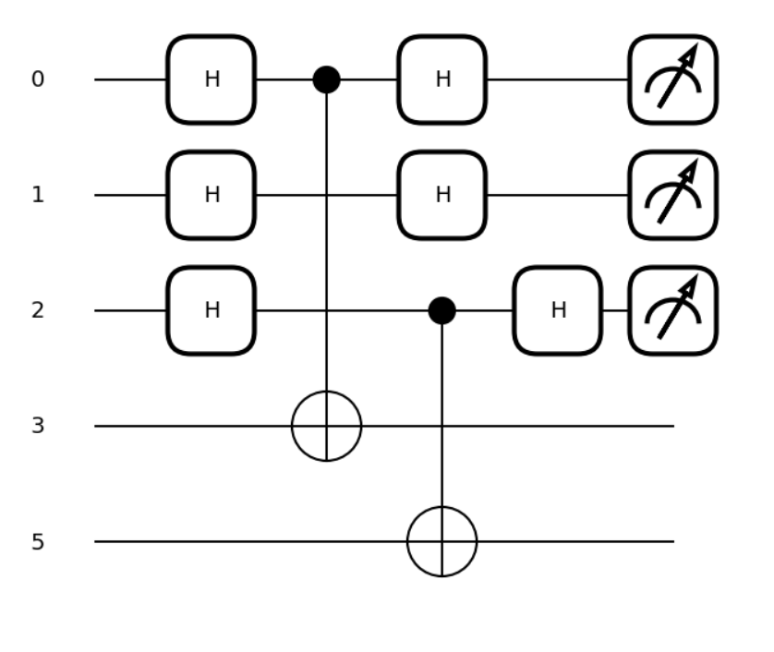
SIMON'S ALGORITHM
Purpose:
Objective: Identify hidden period bitstring sss in function f(x)=f(x⊕s)f(x) = f(x \oplus s)f(x)=f(x⊕s).
Quantum Advantage: Solves problem in polynomial time vs. classical exponential time.
Ideal (No Noise):
Produces orthogonal bitstrings to sss in one run.
Collecting nnn orthogonal bitstrings (for nnn-qubit system) enables linear algebra solution for sss.
Noise Impact:
Bit Flip Noise:
Errors in qubits lead to incorrect, linearly dependent bitstrings.
Even minimal bit flip noise can prevent determination of sss.
Phase Flip Noise:
Disrupts phase coherence; results in inaccurate, non-orthogonal bitstrings.
Higher noise levels complicate gathering correct samples.
Depolarizing Noise:
Randomizes both amplitude and phase, heavily impacting results.
Moderate to high noise levels make solving for sss infeasible due to loss of orthogonal samples.

Slide 9
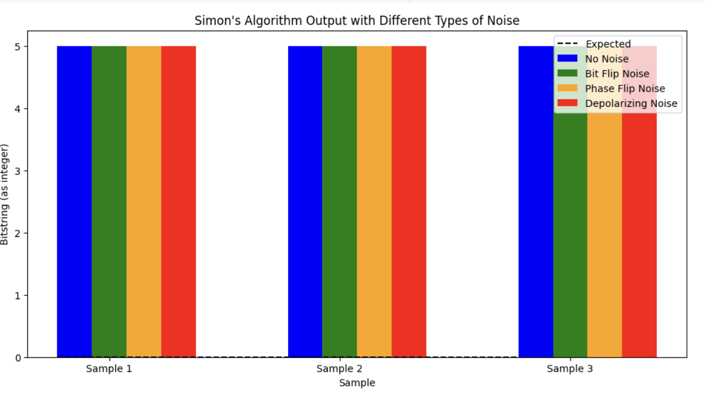
SIMON'S ALGORITHM
Interpretation of Results
No Noise (Baseline):
Produces bitstrings that satisfy x⋅s=0x \cdot s = 0x⋅s=0 (mod 2), allowing recovery of the secret bitstring sss using linear algebra.
Bit Flip Noise:
Randomly flips qubit values (0 to 1 or vice versa), corrupting bitstrings.
Increases errors in the output with higher noise probabilities, making it difficult to solve for sss.
Phase Flip Noise:
Alters qubit phases, which disrupts interference patterns without directly changing measurement outcomes.
At high noise levels, interference is affected, leading to incorrect measurements.
Depolarizing Noise:
Combines bit flip, phase flip, and identity (no effect), making it highly disruptive.
Produces a large number of incorrect measurements, preventing recovery of the correct bitstring as noise increases.

Slide 10
summary
Overview of Algorithms:
Deutsch-Jozsa
Purpose: Identifies if function f(x)f(x)f(x) is constant or balanced in a single query.
Ideal (No Noise): Correctly identifies the function type with 100% accuracy.
Bernstein-Vazirani
Purpose: Efficiently finds hidden bitstring aaa in function f(x)=a⋅xf(x) = a \cdot xf(x)=a⋅x.
Ideal (No Noise): Outputs correct bitstring aaa in one measurement.
Simon’s Algorithm
Purpose: Finds hidden period sss in f(x)=f(x⊕s)f(x) = f(x \oplus s)f(x)=f(x⊕s) with polynomial-time advantage.
Ideal (No Noise): Provides orthogonal bitstrings to solve for sss efficiently.
Key Noise Types and Effects:
Bit Flip Noise: Flips qubit values, directly altering measurement results.
Phase Flip Noise: Disrupts phase relationships, impacting interference and causing misclassification.
Depolarizing Noise: Randomizes bit and phase values, compounding errors across qubits.
Link to the code

Slide 11
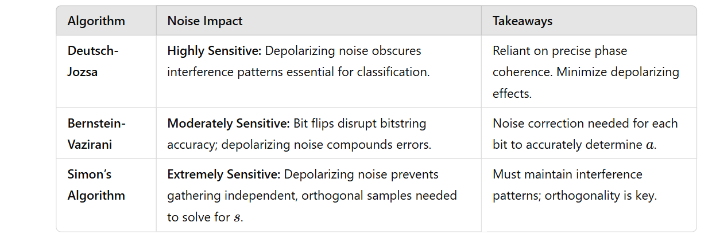

Results & CONCLUSION

Slide 12
Partnerships
Code
Presentation

Slide 13
Thank You
By Ishan Thoke 21328
Rahul Pandey 21213

