Slide 1
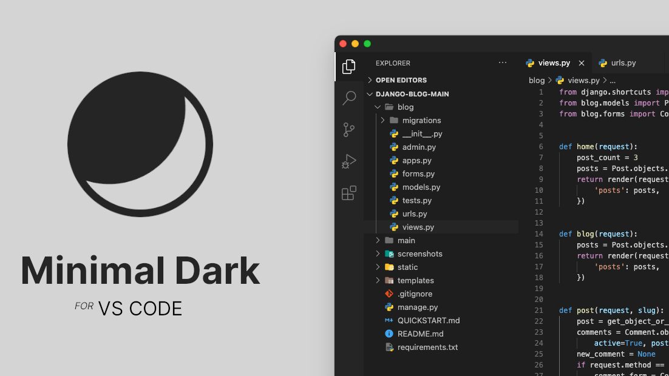
WEB TECHNOLOGY PROJECT
Code
Verse :
A real-time collaborative code editor
Student: Ishan Agrawal
Roll No: 202452321
Student: Happy
Roll No: 202452319
Student: Abhishek Biban
Roll No: 202452339
Subject: Web Technology
Institute: IIIT VADODARA
Semester: IV | Academic Year: 2026

Slide 2
Introduction
The Evolution of Collaborative Coding
Motivation
This project addresses critical challenges in modern software development and education:
Limitations of Traditional Editors
Isolated Development: Single-user focus prevents simultaneous editing
1
Remote Teamwork: Enable seamless collaboration regardless of location
Manual Version Control: Git conflicts and merge overhead
No Real-Time Sync: File sharing via email/Drive creates inconsistencies
Interactive Learning: Support hands-on coding education and mentoring
2
Context Switching: Separate tools for editing, execution, and debugging
3
Unified Platform: Combine editing, execution, and assistance in one tool
Web-Based
Real-Time
Integrated

Slide 3
Problem Statement
Real-Time Collaborative Code Editor (Development teams need a platform where multiple programmers can join a shared workspace and simultaneously edit, run, and debug code in real-time)
3
A unified, web-based collaborative editor addresses all three challenges

Slide 4
Technology Stack
MySQL
Node.js
Relational database management system for structured data storage
JavaScript runtime for server-side execution
Stores users, workspaces, files, version history
Non-blocking I/O for performance
Uses tables, rows, and columns with predefined schemas
Event-driven architecture
Supports SQL queries for efficient data retrieval and updates
Socket.IO
Express.js
Real-time bidirectional communication
Minimalist backend framework for Node.js
WebSocket-based with fallbacks
RESTful API endpoints for CRUD operations
Room management for workspaces
Middleware for authentication, logging, CORS
HTTP request routing and error handling
React
Component-based UI library for interactive interfaces
Integration Flow
Monaco Editor integration for code editing
React → HTTP/WebSocket
State management with Hooks and Context API
Express → Business Logic
Reusable components for scalability
Node.js → Runtime
mySQL → Persistence
Unified JavaScript Stack: Single language across frontend, backend, and database layers

Slide 5
System Architecture Overview
Client-Server Architecture with Real-Time Communication
Client Layer
Server Layer
Database Layer
React UI: Interactive user interface components
Express.js Server: API routing and middleware
Users Collection: Authentication and profile data
Monaco Editor: Feature-rich code editing experience
Socket.IO Server: WebSocket connection management
Workspaces Collection: Projects and permissions
Authentication: JWT-based user session handling
Files Collection: Code content and metadata
Socket.IO Client: Real-time event handling
Versions Collection: Change history and audit trail
State Management: Application state with React Hooks
Business Logic: Core application functionality

Slide 6
Modular Design of the System
Architecture of 11 Independent Modules
Modular Architecture Approach
10 Modules Overview
The system is divided into 10 independent modules, each handling a specific responsibility.
1
Authentication
2
Workspace Mgmt
User login, roles, access control
Projects, files, permissions
3
Code Editor
4
Syntax Checking
Text editing, undo/redo, cursors
Error detection, highlighting
5
AI Assistance
6
Version Control
Code suggestions, explanations
History, restoration, diff view
Key Design Principles
7
Collaboration
8
Conflict Handling
Scalability: Easy to add new features without affecting existing code
Live editing, user presence
Concurrent edit resolution
Maintainability: Clear module boundaries simplify debugging and updates
Clarity: Well-defined module boundaries make the system understandable
9
Code Execution
10
Activity Logging
Team Development: Different developers can work on separate modules
Compile, run, sandboxed env
User actions, audit trail

Slide 7
Module 1-4: Core Foundation
Authentication, Workspace Management, Editor, and Syntax Checking
1
Authentication & Authorization
2
Workspace & File Management
Secure access control and user management
Project organization and collaboration spaces
JWT-based Login: Stateless authentication with JSON Web Tokens
Project Creation: Users can create, rename, and delete coding projects
Role-based Access Control: Admin and user roles with different permissions
File/Folder Hierarchy: Organize code with nested directory structures
Password Security: Bcrypt hashing for secure storage
Permission Management: Control access to shared workspaces and files
Session Management: Token expiration and refresh mechanisms
Collaborator System: Add/remove users with read/write permissions
Protected Routes: Middleware to secure API endpoints
File Operations: Create, edit, rename, move, and delete files
Ensures only authorized users access resources
Enables organized collaboration across teams
3
Code Editor (Code Writer)
4
Syntax Checking Module
Feature-rich text editing with Monaco Editor
Real-time error detection and code quality
Monaco Editor Integration: VS Code-like editing experience in browser
Error Detection: Identify syntax errors as users type
Text Editing Operations: Insert, delete, replace with efficient algorithms
Syntax Highlighting: Color-coded text for different code elements
Undo/Redo Functionality: Command pattern for operation history
Linting Integration: ESLint/TSLint for code quality enforcement
Cursor Position Tracking: Monitor and sync cursor locations across users
Auto-formatting: Prettier integration for consistent code style
Selection Handling: Multi-character and line selection capabilities
Language Support: JavaScript, Python, C++, Java, and more
Core editing functionality with professional UX
Improves code quality and reduces bugs

Slide 8
Module 5-7: Intelligence & Collaboration
AI Assistance, Version Control, and Real-Time Collaboration
5
AI Assistance & Code Completion
6
Version Control Module
7
Real-Time Collaboration Module
Intelligent Suggestions: AI-powered code completion using LLM APIs
History Tracking: Record every change with user, timestamp, and diff
Live Editing Sync: Socket.IO broadcasts changes to all connected clients
Code Explanation: Generate documentation and clarify complex code
Version Restoration: Revert to any previous version with one click
User Presence: Show active collaborators with colored cursors
Autocomplete: Context-aware variable and function name suggestions
Diff Visualization: Side-by-side comparison highlighting changes
Cursor Positioning: Track and display where each user is editing
Error Correction: AI-suggested fixes for common coding mistakes
Branching: Create experimental versions without affecting main code
Operational Transform: Resolve concurrent edits without conflicts
Code Optimization: Performance and readability improvement suggestions
Change Annotations: See who changed what and when
Room Management: Isolate workspaces to prevent cross-contamination
Enhances productivity and learning
Never lose code changes
Enables seamless team collaboration
Key Technologies & Patterns
AI APIs: OpenAI
Diff Algorithm: Myers' diff algorithm
OT Algorithm: Google Docs-style transforms

Slide 9
Module 8-11: Advanced Features & Quality
Conflict Handling, Code Execution, Logging, and Non-Functional Requirements
8
Conflict Handling Module
9
Code Execution Module
Concurrent edit resolution using Operational Transformation
Safe compilation and execution in sandboxed environment
Operational Transformation (OT): Algorithm to resolve simultaneous edits
Resource Limits: CPU, memory, and time constraints per execution
Intent Preservation: Maintains user intent when transforming operations
Output Capture: Redirect stdout/stderr with formatting
Convergence Guarantee: All clients reach identical document state
Security Restrictions: Network and file system access blocked
Server Authority: Central server resolves conflicts consistently
Edge Case Handling: Insert-insert, insert-delete, delete-delete conflicts
Prevents data loss and ensures consistency
Prevents malicious code execution
10
Activity Logging Module
11
Comprehensive tracking of user actions and system events
These are the 10 modules
User Action Tracking: Log edits, file operations, and collaborations
Audit Trail: Maintain complete history for compliance
Real-time Activity Feed: Live updates of workspace activities
Change Attribution: Track who made what changes and when
Provides transparency and accountability

Slide 10
Web Technology Concepts Used
Core Technologies Powering the Application
HTML5 & CSS3
JavaScript (ES6+)
REST APIs
Semantic Markup: Header, nav, main, section for accessibility
Arrow Functions: Concise syntax and lexical 'this' binding
HTTP Methods: GET, POST, PUT, DELETE for CRUD operations
Responsive Design: Mobile-first approach with media queries
Async/Await: Asynchronous programming with promises
JSON Data Exchange: Standard format for API communication
CSS Grid & Flexbox: Modern layout systems for UI components
Modules: Import/export for code organization
Status Codes: 200, 201, 400, 401, 404, 500 for response handling
Destructuring: Extract values from arrays and objects
CSS Variables: Dynamic theming (dark/light mode support)
Middleware: Authentication, logging, error handling
Classes & Inheritance: Object-oriented programming patterns
Input Validation: Request body and parameter sanitization
Transitions/Animations: Smooth user interactions and feedback

Slide 11
WebSockets (Socket.IO)
Client-Server Model
Bidirectional Communication: Full-duplex client-server messaging
Request-Response Cycle: HTTP protocol for communication
Event-based Messaging: Custom events for different actions
Separation of Concerns: Frontend vs backend responsibilities
Room Management: Isolate workspaces for targeted broadcasting
Stateless Protocol: Each request is independent
Automatic Reconnection: Handle dropped connections gracefully
RESTful Design: Resource-based URL patterns
Database Abstraction: Server handles data persistence
Fallback Mechanisms: Long-polling when WebSockets unavailable

Slide 12
Advantages & Applications
Benefits and Real-World Use Cases
Educational Collaboration
Development Teams
Remote Coding Classes: Instructors demonstrate concepts in real-time
Distributed Team Collaboration: Bridge geographical gaps in remote work
Pair Programming Assignments: Students collaborate on group projects
Code Reviews: Real-time feedback and quality assurance
Interactive Teaching: Live coding sessions with immediate feedback
Real-time Debugging: Multiple developers troubleshoot issues together
Code Reviews: Peer learning through collaborative code examination
Knowledge Sharing: Senior developers mentor junior team members
Remote Coding Sessions
Productivity Enhancement
Key Advantages
Coding Interviews: Evaluate candidates through collaborative problem-solving
No Setup Time: Browser-based access eliminates installation
Accessibility: Any device with a browser
Hackathons: Teams build projects together in timed events
Reduced Context Switching: All tools in one unified platform
Real-time: Instant synchronization
Collaborative: Multiple users simultaneously
Mentoring: Experienced developers guide newcomers
Instant Feedback: Integrated execution provides immediate results
Integrated: Edit, run, debug in one place

Slide 13
Thank
You ☺

