Slide 1

EMOTION DETECTION FROM TEXT.
STUDENT: ISHAN RAY CHAUDHURI
GUIDE: HIMANSHU SOUDA

Slide 2
CONTENTS
• Introduction
• Tools & Technologies
• Project Working
• Output Screenshots
• Applications
• Future Scope
• Project Link

Slide 3
INTRODUCTION
This project predicts human emotions from text using a fine-tuned RoBERTa model. It classifies input sentences into emotions like joy, anger, sadness, fear, love, and surprise.

Slide 4
TOOLS & TECHNOLOGIES
• Python
• Transformers (HuggingFace)
• PyTorch
• Streamlit
• Google Colab
• GitHub

Slide 5
PROJECT WORKING
The model loads, processes input text, and outputs the predicted emotion with confidence to user through streamlit.

Slide 6
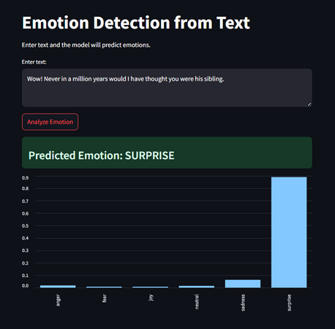
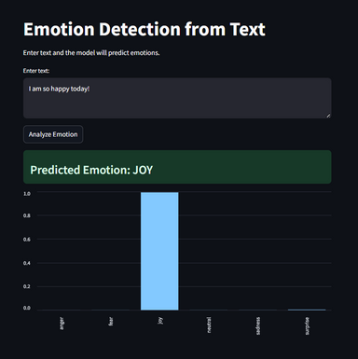
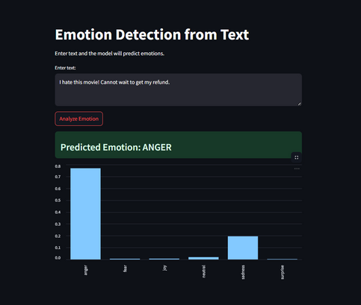
OUTPUT SCREENSHOTS

Slide 7
APPLICATIONS
• Customer support sentiment analysis
• Social media monitoring
• Emotion-aware chatbots
• Non-clinical mental health analysis
• Feedback analytics

Slide 8
FUTURE SCOPE
• Deploy as full web app/API
• Multilingual support
• Better datasets
• Real-time chat emotion tracking
• Visual dashboards

Slide 9
PROJECT LINK
GitHub:
https://github.com/Ishan-R-C/IBM_Project

