Slide 1
BloodLink
Blood bank inventory and compatible allocation, shipped through a full DevOps pipeline
O-
O+
A-
A+
B-
B+
AB-
AB+
Ishan Ganguly · DevOps final capstone · github.com/Ishan007-bot/Bloodlink
Notes:
BloodLink manages a blood bank: donors, donated units, hospital requests, and which units can safely go to which patient. The point of the project is the delivery pipeline around it: every change is tested, scanned, built into an image tagged with its commit, and deployed to Kubernetes, locally on kind and on AWS EKS built with Terraform. O- is highlighted because it is the universal donor: the allocator keeps it for last.

Slide 2
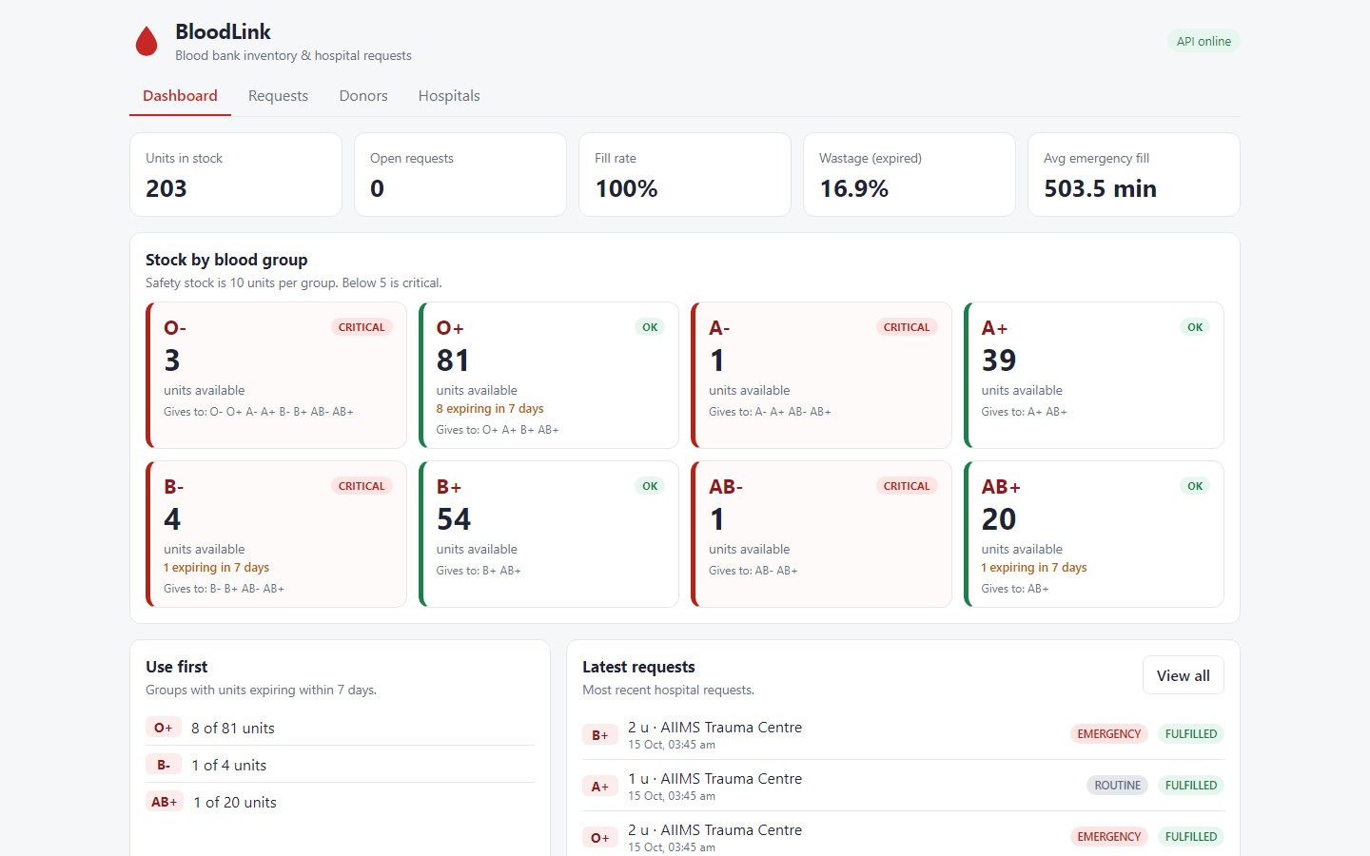
Compatible blood, oldest unit first
1
Compatible allocation
ABO/Rh rules: exact group first, then substitutes; O- kept for last
2
First expiring, first out
Units expire 42 days after collection; the oldest usable unit is issued
3
Emergency queue
Emergency requests are served before routine ones; partial fills are tracked
FastAPI · React · PostgreSQL 16 · 22 API routes · 5 tables managed by Alembic
Notes:
Three rules make this more than CRUD. Compatibility: an A- patient can only get A- or O-; the allocator prefers the exact group and keeps O- for patients who can receive nothing else. Expiry: red cells last 42 days, so the oldest compatible unit goes first to reduce wastage. Emergencies jump the queue. The dashboard shows stock per group with LOW and CRITICAL levels, units about to expire, fill rate and wastage.

Slide 3
From commit to running cluster
Commit
push or pull request
Test and scan
ruff, 81 tests, gitleaks, pip-audit, npm audit, IaC checks
Build + Trivy
both images, gate on HIGH and CRITICAL
GHCR
tagged with the commit SHA, never latest
Helm deploy
kind locally, EKS on AWS via OIDC
6 jobs
1 SHA
0 keys
run on every push; images build only when tests and scans pass
per image: every running pod traces back to one commit
stored in GitHub: AWS access is short-lived OIDC
Notes:
The pipeline is one workflow file. Four jobs run in parallel: backend lint and tests with a 90% coverage floor, the frontend build, secret and dependency scanning, and Terraform and Helm validation with a Trivy misconfiguration scan. Only if all four pass are the images built. Trivy scans them before they are pushed, so a vulnerable image never reaches the registry. Images are tagged with the full commit SHA, so any pod can be traced to its commit. On main, the last job deploys to EKS: GitHub gets short-lived AWS credentials through OIDC, no access keys are stored anywhere.

Slide 4
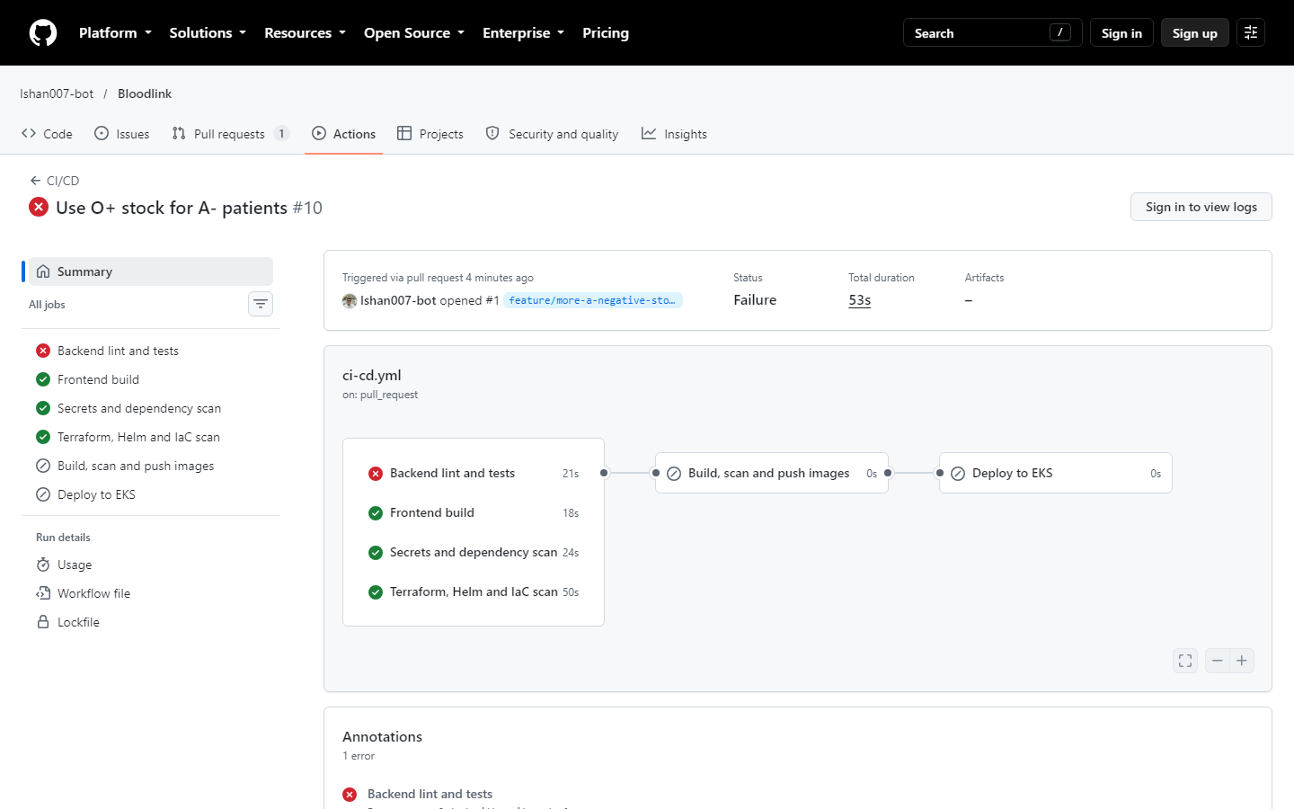
A failing test stopped an unsafe change
Pull request #1: “Use O+ stock for A- patients”
Looks helpful when A- stock is low, but gives Rh-positive blood to Rh-negative patients.
1
Test fails
is_compatible('O+', 'A-') returned True
2
Nothing ships
no image built, no deploy
3
Fix, green, merge
every check passes
81 tests · 97 % coverage · the build fails below 90 %
Notes:
This is the quality gate working on a realistic mistake. The change compiles and the app would run, but it breaks a medical rule. The compatibility test caught it, the pipeline graph shows the build and deploy jobs were skipped, so nothing reached a cluster. Tests run against a throwaway SQLite database, never the real one.

Slide 5
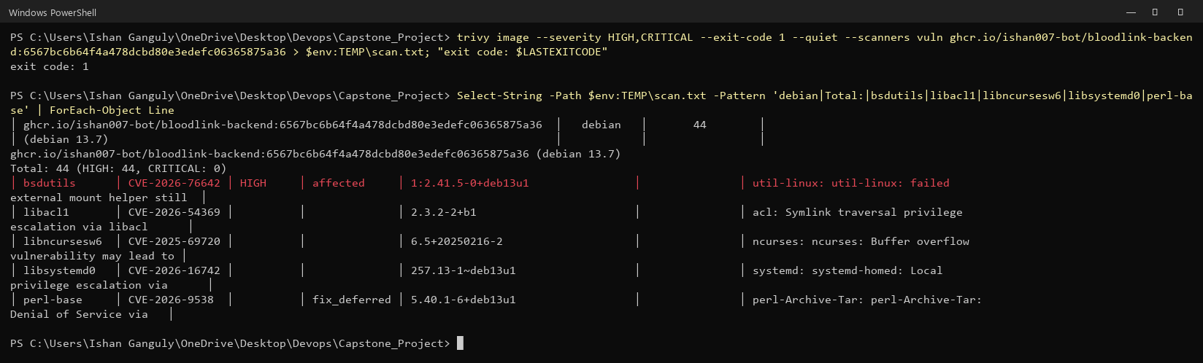
Security gates: 44 HIGH CVEs down to 0
44 → 0
195 MB
Trivy images + IaC
gitleaks: no secrets
HIGH CVEs in the backend image
image size, was 291 MB on Debian slim
pip-audit · npm audit
non-root, read-only
Pod Security restricted
NetworkPolicy to Postgres
One CVE explained: CVE-2026-76642 (util-linux)
mount runs privileged post-mount hooks even when the mount helper failed: local privilege escalation. Low risk here (non-root, read-only, no mount), but it shipped in every image, with no fix available. The gate now fails on unfixed CVEs too, and the backend moved to Alpine, which does not contain it.
OIDC, no AWS keys
DB password in a Secret
Notes:
Trivy scans every image before it is pushed. The first version of the gate ignored vulnerabilities without a fix, and the backend passed. Scanning without that exception showed 44 HIGH findings from 8 CVEs in Debian packages the app never uses, such as util-linux. CVE-2026-76642: mount does not check whether its helper failed before running privileged hooks, so a local user could escalate privileges. Our container runs as a non-root user with a read-only filesystem and never mounts anything, so the practical risk was low, but rather than accept it we moved to Alpine, which does not ship those packages, and made the gate strict. Other layers: gitleaks over the whole history, dependency audits, Pod Security restricted, and a NetworkPolicy so only the backend can reach the database.

Slide 6
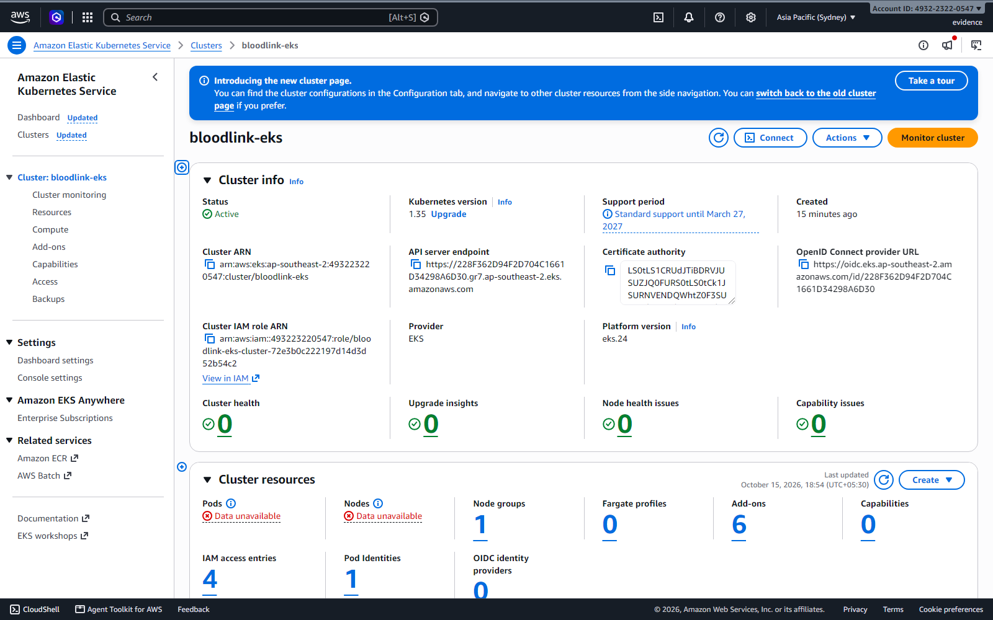
AWS built and destroyed with Terraform
66
2 + 2
resources from one reviewed plan
public and private subnets in 2 zones
EKS 1.35
≈ $0.50
node group and six add-ons
one hour of running, then destroy
VPC with NAT gateway, KMS-encrypted secrets, S3 remote state, GitHub OIDC deploy role. Every apply and destroy ran from a saved plan. Region ap-southeast-2: the account’s organization policy allows only that region.
terraform destroy: 66 destroyed, then nothing left to bill
Notes:
Terraform builds a VPC across two availability zones with public subnets for the load balancer and private subnets for the nodes, a NAT gateway, and an EKS 1.35 cluster with a managed node group and add-ons, including the EBS CSI driver and NetworkPolicy support. State is in S3. I never ran apply blind: plan to a file, review it, apply that file. The cluster ran for about an hour, the app served traffic through an AWS load balancer, and then destroy removed all 66 resources; I checked AWS directly that nothing was left. The region is Sydney because the AWS account's organization policy only allows that region; region is a variable, so nothing else changed.

Slide 7
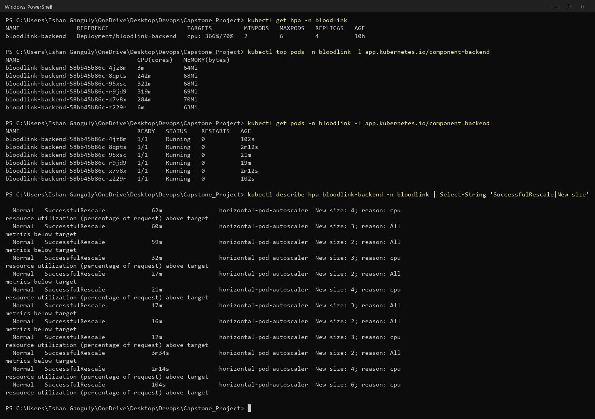
One Helm chart, from laptop to EKS
1
Scales under load
HPA took the backend from 2 to 6 pods during a load test
2
Migrations without races
init container + PostgreSQL advisory lock; rolling updates with no downtime
3
Locked down
Pod Security restricted; only labelled clients reach Postgres
4
Recoverable
nightly pg_dump CronJob, Helm rollback, 6 failure drills
Same chart: kind values locally, EKS values on AWS (gp3 volumes, Network Load Balancer)
Notes:
The chart deploys the backend and frontend with two replicas each, PostgreSQL as a StatefulSet on a persistent volume, ClusterIP services, and an Ingress that routes /api to the backend and / to the frontend. Under a load test the HorizontalPodAutoscaler scaled the backend from 2 to 6 pods. Each pod runs migrations in an init container; an advisory lock means two pods starting together never migrate at the same time. The namespace enforces Pod Security restricted, and a NetworkPolicy lets only database clients reach Postgres. I also practised six failures: bad image tag, a Service with no endpoints, database down, wrong password, out of memory, and a bad release with helm rollback.

Slide 8
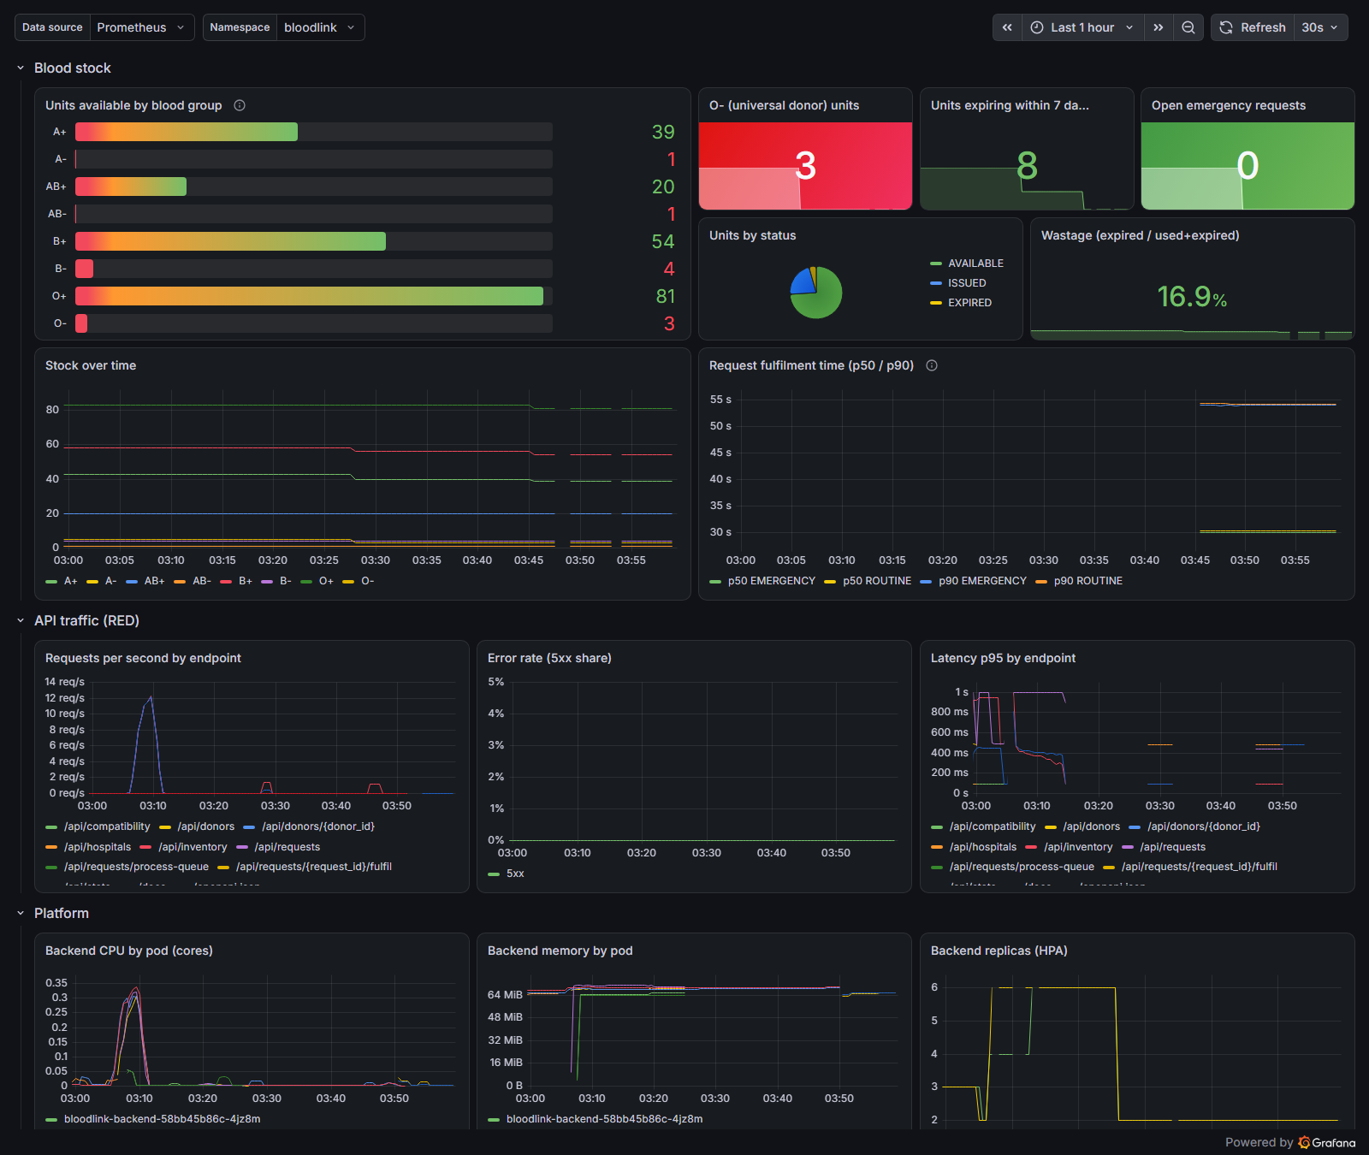
Metrics that matter to a blood bank
1
Business metrics
stock per group, units expiring, fulfilment time
2
API health
requests, error rate, p95 latency per route
3
7 alert rules
critical stock and emergency backlog fire on real data
Prometheus scrapes every backend pod through a ServiceMonitor; the Grafana dashboard ships in the Helm chart.
Notes:
Besides the usual request rate, errors and latency, the backend exports business metrics: available units per blood group, units expiring within seven days, and how long requests take to fill. Seven alert rules cover the service being down, error rate, latency, critical stock, low O- stock, units expiring soon, and emergency requests waiting. Critical stock is firing right now because A-, B- and AB- are below five units. The dashboard shows the load test spike and the HPA scaling out to six replicas.

Slide 9
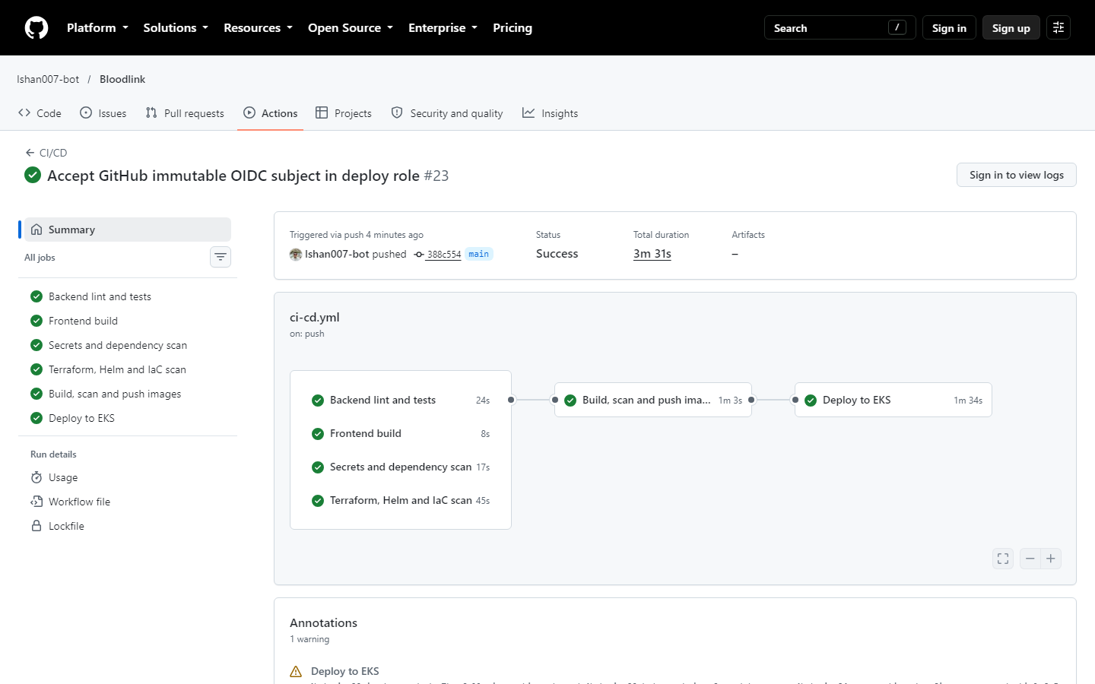
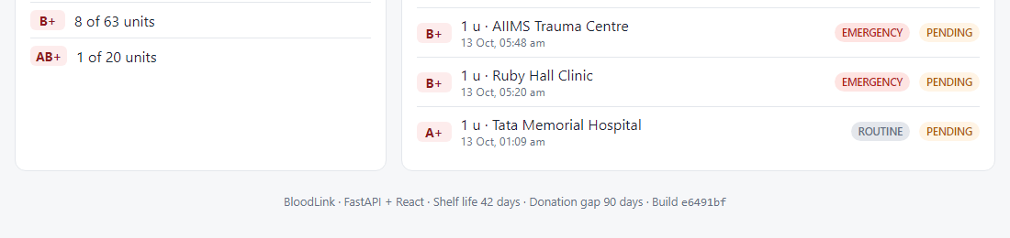
Live demo: commit → pipeline → deployment
1
Commit
push a change to main
2
Pipeline
tests, scans, images: about 2 minutes
3
Deploy
helm upgrade to the new SHA
4
Verify
the footer shows the new build
Recorded run: docs/demo/bloodlink-demo.mp4 · on EKS the deploy job ran by itself through OIDC (commit 388c554)
Notes:
Live: make a small visible change, push, open the Actions run and watch the jobs go green in about two minutes, then run helm upgrade with the new SHA and refresh the app: the footer shows the new build. On EKS this was fully automatic: the deploy job signed in to AWS with OIDC and upgraded the release itself. The first attempt failed because GitHub now sends an immutable subject in its token; CloudTrail showed the exact value and I fixed the trust policy in Terraform. If the network fails during the talk, the recording is in docs/demo.

Slide 10
What broke, and what it taught me
AWS allowed one region
dry-run checks per region showed only ap-southeast-2 passes the organization policy
GitHub could not sign in to AWS
CloudTrail showed the new immutable OIDC subject; fixed in the trust policy
Grafana kept restarting
OOMKilled at 256 MiB under load; limit raised to 512 MiB
Kubernetes control plane crashed
slow disk delayed etcd writes; leader election lost, tuned leases
Evidence for every module: docs/EVIDENCE.md · github.com/Ishan007-bot/Bloodlink
Notes:
These were real problems, not staged ones, and each is written up in the runbook. The pattern each time: read the exact error, find the source of truth, and fix it in code rather than by hand. The AWS account's organization policy only allows Sydney; a dry run per region proved it. The deploy role rejected GitHub because GitHub changed its token format; CloudTrail showed the exact subject. Grafana was killed for using more memory than its limit. And on my laptop's slow disk, etcd writes took over a second, so the scheduler kept losing leader election. Thank you, happy to take questions.

