Slide 1
Emotion-Based Speech Analysis For Disaster Response and Crisis Management
Group-3
Rafa Siddiqua ID:23166023
Rabea Akhter ID: 23366029
Samiu Mostafa Ishan ID: 23273011

Slide 2
Introduction
SER: Core in Human Computer Interaction(HCI)
Importance: Decoding Emotions In speech
Challenges: Achieving high accuracy in natural speech

Slide 3
Literature Review
In [1], the authors Sung-Woo Byun and Seok-Pil Lee constructed a Korean emotional speech database for speech emotion analysis.
In [2], the authors proposed an approach based on emotional perception, which designs an implicit emotional attribute classification.
The authors of [3] used two unidirectional LSTM layers for text recognition and fully connected layers are used for acoustic emotion recognition, which are then merged to produce the predicted emotion categories.
The authors of [4] used a technique in their project, where it classifies emotions into five different categories.
Different approaches for developing speech recognition, which are language and speaker independent, are briefly discussed by the author of [5].

Slide 4
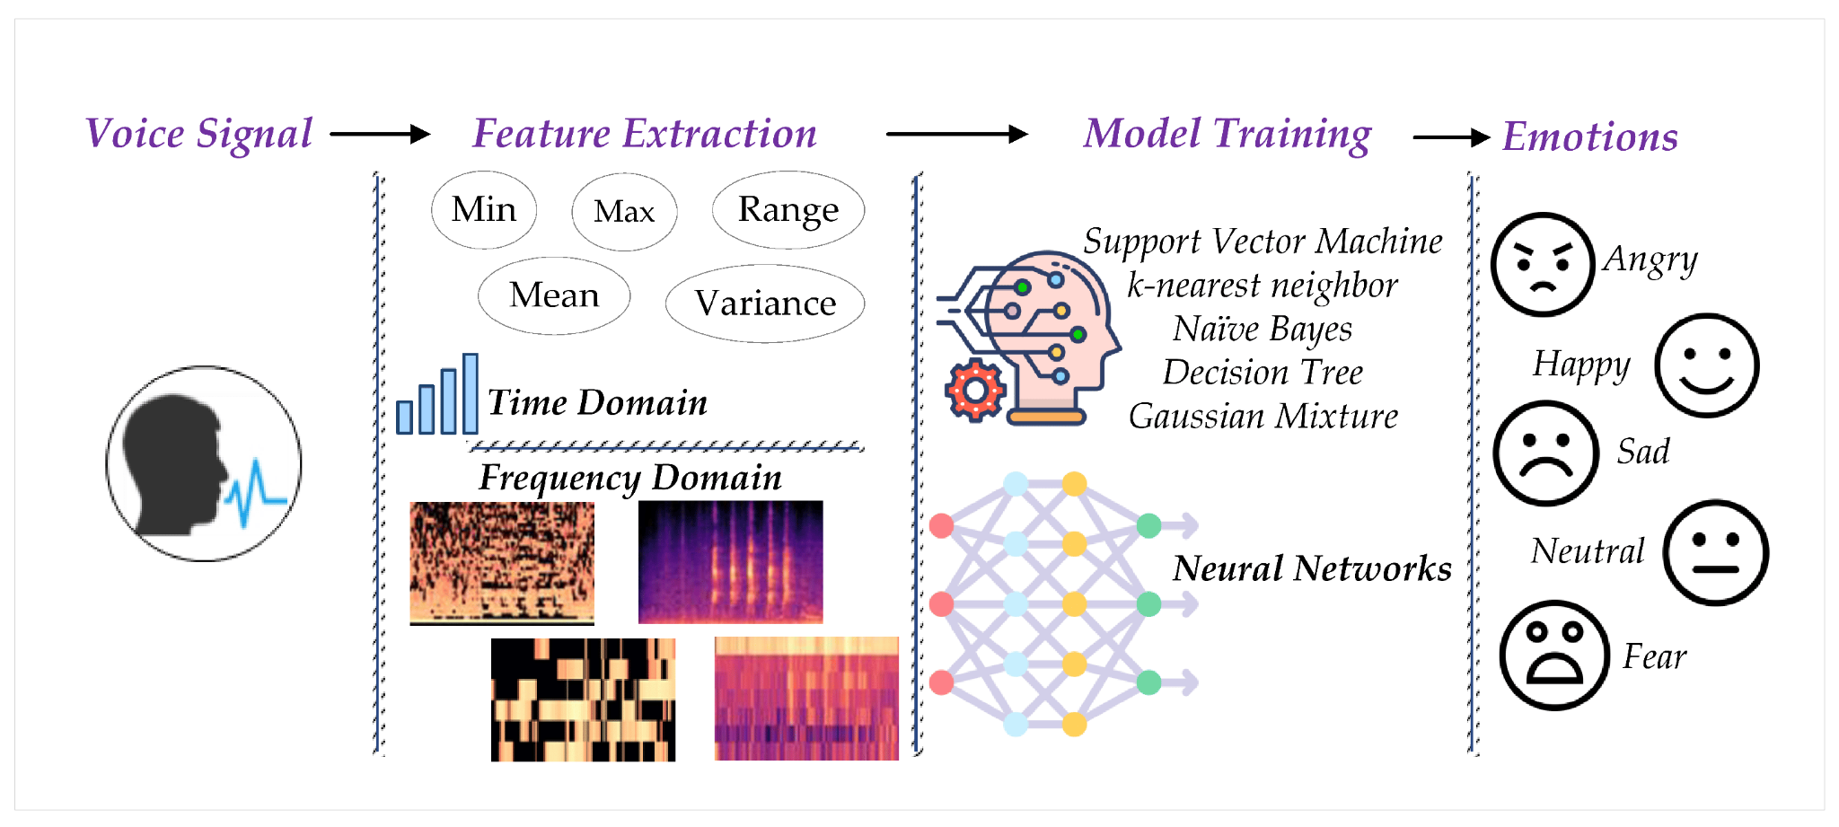
Proposed Methodology
Speech-to-Text (STT) Conversion
Emotion Recognition/Classification
Supervised Machine Learning
Sentiment Analysis
Acoustic Features
Model Training
Ensemble Methods

Slide 5
References
Byun, S.-W.; Lee, S.-P. A Study on a Speech Emotion Recognition System with Effective Acoustic Features Using Deep Learning Algorithms. Appl. Sci. 2021, 11, 1890. https://doi.org/10.3390/app11041890
Liu, G., Cai, S. & Wang, C. Speech emotion recognition based on emotion perception. J AUDIO SPEECH MUSIC PROC. 2023, 22 (2023). https://doi.org/10.1186/s13636-023-00289-4
B. T. Atmaja, K. Shirai and M. Akagi, "Speech Emotion Recognition Using Speech Feature and Word Embedding," 2019 Asia-Pacific Signal and Information Processing Association Annual Summit and Conference (APSIPA ASC), Lanzhou, China, 2019, pp. 519-523, doi: 10.1109/APSIPAASC47483.2019.9023098.
G. Deshmukh, A. Gaonkar, G. Golwalkar and S. Kulkarni, "Speech based Emotion Recognition using Machine Learning," 2019 3rd International Conference on Computing Methodologies and Communication (ICCMC), Erode, India, 2019, pp. 812-817, doi: 10.1109/ICCMC.2019.8819858.
Thakur, A., Dhull, S. (2021). Speech Emotion Recognition: A Review. In: Hura, G.S., Singh, A.K., Siong Hoe, L. (eds) Advances in Communication and Computational Technology. ICACCT 2019. Lecture Notes in Electrical Engineering, vol 668. Springer, Singapore. https://doi.org/10.1007/978-981-15-5341-7_61

