Slide 1
FITNESS-BUDDY ai agent
IBM AICTE PROJECT
Presented By -
ISHAN GROVER
ABES Engineering College , IT Dept.

Slide 2
OUTLINE
Problem Statement
Technology used
Wow factor
End users
Result
Conclusion
Git-hub Link
Future scope
IBM Certifications

Slide 3
Problem Statement
In today’s fast-paced world, many individuals struggle to maintain a healthy lifestyle due to lack of personalized guidance, time constraints, and inconsistent motivation. Traditional fitness solutions often require expensive subscriptions, in-person consultations, or rigid schedules that don't adapt to personal preferences or daily routines. There is a growing need for an accessible, friendly, and intelligent virtual assistant that can provide on demand fitness advice, healthy lifestyle suggestions, and basic nutrition guidance—all tailored to individual needs and available at any time.
Proposed Solution: A conversational FitnessBuddy AI Agent built using IBM Watsonx and Granite foundation models. The agent leverages natural language instructions and Agentic AI capabilities to simulate a personal fitness coach. It provides home workout recommendations, healthy meal suggestions, motivational support, and politely deflects off-topic queries—empowering users to stay on track with their fitness goals through natural, engaging conversations.

Slide 4
Technology used
IBM Cloud Lite Services
Watsonx.ai Studio
Granite Foundation Model (13B)
Watson Machine Learning (WML)
Agentic AI (Agent Lab)
Vector Store
GitHub

Slide 5
IBM cloud services used
IBM Cloud Watsonx AI Studio
IBM Cloud Watsonx AI runtime
IBM Cloud Agent Lab
IBM Granite foundation model

Slide 6
Wow factors
This agent transforms how individuals—especially beginners—approach fitness by offering instant, personalized, and encouraging guidance without needing an app, trainer, or web search. It promotes consistent health habits and empowers users to take control of their fitness journey in a conversational, human-like way.
Unique features:
Fitness-Only AI: Stays focused on workouts, meals, and motivation — filters out unrelated questions.
Natural Coaching Tone: Responds like a friendly fitness coach with motivational language.
Quick Start Prompts: Offers ready-to-use fitness questions for fast, easy interaction.
No-Code & Cloud-Based: Built using IBM Agentic AI tools, deployed fully on IBM Cloud.

Slide 7
End users
Fitness Enthusiasts and Beginners
Wellness Coaches and Personal Trainers
Educational Institutions and Universities
Corporate Wellness Programs

Slide 8
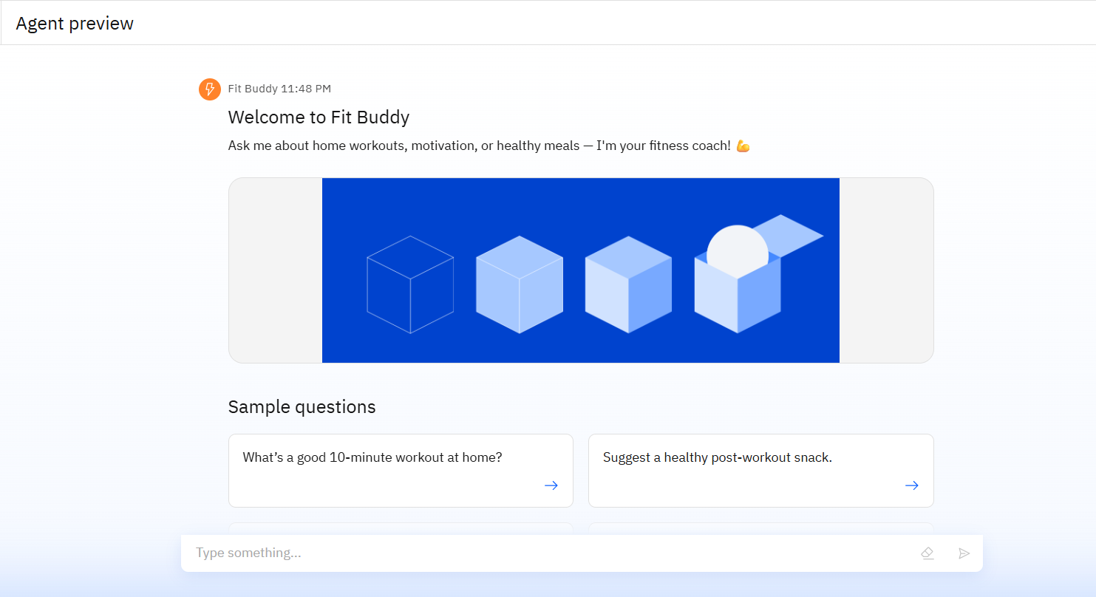
Results

Slide 9
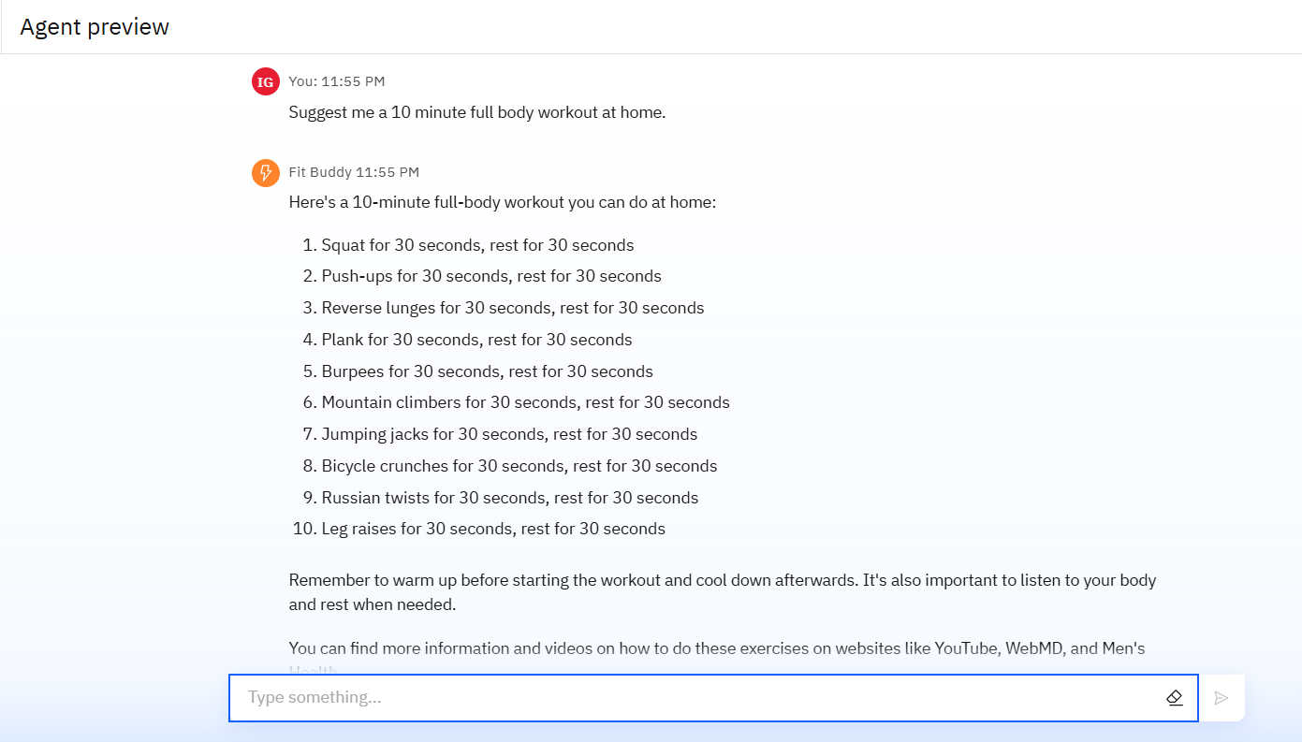
Results

Slide 10
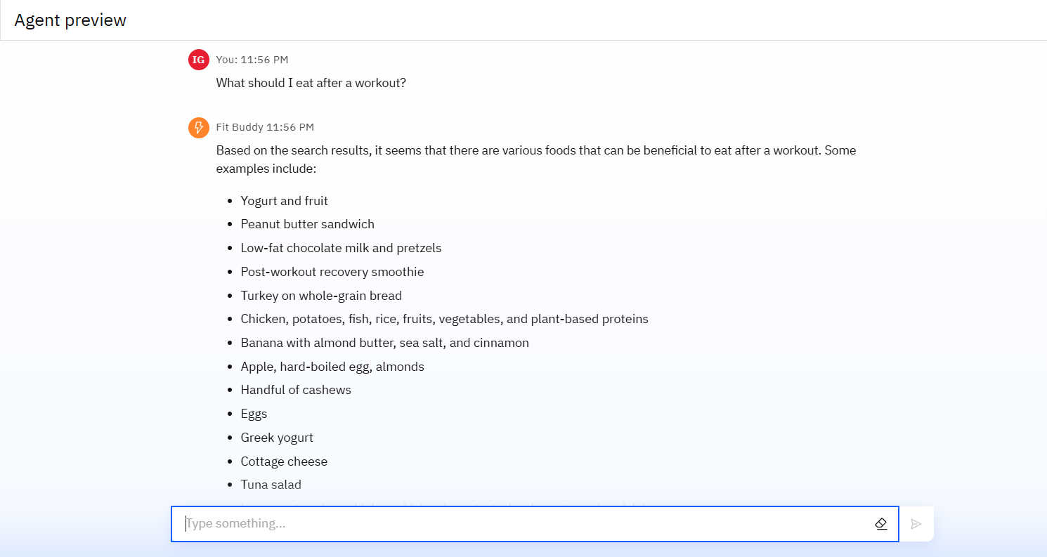
Results

Slide 11
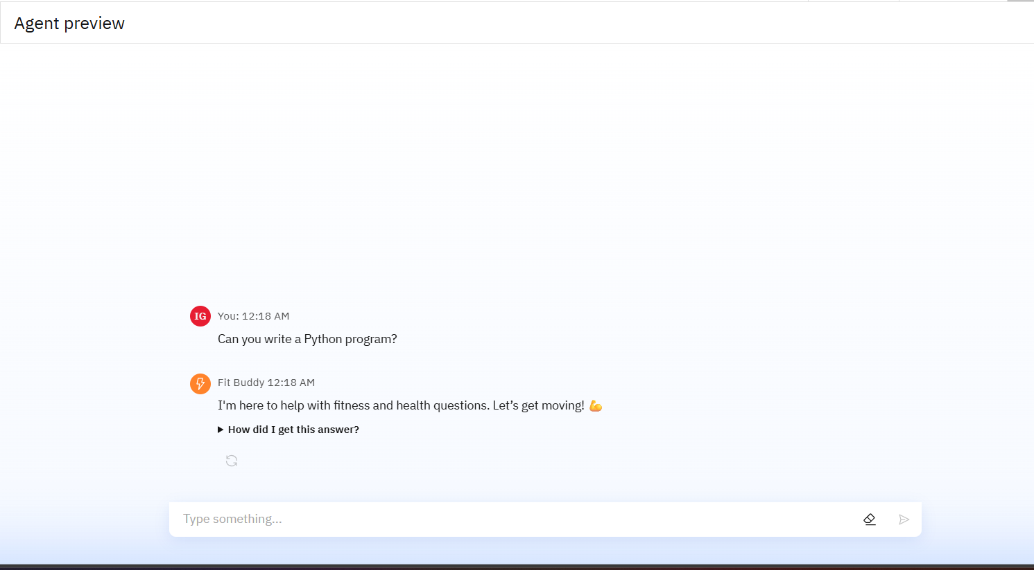
Results

Slide 12
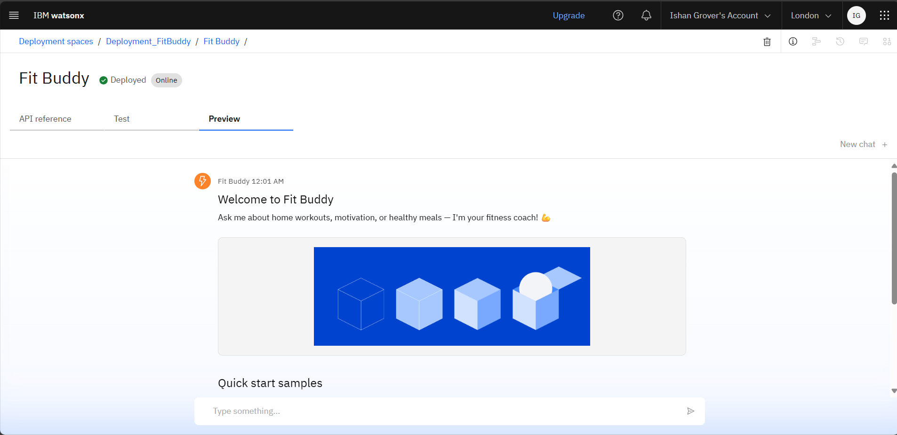
Results
Deployed AI Agent

Slide 13
Conclusion
The agent offers instant, personalized fitness advice through natural language conversation.
It recommends home workouts, healthy meals, and motivational quotes — all without needing an app or trainer.
Saves time by eliminating the need to browse multiple sources for fitness guidance.
Improves consistency by keeping users engaged and motivated with friendly coaching.

Slide 14
GitHub Link
https://github.com/Ishan1210/Fitness_Buddy_AI_Agent

Slide 15
Future scope
User Personalization
Health Data Integration
Multi-Language Support
Voice Interaction
AI-Driven Goal Setting

Slide 16
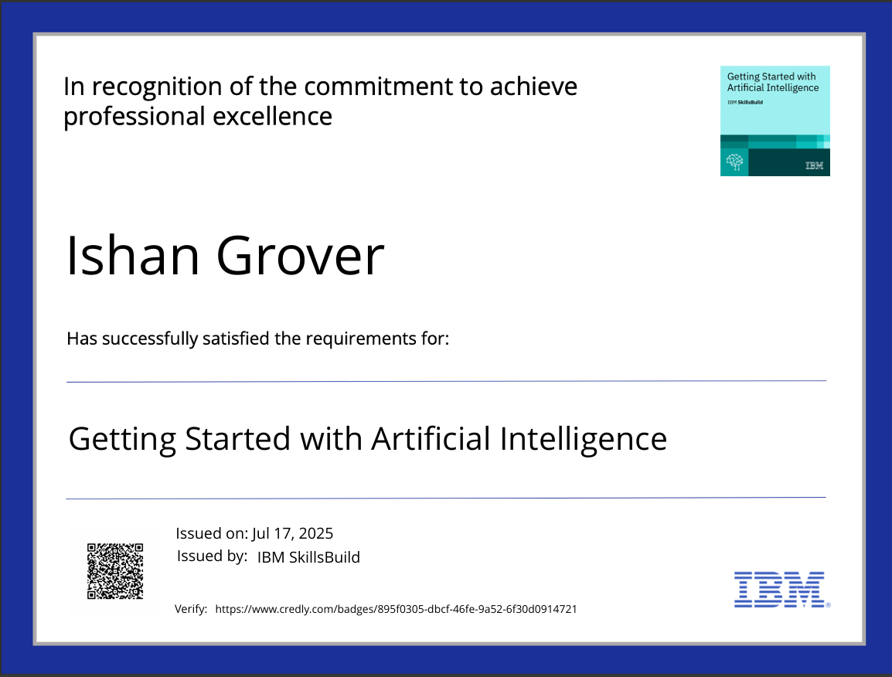
IBM Certifications

Slide 17
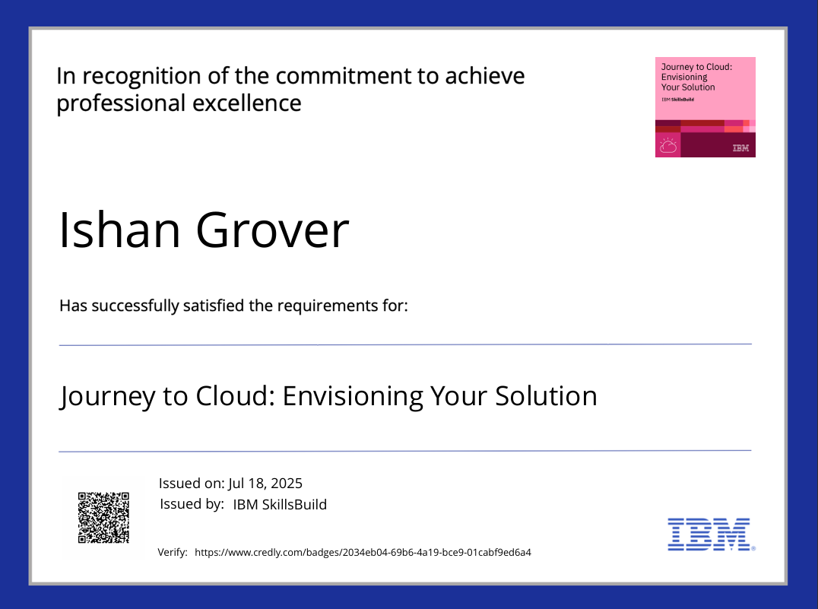
IBM Certifications

Slide 18
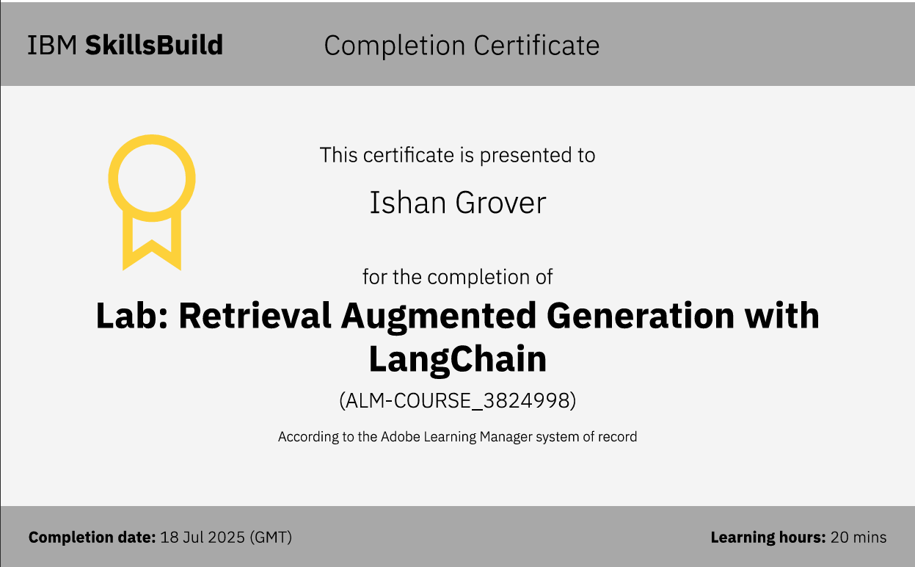
IBM Certifications

Slide 19
THANK YOU

