Slide 1


Nexora HR Employee Analytics Dashboard
Using Power BI for Data-Driven HR Decisions
Presented By: Rudrashis Chowdhury, Gourab Mondal and Tuhin Roy
Notes:
1

Slide 2

Agenda
01
02
03
Problem Statement & Objectives
Dataset & Data Cleaning
Data Model & DAX Measures
Understanding the HR challenge and project goals
Nexora HR dataset, Power Query transformations
Architecture, calculated columns, KPI measures
04
05
Dashboard Architecture
Insights, Recommendations & Future Scope
Interactive dashboard walkthrough with KPIs and Charts
Business findings, strategy, and next steps
Notes:
2

Slide 3

Problem Statement
Challenge
HR departments lack real-time visibility into employee attrition patterns, salary distribution, and departmental performance.
Impact
Reactive decision-making, high turnover costs, and missed retention opportunities erode organizational performance.
Solution
An interactive Power BI dashboard enabling data-driven HR strategy — from attrition analysis to compensation benchmarking.
Notes:
3

Slide 4

Project Objectives
Attrition Trend Analysis
Analyze employee attrition across departments and job roles
Compensation Visualization
Map salary distribution and compensation patterns across the workforce
Workforce Demographics
Surface tenure insights, age distribution, and diversity metrics
Interactive Exploration
Enable slicers, filters, and drill-through for self-service analytics
Actionable KPIs
Support strategic HR decision-making with measurable business outcomes
Notes:
4

Slide 5
Dataset Overview & Data Cleaning
Power Query Transformations
Source
Volume
Nexora HR Analytics Employee Attrition Dataset — industry-standard benchmark dataset
1,470 employee records across 35 attributes covering the full employee lifecycle
Removed Redundant Columns
EmployeeCount, Over18, StandardHours — constant values with zero analytical value
Format
Data Validation
Structured CSV file encompassing demographics, compensation, performance & attrition status
Verified data types, checked for missing values and duplicate records across all 35 fields
Clean Output
1,470 records × 32 refined columns — fully validated and ready for modeling
Notes:
5

Slide 6
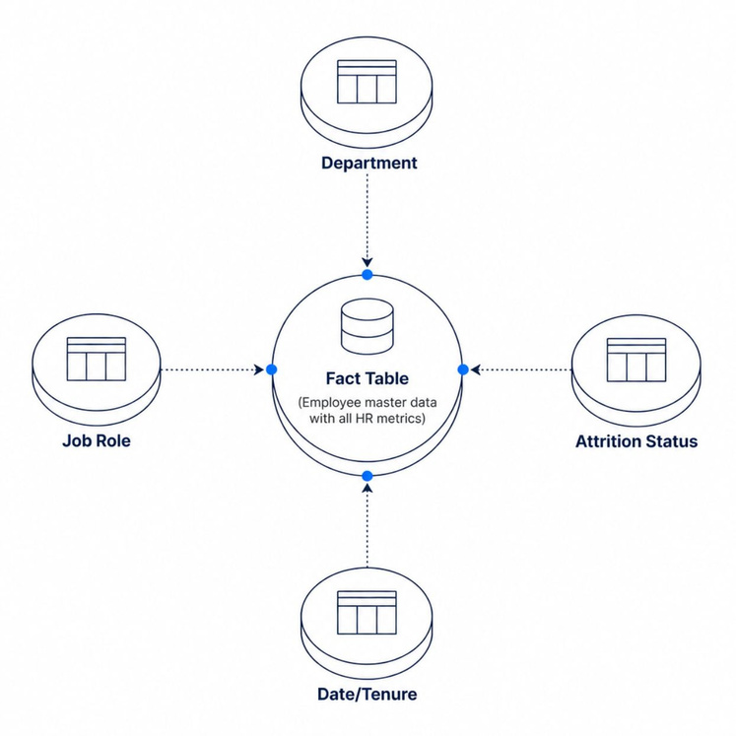
Data Model & Calculated Columns
Model Architecture
Fact Table: Employee master data with all 32 HR metrics
Dimensions: Department, Job Role, and Attrition Status
Optimization: Indexed key columns for fast query performance
Scalability: Designed to accommodate additional HR data sources
Calculated Columns
Age Group
18–25 · 26–35 · 36–45 · 46–55 · 55+
Salary Band
Low · Medium · High · Executive
Notes:
6

Slide 7

DAX Measures & KPIs
Headcount Metrics
Total Employees, Employees Left, Employees Stayed — the foundational workforce snapshot
Attrition Analysis
Attrition Rate (%), Attrition by Department, Attrition by Job Role — pinpointing flight-risk zones
Compensation KPIs
Average Salary, Maximum Salary, Minimum Salary — enabling pay equity and benchmarking
Demographics
Average Age, Tenure Distribution — revealing workforce maturity and generational composition
Notes:
7

Slide 8
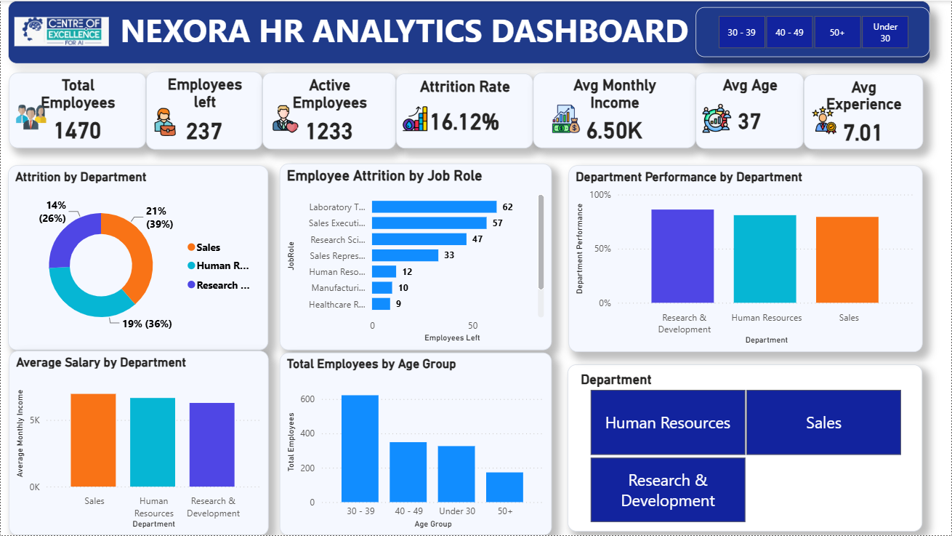
Dashboard Page 1: HR Analytics Overview
KPI Cards
Total Employees · Employees Left · Attrition Rate % · Average Salary
Visualizations
Attrition by Department (pie chart)
Attrition by Job Role (horizontal bar)
Salary Analysis by Departments
Age Distribution histogram
Interactive Elements
Slicers: Department · Job Role · Overtime Status
Age Group Filters: 30–39 • 40–49 • 50+ • Under 30
Department Selection: Human Resources, Sales, Research & Development (Treemap)
Cross-filtering: Selecting an age group or department dynamically updates all KPI cards and visualizations on the dashboard.
Interactive Dashboard: All charts are interconnected, enabling users to explore HR metrics through real-time filtering.
Notes:
8

Slide 9
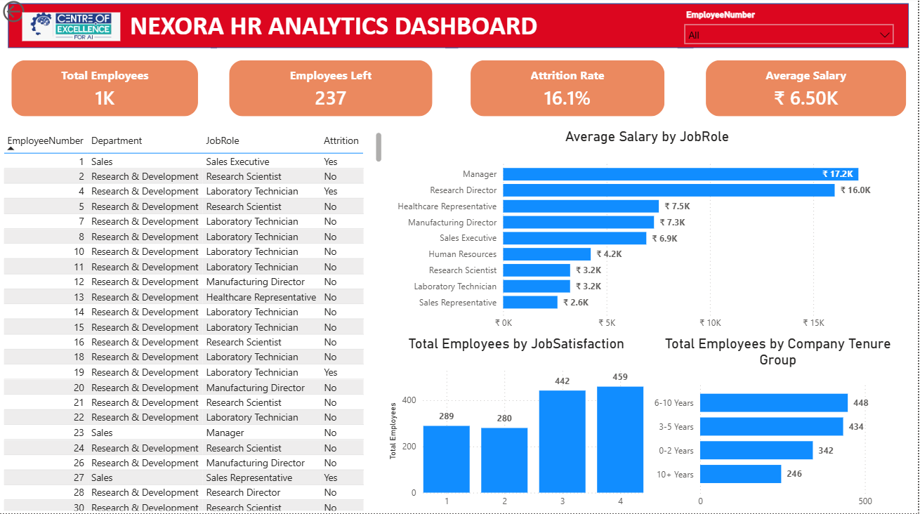
Employee Details & Analysis
PAGE 2 OF 3
Employee Detail Table
Searchable employee records with key HR metrics at a glance — name, role, salary, tenure, satisfaction score.
Salary Analysis
Compensation by Job Role with trend indicators highlighting over- and under-paid segments.
Satisfaction Metrics
Job satisfaction levels correlated with years at company — visualizing engagement across tenure bands.
Drill-Through
Click any employee row to navigate to a detailed individual profile page with full HR history.
Notes:
9

Slide 10
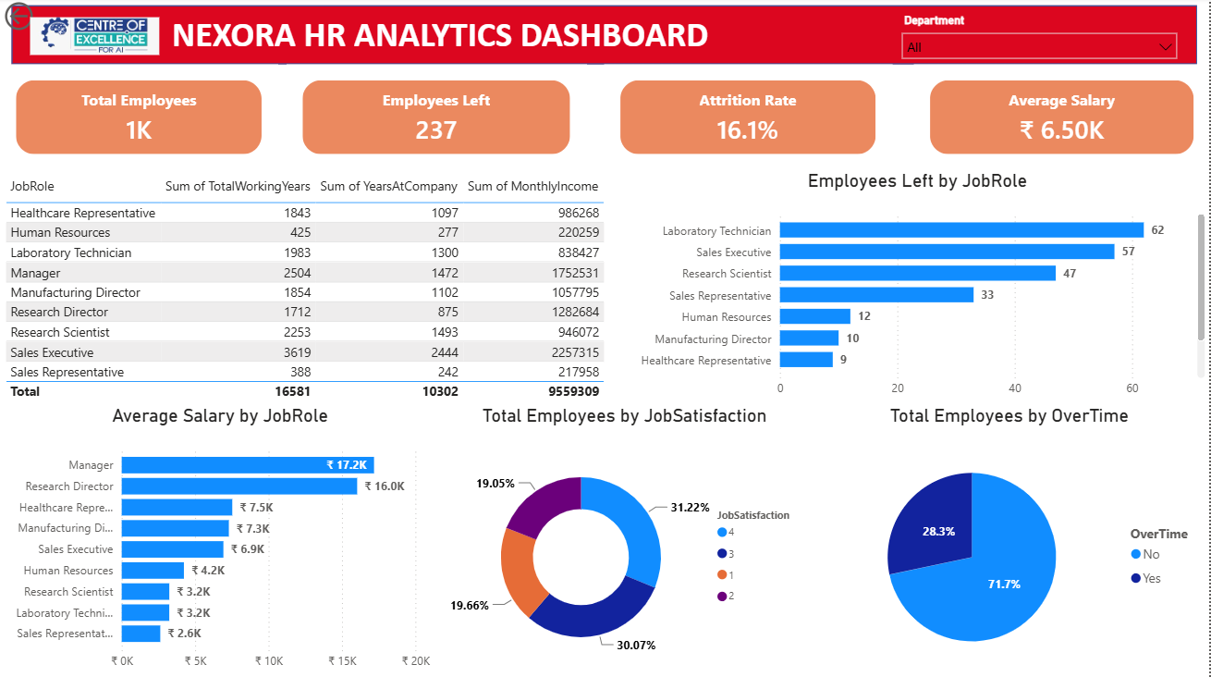
Department Performance
PAGE 3 OF 3
Department Summary Table
Working years, tenure, income
Employee Job Role
Employees Left by Job Role and Average Salary by Job Role
Job Satisfaction breakdown
Job satisfaction levels correlated with sum of years at company, sum of monthly income, and sum of total working years – and visualizing of all employee and salary.
Notes:
9

Slide 11

Key Business Insights
16.1%
Overall Attrition Rate
237 of 1,470 employees left — above the 10% healthy benchmark
20.6%
Sales Dept. Attrition
Highest attrition of all departments — a critical retention risk zone
2.3x
Overtime Impact
Employees on overtime are 2.3× more likely to leave the organization
26–35
Peak Attrition Age
The 26–35 age cohort accounts for the majority of voluntary departures
Notes:
10

Slide 12
Strategic Recommendations
Strategic Recommendations
1
2
3
4
Targeted Retention Programs
Overtime Policy Reform
Early-Career Engagement
Compensation Benchmarking
Design role-specific retention incentives for Sales and Research roles with highest attrition
Cap excessive overtime and introduce flexible work arrangements to reduce the 2.3× attrition multiplier
Implement structured mentorship and career ladders for the high-risk 26–35 cohort
Align salary bands with market data to close pay gaps identified in the dashboard
Notes:
11

