Slide 1
Project
on
Movie Ticket Booking System
(Course Code: CS253)
Presented By:
Ishan (2211981175)
1

Slide 2
Introduction
The Movie Ticket Booking System is a web-based application that connects customers with cinema theatres through a single integrated digital platform.
The application is built as a full-stack system using modern enterprise technologies:
Frontend — Built with HTML5, CSS3, JavaScript, and Bootstrap for a responsive, device-friendly user interface.
Backend — Powered by Java with Spring Boot, providing RESTful APIs for user management, movie scheduling, seat booking, and ticket processing.
Security — Managed by Spring Security with BCrypt password hashing and role-based access control (USER / ADMIN).
The system addresses the growing demand for fast, convenient, and user-friendly digital ticket reservation, replacing traditional queuing at cinema counters.

Slide 3
Objectives
The primary objectives of the Movie Ticket Booking System are:
Enable Online Movie Browsing — Allow users to explore currently running and upcoming movies with complete details including genre, timing, and ratings.
Real-Time Seat Selection — Provide an interactive seating layout with live availability, allowing users to choose and lock seats instantly.
Secure Authentication — Implement robust user registration and login using Spring Security with role-based access control for users and administrators.
Streamline Ticket Booking — Automate the complete booking lifecycle from seat reservation to digital ticket generation, reducing manual errors.
Efficient Theatre Management — Enable admins to manage movie schedules, show timings, seat configurations, and theatre info through a centralized panel.
Scalable Architecture — Follow MVC design patterns with Spring Boot, ensuring clean separation between data models, business logic, and presentation layers.

Slide 4
Market Analysis
The global online movie ticketing market was valued at approximately $9.2 billion in 2023 and is expected to grow at a CAGR of 5.8% through 2030, driven by increasing smartphone usage and internet penetration worldwide.
The Movie Ticket Booking System targets the digital cinema reservation space where users need:
No physical queues — Fully web-based booking from any device, anywhere.
Real-time seat visibility — Interactive layout with live availability and instant seat locking.
Secure digital payments — Integrated payment gateway with transaction verification.
Digital ticket access — Instant generation of downloadable/showable digital tickets post-booking.
Students & General Public — Easy movie discovery and quick bookings for entertainment.
Cinema Chains & Multiplexes — Centralized show and seat management with reduced manual overhead.
Event Organizers — Manage special screenings, premieres, and limited-seat events efficiently.
Existing Platforms (BookMyShow, PVR, INOX) — Benchmarked for UI/UX, feature completeness, and performance standards.

Slide 5
Key Features
Authentication & Security
Spring Security Login — Secure user registration and login with BCrypt password hashing and session management.
Role-Based Access Control — Separate USER and ADMIN roles; each redirects to its dedicated dashboard.
Protected REST Endpoints — All sensitive API endpoints secured with Spring Security authorization filters.
Booking & Seat Management
Interactive Seat Layout — Real-time seating map showing available, booked, and selected seats per show.
Seat Locking Mechanism — Temporary seat locks during reservation to prevent double-booking conflicts.
Digital Ticket Generation — Instant booking confirmation with a digital ticket containing all show and seat details.
Booking History & Cancellation — Users can view past/upcoming bookings and cancel tickets with seat auto-release.
Admin & Theatre Management
Movie & Show Management — Admins add, edit, and remove movies; configure theatres and show schedules.
Booking Analytics — Track occupancy rates, revenue, peak timings, and audience preferences.
REST API Architecture — Spring Boot RESTful APIs connect frontend and backend for all data operations.

Slide 6
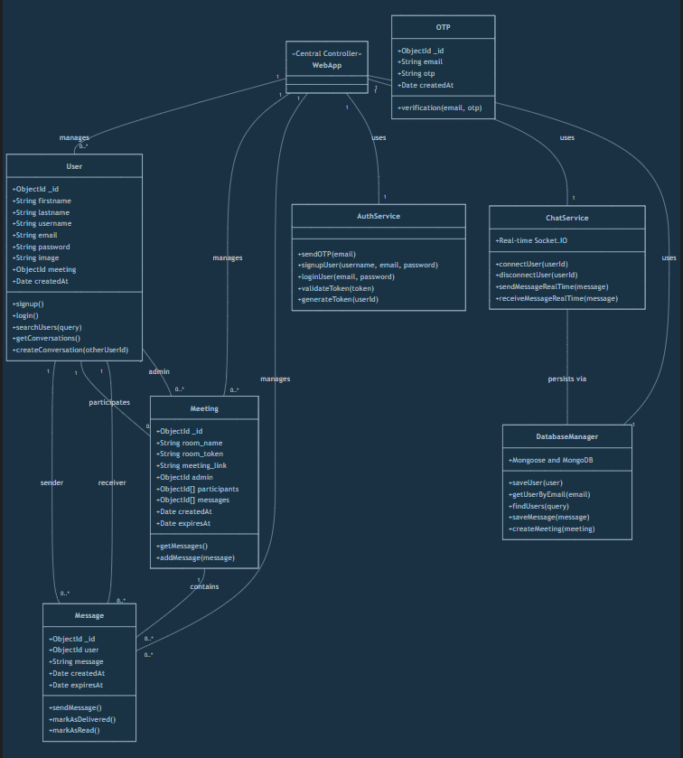
Class Diagram

Slide 7
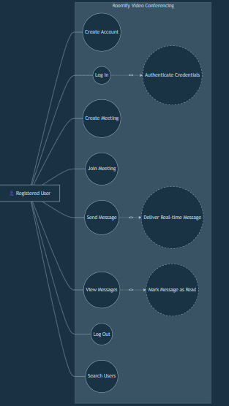
Use Case Diagram

Slide 8
How to Use the System
Visit the application to access the Movie Ticket Booking System home page.
Sign up or log in. New users register with credentials; returning users log in directly with role-based dashboard access.
Browse currently running and upcoming movies. View movie details including title, genre, duration, language, and ratings.
Select a movie, then choose your preferred theatre, show date, and time from available options.
Pick seats from the interactive seating layout. Available, booked, and selected seats are clearly color-coded.
Confirm your booking and complete payment. A digital ticket with all booking and seat details is generated instantly.
View your booking history, download digital tickets, or cancel bookings from your account dashboard.

Slide 9
References
Oracle Corporation (2024). "Java Official Documentation." docs.oracle.com/en/java/
Pivotal Software (2024). "Spring Boot Official Documentation." spring.io/projects/spring-boot
Oracle Corporation (2024). "MySQL Official Documentation." dev.mysql.com/doc/
Spring Framework Guides (2024). "Building a RESTful Web Service." spring.io/guides
Apache Maven Project (2024). "Maven Build Tool Documentation." maven.apache.org/guides/
Research Papers and Case Studies on Online Movie Ticket Booking Systems, 2021-2023.

Slide 10
Thank You

