Slide 1

Airline Passenger Satisfaction Prediction Dataset: Airline Passenger Satisfaction (Kaggle)
Group Number 20:
Pratik Darade (A20536376)
Harshal Sawant (A20538827)
Ishan Prabhune (A20538828)

Slide 2
Data Background
The given data included airline passenger satisfaction details, on how they were satisfied with the flight services both internal services and while checking in.

Slide 3
Project Purpose
Recognize variables and predict passenger’s satisfaction.
Investigate the impact of airline services, food , cleanliness, and other factors on passenger's satisfaction.
Determining the average age of passengers based on their gender.
Understand how one service may be associated with the linearity of another service provided by the airline.

Slide 4
General view of our given data
Gender: Genders given in data are Male and Female.
Age: There is a wide range of age of passengers.
Flight distance: Distance travelled by the airline.
Food and Drink: Food and Drinks given during the flight.
Seat Comfort: Comfort in the seating of the airline.
Cleanliness: A measure of how clean the airline was inside during the flight for an individual.
Satisfaction: A measure of how satisfied was the passenger with the airline services.

Slide 5
Data preparation and Exploration
Number of Observations found were 25976
Number of Attributes found were 25
The missing values were identified and omitted.
There were no duplicate values found.
The outliers in Flight Distance were found.
Average Age of passengers onboard were analyzed by Gender.

Slide 6
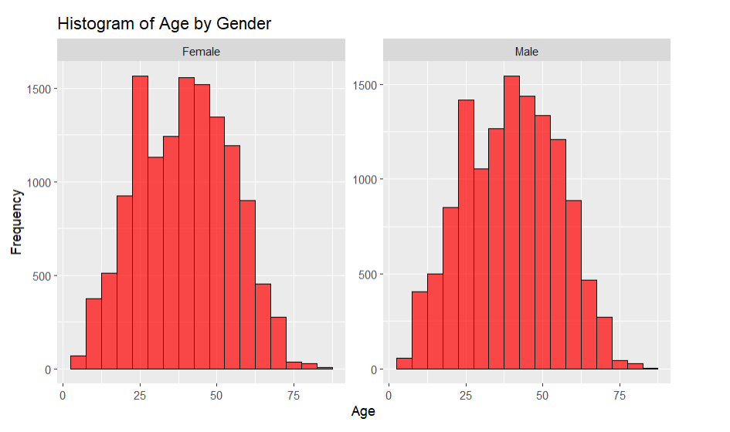
Data Exploration (EDA): Histogram
Summary for Histogram visualizations:
We have plotted the histogram for Age by Gender
On X - axis we have Age of passengers and on Y - axis is the frequency.
Highest score for reading for Females is estimated at 25 years old but the range is wider from 40 to 50 years old and for Males, it is estimated at 40 and the range gets wider from 40 to 50.
Overall, Females aged 25 were highest among others who showed satisfaction for airline services.

Slide 7
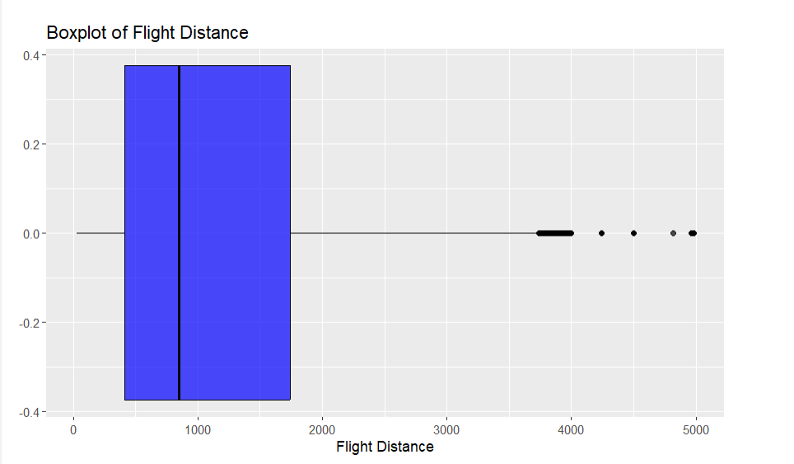
Data Exploration(EDA): Boxplot
Summary for Boxplot visualizations:
Flight distance has an IQR range from 400 to 1800.
The 25th percentile i.e. Q1 is at 400, the 75th percentile i.e. Q3 is 1800 and the median is at 900.
There is a presence of outliers beyond 3800 miles

Slide 8
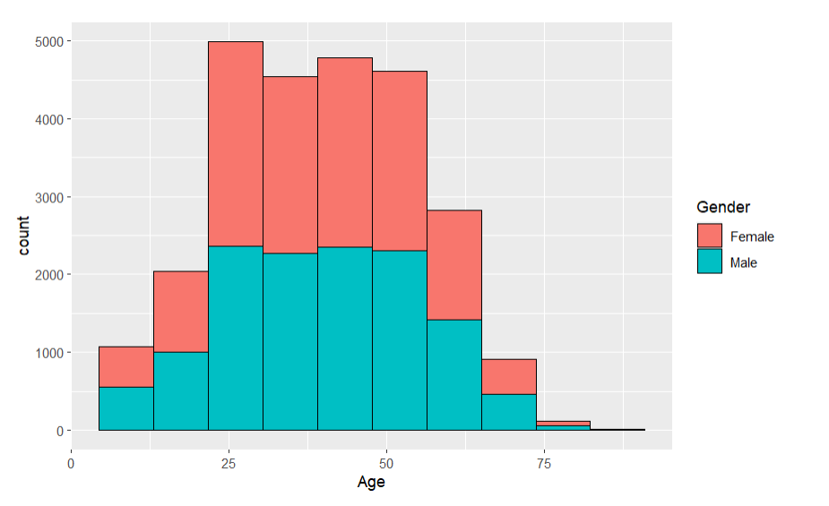
Data Exploration(EDA): Overlay Histogram
Summary for Histogram visualizations:
1. We have plotted the overlay histogram for Age and Gender wise
2. Female passengers tend to have better range of satisfaction compared to male passengers ranging from 25 years old to 55 years old where 25 being the hughest

Slide 9
HYPOTHESIS TESTING QUESTION: How does airline’s online boarding service affect passenger’s satisfaction?
The EDA where we plotted Histogram for Age by Gender, we found that Females in good numbers showed satisfaction , the boxplot showed us the range of Flight Distance travelled in almost all occasions and Overlay histogram showed us similar outcome where Females here in large numbers to fly via the airlines and who showcased their satisfaction.
Now for such long-distance flights there must be huge number of bookings for tickets.
This offers us a broad sense of how a boarding an airline could be influenced.
So, the shift towards increased boardings is main concern for many passengers.
Hypothesis testing can be conducted to find the difference in online boarding satisfaction between groups.

Slide 10
Null Hypothesis (H0): There is a significant difference in online boarding satisfaction between groups.
Alternative Hypothesis (H1): It might be that there is no significant difference in online boarding satisfaction between groups.
We have One Sample T test.
The choice of test statistic depends on our data and the type of test we are conducting
(e.g., t-test, chi-square test, ANOVA)- we chose One Sample T-test for our data because we found online boarding attribute appropriate to define our hypothesis testing since other attributes with much fluctuating values.
We found our p-value = 0.2665 with Confidence Interval 95% that gives us our Alpha (α) value-0.05.
Our p-value is greater > than our Alpha α value so we Fail to reject the null hypothesis.
That means our H0 that there is a significant difference in online boarding satisfaction between groups is not rejected.

Slide 11
Linear Regression Summary In this section we are going to build a linear regression model, predicting Arrival Delay and Satisfaction of passenger’s.
Linear regression is a statistical technique that aims to understand the relationship between two variables. In our case, we are exploring how the cleanliness of a service relates to the check-in service at a particular location.
Dependent Variable (DV): The variable we want to predict or understand is the delay of Arrival (Arrival Delay).
Independent Variable (IV): The variable that we believe influences the dependent variable is the level of the Satisfaction (Satisfaction).

Slide 12
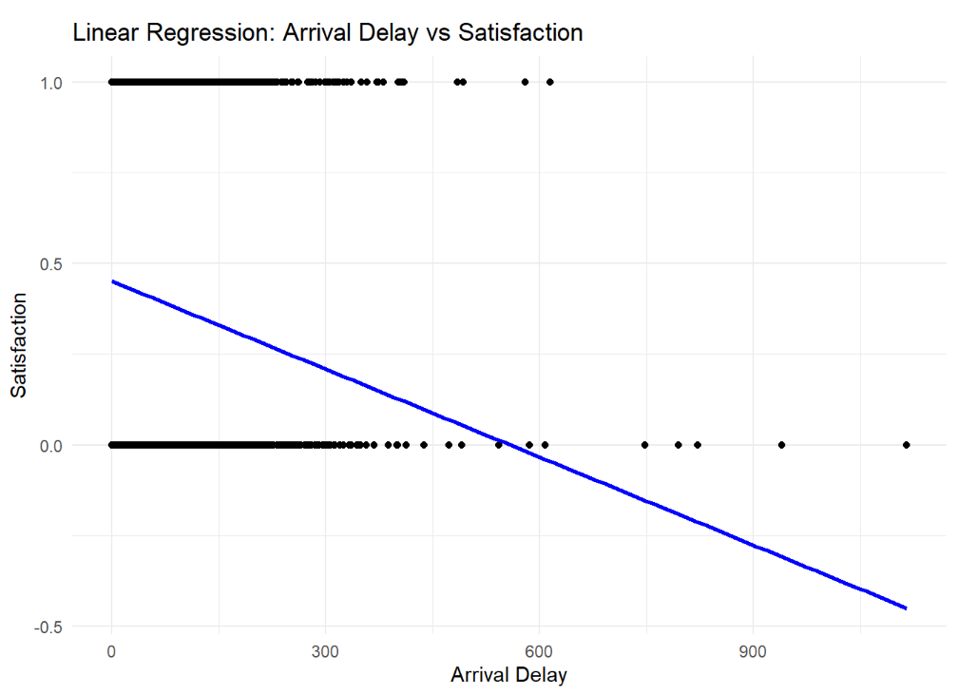
Interpretation:
A positive slope of the regression line indicates that, on average, as the quality of the check-in service increases, the cleanliness of the service also tends to increase.
The scatter plot allows us to see the spread of data points around the regression line, providing insights into the variability of the relationship.
Conclusion:
We can say that as the Arrival Delay increases, The satisfaction decreases and hence it is Inversely proportional. The visual representation aids in conveying this relationship to others.

Slide 13
THANK YOU!

